Slide 1
Comp/Math 553: Algorithmic Game Theory
Lecture 08
Yang Cai

Slide 2
Today’s Menu
Mechanism Design
Single-Item Auctions
Vickrey Auction

Slide 3
Mechanism Design
Most of Game Theory/Economics devoted to
Understanding an existing game/economic system.
Explain/predict the outcome.
Mechanism Design − reverse the direction
Identifies the desired objective first!
Asks whether it is achievable
And, if so, how?
The Engineering side of Game Theory/Economics
Existing
System
Outcome
Predict
Achievable?
Goal
System
Mechanism Design

Slide 4
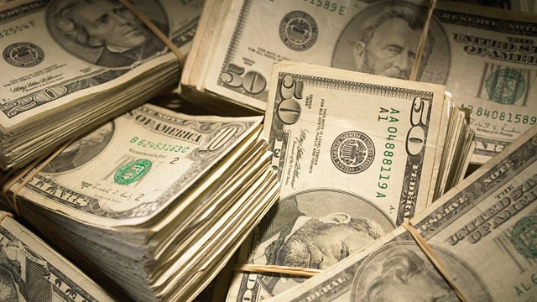
Auctions
Mechanism Design
Auctions
Elections, fair division, etc.

Slide 5






Example 1 − Online Marketplaces

Slide 6


Example 2 − Sponsored Search
Notes:
Indeed, not just search. Facebook lso use auctions to decide who and how the ads will be displayed.

Slide 7
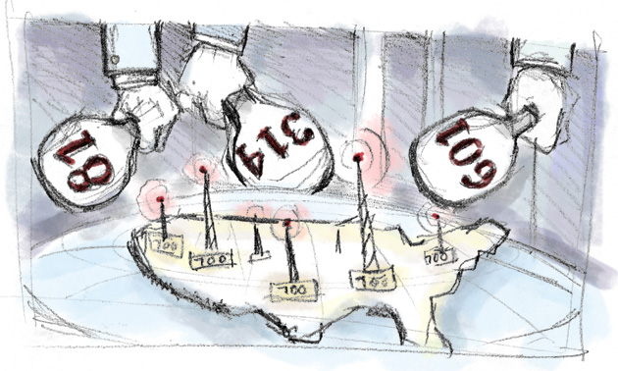
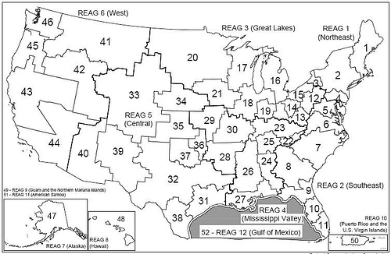




Example 3 − Spectrum Auctions
Notes:
Selling spectrum licenses to telecoms. Helps allocate the bands to companies that value them the most, and generates huge revenue for the government.
Canada 2008, 4.25 billion. Took two months for the auction to complete. 2014, 5.3 billion.
United states, FCC (Federal communication commission) since 94, has conducted 87 auctions. Raised over 60 billion. New double auction is running now.

Slide 8
Single item auctions

Slide 9
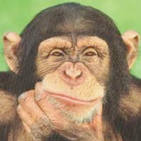


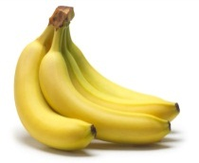
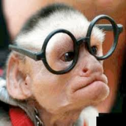
Single-item Auctions: the setup
Bidders
Auctioneer
1
v₁
Item
…
i
v_{i}
…
n
Bidders:
have values on the item.
These values are Private.
Quasilinear utility:
v_{i} – p_{i}, if wins.
-p_{i}, if loses.
v_{n}

Slide 10
Auction Format: Sealed-Bid Auctions
Bidders
1
v₁
Auctioneer
Item
…
i
v_{i}
…
n
v_{n}
Sealed-Bid Auctions:
Each bidder i privately communicates a bid b_{i} to the auctioneer — e.g. in a sealed envelope.
The auctioneer decides who gets the good (if anyone).
The auctioneer decides on prices charged.
allocation rule x: R^{n} → [0,1]^{n}
price rule p: R^{n} → R^{n}
Notes:
May also charge losers

Slide 11
Auction Objective: Welfare Maximization
Bidders
1
v₁
Auctioneer
Item
…
i
v_{i}
…
n
v_{n}
Def: A sealed-bid auction with allocation rule x and price rule p derives welfare:
focus of this lecture: welfare maximization
bidding strategies of bidders based on information they have about each other’s values (if any), x, p

Slide 12
Auction Format: Allocation and Price rules
Bidders
1
v₁
Auctioneer
Item
…
i
v_{i}
…
n
v_{n}
Natural Choice: give item to highest bidder, i.e.
Sealed-Bid Auctions:
Each bidder i privately communicates a bid b_{i} to the auctioneer — e.g. in a sealed envelope.
The auctioneer decides who gets the good (if anyone).
The auctioneer decides on prices charged.
allocation rule x: R^{n} → [0,1]^{n}
price rule p: R^{n} → R^{n}
price rule
Notes:
use some tie-breaking for the argmax

Slide 13
Auction Format: Selecting the Price Rule
Idea 1: Charge no one
Each bidder will report +∞
Fails miserably

Slide 14
Auction Format: Selecting the Price Rule
Idea 2: Winner pays her bid (first-price auction)
Hard to reason about.
What did you guys bid?
Incomplete Information Setting

Slide 15
First Price Auction Analysis
2 players. Everyone’s value v_{i} is sampled from U[0,1].
Bidder i’s perspective:
b_{i} ≤ v_{i}, otherwise even if I win I make negative utility
should discount my value, but by how much?
it depends on how much other bidders decide to discount their values…
let me try this first: assume my opponent uses b_{j}=½ v_{j}
under this assumption what is my optimal strategy?
expected[utility from bidding b_{i}] = (v_{i}-b_{i}) Pr[b_{j} ≤ b_{i}]
optimal b_{i}= ½ v_{i} !!!
I.e. everyone discounting their value by ½ is an equilibrium!
example of a Bayesian Nash Equilibrium

Slide 16
[Games of Incomplete Information
Def: A game with (independent private values and strict) incomplete information and players 1,…, n is specified by the following ingredients:
A set of actions X_{i} for each player i.
A set of types T_{i}, for each player i.
An element t_{i} ∈ T_{i} is the private information of player i
Sometimes also have a distribution F_{i} over T_{i} (Bayesian Setting)
(iii) For each player i, a utility function
u_{i}(t_{i}, x₁,…, x_{n}) is the utility of player i, if his type is t_{i} and the players use actions x₁,…, x_{n}

Slide 17
Strategy and Equilibrium
Def: A (pure) strategy of a player i is a function
Def: Equilibrium (ex-post Nash and dominant strategy)
A profile of strategies is an ex-post Nash equilibrium
if for all i, all , and all we have that
A profile of strategies is a dominant strategy equilibrium
if for all i, all , and all we have that

Slide 18
Bayesian Nash Equilibrium
Def:
In the Bayesian setting, a profile of strategies is a Bayesian Nash equilibrium if for all i, t_{i} and all we have that:
]

Slide 19
First Price Auction
Idea 2: Winner pays her bid (first-price auction)
For two U[0,1] bidders,each bidding half of her value is a Bayesian Nash equilibrium
How about three U[0,1] bidders? or n bidders?
Discounting a factor of 1/n is a Nash eq.

Slide 20
First Price Auction
Idea 2: Winner pays her bid (first-price auction)
What if the values are not drawn from U[0,1], but from some arbitrary distribution F?
b_{i}(v) = E[max_{j≠i} v_{j} | v_{j} ≤ v for all j≠i ]
What if different bidders have their values drawn from different distributions?
Eq. strategies could get really complicated

Slide 21
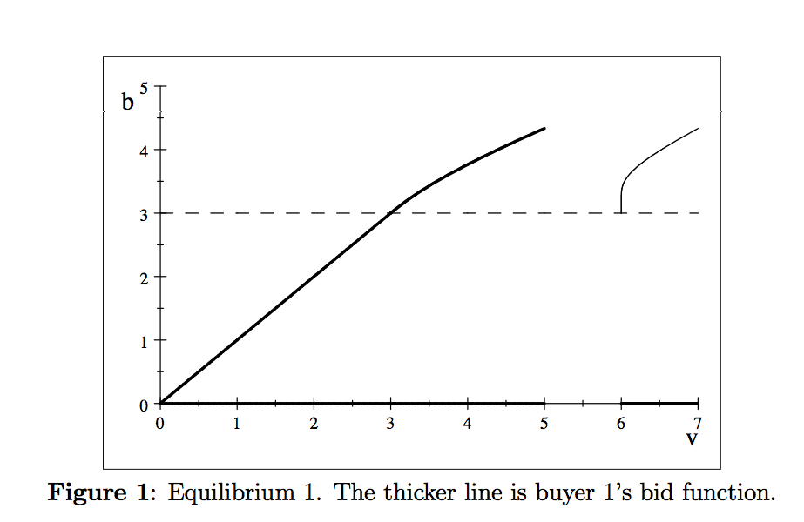
First Price Auction
Example [Kaplan and Zamir ’11]: Bidder 1’s value is drawn from U[0,5], bidder 2’s value is drawn from U[6,7].

Slide 22
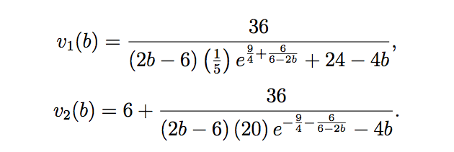
First Price Auction
Example [Kaplan and Zamir ’11]: Bidder 1’s value is drawn from U[0,5], bidder 2’s value is drawn from U[6,7].
Bayesian Nash eq. : bidder 1 bids his value if it lies in [0,3], otherwise for all b in (3, 13/3], if bidder i ∈ {1,2} bids b, then her value is:

Slide 23
First Price Auction (Summary)
First Price Auction:
Optimal bidding depends on the number of bidders, bidders’ information about each other
Optimal bidding strategy easily gets complicated
Nash eq. might not be reached.
Winner might not value the item the most.

Slide 24
VICKREY auction

Slide 25
Second Price/Vickrey Auction
Another idea:
Charge the winner the second highest bid!
maybe a bit strange
But essentially used by Sotheby’s (modulo reserve price).

Slide 26
Second-Price/Vickrey Auction
Lemma 1: In a second-price auction, every bidder has a dominant strategy: set her bid b_{i} equal to her private value v_{i}. That is, this strategy maximizes the utility of bidder i, no matter what the other bidders bid.
Hence trivial to participate in. (unlike first price auction)
Proof: See the board.

Slide 27
Second-Price/Vickrey Auction
Lemma 2: In a second-price auction, every truthful bidder is guaranteed non-negative utility.
Sometimes called Individual Rationality
Proof: See the board.

Slide 28


Second Price/Vickrey Auction
[Vickrey ’61 ] The Vickrey auction satisfies the following:
[strong incentive guarantees] It is dominant-strategy incentive-compatible (DSIC) and IR
(2) [strong performance guarantees] If bidders report truthfully, then the auction maximizes the social welfare Σ_{i} vixi,
where xi is 1 if i wins and 0 if i loses.
(3) [computational efficiency] The auction can be implemented in polynomial (linear) time.

Slide 29
Second Price/Vickrey Auction
Questions:
What’s so special about 2nd price?
How about charging the highest bidder the 3rd price?

Slide 30
What’s next?
These three properties are criteria for a good auction. Our goal in future lectures will be to:
Tackle more complex allocation problems
Tackle more complex objectives, such as revenue

