Slide 1
Comp/Math 553: Algorithmic Game Theory Lecture 13
Yang Cai

Slide 2
Menu
Recap: Virutal Welfare = Revenue
Myerson’s Optimal Auction
Prophet Inequalities

Slide 3


Revenue-Optimal Auctions
[Myerson ’81 ]
  Bayesian Single-dimensional settings.
  Exists Revenue-Optimal auction that is “simple” direct DSIC
Optimality: The expected revenue of Myerson’s auction when all bidders report truthfully (which is in their best interest to do since the auction is DSIC) is as large as the expected revenue of any other (potentially indirect) interim IR auction, when bidders use Bayesian Nash equilibrium strategies.
Notes:
Def: An auction with Bayesian Nash equilibrium s₁,…,s_{n} is interim IR, if for all bidders i and all v_{i}, the expected utility of bidder i when her value is v_{i} and she plays s_{i}(v_{i}) is non-negative in expectation over the other bidders’ values assuming they also use their Bayesian Nash equilibrium strategies s_{-i}.

Slide 4

Revenue = Virtual Welfare
[Myerson ’81] Fix a Bayesian single-dimensional environment, where bidder distributions are F₁,…,F_{n}, and F=F₁x…xF_{n}.
Let also (x,p) be a BIC mechanism satisfying interim IR and NPT.
The expected revenue of this mechanism under truth-telling is
  E_{v~F}[Σ_{i} p_{i}(v)]=E_{v~F}[Σ_{i} x_{i}(v) φ_{i} (v_{i})],
  where φ_{i} (v_{i}) := v_{i}- (1-F_{i}(v_{i}))/f_{i}(v_{i}) is bidder i’s “virtual value function” (f_{i} is the density function for F_{i}).
Notes:
IMPORTANT REMARK: The equality between expected payment and expected virtual welfare of the mechanism is only true in expectation and not point-wise wrt v ~ F

Slide 5
Example Applications

Slide 6
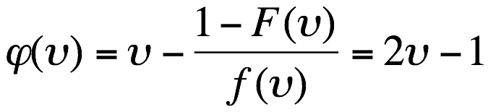

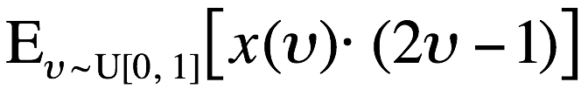
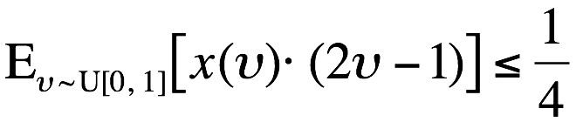
One U[0,1] Bidder, One Item
Recall that posting a price of ½ achieves expected revenue ¼.
Is ¼ the optimal expected revenue of any IR auction?
Answer: yes, it is!
Proof:
  The virtual transform for U[0,1] distribution is:
  By Myerson’s theorem, any BIC, IR, NPT mechanism (x,p) has revenue .
  Notice that for all possible x():
  Hence, posting a price of ½ is optimal as it achieves the best possible expected virtual welfare, and hence expected revenue.
Notes:
In this derivation, we assume that the optimal auction (x,p) satisfies NPT. If not, then its revenue could be increased by using instead the following price rule p(v)-p(0).

Slide 7
Two U[0,1] Bidders, One Item
Recall that Vickrey without reserve has expected revenue ⅓, while Vickrey with reserve ½ has expected revenue 5/12.
Is 5/12 the optimal expected revenue of any interim IR auction?
Answer: yes it is!

Slide 8
Two U[0,1] Bidders, One Item (cont.)
Recall that the virtual transform for v~U[0,1] is: φ(v)= 2v-1
By Myerson’s theorem,
Optimizing expected revenue = Optimizing expected virtual welfare
subject to interim monotonicity (needed for BIC)
Let’s try to optimize virtual welfare point-wise on every bid profile (forgetting about interim monotonicity temporarily)
On bid profile (v₁,v₂), the pair of virtual values are (φ(v₁), φ(v₂))=(2v₁-1, 2v₂-1). How should we allocate?
  If max{v₁,v₂} ≥ ½, let’s give the item to the bidder with highest value/virtual value.
  Otherwise, φ(v₁), φ(v₂) < 0. So let’s not allocate the item.
Note that the above allocation rule is monotone, so by Myerson’s lemma there is a price rule that makes it DSIC.
DSIC + pointwise optimal virtual welfare => DSIC, Revenue-optimal
Now, notice that the above auction is identical to Vickrey auction with reserve ½ (which has revenue 5/12 and is actually DSIC).
Notes:
In this derivation, we implicitly assume that the optimal auction (x,p) satisfies interim NPT. If not, then its revenue can be increased by changing each bidder’s interim price rule to p_{i}(v_{i})-p_{i}(0), by subtracting a constant from their price rule.

Slide 9
Myerson’s Optimal Auction

Slide 10
Revenue-optimal Single-Dimensional Auction
By revelation principle, instead of optimizing over all (potentially indirect) interim IR auctions, can optimize over direct interim IR, BIC auctions.
In fact, can also assume interim NPT, as if interim NPT is not satisfied expected revenue can be increased by turning it interim NPT.
Hence, by Myerson’s theorem suffices to find the interim monotone allocation rule that optimizes expected virtual welfare.
Let’s ignore interim monotonicity temporarily. What allocation rule optimizes expected virtual welfare?
Answer: Optimize virtual welfare pointwise, i.e. on every bid profile v.
i.e. on bid profile v solve: max Σ_{i} x_{i} φ_{i} (v_{i}), s.t x ∈ X
Call this allocation rule the Virtual Welfare-Maximizing Rule.

Slide 11
Revenue-optimal Single-Dimensional Auction
Pertinent Question: Is the Virtual Welfare-Maximizing Rule monotone?
If yes, done! And, in fact, with a DSIC mechanism ☺
But answer depends on the distribution:
  e.g. suppose one item is sold to one bidder whose value is ⅔U[0,1] + ⅓ U[1,3]; then virtual welfare-maximizing rule is not monotone
Distributions resulting in monotone allocation rules?
Notes:
Analyzing example: The virtual transformation for the distribution ⅔U[0,1] + ⅓ U[1,3] is:
2 x - 1.5, if 0 ≤x≤1
φ( x ) =
2x -3, if 1≤x≤3
So, e.g. the virtual welfare maximizing allocation rule allocates the item to type 1 but not type 1.2

Slide 12
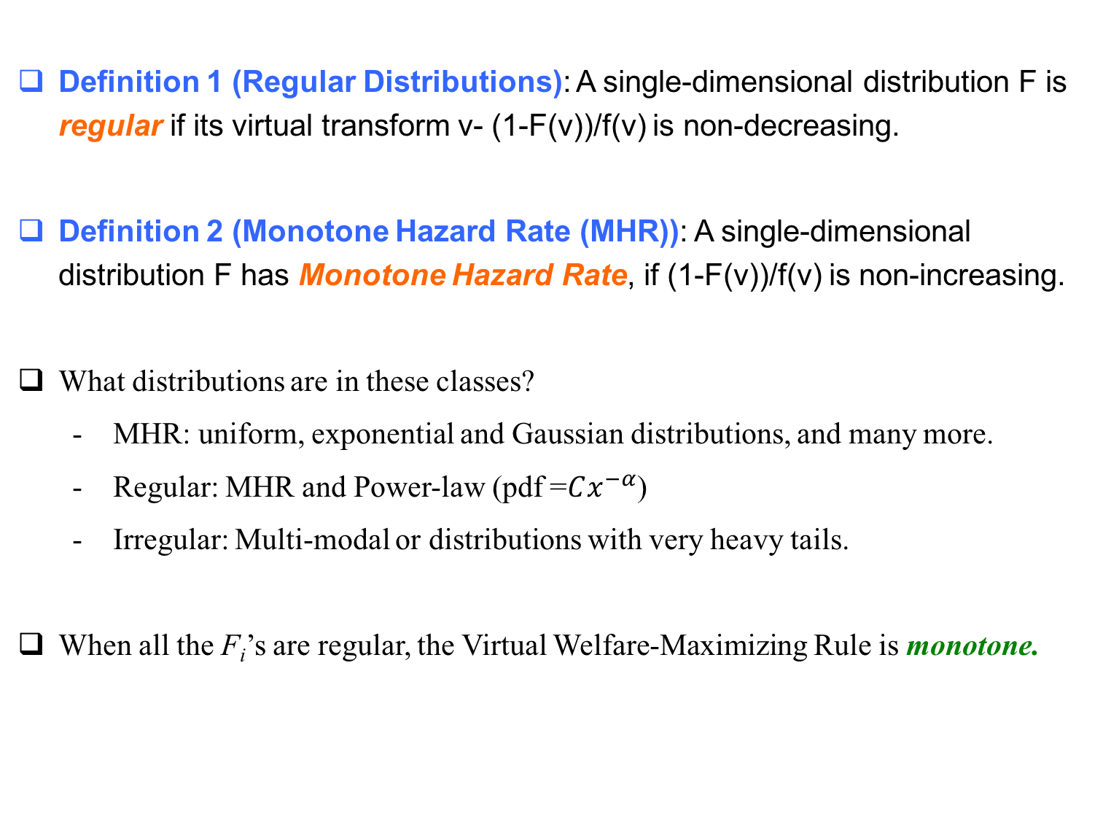
Regular Distributions
Definition 1 (Regular Distributions): A single-dimensional distribution F is regular if its virtual transform v- (1-F(v))/f(v) is non-decreasing.
Definition 2 (Monotone Hazard Rate (MHR)): A single-dimensional distribution F has Monotone Hazard Rate, if (1-F(v))/f(v) is non-increasing.
What distributions are in these classes?
  MHR: uniform, exponential and Gaussian distributions, and many more.
  Regular: MHR and Power-law (pdf =$Cx^{−α}$)
  Irregular: Multi-modal or distributions with very heavy tails.
When all the F_{i}’s are regular, the Virtual Welfare-Maximizing Rule is monotone.

Slide 13
Optimal Auction for Regular Distributions
[Myerson ’81] Fix a Bayesian single-dimensional environment, where all bidders draw values from regular distributions.
Then the auction whose allocation rule is the virtual welfare maximizing allocation rule (and whose price rule is uniquely determined by the allocation rule so that the resulting auction is interim IR, NPT) is DSIC and revenue-optimal (among all interim IR, potentially indirect auctions).

Slide 14
Discussion about Myerson’s Auction

Slide 15
How Simple is Myerson’s Auction?
Single-item setting, w/ regular i.i.d. bidders, i.e. F₁=F₂=...=F_{n}:
  All φ_{i} ( )’s are the same and monotone.
  ∴the highest bidder has the highest virtual value
  ∴ the optimal auction is the Vickrey auction with reserve price φ⁻¹(0).
Killer application: eBay (assuming the starting prices are chosen well...)

Slide 16
How Simple is Myerson’s Auction?
Single-item setting, w/ regular independent bidders, but F₁≠F₂≠...≠F_{n}
All φ_{i} ( )’s are monotone, but are not the same.
e.g. 2 bidders, v₁ uniform in [0,1]. v₂ uniform in [0,100].
  φ₁(v₁) = 2v₁-1, φ₂(v₂) = 2v₂-100
  Optimal Auction:
    When v₁ > ½, v₂ < 50, allocate to 1 & charge ½.
    When v₁ < ½, v₂ > 50, allocate to 2 & charge 50.
    When 0 < 2v₁ -1 < 2v₂ – 100, allocate to 2 & charge:
    (99+2v₁ )/2, a tiny bit above 50
    When 0 < 2v₂ -100 < 2v₁ -1, allocate to 1 & charge:
    (2v₂ -99)/2, a tiny bit above ½.

Slide 17
How Simple is Myerson’s Auction?
In non-i.i.d. single-dimensional settings, Myerson’s auction is hard to explain to someone who hasn’t studied virtual valuations.
“Weirdness” of auction is inevitable if you are 100% confident in your model (i.e., the F_{i}’s) and you want every last cent of the maximum-possible expected revenue.
Alternatives to Myerson’s Auction?
  Are there simpler, more practical, and more robust auctions than the theoretically optimal auction?
  Optimality requires complexity, thus we’ll only look for approximately optimal solutions.

Slide 18
Prophet Inequalities

Slide 19
Optimal Stopping Rules
Consider the following game:
  there are n stages
  in stage i, you are offered a nonnegative prize π_{i}, drawn from some distribution G_{i}
  you are given the distributions G₁, . . . , G_{n} before the game begins, and told that the prizes are drawn independently from these distributions
  but each π_{i} is revealed at the beginning of stage i.
  after seeing π_{i}, you can either accept the prize and end the game, or discard the prize and proceed to the next stage.
Question: Is there a strategy for playing the game, whose expected reward competes with that of a prophet who knows all realized π_{i}’s and picks the largest?
The difficulty in answering this question stems from the trade-off between the risk of accepting a reasonable prize and missing out on a better one later vs the risk of having to settle for a lousy prize in one of the final stages.

Slide 20
Prophet Inequality
Prophet Inequality [Krengel-Sucheston-Garling ’79]: There exists a strategy guaranteeing:
expected payoff ≥ 1/2 E[max_{i} π_{i}].
In fact, a threshold strategy suffices.
- Proof: On board; proof by Samuel-Cahn 1984.
- Remark: Our lower-bound only credits ζ units of value when more than one prize is above ζ. This means that factor of ½ applies even if, whenever there are multiple prizes above the threshold, the strategy picks the smallest one.
Notes:
Def: A threshold strategy is one that sets a threshold ζ, and picks the first prize that exceeds that threshold.

