Slide 1
Comp/Math 553: Algorithmic Game Theory Lecture 14
Mingfei Zhao

Slide 2
Menu
Recap: Myerson’s Optimal Auction
Prophet Inequalities
Bulow-Klemperer Theorem

Slide 3
How Simple is Myerson’s Auction?
Single-item setting, w/ regular independent bidders, but F₁≠F₂≠...≠F_{n}
All φ_{i} ( )’s are monotone, but are not the same.
e.g. 2 bidders, v₁ uniform in [0,1]. v₂ uniform in [0,100].
  φ₁(v₁) = 2v₁-1, φ₂(v₂) = 2v₂-100
  Optimal Auction:
    When v₁ > ½, v₂ < 50, allocate to 1 & charge ½.
    When v₁ < ½, v₂ > 50, allocate to 2 & charge 50.
    When 0 < 2v₁ -1 < 2v₂ – 100, allocate to 2 & charge:
    (99+2v₁ )/2, a tiny bit above 50
    When 0 < 2v₂ -100 < 2v₁ -1, allocate to 1 & charge:
    (2v₂ -99)/2, a tiny bit above ½.

Slide 4
How Simple is Myerson’s Auction?
In non-i.i.d. single-dimensional settings, Myerson’s auction is hard to explain to someone who hasn’t studied virtual valuations.
“Weirdness” of auction is inevitable if you are 100% confident in your model (i.e., the F_{i}’s) and you want every last cent of the maximum-possible expected revenue.
Alternatives to Myerson’s Auction?
  Are there simpler, more practical, and more robust auctions than the theoretically optimal auction?
  Optimality requires complexity, thus we’ll only look for approximately optimal solutions.

Slide 5
Prophet Inequalities

Slide 6
Optimal Stopping Rules
Consider the following game:
  there are n stages
  in stage i, you are offered a nonnegative prize π_{i}, drawn from some distribution G_{i}
  you are given the distributions G₁, . . . , G_{n} before the game begins, and told that the prizes are drawn independently from these distributions
  but each π_{i} is revealed at the beginning of stage i.
  after seeing π_{i}, you can either accept the prize and end the game, or discard the prize and proceed to the next stage.
Question: Is there a strategy for playing the game, whose expected reward competes with that of a prophet who knows all realized π_{i}’s and picks the largest?
The difficulty in answering this question stems from the trade-off between the risk of accepting a reasonable prize and missing out on a better one later vs the risk of having to settle for a lousy prize in one of the final stages.

Slide 7

Prophet Inequality
Prophet Inequality [Krengel-Sucheston-Garling ’79]: There exists a strategy guaranteeing:
expected payoff ≥ 1/2 E[max_{i} π_{i}].
In fact, a threshold strategy suffices.
- Proof: On board; proof by Samuel-Cahn 1984.
- Remark: Our lower-bound only credits ζ units of value when more than one prize is above ζ. This means that factor of ½ applies even if, whenever there are multiple prizes above the threshold, the strategy picks the smallest one.
Notes:
Def: A threshold strategy is one that sets a threshold ζ, and picks the first prize that exceeds that threshold.

Slide 8
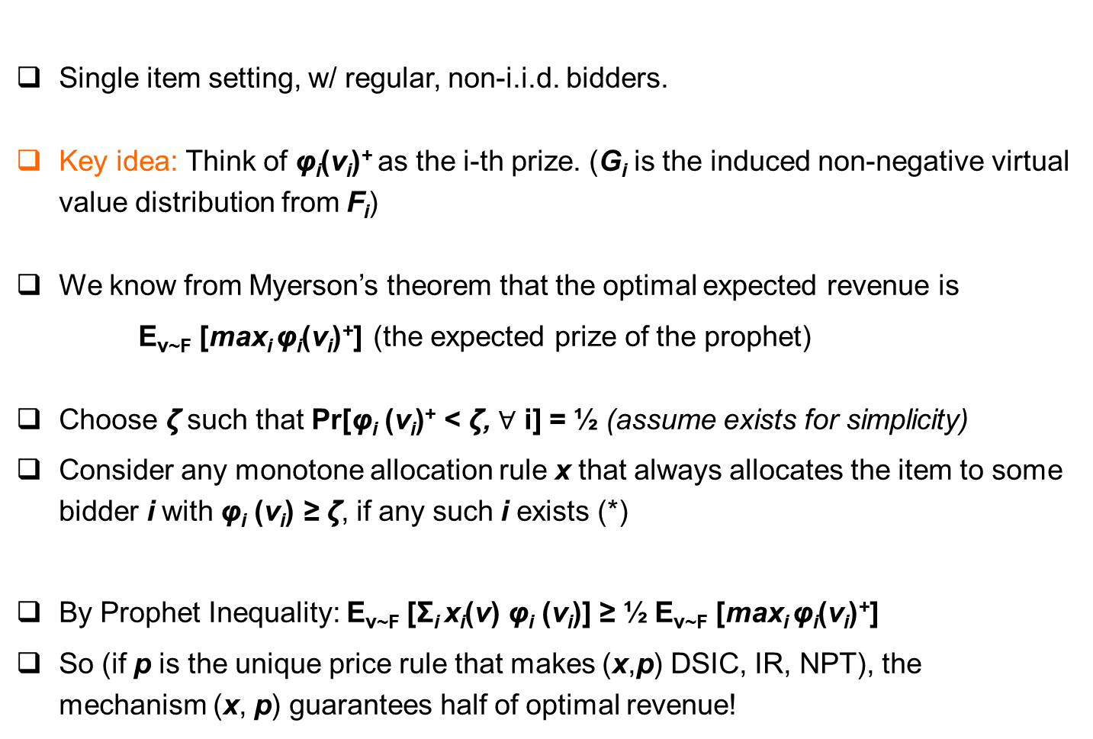
Application to Single-item Auctions
Single item setting, w/ regular, non-i.i.d. bidders.
Key idea: Think of φ_{i}(v_{i})⁺ as the i-th prize. (G_{i} is the induced non-negative virtual value distribution from F_{i})
We know from Myerson’s theorem that the optimal expected revenue is
E_{v~F} [max_{i} φ_{i}(v_{i})⁺] (the expected prize of the prophet)
Choose ζ such that Pr[φ_{i} (v_{i})⁺ < ζ, $∀$ i] = ½ (assume exists for simplicity)
Consider any monotone allocation rule x that always allocates the item to some bidder i with φ_{i} (v_{i}) ≥ ζ, if any such i exists (*)
By Prophet Inequality: E_{v~F} [Σ_{i} x_{i}(v) φ_{i} (v_{i})] ≥ ½ E_{v~F} [max_{i} φ_{i}(v_{i})⁺]
So (if p is the unique price rule that makes (x,p) DSIC, IR, NPT), the mechanism (x, p) guarantees half of optimal revenue!
Notes:
Modification if there is no ζ such that Pr[max_{i} φ_{i} (v_{i})⁺ ≥ ζ] = ½ :
find a ζ such that Pr[max_{i} φ_{i} (v_{i})⁺ ≥ ζ] ≥ ½ ≥ Pr[max_{i} φ_{i} (v_{i})⁺ > ζ]
Claim: one of “always allocate to some bidder i with φ_{i} (v_{i}) ≥ ζ” OR “always allocate to some bidder i with φ_{i} (v_{i}) > ζ works.”
Proof: follows by the proof of the prophet inquality

Slide 9
Application to Single-item Auctions (cont’d)
Here is a specific auction whose allocation rule satisfies (*) :
  Set reserve price r_{i} =φ_{i}⁻¹ (ζ) for each bidder i.
  Give the item to the highest bidder i who meets her reserve price (if any), and charge him the maximum of his reserve r_{i} and the second highest bid.
Interesting Open Problem: How about anonymous reserve? We know it’s between [1/4, 1/2], can you pin down the exact approximation ratio?
Another auction whose allocation rule satisfies (*) is the following sequential posted price auction:
  Visit bidders in order 1,…,n
  Until item has not been sold, offer it to the next bidder i at price φ_{i}⁻¹(ζ)
Notes:
Modification if there is no ζ such that Pr[max_{i} φ_{i} (v_{i})⁺ ≥ ζ] = ½ :
find a ζ such that Pr[max_{i} φ_{i} (v_{i})⁺ ≥ ζ] ≥ ½ ≥ Pr[max_{i} φ_{i} (v_{i})⁺ > ζ]
In Step 2: “give to the highest bidder who meets her reserve” or “give to the highest bidder who exceeds her reserve” works.

Slide 10
Prior-Independent Auctions

Slide 11
Another Critique to the Optimal Auction
What if bidder distributions are unknown?
When there are enough past data, it may be reasonable to assume that the distributions have been learned.
But, if the market is “thin,” we may not be confident about bidders’ distributions.
Can we design auctions that do not use any knowledge about the distributions, but perform almost as well as if they knew everything about the distributions?
Active research agenda, called prior-independent auction design.

Slide 12
Bulow-Klemperer Theorem
[Bulow-Klemperer’96] Consider any regular distribution F and integer n :
Remarks:
  Vickrey auction is prior-independent
  Theorem implies that more competition is better than finding the right auction format.

Slide 13
Proof of Bulow-Klemperer
Consider another auction M with n+1 bidders:
  Run Myerson on the first n bidders.
  If the item is unallocated, give it to the last bidder for free.
This is a DSIC mechanism. It has the same revenue as Myerson’s auction with n bidders.
It’s allocation rule always gives out the item.
Vickrey Auction also always gives out the item, but always to the bidder who has the highest value (also with the highest virtual value).
Vickrey Auction has the highest virtual welfare among all DSIC mechanisms that always give out the item!
    ☐

Slide 14
Bulow-Klemperer Theorem
[Bulow-Klemperer’96] Consider any regular distribution F and integer n :
Corollary: Consider any regular distribution F and integer n :

