Slide 1
COMP/MATH 553 Algorithmic Game Theory
Lecture 16: VCG Mechanism
Oct 27, 2016
Yang Cai

Slide 2
An overview of today’s class
Recap: Prior-Independent Mechanisms
General Mechanism Design Problems
Vickrey-Clarke-Groves Mechanism

Slide 3
A Critique to the Myerson’s Auction
What if your distributions are unknown?
When there are many bidders and enough past data, it is reasonable to assume you know exactly the value distributions.
But if the market is “thin”, you might not be confident or not even know the value distributions.
Can you design an auction that does not use any knowledge about the distributions but performs almost as well as if you know everything about the distributions.
Active research agenda, called prior-independent auctions.

Slide 4

Bulow-Klemperer Theorem
[Bulow-Klemperer’96] Consider any regular distribution F and integer n :
Remarks:
  Vickrey auction is prior-independent
  2. Theorem implies that more competition is better than finding the right auction format.

Slide 5
Prior Independent vs. Single Sample
Consider the auction with single item and single bidder.
What can mechanism designer do if he has no information about distribution?
Assume there is a single sample of the bidder’s value distribution.
Using this sample as a reserve price gives at least half of the optimal revenue if the distribution is regular! (proof on board)
For multiple non-i.i.d. bidders, if there is a single sample for each bidder, Vickrey with reserve gives good approximation to optimal revenue (not shown here).

Slide 6
General Mechanism Design Problem (Multi-Dimensional)

Slide 7
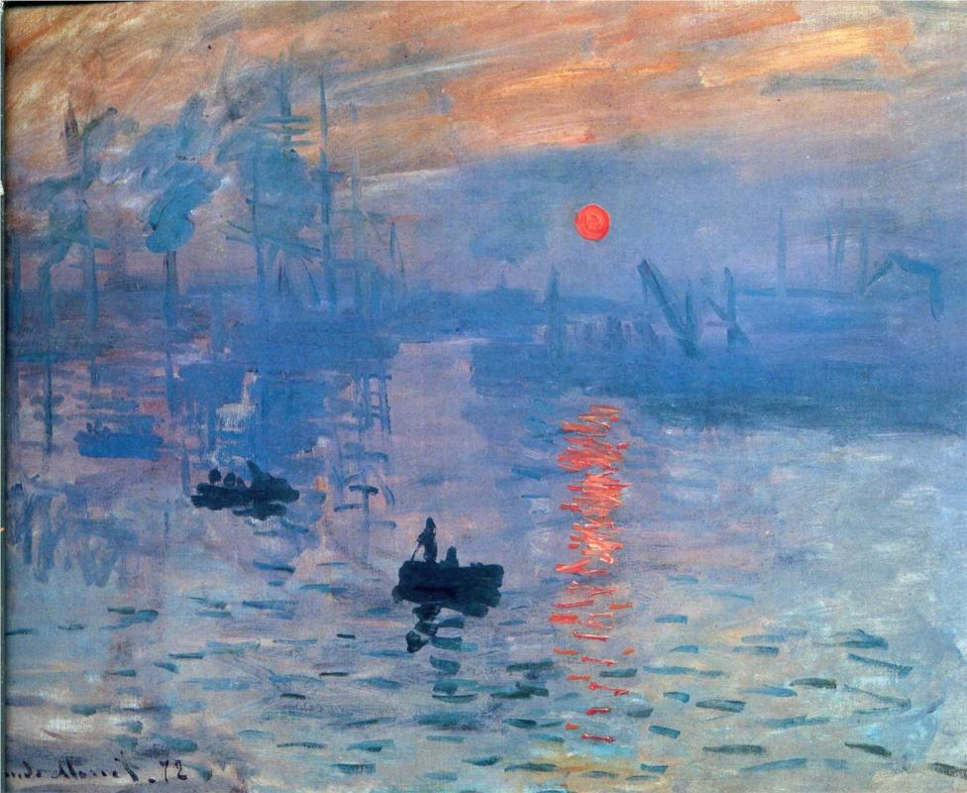
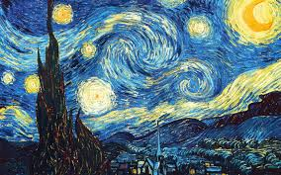
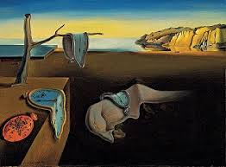
Multi-Dimensional Environment
So far, we have focused on single-dimensional environment.
In many scenarios, bidders have different value for different items.
- Sotherby’s Auction:
Multi-Dimensional Environment
  n strategic participants/agents,
  a set of possible outcomes Ω.
  agent i has a private value v_{i}(ω) for each ω in Ω (abstract and could be large).

Slide 8
Examples of Multi-Dimensional Environment
Single-item Auction in the single-dimensional setting:
  n+1 outcomes in Ω.
  Bidder i only has positive value for the outcome in which he wins, and has value 0 for the rest n outcomes
Single-item Auction in the multi-dimensional setting:
  Imagine you are not selling an item, but auctioning a startup who has a lot of valuable patents.
  n companies are competing for it.
  Still n+1 outcomes in Ω.
  But company i doesn’t win, it might prefer the winner to be someone in a different market other than a direct competitor.
  So besides the outcome that i wins, i has different values for the rest n outcomes.

Slide 9
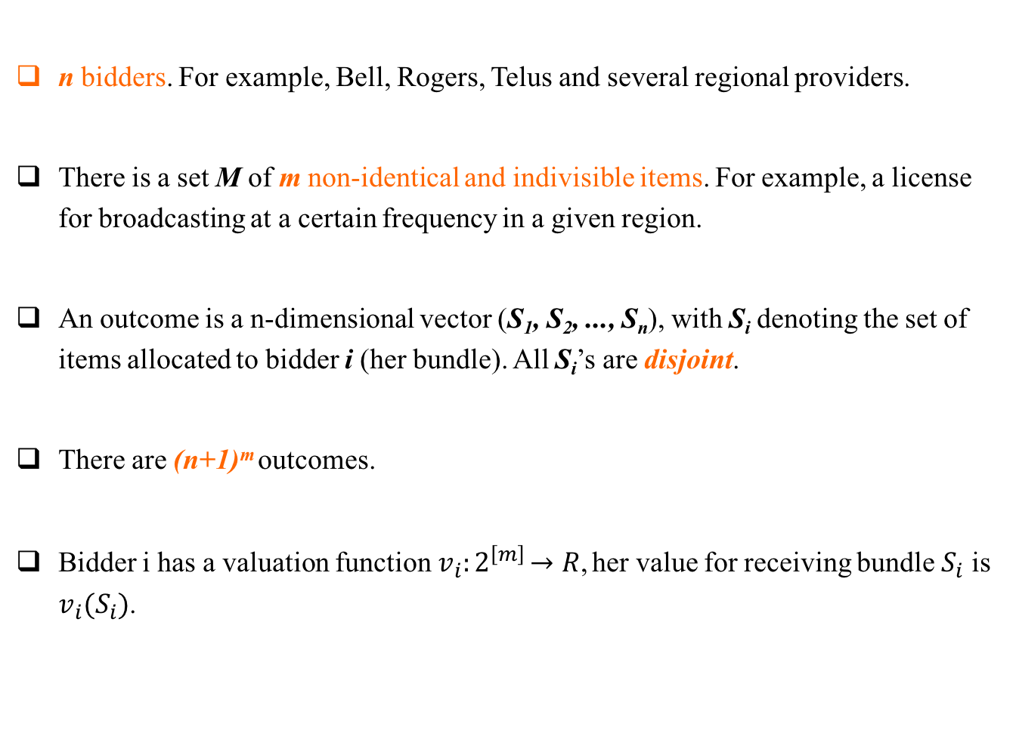
Combinatorial Auctions
n bidders. For example, Bell, Rogers, Telus and several regional providers.
There is a set M of m non-identical and indivisible items. For example, a license for broadcasting at a certain frequency in a given region.
An outcome is a n-dimensional vector (S₁, S₂, ..., S_{n}), with S_{i} denoting the set of items allocated to bidder i (her bundle). All S_{i}’s are disjoint.
There are (n+1)^{m} outcomes.
Bidder i has a valuation function$v_{i}{:2}^{\left[m\right]}→R$, her value for receiving bundle $S_{i}$ is $v_{i}(S_{i})$.

Slide 10
How do you optimize Social Welfare?
What do I mean by optimize social welfare (algorithmically)?
  ω* := argmax_{ω} Σ_{i} v_{i}(ω)
How do you design a DSIC mechanism that optimizes social welfare.
  Take the same two-step approach.
  Sealed-bid auction. Bidder i submits b_{i} which is indexed by Ω.
  Allocation rule is clear: assume b_{i}’s are the true values and choose the outcome that maximizes social welfare.
  In single-dimensional settings, given the allocation rule, Myerson’s lemma provides the unique payment rule.
  In multi-dimensional settings, Myerson’s lemma doesn’t apply ... How can you define monotone allocation rule when bids are multi-dimensional?
  Similarly, how can we define the payment rule even if we know the allocation rule.

Slide 11
Vickrey-Clarke-Groves (VCG) Mechanism

Slide 12
The VCG Mechanism
[The Vickrey-Clarke-Groves (VCG) Mechanism] In every general mechanism design environment, there is a DSIC mechanism that maximizes the social welfare. In particular the allocation rule is
  x(b) = argmax_{ω} Σ_{i} b_{i}(ω) (1);
  and the payment rule is
  p_{i}(b) = h_{i}(b_{-i})– Σ_{j≠i} b_{j}(ω*) (2),
  where ω* = argmax_{ω} Σ_{i} b_{i}(ω) is the outcome chosen in (1).

Slide 13
Clark Pivot Payment
A payment function p() is called the Clark Pivot Payment if p_{i}(b) = max_{ω} Σ_{j≠i} b_{j}(ω) – Σ_{j≠i} b_{j}(ω*) .
Theorem: VCG with Clarke pivot payments makes no positive transfers (i.e. prices are always non-negative). Also if the valuation functions are non-negative, it is individually rational.
N.B. if the valuations could take negative values, then the payments might not be IR.

Slide 14
Understanding the Clarke Pivot Payment
What does the payment rule mean?
  p_{i}(b) = max_{ω} Σ_{j≠i} b_{j}(ω) – Σ_{j≠i} b_{j}(ω*)
  max_{ω} Σ_{j≠i} b_{j}(ω) is the optimal social welfare when i is not there.
  ω* is the optimal social welfare outcome, and Σ_{j≠i} b_{j}(ω*) is the welfare from all agents except i.
  The difference max_{ω} Σ_{j≠i} b_{j}(ω) – Σ_{j≠i} b_{j}(ω*) can be viewed as “the welfare loss inflicted on the other n−1 agents by i’s presence”. Called “externality” in Economics.

Slide 15
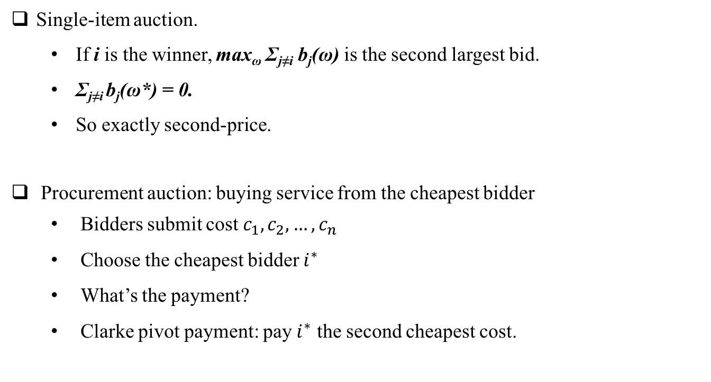
Examples of VCG
Single-item auction.
  If i is the winner, max_{ω} Σ_{j≠i} b_{j}(ω) is the second largest bid.
  Σ_{j≠i} b_{j}(ω*) = 0.
  So exactly second-price.
Procurement auction: buying service from the cheapest bidder
  Bidders submit cost $c_{1}, c_{2},…,c_{n}$
  Choose the cheapest bidder $i^{∗}$
  What’s the payment?
  Clarke pivot payment: pay $i^{∗}$ the second cheapest cost.

Slide 16
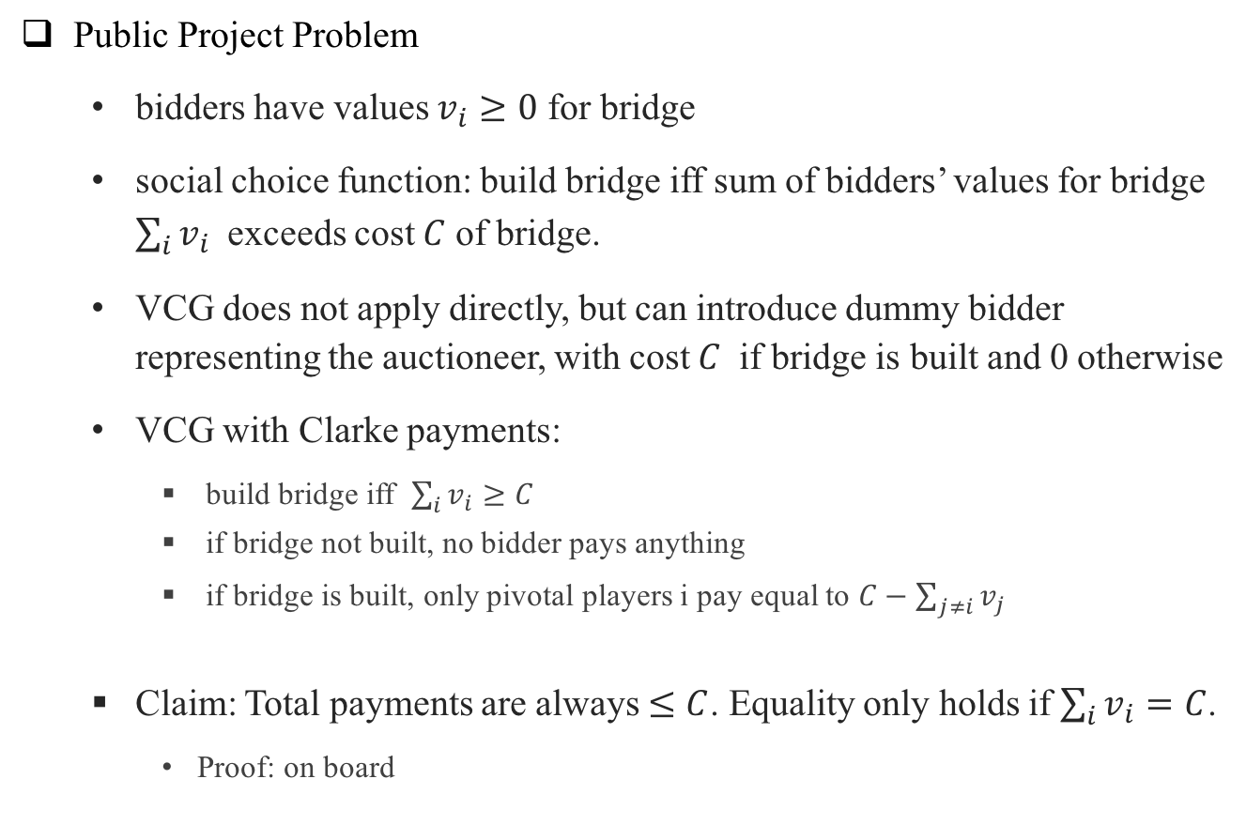
Examples of VCG
Public Project Problem
  bidders have values $v_{i}≥0$ for bridge
  social choice function: build bridge iff sum of bidders’ values for bridge ${\sum_{i}{v_{i}}}_{ }$ exceeds cost $C$ of bridge.
  VCG does not apply directly, but can introduce dummy bidder representing the auctioneer, with cost $C$ if bridge is built and 0 otherwise
  VCG with Clarke payments:
    build bridge iff $\sum_{i}{v_{i}}≥C$
    if bridge not built, no bidder pays anything
    if bridge is built, only pivotal players i pay equal to ${C−\sum_{j≠i}{v_{j}}}^{ }$
  Claim: Total payments are always $≤C$. Equality only holds if $\sum_{i}{v_{i}}=C$.
    Proof: on board

Slide 17
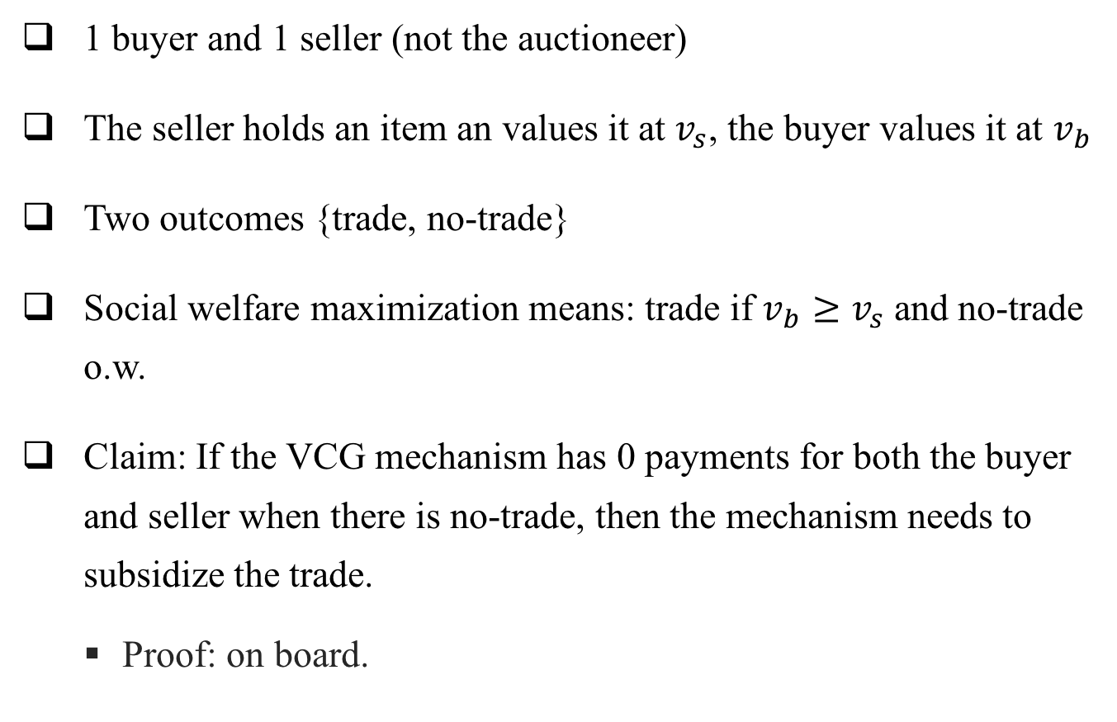
Bilateral Trading
1 buyer and 1 seller (not the auctioneer)
The seller holds an item an values it at $v_{s}$, the buyer values it at $v_{b}$
Two outcomes {trade, no-trade}
Social welfare maximization means: trade if $v_{b}≥v_{s}$ and no-trade o.w.
Claim: If the VCG mechanism has 0 payments for both the buyer and seller when there is no-trade, then the mechanism needs to subsidize the trade.
  Proof: on board.

Slide 18
Discussion of the VCG mechanism
DSIC mechanism that optimizes social welfare for any mechanism design problem !
However, sometimes impractical.
How do you find the allocation that maximizes social welfare. If Ω is really large, what do you do?
  m items, n bidders, each bidder wants only one item.
  m items, n bidders, each bidder is single-minded (only like a particular set of items).
  m items, n bidders, each bidder can take any set of items.
Computational intractable.
If you use approximation alg., the mechanism is no longer DSIC.

