Slide 1
Comp/Math 553: Algorithmic Game Theory Lecture 21
Mingfei Zhao

Slide 2
Menu
Atomic Congestion Game
Potential Function
PoA & PoS
Network Design Game

Slide 3
Traffic Routing
1 hour
Town A
Town B
x/100 hours
Suppose 100 drivers leave from town A towards town B.
Every driver wants to minimize her own travel time.
What is the traffic on the network?
In any unbalanced traffic pattern, all drivers on the most loaded path have incentive to switch their path.
Notes:
(Ex): Verify that the 50-50 split is the unique Nash equilibrium of the system shown above.

Slide 4
Traffic Routing
1 hour
Town A
Town B
x/100 hours
If both paths have 50, average delay is 0.75 hours.
In a NE, every one goes bottom. Average delay is 1 hour.
NE leads to slower travel times !
Notes:
(Ex): Verify that the 50-50 split is the unique Nash equilibrium of the system shown above.

Slide 5
Traffic Routing
50
x/100 hours
1 hour
Town A
Town B
1 hour
x/100 hours
50
Delay is 1.5 hours for everybody at the unique Nash equilibrium
Notes:
(Ex): Verify that the 50-50 split is the unique Nash equilibrium of the system shown above.

Slide 6
Traffic Routing
100
x/100 hours
1 hour
Town A
0
Town B
1 hour
x/100 hours
A benevolent mayor builds a superhighway connecting the fast highways of the network.
What is now the traffic on the network?
No matter what the other drivers are doing it is always better for me to follow the zig-zag path.
Delay is 2 hours for everybody at the unique Nash equilibrium.

Slide 7
Traffic Routing
50
100
A
B
vs
A
B
50
Adding a fast road on a road-network is not always a good idea!
Braess’s paradox
In the RHS network there exists a traffic pattern where all players have delay 1.5 hours.
Question: How well can a Nash Equilibrium perform, compared to the optimal solution?

Slide 8
Traffic Routing
Do a pure strategy NE always exist in traffic routing games?
Given others’ paths, the driver will choose a best path to minimize travel time.
(best response dynamics)
Aim to find a PSNE: start at some circumstance and perform best response dynamics iteratively.
Will this process stop?

Slide 9

The Existence of PSNE
Theorem 1:
In an Atomic Congestion Game, any iterative best response process will terminate and eventually converge to a PSNE.
Traffic routing game is an atomic congestion game.

Slide 10
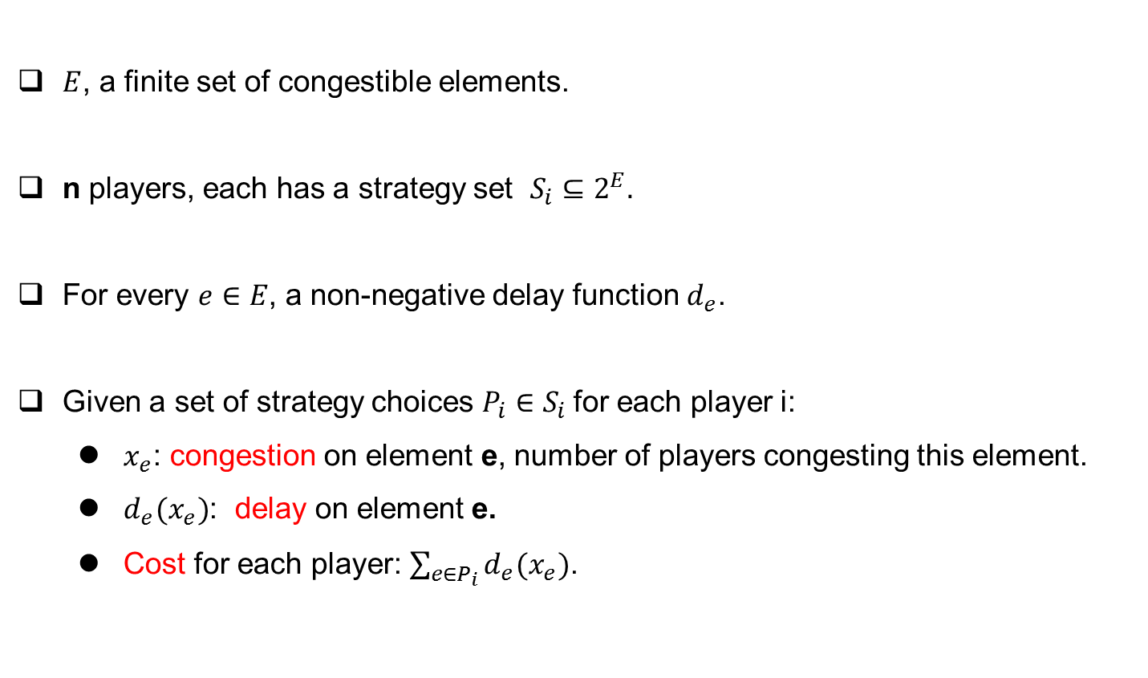
Atomic Congestion Game
$E$, a finite set of congestible elements.
n players, each has a strategy set $S_{i}⊆2^{E}.$
For every $e∈E$, a non-negative delay function $d_{e}$.
Given a set of strategy choices $P_{i}∈S_{i}$for each player i:
$x_{e}$: congestion on element e, number of players congesting this element.
$d_{e}(x_{e})$: delay on element e.
Cost for each player: $\sum_{e∈P_{i}}{d_{e}(x_{e})}$.

Slide 11

Proof of Theorem: Potential Function
Theorem:
In an Atomic Congestion Game, any iterative best response process will terminate and eventually converge to a PSNE.
For any ${S=(P}_{1},P_{2}$, …, $P_{n}),$define potential function $φ(S)$:
$$φ\left(S\right)=\sum_{e∈E}{\sum_{i=1}^{x_{e}(S)}{d_{e}(i)}}$$
After each iteration, value of the potential function falls. (Proof on board)
The process will terminate since there is no loop.
When terminate, all best responses are same as current strategies → PSNE.

Slide 12
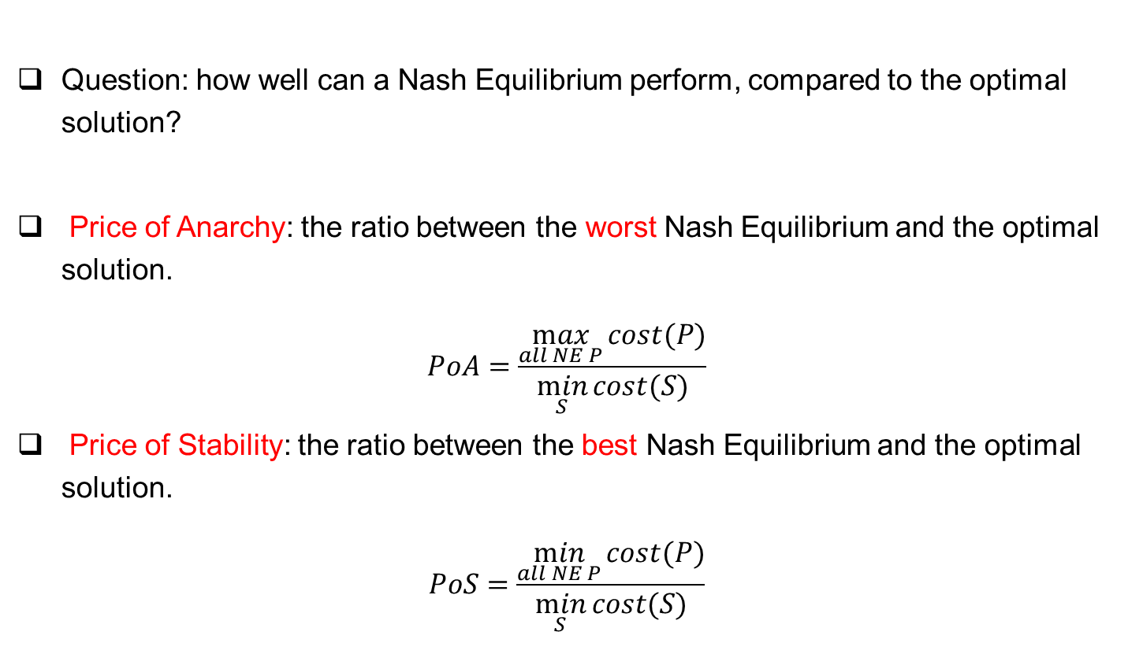
PoA & PoS
Question: how well can a Nash Equilibrium perform, compared to the optimal solution?
Price of Anarchy: the ratio between the worst Nash Equilibrium and the optimal solution.
$$PoA=\frac{\max_{all NE P}{cost(P)}}{\min_{S}{cost(S)}}$$
Price of Stability: the ratio between the best Nash Equilibrium and the optimal solution.
$$PoS=\frac{\min_{all NE P}{cost(P)}}{\min_{S}{cost(S)}}$$

Slide 13

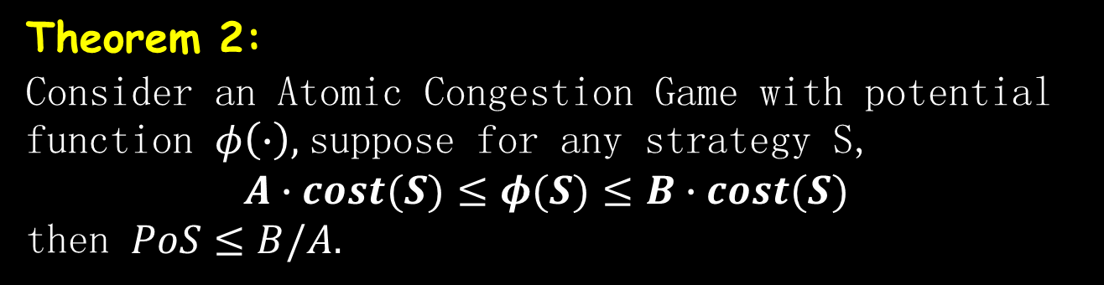
PoS for Atomic Congestion Game
Theorem 2:
Consider an Atomic Congestion Game with potential function $φ\left(∙\right),$suppose for any strategy S,
$A∙cost(S)≤φ(S)≤B∙cost(S)$
then $PoS≤B/A.$
Corollary 1:
For Atomic Congestion Game with linear delays ($d_{e}\left(x_{e}\right)=a_{e}x_{e}+b_{e}$),
$PoS≤2$

Slide 14
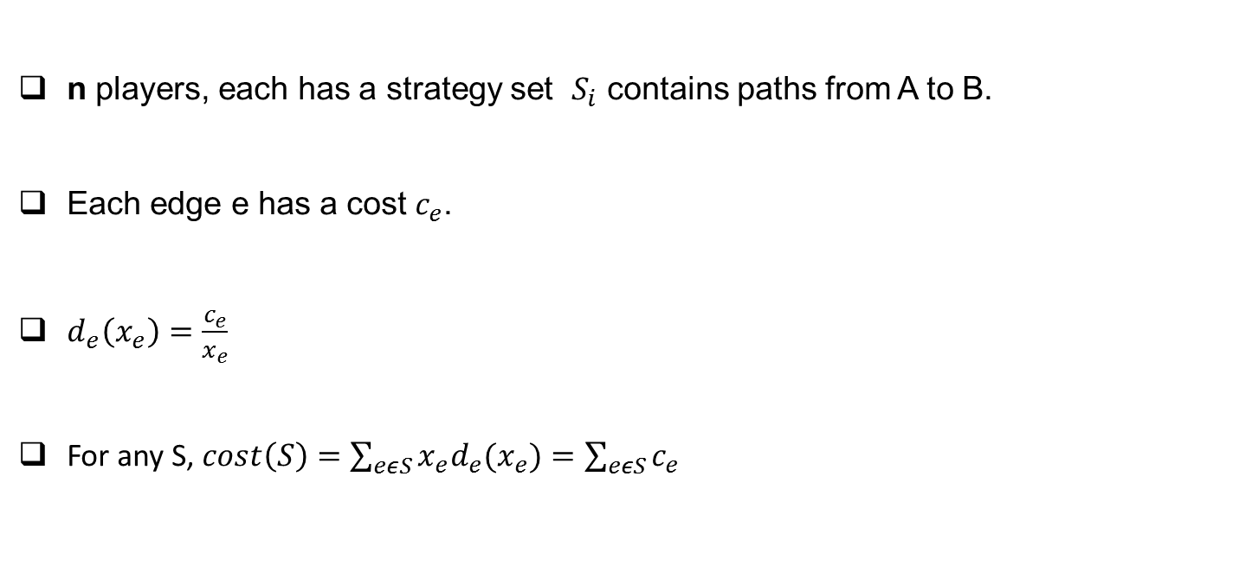
Network Design Games
Town A
Town B
n players, each has a strategy set $S_{i}$ contains paths from A to B.
Each edge e has a cost $c_{e}$.
$d_{e}\left(x_{e}\right)=\frac{c_{e}}{x_{e}}$
For any S, $cost\left(S\right)=\sum_{eεS}{x_{e}d_{e}(x_{e})}=\sum_{eεS}{c_{e}}$

Slide 15




Network Design Games: PoA
$$1+ε$$
Town A
Town B
$$n$$
Two Nash for this game:
All choose top: with delay $\frac{1+ε}{n}$.
All choose bottom: with delay 1.
$PoA$ can at most be n:
For any NE $P$, ${cost}_{i}(P)≤{cost}_{i}({OPT}_{i}, P_{−i})≤\sum_{eε{OPT}_{i}}{c_{e}}≤cost(OPT)$
$PoA=n$
$$−→PoA≥n$$

Slide 16
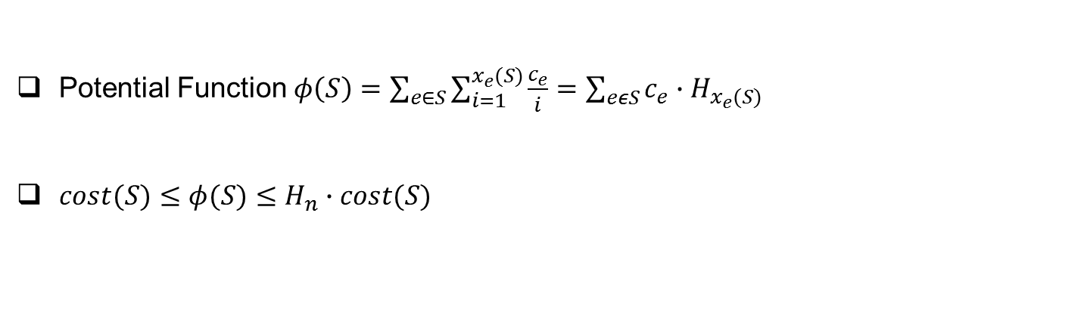
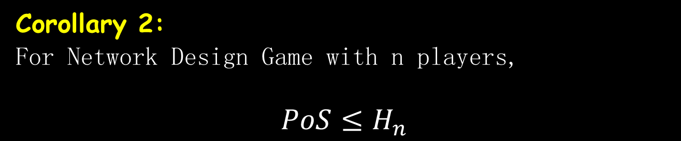
Network Design Games: PoS
Potential Function $φ\left(S\right)=\sum_{e∈S}{\sum_{i=1}^{x_{e}(S)}{\frac{c_{e}}{i}}}=\sum_{eεS}{c_{e}∙H_{x_{e}(S)}}$
$cost(S)≤φ(S)≤H_{n}∙cost(S)$
Harmonic Number
Corollary 2:
For Network Design Game with n players,
$$PoS≤H_{n}$$

