Slide 1
COMP 553: Algorithmic Game Theory
Lecture 24
Fall 2016
Yang Cai

Slide 2
In the beginning of the semester, we showed Nash’s theorem – a Nash equilibrium exists in every game.
In our proof, we used Brouwer’s fixed point theorem as a Black-box.
In today’s lecture, we explain Brouwer’s theorem, and give an illustration of Nash’s proof.
We proceed to prove Brouwer’s Theorem using a combinatorial lemma, called Sperner’s Lemma, whose proof we also provide.

Slide 3
Brouwer’ s Fixed Point Theorem

Slide 4

Brouwer’s fixed point theorem
Theorem: Let f : D D be a continuous function from a convex and compact subset D of the Euclidean space to itself.
Then there exists an x s.t. x = f (x) .
closed and bounded
Below we show a few examples, when D is the 2-dimensional disk.
f
D
D
N.B. All conditions in the statement of the theorem are necessary.

Slide 5
Brouwer’s fixed point theorem
fixed point

Slide 6
Brouwer’s fixed point theorem
fixed point

Slide 7
Brouwer’s fixed point theorem
fixed point

Slide 8
Nash’s Proof

Slide 9
Nash’s Function
where:

Slide 10
Visualizing Nash’s Construction
Kick Dive | Left | Right
Left | 1 , -1 | -1 , 1
Right | -1 , 1 | 1, -1
ƒ: [0,1]² →[0,1]², continuous
such that
fixed points ≡ Nash eq.
Penalty Shot Game

Slide 11
Visualizing Nash’s Construction
0
Pr[Right]
1
0
Kick Dive | Left | Right
Left | 1 , -1 | -1 , 1
Right | -1 , 1 | 1, -1
Pr[Right]
Penalty Shot Game
1

Slide 12
Visualizing Nash’s Construction
0
Pr[Right]
1
0
Kick Dive | Left | Right
Left | 1 , -1 | -1 , 1
Right | -1 , 1 | 1, -1
Pr[Right]
Penalty Shot Game
1

Slide 13
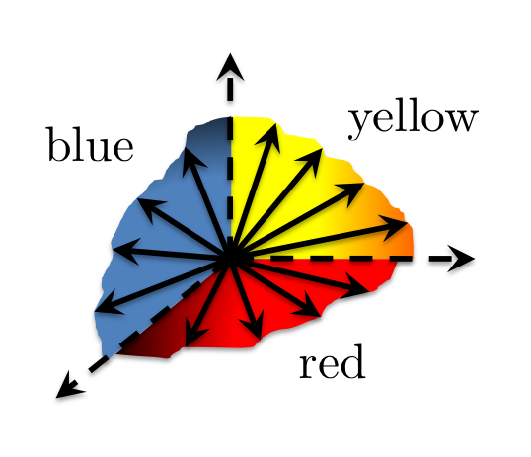
Visualizing Nash’s Construction
0
Pr[Right]
1
0
Kick Dive | Left | Right
Left | 1 , -1 | -1 , 1
Right | -1 , 1 | 1, -1
Pr[Right]
Penalty Shot Game
1

Slide 14
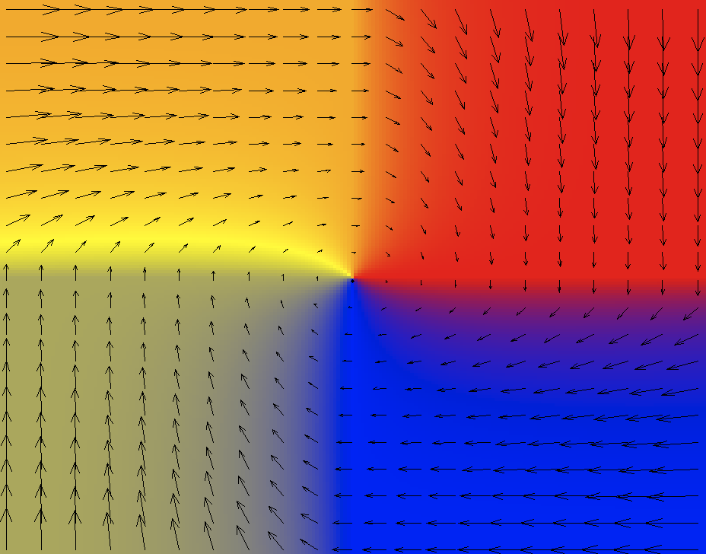
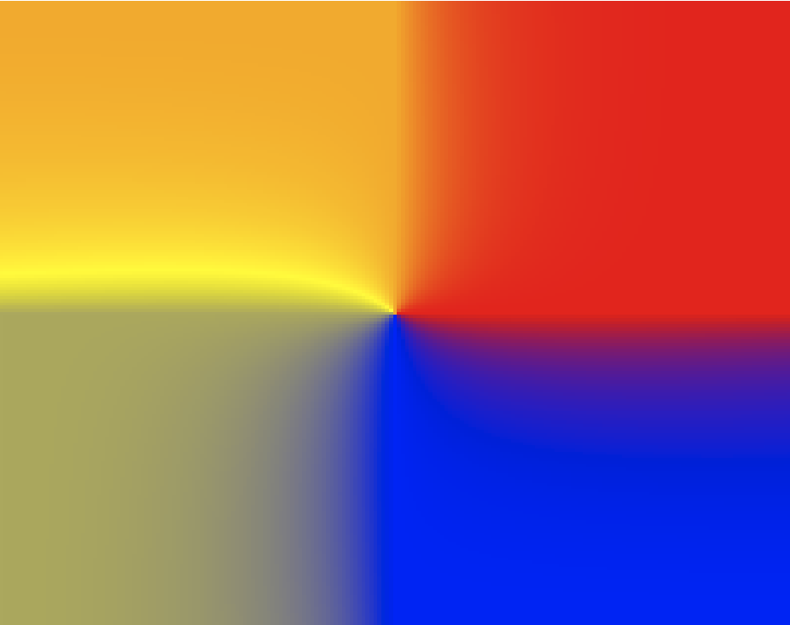
Visualizing Nash’s Construction
0
Pr[Right]
1
½
½
0
Kick Dive | Left | Right
Left | 1 , -1 | -1 , 1
Right | -1 , 1 | 1, -1
ƒ: [0,1]² →[0,1]², cont.
such that
fixed point ≡ Nash eq.
Pr[Right]
½
½
Penalty Shot Game
1
fixed point

Slide 15
Sperner’s Lemma

Slide 16
Sperner’s Lemma

Slide 17
Sperner’s Lemma
no yellow
no blue
no red
Lemma: Color the boundary using three colors in a legal way.

Slide 18
Sperner’s Lemma
no yellow
no blue
no red
Lemma: Color the boundary using three colors in a legal way. No matter how the internal nodes are colored, there exists a tri-chromatic triangle. In fact an odd number of those.

Slide 19
Sperner’s Lemma
Lemma: Color the boundary using three colors in a legal way. No matter how the internal nodes are colored, there exists a tri-chromatic triangle. In fact an odd number of those.

Slide 20
Sperner’s Lemma
Lemma: Color the boundary using three colors in a legal way. No matter how the internal nodes are colored, there exists a tri-chromatic triangle. In fact an odd number of those.

Slide 21
Proof of Sperner’s Lemma
For convenience we introduce an outer boundary, that does not create new tri-chromatic triangles.
Next we define a directed walk starting from the bottom-left triangle.
Lemma: Color the boundary using three colors in a legal way. No matter how the internal nodes are colored, there exists a tri-chromatic triangle. In fact an odd number of those.
Notes:
Think of each triangle as a little room, where each edge is a door that leads you to the next room.

Slide 22
Proof of Sperner’s Lemma
Space of Triangles
Transition Rule:
If ∃ red - yellow door cross it with red on your left hand.
?
₂
₁
Lemma: Color the boundary using three colors in a legal way. No matter how the internal nodes are colored, there exists a tri-chromatic triangle. In fact an odd number of those.

Slide 23
Proof of Sperner’s Lemma
Claim: The walk cannot exit the square, nor can it loop around itself in a rho-shape. Hence, it must stop somewhere inside. This can only happen at tri-chromatic triangle…
For convenience we introduce an outer boundary, that does not create new tri-chromatic triangles.
Next we define a directed walk starting from the bottom-left triangle.
!
Starting from other triangles we do the same going forward or backward.
Lemma: Color the boundary using three colors in a legal way. No matter how the internal nodes are colored, there exists a tri-chromatic triangle. In fact an odd number of those.

