Slide 1
Design and Implementation of Privacy‑Preserving Surveillance
Aaron Segal
Yale University May 11, 2016
Advisor: Joan Feigenbaum
“…an unspeakable blasphemy.” - @Dymaxion
Notes:
Today I’m going to be talking about privacy and surveillance.

Slide 2
Overview
Introduction – Surveillance and Privacy
Privacy Principles for Open Surveillance Processes
Lawful Set Intersection and the High Country Bandits
Contact Chaining
Anonymity through Tor and Verdict
Notes:
Start by reviewing the current state of affairs when it comes to mass surveillance and privacy
Get some privacy back into the surveillance process and open it up to accountability and oversight

Slide 3
The Problem
Open season on private personal data
No accountability
No guarantees
The government is part of the problem

Slide 4
Motivation & Goals
Replace law enforcement’s secretive, unprincipled treatment of citizens’ big data with an open privacy policy.
Secret processes for data collection
Public is asked to trust the government
Presumed tradeoff between national security and personal privacy
Ideal world: No surveillance
Notes:
Released information: NSA doesn’t store data on its own servers, but telecoms do; warrants obtained from secret courts

Slide 5
Motivation & Goals
Replace law enforcement’s secretive, unprincipled treatment of citizens’ big data with an open privacy policy.
Secret processes for data collection
Public is asked to trust the government
Presumed tradeoff between national security and personal privacy
Ideal world: No surveillance
Realistic goal: Surveillance with privacy preservation
Notes:
This may sound like an oxymoron, but we don’t agree that there is an absolute tradeoff…

Slide 6
Motivation & Goals
Replace law enforcement’s secretive, unprincipled treatment of citizens’ big data with an open privacy policy.
Secret processes for data collection
Public is asked to trust the government
Presumed tradeoff between national security and personal privacy
No need to abandon personal privacy to ensure national security
Ideal world: No surveillance
Realistic goal: Surveillance with privacy preservation
Notes:
Furthermore, it is not necessary to simply trust the government; we can have accountability…

Slide 7
Motivation & Goals
Replace law enforcement’s secretive, unprincipled treatment of citizens’ big data with an open privacy policy.
Secret processes for data collection
Public is asked to trust the government
Accountability guaranteed by existing cryptographic technology
Presumed tradeoff between national security and personal privacy
No need to abandon personal privacy to ensure national security
Ideal world: No surveillance
Realistic goal: Surveillance with privacy preservation
Notes:
And this technology can get law enforcement the information it needs, and only that information, in a way that replaces secret processes…

Slide 8
Motivation & Goals
Replace law enforcement’s secretive, unprincipled treatment of citizens’ big data with an open privacy policy.
Secret processes for data collection
Open processes for data collection with a principled privacy policy
Public is asked to trust the government
Accountability guaranteed by existing cryptographic technology
Presumed tradeoff between national security and personal privacy
No need to abandon personal privacy to ensure national security
Ideal world: No surveillance
Realistic goal: Surveillance with privacy preservation

Slide 9
Some Privacy Principles for Lawful Surveillance (1)
Open processes
Must follow rules and procedures of public law
Need not disclose targets and details of investigations
Two types of users:
Targeted users
Under suspicion
Subject of a warrant
Can be known or unknown
Untargeted users
No probable cause
Not targets of investigation
The vast majority of internet users
Notes:
“The person who robbed these banks” or “People building a bomb” are targeted users. People whose data happens to be in the same data set as them are untargeted users. Goal: Reveal information of targeted users, protect untargeted users.

Slide 10
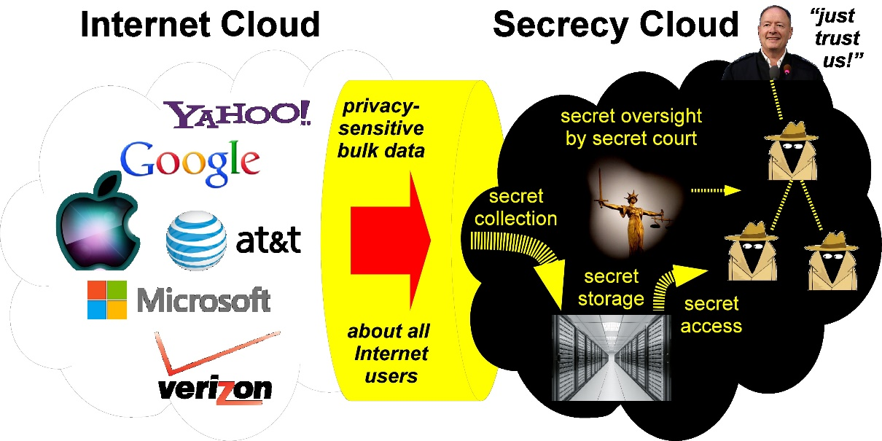
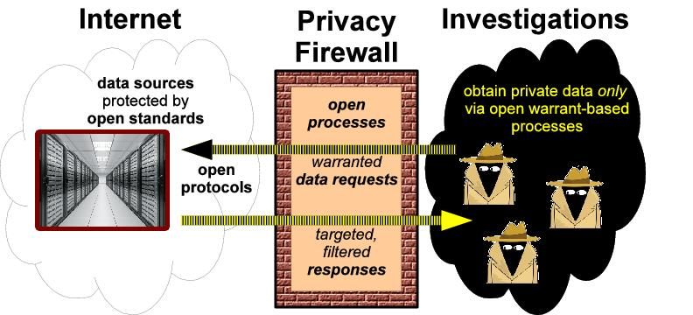
Open Privacy Firewall
Any surveillance or law-enforcement process that obtains or uses private information about untargeted users shall be an open, public, unclassified process.
Any secret surveillance or law-enforcement process shall use only:
public information, and
private information about targeted users obtained under authorized warrants via open surveillance processes.
Notes:
basic openness principle, comprising two main planks. more specifics for surveillance on next slide
current = left

Slide 11
Some Privacy Principles for Lawful Surveillance (2)
Distributed trust
No one agency can compromise privacy.
Enforced scope limiting
No overly broad group of users’ data are captured.
Sealing time and notification
After a finite, reasonable time, surveilled users are notified.
Accountability
Surveillance statistics are maintained and audited.
Notes:
Division of trust – no one agency should have legal authority or technical means to compromise privacy
Scope limiting – must be able to ensure that an overly broad group of users is not captured
Accountability – Must be able to release statistics

Slide 12
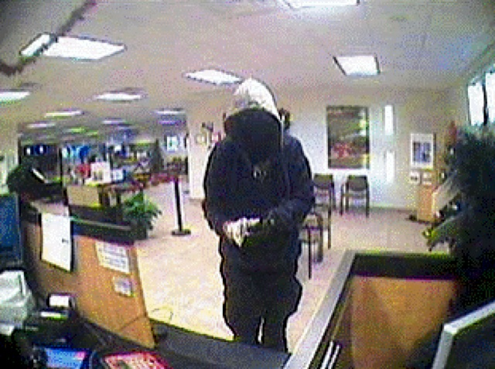
Case Study – High Country Bandits
2010 case – string of bank robberies in Arizona, Colorado
FBI Intersection attack compared 3 cell tower dumps totaling 150,000 users
1 number found in all 3 cell dumps – led to arrest
149,999 innocent users’ information acquired
Notes:
List of numbers that were in range of tower X at time T. This is bad because: untargeted users may be subject to unreasonable scrutiny, have their data mishandled, be put on watch lists, etc.

Slide 13
Intersecting Cell-Tower Dumps
Law enforcement goal: Find targeted, unknown user whose phone number will appear in the intersection of cell-tower dumps
Used in: High Country Bandits case, CO-TRAVELER program
Same principle for any collection of metadata
Cell Tower A Time t₁
650-555-4430
650-555-3435
Cell Tower B
Time t₂
650-555-3222
650-555-2840
650-555-7691
650-555-1505
650-555-9589
650-555-7976
650-555-9266
650-555-7928
Cell Tower C
Time t₃
650-555-3813
650-555-2786
650-555-7976
650-555-0392
650-555-5872
650-555-4891
650-555-9709
650-555-0599
650-555-6445
650-555-7511
650-555-2277
650-555-7976
650-555-2840
650-555-3222
Notes:
also applies to collections of metadata

Slide 14
Intersecting Cell-Tower Dumps
Law enforcement goal: Find targeted, unknown user whose phone number will appear in the intersection of cell-tower dumps
Used in: High Country Bandits case, CO-TRAVELER program
Same principle for any collection of metadata
Cell Tower A Time t₁
650-555-4430
650-555-3435
Cell Tower B
Time t₂
650-555-3222
650-555-2840
650-555-7691
650-555-1505
650-555-9589
650-555-7976
650-555-9266
650-555-7928
Cell Tower C
Time t₃
650-555-3813
650-555-2786
650-555-7976
650-555-0392
650-555-5872
650-555-4891
650-555-9709
650-555-0599
650-555-6445
650-555-7511
650-555-2277
650-555-7976
650-555-2840
650-555-3222

Slide 15
Privacy-Preserving Solution [SFF, FOCI’14]
A private set intersection protocol built to satisfy surveillance privacy principles (based on Vaidya-Clifton ‘05)
Catching Bandits and Only Bandits: Privacy-Preserving Intersection Warrants for Lawful Surveillance
Presented at the 4th USENIX Workshop on Free and Open Communications on the Internet (FOCI '14)
Notes:
Uses two types of encryption that have a special property: Normally, if you run a record through an encryption function and then run the output through another encryption function, you would have to decrypt in the reverse order. Not so with these.

Slide 16
Privacy-Preserving Cryptography
Probabilistic ElGamal encryption for secure storage of cell-tower records.
Same records encrypt to different random-looking byte strings
Deterministic Pohlig-Hellman encryption for temporary, per-execution blinding of those records.
Same records encrypt to identical random-looking byte strings
a = "650-555-2840" b = "650-555-2840" print ElGamalEncrypt(a)
> 0x00d07e08ec44712b
print ElGamalEncrypt(b)
> 0x58c82a7f050f9683
a = "650-555-2840"
b = "650-555-2840"
print PohligHellmanEncrypt(a)
> 0x0cb508480f207ec5
print PohligHellmanEncrypt(b)
> 0x0cb508480f207ec5
Notes:
The point is to move from the first type to the second type, without ever revealing data in between.

Slide 17
Private Set Intersection Setup
ElGamal encryption and Pohlig-Hellman encryption are mutually commutative with one another
D₂(D₃(D₁(E₃(E₂(E₁(x)))))) = x
D₃(D₂(E₃(D₁(E₂(E₁(x)))))) = x
Relies on multiple, independent agencies to execute protocol, providing distributed trust and accountability, e.g.:
Executive agency (FBI, NSA)
Judicial agency (warrant-issuing court)
Legislative agency (oversight committee established by law)
Each agency must participate at each step or else no one can decrypt!
Notes:
Normally, if you run data through an encryption function and then run the output through another encryption function, you could only recover the data by decrypting in reverse order, like adding or removing layers. With mutually commutative encryption, you can instead decrypt in any order.

Slide 18
Private Set Intersection Protocol (Step 1)
Repository serves data encrypted with ElGamal encryption
Uses agencies’ long-term public (encryption) keys
Agencies encrypt the encryptions with Pohlig-Hellman encryption
Uses agencies’ ephemeral encryption keys
Agencies decrypt the encrypted encryptions with ElGamal decryption
Uses agencies’ long-term private (decryption) keys
Can now inspect data, which is encrypted under Pohlig-Hellman
E₃(E₂(E₁(x)))
1
2
3
Notes:
Key points: At the beginning of this process, identical inputs produced random outputs. At the end, identical inputs produce random outputs.

Slide 19
Private Set Intersection Protocol (Step 1)
Repository serves data encrypted with ElGamal encryption
Uses agencies’ long-term public (encryption) keys
Agencies encrypt the encryptions with Pohlig-Hellman encryption
Uses agencies’ ephemeral encryption keys
Agencies decrypt the encrypted encryptions with ElGamal decryption
Uses agencies’ long-term private (decryption) keys
Can now inspect data, which is encrypted under Pohlig-Hellman
E₃(E₂(E₁(E₃(E₂(E₁(x))))))
1
2
3
1
2
3
Notes:
Key points: At the beginning of this process, identical inputs produced random outputs. At the end, identical inputs produce random outputs.

Slide 20
Private Set Intersection Protocol (Step 1)
Repository serves data encrypted with ElGamal encryption
Uses agencies’ long-term public (encryption) keys
Agencies encrypt the encryptions with Pohlig-Hellman encryption
Uses agencies’ ephemeral encryption keys
Agencies decrypt the encrypted encryptions with ElGamal decryption
Uses agencies’ long-term private (decryption) keys
Can now inspect data, which is encrypted under Pohlig-Hellman
E₃(E₂(E₁(x)))
1
2
3
Notes:
Key points: At the beginning of this process, identical inputs produced random outputs. At the end, identical inputs produce random outputs.

Slide 21
Private Set Intersection Protocol (Step 2)
Accomplished: Moved from an ElGamal state to a Pohlig-Hellman state without ever fully decrypting the private data!
Agencies can now inspect encrypted data to find matching records
Last step: decrypt only those records with Pohlig-Hellman
a = "650-555-2840"
b = "650-555-2840" print ElGamalEncrypt(a)
> 0x00d07e08ec44712b
print ElGamalEncrypt(b)
> 0x58c82a7f050f9683
a = "650-555-2840"
b = "650-555-2840"
print PohligHellmanEncrypt(a)
> 0x0cb508480f207ec5
print PohligHellmanEncrypt(b)
> 0x0cb508480f207ec5

Slide 22
Protocol Satisfies Privacy Principles
Open Process
Can openly standardize the protocol and the crypto without compromising investigative power
Distributed trust
No one agency can decrypt or perform intersection.
Enforced scope limiting
Any agency can stop an execution if sets or intersection are too large.
Sealing time and notification
Implementable by policy – all agencies get final data set
Accountability
Because every agency must participate, no agency can perform illegitimate surveillance without the other agencies’ learning and getting statistics.

Slide 23
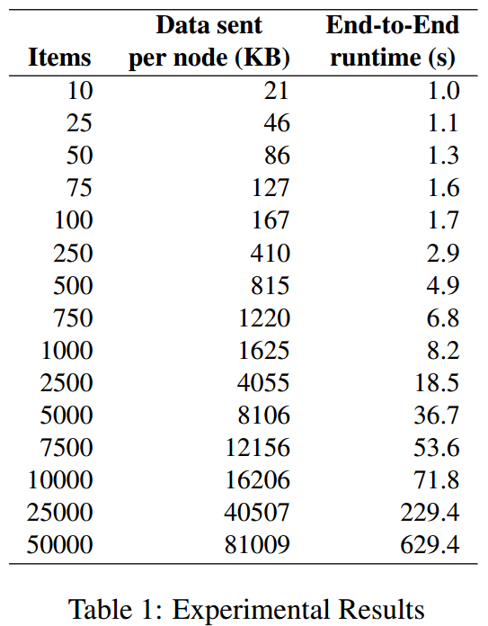
Evaluation of Implementation
Java implementation of protocol run in parallel on Yale CS Cloud
High Country Bandits example with 50,000 items per set takes less than 11 minutes to complete.
Note that this is an offline process.
Notes:
It takes the FBI two hours to do anything anyway

Slide 24
Contact Chaining
Government knows phone number of target X.
Goal: Consider the “k-contacts” of X (nodes within distance k).
x
Notes:
Example: Red is ISIS recruiter, if k = 2 then gov’t wants all yellow and green names, if k=3 then it also wants light blue names

Slide 25
Privacy-Preserving Contact Chaining Goals
Government learns actionable, relevant intelligence
Telecommunications companies learn nothing more about other companies’ clients
x
Notes:
Example: Red is ISIS recruiter, if k = 2 then gov’t wants all yellow and green names, if k=3 then it also wants light blue names

Slide 26
Privacy-Preserving Contact Chaining Goals
Government learns actionable, relevant intelligence
Telecommunications companies learn nothing more about other companies’ clients
Notes:
Circles, squares, and diamonds represent 3 providers

Slide 27
Privacy-Preserving Contact Chaining Goals
Government learns actionable, relevant intelligence
Telecommunications companies learn nothing more about other companies’ clients
Notes:
Circle’s view of the network.

Slide 28
Restrictions on Contact Chaining
Respect the distinction between targeted and untargeted users
Enforce scope limiting
Enforce division of trust between authorities
Notes:
Circles, squares, and diamonds represent 3 providers

Slide 29
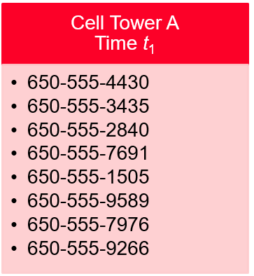
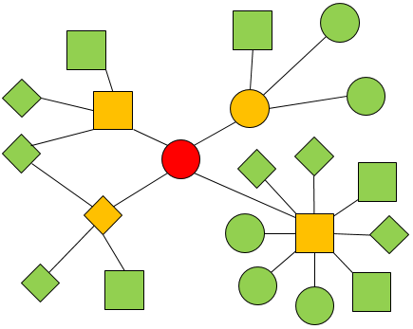
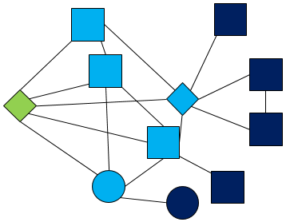
Using Contact Chaining - Main Idea
Use privacy-preserving contact chaining protocol to get encryptions of k‑contacts of target
Use privacy-preserving set intersection to filter k‑contacts and decrypt only new targets
650- 555- 7976
Notes:
Remember k-contacts = users within distance k

Slide 30
Privacy-Preserving Contact Chaining Protocol
Government agencies agree on a warrant:
Initial target id X
Maximum chaining length k
Scope-limiting parameter d : Maximum degree
Each telecom has:
List of client identities served
Contact list for each client
Agencies repeatedly query telecoms about their data
Notes:
And receive encrypted-only replies

Slide 31
Privacy-Preserving Contact Chaining Protocol Setup
Agencies perform a modified parallel breadth-first search by querying telecoms
Enc_{T(a)}(a) is a public-key encryption of a under the encryption key of T(a), the telecom that serves user a
Enc_{Agencies}(a) is an ElGamal encryption of a under the keys of all agencies
Query to T(a)
Enc_{T(a)}(a)
Signatures from all agencies
Response from T(a)
Enc_{Agencies}(a)
Enc_{T(b)}(b) for all b in a’s set of neighbors
Signature from T(a)
Notes:
Telecom ciphertext and agency ciphertext

Slide 32
Privacy-Preserving Contact Chaining Protocol
Step 0:
Query T(x) on original target x
Step 1 through k:
Query appropriate telecom on all ciphertexts received during previous step
Exception: If a single response has more than d contacts, do not query them
Output: Agency ciphertexts received
Query to T(a)
Enc_{T(a)}(a)
Signatures from all agencies
Response from T(a)
Enc_{Agencies}(a)
Enc_{T(b)}(b) for all b in a’s set of neighbors
Signature from T(a)
Notes:
Send queri

Slide 33
Protecting Private Data
Agencies see no cleartext identities from this contact chaining protocol
Telecoms learn no information about other telecoms’ users by responding to queries
Signatures ensure validity of all messages
Query to T(a)
Enc_{T(a)}(a)
Signatures from all agencies
Response from T(a)
Enc_{Agencies}(a)
Enc_{T(b)}(b) for all b in a’s set of neighbors
Signature from T(a)
Notes:
Information theoretically they might learn vague information from order of queries, like the fact that there is a path between two of their own users

Slide 34
Protocol Satisfies Privacy Principles
Open Process
Can openly standardize the protocol and the crypto without compromising investigative power
Distributed trust
Telecoms disregard queries unless signed by all agencies
No one agency can decrypt responses
Enforced scope limiting
Any agency can block paths through high-degree vertices
Sealing time and notification
Agencies can notify targeted users after intersection step
Accountability
Surveillance statistics collected by any or all agencies

Slide 35
Implementation of Contact-Chaining Protocol
Java implementation of protocol run in parallel on Yale CS Cloud
Used actual network data from a Slovakian social network as “realistic” stand-in for a telephone network
Created 4 “telecoms” owning 44%, 24%, 17%, and 15% of the network to simulate proportional sizes of largest 4 telecoms
Notes:
Note: The amount of data, not the structure of the graph, is what determines running time

Slide 36
Contact Chaining Experimental Setup
Java implementation of protocol run in parallel on Yale CS Cloud
Used actual network data from a Slovakian social network as “realistic” stand-in for a telephone network
Ciphertexts in result | Degree of Target x | Maximum Path Length k | Large Vertex Degree Cutoff d
582 | 40 | 2 | 50
1061 | 47 | 2 | 75
5301 | 128 | 2 | 150
10188 | 123 | 2 | 500
27338 | 32 | 3 | 200
49446 | 40 | 3 | 150
102899 | 230 | 3 | 100
149535 | 159 | 3 | 150
194231 | 128 | 3 | 500
297474 | 123 | 3 | 500

Slide 37
Contact Chaining Experimental Results
Varied starting position, k, and d to examine a variety of neighborhood sizes
Measured
End-to-end running time
CPU time used by all telecoms
Total bandwidth sent over network
Ciphertexts in result | End-to-end runtime MM:SS | Telecom CPU Time H:MM:SS | Bytes transferred MB
582 | 00:05 | 0:00:32 | 18
1061 | 00:06 | 0:00:57 | 6
5301 | 00:23 | 0:04:43 | 22
10188 | 00:37 | 0:08:41 | 36
27338 | 01:50 | 0:28:23 | 132
49446 | 03:15 | 0:46:28 | 222
102899 | 07:43 | 1:58:16 | 804
149535 | 10:25 | 2:42:49 | 896
194231 | 13:57 | 3:34:48 | 978
297474 | 21:51 | 5:41:43 | 1570
Notes:
Telecom CPU time is for *all* telecoms. Bytes transferred is for *all* participants. Next slide shows linear growth

Slide 38
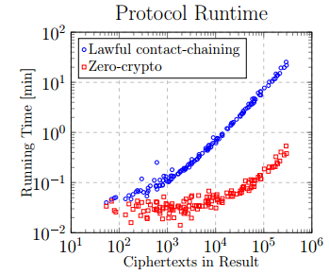
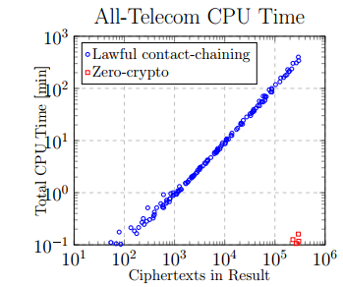
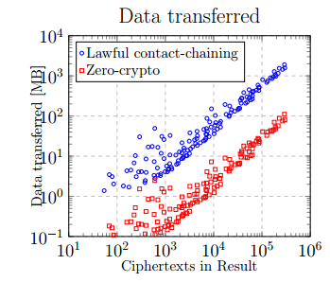
Contact Chaining Experimental Results
Notes:
Shows linear scaling and comparison with zero-crypto

Slide 39
Privacy-Preserving Contact Chaining and Intersection
Privacy-preserving contact chaining & set intersection together
Our principles apply to other surveillance of private data
No need for new cryptographic tools, “backdoors,” or secret processes

Slide 40
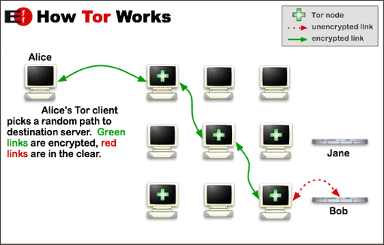
Anonymity: Users Protecting Themselves With Tor
Anonymous communication dissociates network activity from user identity
Tor: The Second-Generation Onion Router [DMS 2004]
2 million Tor users daily
7000+ volunteer relays in the Tor network
Connections made through three relays: guard, middle, exit
Vulnerability: Adversary who can view guard and exit traffic together
Notes:
Roger Dingledine, Nick Mathewson, Paul Syverson

Slide 41
TorFlow: Critical but Vulnerable
TorFlow conducts bandwidth scans to measure all 7000+ relays
Relays can determine when they’re being scanned
Exploit: Give better service to measurement authorities
Bandwidth scans use only two relays, not three
Exploit: Launch DoS on another relay by blocking traffic only when on a circuit with that relay
Results of scans are used only to proportionally adjust self-reported measurements
Exploit: Lie
Notes:
Explain each attack. Measurements are for load-balancing; we want higher bandwidth relays to have more traffic.

Slide 42
PeerFlow: Secure Load Balancing Alternative
Periodically estimate relay bandwidth and use estimates to calculate selection weight
Three estimates of relay bandwidth:
Measurements collected from relays about other relays
Use natural traffic to generate measurements
Ignore measurements made by smaller relays
Add random noise to measurements before sending
Self-reports from relays
Relays report estimate of own capacity
Reports are not trusted
Expected traffic carried
Based on selection weight in last measurement period
Notes:
Selection weight ~= fraction of traffic. Laplace distributed.

Slide 43
PeerFlow: High-level Idea
Use estimates to choose relay selection weight
Selection weight ~= fraction of traffic carried
If measured bandwidth ≥ expected bandwidth and self-reported bandwidth > measured bandwidth:
Increase selection weight
If measured bandwidth < expected bandwidth and self-reported bandwidth > measured bandwidth:
Decrease selection weight in next period to be equal to measured bandwidth in that period
Notes:
In latter case, relay is expected to send dummy traffic to increase measured bandwidth

Slide 44
Performance of Peerflow

Slide 45
Verdict: Alternative to Tor
Verdict: accountable anonymity through Dining-Cryptographers Networks (DC-Nets)
Original paper: Henry Corrigan-Gibbs, David Isaac Wolinsky, Bryan Ford (USENIX 2013)
Not vulnerable to an adversary, even if they can view all messages
Trade-off: Users take turns sending messages over network, increasing latency
Proof of security!

Slide 46
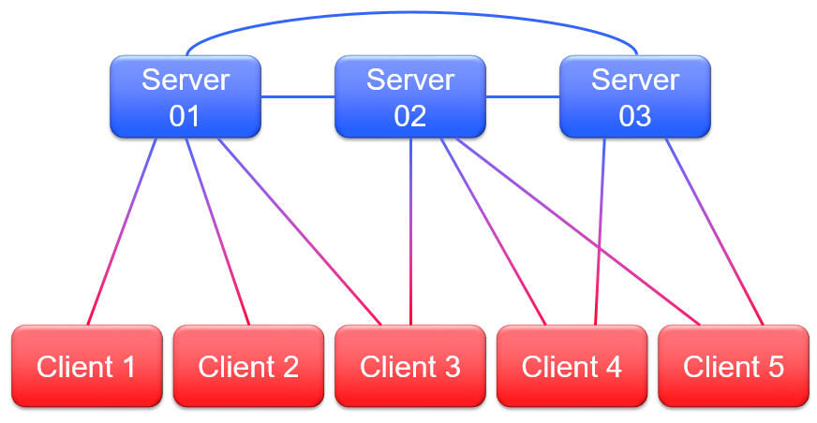
Verdict Architecture
Multi-provider cloud
Each client connected with one or more servers
Each server connected with all other servers
Anytrust
At least one server is honest
Notes:
Clients send messages, servers assist in the protocol

Slide 47
Verdict Properties Proven
Accountability
Whenever the protocol fails, an honest node can produce a proof that shows a deviation from the protocol on the part of one other participant
A dishonest participant can’t produce a proof blaming an honest participant
With every message, each participant sends a non-interactive zero-knowledge proof that the sender is following the protocol
Anonymity
Integrity

Slide 48
Verdict Properties Proven
Accountability
Anonymity
As long as there are two honest clients, no other participant can tell which client sends which message, even if they can see all messages being sent over the wire
Adversary can’t distinguish between encryptions of messages without breaking security of underlying encryption scheme or zero-knowledge property of proof scheme
Integrity

Slide 49
Verdict Properties Proven
Accountability
Anonymity
Integrity
Either all clients receive accurate messages from all other clients, or all clients know that the protocol failed
Forging or altering messages is impossible
Straightforward as long as E(m)+E(0)+E(0)+E(0)+... = E(m) and proofs of knowledge can’t be forged

Slide 50
Conclusions
Privacy-preserving surveillance is technologically feasible
Privacy-preserving set intersection and contact chaining can accomplish law-enforcement goals with open processes and without users losing control of their data
Anonymity through Tor is practical and can be secured against bandwidth-inflation attacks using PeerFlow
Verdict offers provably accountable anonymity as alternative to Tor

Slide 51
Thank you!

