Slide 1
Practical and Deployable
Secure Multi-Party Computation
Jai Dadabhai
Debayan Gupta
Yale University
May 11, 2016

Slide 2
The Apparent Paradox of
Modern Cryptography
Intuitive ideas of secrecy
  Encrypted data are safe; but they appear to be unusable
If people have secrets, and want to do a joint computation
  They can use a trusted third party
Modern cryptography
  You may not have to decrypt
  There may not need to be a trusted third party
Notes:
<CLICK>As humans, we know what secrecy is. We have some notion of how it relates to safety.
We play hide and seek as children, we lock things in safe boxes. Lying is keeping a secret by providing false data.
<CLICK>Most people have intuitive ideas about enciphering something (I’ll signal by knocking four times)
But in general, most people believe that to use data, you need to see it – in plaintext.
In order to act upon a signal, you must know what it means. Encrypted data are safe; but they appear to be unusable
<CLICK> If people have secret data, and want to do a joint computation, <CLICK> they can use a trusted third party.
They give this third party the unencrypted information, and the third party does the computation.
<CLICK>Trusted third party => Modern cryptography (a) you may not have to decrypt and (b) there may not need to be a trusted third party

Slide 3
Secure Multi-Party Computation (SMPC)
Have your cake and eat it too
Secret inputs; joint computation of desired output (Yao82)
SMPC or Secure Function Evaluation (SFE)
State of the art
  2P-SFE: Currently fast enough for many applications
  SMPC: Fast enough in some cases
  Fully Homomorphic Encryption: Slow, but improving
Notes:
No information – other that what is logically implied by the output – should be revealed.
Unfortunately, most of our tests aren’t important enough for God to intervene in, so we have been unable to gauge the efficiency of such protocols
SFE / 2P-SFE or SMPC / S2PC – we should really use just one type of notation, but sadly, we haven’t really been able to decide.
Not been deployed i

Slide 4
Talk Outline
Example: Privacy-preserving Proximity
PartialGC (ACM CCS'14*)
  With Benjamin Mood, Kevin Butler, and Joan Feigenbaum
Other work on practical, secure computation
  SMPC: Overview and challenges
  Frigate, SGX, Systematization
Deploying SMPC
Ongoing and future work
*Expanded version: http://arxiv.org/abs/1506.02954
Notes:
First I want to start with a motivating example ppp
Then I want to spend the bulk of the talk talking about pgc
Go into detail onPartialGC, overvew of 3 other pieces of work, and then explain how to tie things together

Slide 5
Talk Outline
Example: Privacy-preserving Proximity
PartialGC (ACM CCS'14*)
  With Benjamin Mood, Kevin Butler, and Joan Feigenbaum
Other work on practical, secure computation
  SMPC: Overview and challenges
  Frigate, SGX, Systematization
Deploying SMPC
Ongoing and future work
*Expanded version: http://arxiv.org/abs/1506.02954
Notes:
First I want to start with a motivating example ppp
Then I want to spend the bulk of the talk talking about pgc

Slide 6
Privacy-Preserving Proximity
2 parties
  They want to know whether they are within 1 mile of each other
  Locations are private
Classic 2P-SFE problem (garbled circuits, Yao82)
  Every pair needs to start from scratch
  Basic GC is still not efficient enough for mobile devices
Could use a trusted cloud server
  Location is kept private from other party but is known to server
Cloud Server
SFE
Are the locations within 1 mile of one another?
Bob
2. Location-2
1. Location-1
Alice
4. Result
3. Result
Notes:
Basic GC still not efficient enough for mobile devices (e.g., phones or tablets).
Cloud server: Each person sends his location to the server, and the server tells both of them “yes, you’re within one mile of each other” or “no, you’re not.”
That keeps each person’s location private from the other but not from the server; the server is treated as a “trusted third party.”
Having a cloud server provides a lot of advantages other than the all-pairs communication pattern

Slide 7
Proximity using PartialGC
We want the advantages of a cloud server
  But the privacy guarantees of SFE
  Location data remain private from each other and cloud
PartialGC is a garbled-circuit based, general method
for fully privacy-preserving server-aided computation
Cloud Server
SFE
SFE
Alice
Bob

Slide 8
Overview of PartialGC
Garbled circuits
Cut-and-choose for GCs secure against malicious adversaries
Partial garbled circuits
  Break a large garbled circuit into smaller sub-circuits
  Encrypted outputs of one GC become inputs to the next
  No intermediate decryption
To achieve this, we need novel circuit-generation and cut-and-choose techniques
Notes:
<CLICK> To explain partialGC, we'll first need some background on garbled circuits. This is in the honest-but-curious model, where parties dutifully follow the protocol.
<CLICK> We'll also talk about security against malicious adversaries using cut-and-choose.
<CLICK> So what are partial garbled circuits? Why are they "partial"? We're taking a large garbled circuit and breaking it into smaller pieces, allowing for different evaluators to execute each of these sub-circuits. The output of each sub-circuit is never decrypted until the end; it becomes an input to the next sub-circuit. This allows us to securely save state between garbled circuit computations and reuse these intermediate values for iterative computations.
<CLICK> There are some pitfalls; we'll need to modify the way we generate circuits to allow for the reuse of these encrypted intermediate values. The standard cut-and-choose also has some problems in this setup, so we'll present a variant that works for us.

Slide 9
Garbled Circuits
2 parties
Private inputs; outputs may be private or public
Public function represented as a Boolean circuit
The generator creates and encrypts (or “garbles”) the circuit
The evaluator evaluates the garbled circuit
  Gate by gate
  Online: Evaluation involves interaction with the generator
Notes:
But first, garbled circuits. <CLICK> We have 2 parties with <CLICK> private inputs that wish to jointly compute a
<CLICK> public function. We'll call them the <CLICK> generator and the <CLICK> evaluator.
The generator generates the garbled circuit - that is, it takes a function represented as a boolean circuit and encrypts, or "garbles" it - and the evaluator evaluates this garbled circuit with help from the generator.
In the end, we want to learn the output of the function without revealing anything about the other party's input.(Beyond what is implied by the output; so, for example, if the function is the sum of two inputs, there's nothing that garbled circuits or any SFE mechanism can do for you.)

Slide 10
Generating a Garbled Circuit
AND
AND
OR
A | B | C
0 | 0 | c₀
0 | 1 | c₁
1 | 0 | c₂
1 | 1 | c₃
A | B | C
0 | 0 | E(A0.B0, c₀)
0 | 1 | E(A0.B1, c₁)
1 | 0 | E(A1.B0, c₂)
1 | 1 | E(A1.B1, c₃)
Permute
E(A1.B1, c₃)
E(A1.B0, c₂)
E(A0.B0, c₀)
E(A0.B1, c₁)
Generator creates 4 keys, one each for A=0, A=1, B=0, and B=1
This is sent to the evaluator
Notes:
So how does this work? Let's start by talking about how the generator creates a garbled circuit. I won't really discuss any optimizations - this is just a very basic, simplified version.
We begin with a function represented as a Boolean circuit.
Each gate <CLICK> in this circuit can be represented as a truth table. <CLICK>A and B are inputs to the gate, and C is the output. We won't worry about what the various c values are for now and treat it as an arbitrary gate.<CLICK> The generator now creates 4 keys, one for each possible input wire value.
<CLICK>
So I know this notation is weird – it just means that c_0 is encrypted using “A0 concatenated with B0” as the key.
The generator then encrypts each c value with a combination of 2 out of the 4 keys. c_0 was output when A=0 and B=0, so it is encrypted with A0.B0; c_1 was output when A=0 and B=1, so we use A0.B1 to encrypt it, and so on. So, each row of C is encrypted with a unique combination of 2 keys, and these keys represent the input values that produced that output.
<CLICK> We then randomly permute this table and send it to the evaluator. <CLICK>

Slide 11
Evaluating a Garbled Circuit
Received
E(A#.B#, c#)
E(A#.B#, c#)
E(A#.B#, c#)
E(A#.B#, c#)
Gen-input
E(A0.B#, c#)
E(A0.B#, c#)
E(A0.B#, c#)
E(A0.B#, c#)
Eval-input
E(A0.B0, c#)
E(A0.B0, c#)
E(A0.B0, c#)
E(A0.B0, c#)
Generator sends A0 if its input is 0 or A1, if its input is 1
Plug in B0 (e.g.)
B0
Eval-input
E(A0.B0, c#)
E(A0.B0, c#)
E(A0.B0, c#)
E(A0.B0, c#)
This should be B0 if the evaluator’s input was 0, and B1 if it was 1
B1
Value of C for one row of the table
How do we do this? Oblivious Transfer
Evaluator’s input
Notes:
The evaluator receives the permuted table <CLICK> Remember, the evaluator doesn't know which row is which.
If we can get the A and B values corresponding to the two inputs, we can retrieve the correct C value.
How? Well, the generator sends either A0 or A1, depending upon its input.<CLICK> The evaluator doesn't know whether the value it receives represents 0 or 1; it simply plugs this into the table.
<CLICK> This table shows the status after the generator's input has been plugged in; of course, we know that A0 is valid for only 2 of the 4 rows, but we don't know which.
Now, all we need to do is to somehow get the correct B0 or B1 corresponding to the evaluator's input.
<CLICK>We need a protocol that does the following: The generator offers up B0 and B1.The evaluator provides its input - 0 or 1 - as a sort of secret "select" bit.
The protocol must output B0 if the evaluator's input is 0, and 1 if the input is 1.Of course, the generator must not learn what the evaluator's input was and the evaluator must not learn anything about the other B key. So if it selects B0, it must learn nothing about B1, and the generator must not know which one was selected.
<CLICK>We have a well studied cryptographic primitive that does exactly this -- oblivious transfer.
I don't have time to explain how Oblivious Transfer works, but it's a very well studied primitive, and we just use it 'off the shelf' in this construction.
<CLICK>The evaluator now plugs in this new B-key.<CLICK>Of course, this will work for only 1 out of the 4 rows.<CLICK>
<CLICK>And that gives the correct C (output) value for that gate.<CLICK>
<CLICK>In a real implementation with multiple layers of gates, these c values will simply be A-key values for the next gate.
Computing the result of one gate will thus provide the next A0 or A1 and we'll just need to perform the oblivious transfer.

Slide 12
Cut-and-Choose
How can we defend against malicious adversaries?
  Many copies of the circuit
  Check some circuits, evaluate the rest normally
  Final result is majority output
Malicious evaluator: sign output within the circuit
  Does not guarantee fair release
Generator creates Boolean circuit from program
Generator builds many different garbled versions of this circuit
Evaluator randomly selects some circuits as “check”
All circuits are sent to the evaluator
Generator sends all keys (A0,A1,B0,B1) for that circuit to the evaluator
Notes:
So that works as long as the parties follow the protocol - that is, they follow the honest-but-curious model.
<CLICK> But how do we prevent malicious parties from cheating?
<CLICK> The generator takes the original function and produces a Boolean circuit<CLICK> It builds, garbles, and sends over multiple copies of the circuit <CLICK>
<CLICK> The evaluator will randomly select some subset of these to be checked and evaluate the rest<CLICK>
The generator must send over all keys for the check circuits so that the evaluator can verify them.
The rest of the circuits are evaluated normally; if we evaluate more than one, the majority output value is usually taken as the answer, in case the generator managed to sneak in a corrupted circuit.
<CLICK> Handling a malicious evaluator is a lot easier - we simply have a MAC within the circuit which we can use to verify the output.
Of course, <CLICK> this doesn't prevent the evaluator from simply not sending the output.
There are a ways to get around this, e.g., by having both parties generate and evaluate half the circuits, but that's beyond the scope of this talk.

Slide 13
Talk Outline
Example: Privacy-preserving Proximity
PartialGC (ACM CCS'14*)
  With Benjamin Mood, Kevin Butler, and Joan Feigenbaum
Other work on practical, secure computation
  SMPC: Overview and challenges
  Frigate, SGX, Systematization
Deploying SMPC
Ongoing and future work
*Expanded version: http://arxiv.org/abs/1506.02954
Notes:
First I want to start with a motivating example ppp
Then I want to spend the bulk of the talk talking about pgc

Slide 14
Partial Garbled Circuits
We need to take encrypted output from one GC
  And feed it as input into another GC
  Different evaluator
Trivial if we have a trusted third party
  Take the encrypted output from GC₁, decrypt
  Re-encrypt with new keys, and send as input to GC₂
But we have a way to jointly compute a function without requiring a trusted third party – garbled circuits!
Trusted Third Party
GC₁
Transform
GC₂
Notes:
To be able to split up a garbled circuit and save state between sub-circuits, we need to
<CLICK> Take the output from one GC computation and
<CLICK> feed it into another
<CLICK> This new GC may involve a different evaluator
<CLICK> This is very easy if we have a trusted third party
<CLICK> It simply decrypts the output of one GC
<CLICK> And re-encrypts it as input for the nextOf course, using a trusted third party defeats the purpose of our whole protocol.
So how do we get around this?
We have a way to solve precisely this problem - one where two parties wish to jointly compute something without revealing their private values –
<CLICK> garbled circuits!

Slide 15
Transformation
Augment circuits with an extra layer of input gates
These are 1-input gates, attached to each input bit
Output from this gate is a valid input for the new circuit
  Same idea as normal garbled circuits
  One nonce per sub-circuit copy
  More variants available in thesis
Output-0
Output-1
Input-0
Input-1
GATE
GATE
nonce = random(), group_enc(info)
Transform-0 = hash( Output-0 . nonce ) XOR Input-0
Transform-1 = hash( Output-1 . nonce ) XOR Input-1
Send to Evaluator
Gets Output-X from info
Input-X = hash( Output-X . nonce ) XOR Transform-X
hash(…) XOR Input-X XOR hash(...) = Input-X
Notes:
We need to add these special circuits in-between sub-circuit computations.
<CLICK> We do this by augmenting all but the first sub-circuit
<CLICK> We add a layer of special gates in front of the input gates of these sub-circuits with these truth tables
<CLICK> At the end of a circuit, we do not release the final Boolean values; these remain encrypted wire-values
<CLICK> Each bit, of course, may represent either a 0 or a 1. We call these two Output-0 and Output-1.
<CLICK> The generator produces a random nonce and creates two special “transform” values, hiding the input wire decryption keys for 0 and 1 using an XOR
<CLICK> These three values (nonce, Transforms) are sent to the evaluator; everything on the right side is done by the evaluator
<CLICK> Remember, we need to learn one of the two input keys
<CLICK> The evaluator gets one of the output values (the generator never learns which one)
It already has the nonce, so it can compute the hash. It XORs this hash with both the Transform values, one of which yields a valid key for the one-input gate.
(XOR, of course, is self inverse)
<CLICK> The gates simply transform the old encrypted values into ones valid for the new sub-circuit
<CLICK> This is very similar to how normal GCs work between layers - the output of the previous layer is required to decrypt the next.
<CLICK> We use one nonce per circuit, that is, one per sub-circuit copy. The nonce is needed because our security parameter is set for a single circuit copy. The hash function might be collision resistant for whatever output size we have, but not for 1024x that number (in case we use 1024 circuits for the cut-and-choose).

Slide 16
Cut-and-Choose Complications
Standard cut-and-choose
  Each circuit has multiple copies*
  Generator knows which circuits are being checked after the first round (first evaluator)
  We cannot have a different set of check circuits (this leaks information)
The generator must not learn which circuits are being checked
  Use oblivious transfer!
GC₁
GC₂
Check
Check
Check
Check
Evaluate
Evaluate
Check
Evaluate
Evaluate
Check
Notes:
So we now have a way to securely save intermediate data between sub-circuits.
<CLICK> Unfortunately, this completely messes up our standard cut-and-choose.
<CLICK> Instead of each circuit, each sub-circuit has multiple copies
<CLICK> Some for checking, others for evaluation
<CLICK> The generator learns which are which the moment the first evaluator asks for all the keys for the check circuits.
<CLICK> Unfortunately, subsequent evaluators cannot select a different check/evaluation set.
<CLICK> Evaluating after a check or checking after an evaluate would leak information - we must stick to the same
<CLICK> set throughout.
<CLICK> We must hide this set somehow.
<CLICK> And it turns out we can use oblivious transfer to do this.

Slide 17
PartialGC Cut-and-Choose
Generator offers check and evaluation keys for each sub-circuit copy
  Evaluator selects one key for each via OT
  Generator never learns whether a sub-circuit was checked or evaluated
Use OT cut-and-choose for first round
Subsequent rounds
  No need to select a new set of check and evaluation circuits
  Use saved (encrypted) data to pass on this information
GC₁
1 copy of sub-circuit
Check-key
OT
Check
Evaluate-key
Check-key
OT
Evaluate
Evaluate-key
Check-key
OT
Check
Evaluate-key
Notes:
<CLICK> The generator offers up the check and evaluation key sets for each copy of the circuit <CLICK>
<CLICK> We run an oblivious transfer so that the evaluator gets one of the two and learns nothing about the other.
<CLICK> It then uses these keys to check or evaluate the circuits<CLICK> And the generator doesn't learn anything about these sets
<CLICK> Since we can't change the sets, we simply do this the first time
<CLICK> For all other rounds<CLICK>
<CLICK> We simply use the saved data to pass on this information to the evaluator.

Slide 18
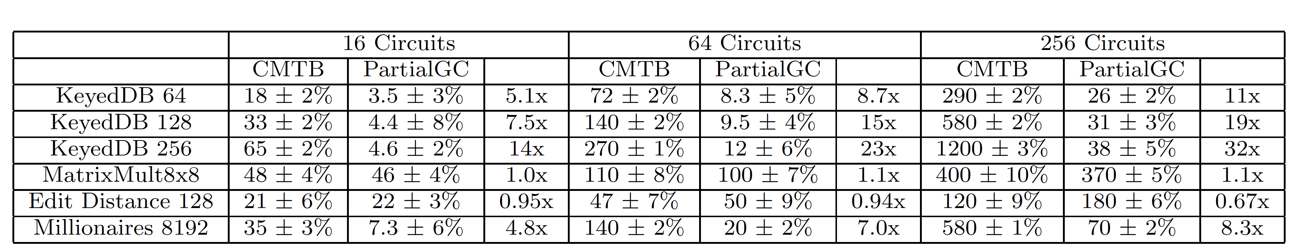
Performance
We compare PartialGC to CMTB, which is based on the PCF (Kreuter-Shelat-Shen) system.
Time taken to save and load a bit in PartialGC
(using 256 copies in the cut-and-choose)
Notes:
<CLICK> Here are some timing results comparing PartialGC to CMTB. All times in seconds.
CMTB is a 2P-SFE system. It was based on the Kreuter-shelat-Shen (PCF/betterYao) secure execution runtime and had the best efficiency results at the time.
The fact that we implemented and extensively tested this system distinguish our work from previous work on reusing encrypted data.
We modified CMTB to allow for the saving of intermediate wire labels and loading wire labels from a different SFE computation.
Both systems ran on an identical setup.
(16, 64, and 256 copies of the circuit in the cut-and-choose)
<CLICK> Our system outperforms theirs by a significant margin in most cases.
<CLICK> Note that, for some small programs, the overhead of loading and saving values can result in PartialGC being slower, but as the problem sizes increase, this issue disappears.
<CLICK> Here’s the time taken to save and load a bit in PartialGC.

Slide 19
Solving Privacy-Preserving Proximity
Question: Are we within 1 mile of each other?
  Users communicate with the server in rounds
  During each round, the user provides its current location, which is checked against the last reported location of the other user
N users
  One party’s leaving does not stop the protocol
Cloud
Saved (encrypted) data
Server
Server
Server
Server
Server
Server
PGC
PGC
PGC
PGC
PGC
PGC
Alice
Bob
Charlie
Alice
Bob
Charlie
Alice
Alice
Bob
Notes:
<CLICK> So let’s see how we can answer this question using PartialGC
<CLICK> We’ll have the users communicate in rounds
<CLICK> And during each round, a user’s current location will be compared to the last reported location of the other user
<CLICK> We start with a server on a cloud, and a user, <CLICK>Alice
<CLICK>The two of them carry out a PartialGC computation, where Alice provides her location, and the server tells if whether there is anybody within 1 mile.
Some time later, Bob comes along <CLICK> Bob also performs the same computation to check for a user within 1 mile<CLICK>
I’m showing this server separately, but of course, it’s the same server on the same cloud, and thus has access to the same encrypted data that was left after the previous computation with Alice. <CLICK> Of course, it is perfectly possible to save the data on the cloud, shut down the server, and start a new one. One might even choose to have multiple servers, but that’s a more complicated setup with some very very very strange consequences for the security of the system.
<CLICK> After a while – one heartbeat or round – Alice comes back to check whether there’s anyone within a mile.
And then Bob checks back.<CLICK> And so on <CLICK><CLICK>
At any point in time, the system reports the answer based on the last known location of the other user.
That is, Alice and Bob need not be online at the same time.
<CLICK> This gives us another idea – another “mode” for this system. There’s no reason why we should be restricted to two users!
<CLICK> A third user can be added trivially, without any other changes. In fact, we can add any number of users without affecting the performance on the user end.
<CLICK> One party’s leaving doesn’t affect anything – the rest can simply proceed with the same protocol

Slide 20
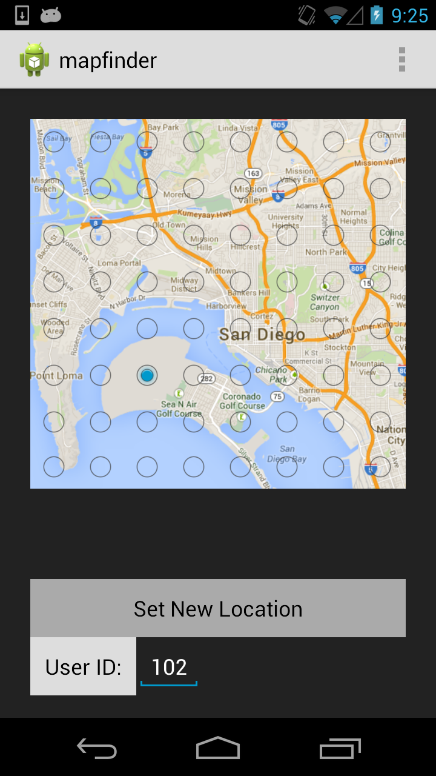
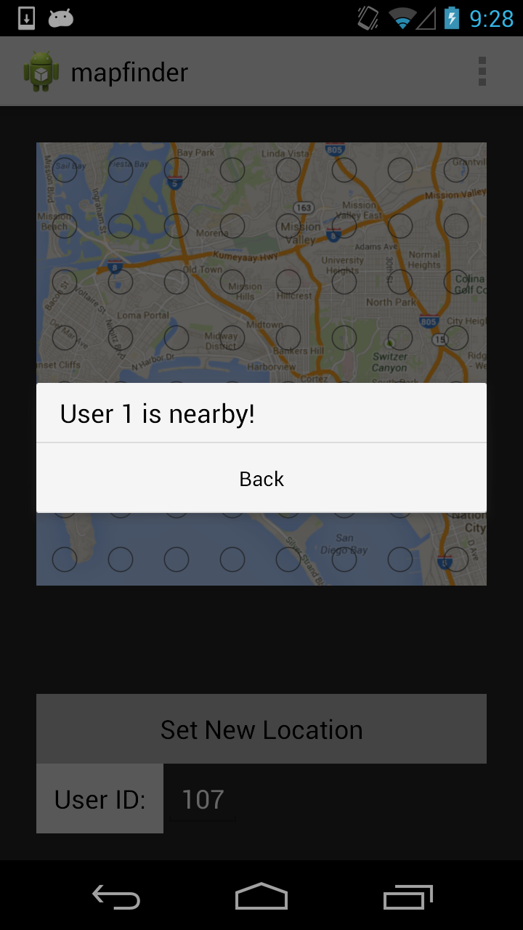

Implementation
Notes:
Given our efficiency results, we decided to actually implement privacy-preserving proximity on a mobile device
A proximity finder is rather useless unless the device moves around!
Members sign in securely; they can poll the app to check whether any friends are nearby.
This was the first SFE app fast and light enough to run on a standard phone
Still hard on the battery

Slide 21
PartialGC is a fully general, server-aided, secure, multiparty computation mechanism
We implemented privacy-preserving proximity
  First SFE app fast and light enough to run on a standard phone
Entry system that counts the number of people in a building
  Disallows entry if there are too many people
Saving credit card details across multiple purchases
  One person could also pay for a group of purchases by different people
Secure auctions
  Only the highest/lowest values are saved per round
Any iterative computation

Slide 22
Talk Outline
Example: Privacy-preserving Proximity
PartialGC (ACM CCS'14*)
  With Benjamin Mood, Kevin Butler, and Joan Feigenbaum
Other work on practical, secure computation
  SMPC: Overview and challenges
  Frigate, SGX, Systematization
Deploying SMPC
Ongoing and future work
*Expanded version: http://arxiv.org/abs/1506.02954
Notes:
Now, I’m going to provide a general overview of SMPC and talk about some of my other work, as well as current challenges in the field.

Slide 23
Secure, Multiparty Computation (SMPC)
x _{n-1}
. . .
x ₃
x _{n}
x₂
x₁
y = F (x ₁, …, x _{n})
Each i learns y
No i can learn anything about x_{j}
(except what he can infer from x_{i} and y )
Very general positive results (e.g., GMW87, BGW88)
Not very widely used in practice … YET!
Notes:
n parties, each with private inputs x_i…
After third bullet, mention that classical GC is a general S2PC mechanism.
GMW (Goldreich-Micali,Wigderson) the approach is to have 2-out-of-2 secret sharing for every wire value. The protocol proceeds layer by layer, beginning with the input layer 1-4 OT
(Choi et al)
BGW (Ben-Or, Goldwasser and Widgerson)

Slide 24
Last 10 or 15 Years: Substantial Progress on Making SMPC Practical and Usable
Better conceptual frameworks
Development environments and tools (languages, compilers, intermediate circuit formats, run-time systems)
Realistic use cases
Realistic execution environments,
e.g., handheld devices and cloud servers
Theoretical advances and new techniques
Experiments and performance analysis
Notes:
We’ve started to develop better and general frameworks capable of greater expressivity.
Starting with Fairplay in 2004, we’ve had numerous compilers, runtime systems, and libraries for SMPC.
As we begin to use SMPC, we’ve begun to understand what real-life use cases we could use it for.

Slide 25
Communication Pattern:
Trusted-Party Computations
Notes:
One very basic advance made in the last 10 or 15 years addresses the original motivation for SMPC: In principal, it eliminates the need for a trusted third party.
(Everybody communicates with the TTP)

Slide 26
Communication Pattern:
General SMPC Protocols
Notes:
Unfortunately, some of the powerful and general SMPC protocols require every party to communicate with every other party in each round of the multiparty computation. Not practical for very large number of parties.

Slide 27
Communication Pattern:
K-for-N “Secure Outsourcing”
Notes:
In the “secure-outsourcing” model, there are N “input providers” (the “parties” in SMPC) and K “computation servers.” Here N=8 and K=4. Instead of trusting one party absolutely, the N parties distribute their trust over the K servers.
Inputs stay private as long as few enough of the servers collude with each other. Potentially commercially viable model.
Sharemind, a system developed by the Estonian company Cybernetica as part of the PROCEED program, uses this model.
This is currently being used by the Estonian government to calculate and publish aggregate salary statistics for government employees.

Slide 28
Frigate Compiler
Many existing development tools for secure protocols are unstable, buggy, and hard to use
Frigate is a validated, extensible, and efficient compiler for SMPC
  Dramatically more efficient than others (experimental comparisons with KSS, PCF, and CMBC)
  Carefully tested and validated to ensure correctness
  Easy to install and use; C-like language
Compiles C-like programs into a Boolean-circuit representation that can be executed in a variety of SMPC run-time systems
"Frigate: A Validated, Extensible, and Efficient Compiler and Interpreter for Secure Computation”
In Proceedings of the 2016 IEEE European Symposium on Security and Privacy (EuroS&P) 2016
(with Benjamin Mood, Henry Carter, Kevin Butler, Patrick Traynor)
Notes:
<CLICK> … We ran into such problems enough times that we simply decided to write our own.
<CLICK>
Approximately 25,000 lines of C++; gate counts comparable to previous work
Compile time speedups as high as 100x-1000x. Combines many ideas from the (diffuse) state-of-the-art.
The compiler is heavily tested and validated (ARM and SuperTest). We ran a test suite with over 17,000 different tests, and separately unit- and integration-tested the system with over 10,000 more.
The language is basically C, with some extra features that are useful for efficient circuit compilation, such as specifying bit-lengths.
<CLICK> … We do not use C or a common intermediate representation like LLVM’s bytecode as input to allow for innovative operators and non-standard bit-width operations.

Slide 29
Frigate Compile-time Speedup

Slide 30
Frigate Execution-time Speedup
Notes:
All crypto people this time; good results, and much more work going on
Confident that we can make this even faster

Slide 31
Using Intel Software Guard Extensions for Efficient Two-Party Secure Function Evaluation
We analyze the difficulties of using SGX for 2P-SFE and why naïve protocols do not work
We show how to augment an SGX system to provide stronger guarantees, and we provide a protocol that enables two SGX systems to perform 2P-SFE efficiently
Outsourcing and hybrid protocols
Augment honest-but-curious to malicious
"Using Intel Software Guard Extensions for Efficient Two-Party Secure Function Evaluation”
In Proceedings of the Workshop on Encrypted Computing and Applied Homomorphic Cryptography (WAHC), 2016
(with Benjamin Mood, Joan Feigenbaum, Kevin Butler, Patrick Traynor)
Notes:
Intel architecture extension that allows the creation of secure containers called enclaves; reverse-sandbox enforced by hardware
SGX-supported 2P-SFE, secure outsourcing of SGX-supported 2P-SFE, modification of 2P-SFE protocols from semi-honest to malicious

Slide 32
Systematization of Secure Computation
We classify approximately 180 secure-computation protocols along major axes (security, efficiency, adversarial model, execution environment, etc.)
By-product: annotated bibliography
We develop a graphical tool (“SysSC-UI”) for exploring the secure-protocol space, comparing protocols, discovering dependencies and trade-offs among properties, etc.
So far, the classification and SysSC-UI have helped newcomers get “up to speed” on the state of the art in secure-computation research
"Systematizing Secure Computation for Research and Decision Support”
In Proceedings of the 9th Conference on Security and Cryptography for Networks (SCN’14), pp. 380-397, Springer, 2014
(with Jason Perry, Joan Feigenbaum, and Rebecca Wright)
Notes:
<CLICK> We studied pretty much all the major papers we could find and classified them in various ways – adversarial model, whether they required a secure setup, how many partied would need to collude to break security, etc.
<CLICK> In the process of doing this, we also created an annotated bibliography of these papers, so one can search and find papers tagged with, say “covert adversary”
<CLICK> … This tool allows us to navigate all of the papers and find setups that have not been investigated or solved; this means that there could be an impossibility result there, or a gap in research.
<CLICK> Of course, the GUI means that newcomers can quickly look up all major papers in the setup they’re interested in.
We did this to help people decide on which protocols to use and jumpstart newcomers.
In fact, let’s talk about some cases where we worked with people outside of crypto

Slide 33
SMPC
PartialGC
Frigate
SGX
Systematization

Slide 34
Ongoing✓ and Future Work
Practical reusable garbled circuits, using novel symbolic encryption, gate representation, and mini-circuits
  (w/ Mood, Hopkins, Carter, Feigenbaum, Butler)
Improved SMPC for stable matching
  (w/ Terner, shelat, Feigenbaum)
Implementations of Intel SGX-enabled 2P-SFE protocols
  (w/ Mood, Butler, Feigenbaum)
Economic, legal, and social barriers to adoption
  Idiosyncratic SMPC trust model (Libicki et al., 2014)
  Need to comply with laws and organizational policies
  Hard to displace an existing TTP
Notes:
Don’t recite the names of all of the coauthors.
Reusable Garbled Circuits
Allows cheap “refreshing” of garbled circuits. First feasible rgc system – there has been previous work (Goldwasser, Ostroevsky), but those have been theoretical
Uses symbolic encryption, gate representation, mini-circuits, and checkpoints
We’re working on an implementation; eventual merge with partialGC
Stable-matching
Very good fit for SMPC; current instances use a trusted third party
First feasible, privacy-preserving protocols for stable matching
Good performance for reasonable sized matchings with hundreds of participants (700 participants and 20 sororities, ~5 hours on AWS Large)
-----
Trust model of SMPC: trust enough to do business, but not enough to share data, and no trusted third party!
People, especially lawyers, don’t trust such mechanisms. They prefer easy-to-understand legal protection and a tried-and-trusted TTP over more powerful cryptographic protection.
If time: Hard to use/adopt
Buggy compilers/IDEs (Frigate solves some of these problems)
Doesn’t really work well with standard development workflows
High switching cost (developers and users need to learn new concepts)
Understanding privacy standards and incentives

Slide 35
The End

