Slide 1
Data exploitation and privacy protection in the era of data sharing
Lihi Idan
Yale University
Advisor: Professor Joan Feigenbaum
Notes:
1

Slide 2
Using Bayesian networks and Dynamic Bayesian networks to infer behavioral intentions of social-network users
This work was published in ACM/IEEE ASONAM 2019
Notes:
2

Slide 3
Problem statement
Let u be a social-network (SN) user.
U may have one account on one SN platform, or multiple accounts on different SN platforms (Su).
X(u,s): u’s account on network s.
Each account has a private portion X^{pr}(u,s) and a public portion X^{pu}(u,s).
Our goal: inferring offline decision and intentions of a user u given data that is solely extracted from the public portion of each online profile, {X^{pu}(u,s)}{s ∈ Su}.
3
Notes:
3

Slide 4
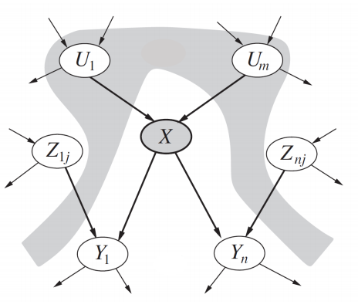
Bayesian networks
4
Notes:
4

Slide 5
Why Bayesian networks?
Combine data and prior knowledge
Handle incomplete data sets (in both training and inference)
Intuitively understandable (“white box”): Parameters have clear semantic interpretations.
Encode correlations among input variables
Less prone to overfitting
5
Notes:
5

Slide 6
First inference task
Goal: Predict the voting behavior of Facebook users using data that is extracted solely from the public portion of their Facebook profile.
“voting behavior”: voting choice in a given election
Test case: 2016 US Presidential election
6
Notes:
6

Slide 7
Limitations of prior work
Twitter non-representative social network
Relying solely on user-generated content All users in dataset have publicly performed a politically-oriented activity.
Self-reported labels Only users who voluntarily disclose their political preference have labels.
Ignoring non-voters All users in the dataset voted in a given election.
7
Notes:
7

Slide 8
Features
Parsimonious set of features: demographic attributes, political activity on Facebook, a restricted notion of the user’s network neighborhood
Goal: reduce bias
DATASET
Labeled data: Surveys
Unlabeled data: public portion of Facebook profiles
8
Notes:
8

Slide 9
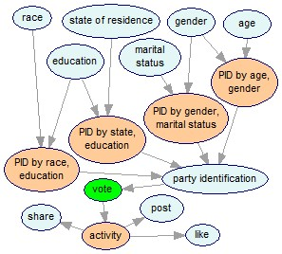
BASIC model
Static and dynamic subnetworks (causes and effects)
Intermediate nodes (``divorcing’’)
Priors: surveys (Pew research center)

Slide 10
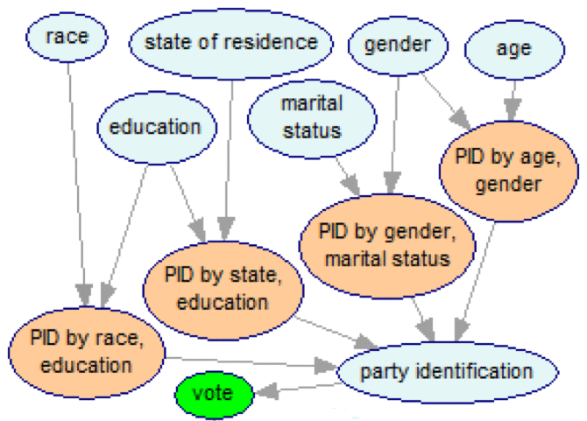
Revised+SELF-INFER model
Observable attribute
Hidden attribute
Party identification

Slide 11
Network neighborhood
A restricted notion of the user’s network neighborhood: close friends. Why?
Homophily: Users tend to link to others who are similar to them.
Users that are closer are more similar.
Representation of a user’s neighborhood: aggregator nodes in our BN.
11
Notes:
11

Slide 12
FULL model: adding the social subnetwork

Slide 13
Parameter learning
Bayesian approach (data+prior)
The Expectation Maximization algorithm (latent variables, missing values)
Combined both labeled and unlabeled data in our training set (semi-supervised learning).
13
Notes:
13

Slide 14
Results
14
Notes:
14

Slide 15
Second inference task
Goal: Predict SN users’ behavioral intentions given data that is extracted solely from the public portion of their SN accounts.
Test case: 5 behavioral intentions.
Vaccination intentions
Weight-loss intentions
Borrowing intentions
Travel-purchase intentions
Job-searching intentions
15
Notes:
15

Slide 16
Second inference task
General methodology for inference of different types of intentions.
Bayesian network
Intention-specific, temporal models.
Dynamic Bayesian network
New representation of SN users using DBNs.
General attribute inference of dynamic attribute.
16
Notes:
16

Slide 17
Our methodology
Extract the best determinants of behavioral intentions. Behavioral psychology.
2. Extract (observable) network features.
3. Extract intention-specific features.
4. Map features to BN nodes.
4. Select the best features (feature selection) and the best model (model selection). Static BN.
5. Enhance the BNs in 4. with temporal relations between different features and each intention. Dynamic Bayesian networks.
17
Notes:
17

Slide 18
General-purpose BN
18
Notes:
18

Slide 19
Features
Two-wave survey
Second-layer features:
Personality traits Emotions
Demographic attributes Situational variables
Opinion, Interest
Dataset
Labeled data: surveys
Unlabeled data: ``non responders’’
19
Notes:
19

Slide 20
Features
Challenge: no justification to use the homophily principle
``Wide and shallow’’: more SN accounts (wide), without considering the user’s network neighborhood (shallow).
Third-layer (network) features:
Numeric
Text
MISC (“metadata”)
20
Notes:
20

Slide 21
From BNs to DBNs
Behavioral intentions are dynamic attributes. In order to accurately model each intention we need to model its temporal aspects.
BNs are not able to model temporal processes.
Dynamic Bayesian networks
Present a new conceptual model of SN users, and use it to perform different attribute-inference tasks.
Demonstrate our conceptual model on our five intentions.
21
Notes:
21

Slide 22
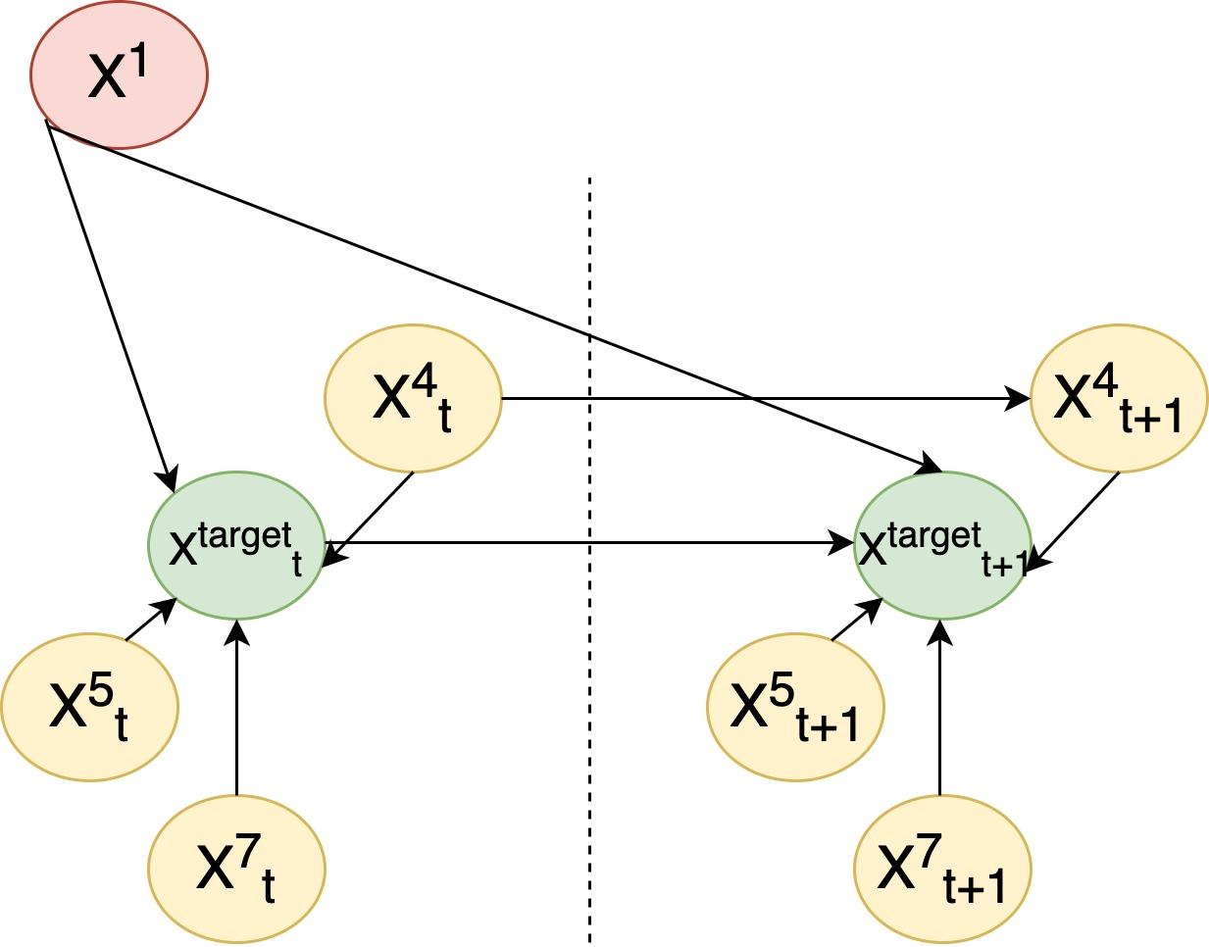
Dynamic Bayesian network
A sequence of BNs
t
t+1
22
Notes:
22

Slide 23
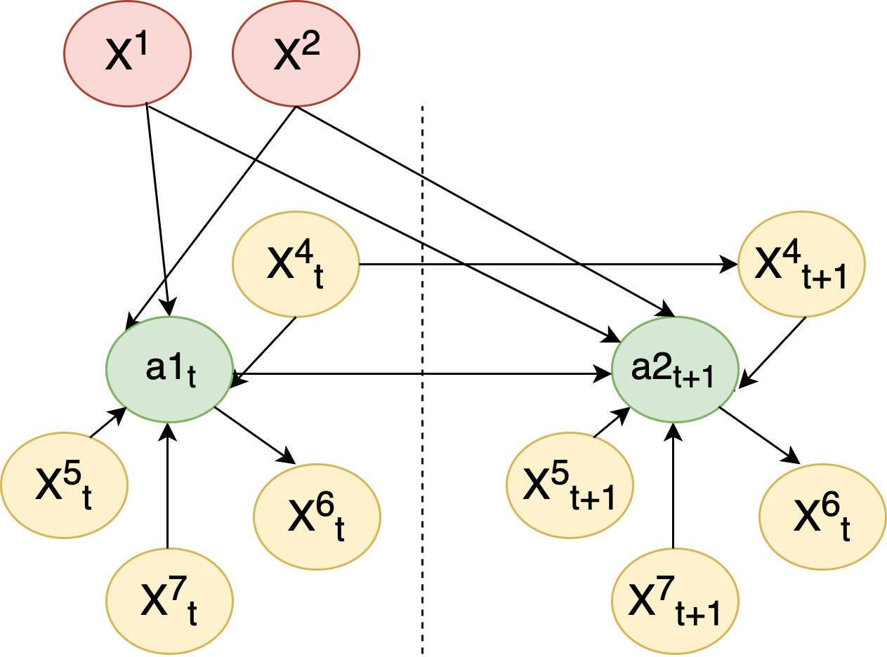
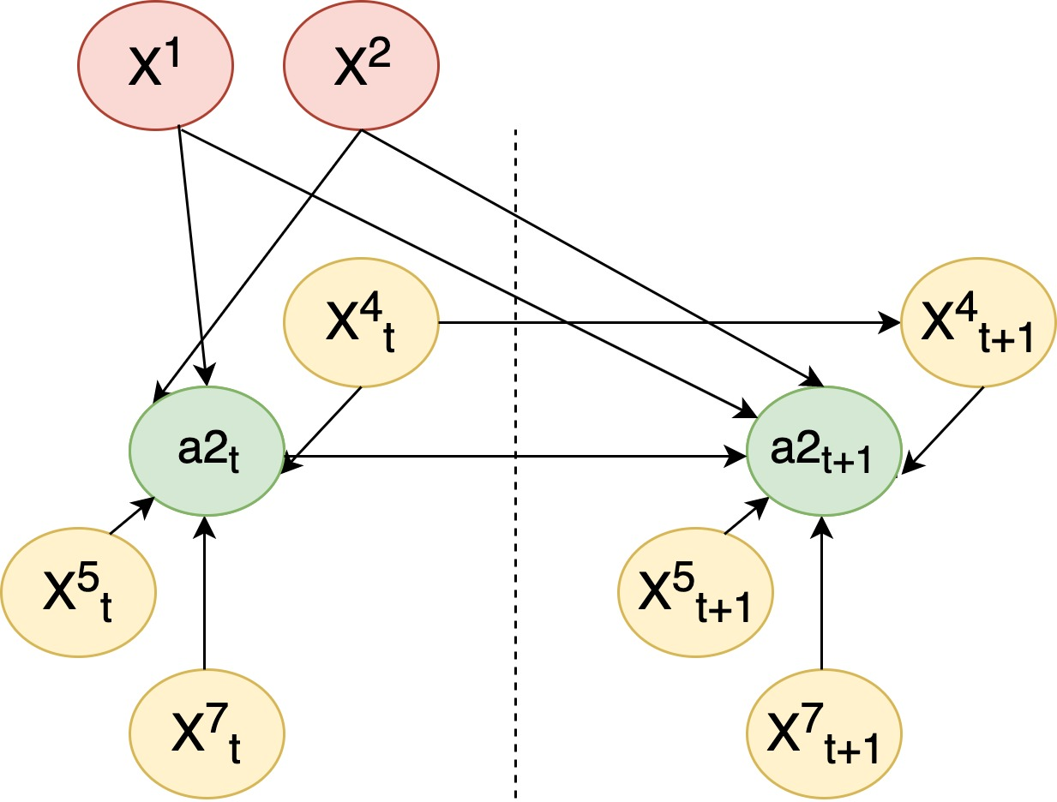
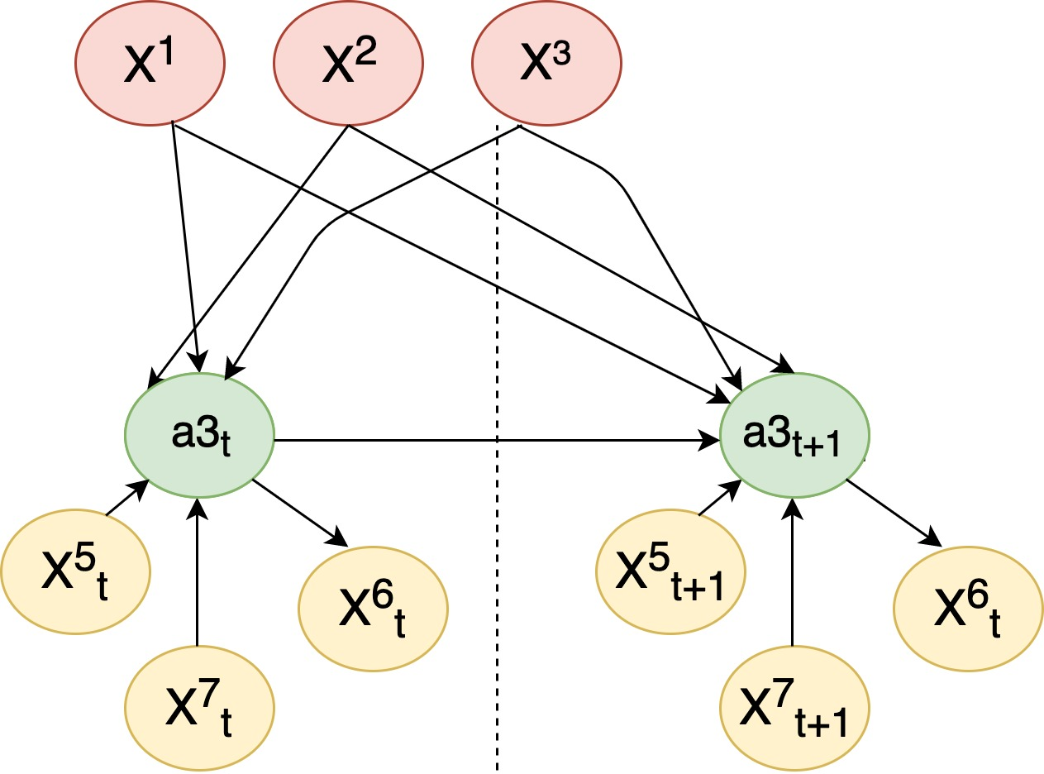
From BNs to DBNs
u1
a1
a2
a3
{X^{pu}(u1,s)}{s ∈ Su}.
a1
a2
a3
u2
{X^{pu}(u2,s)}{s ∈ Su}.
23
Notes:
23

Slide 24
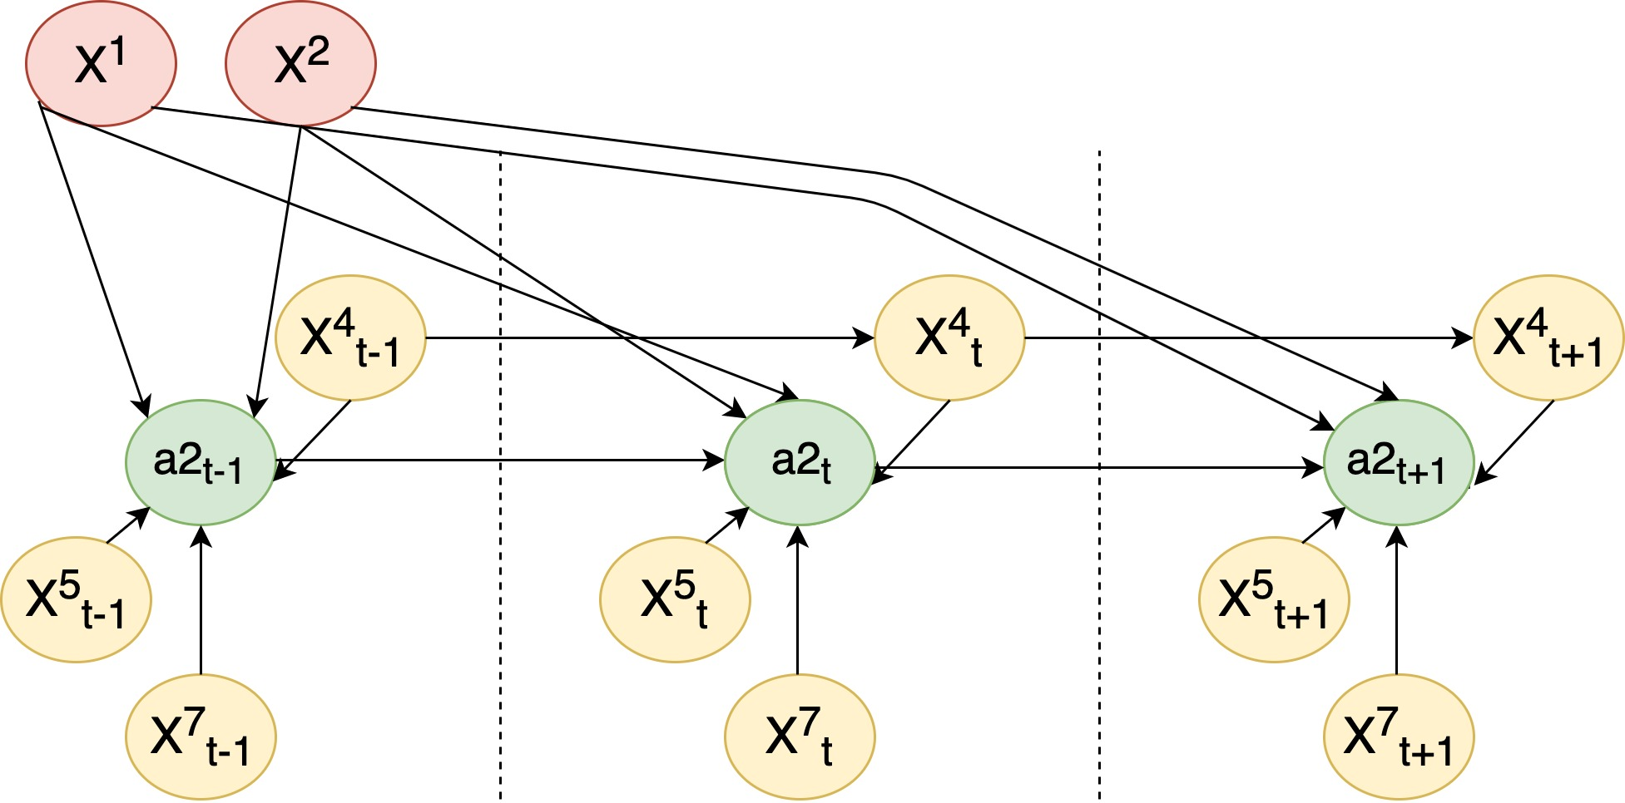
From BNs to DBNs
u1
a2; t+1
24
Notes:
24

Slide 25
Feature selection
A two-stage feature selection method:
Mutual information
Can be applied to incomplete datasets
2. BNs, markov blankets
“multivariate” method
25
Notes:
25

Slide 26
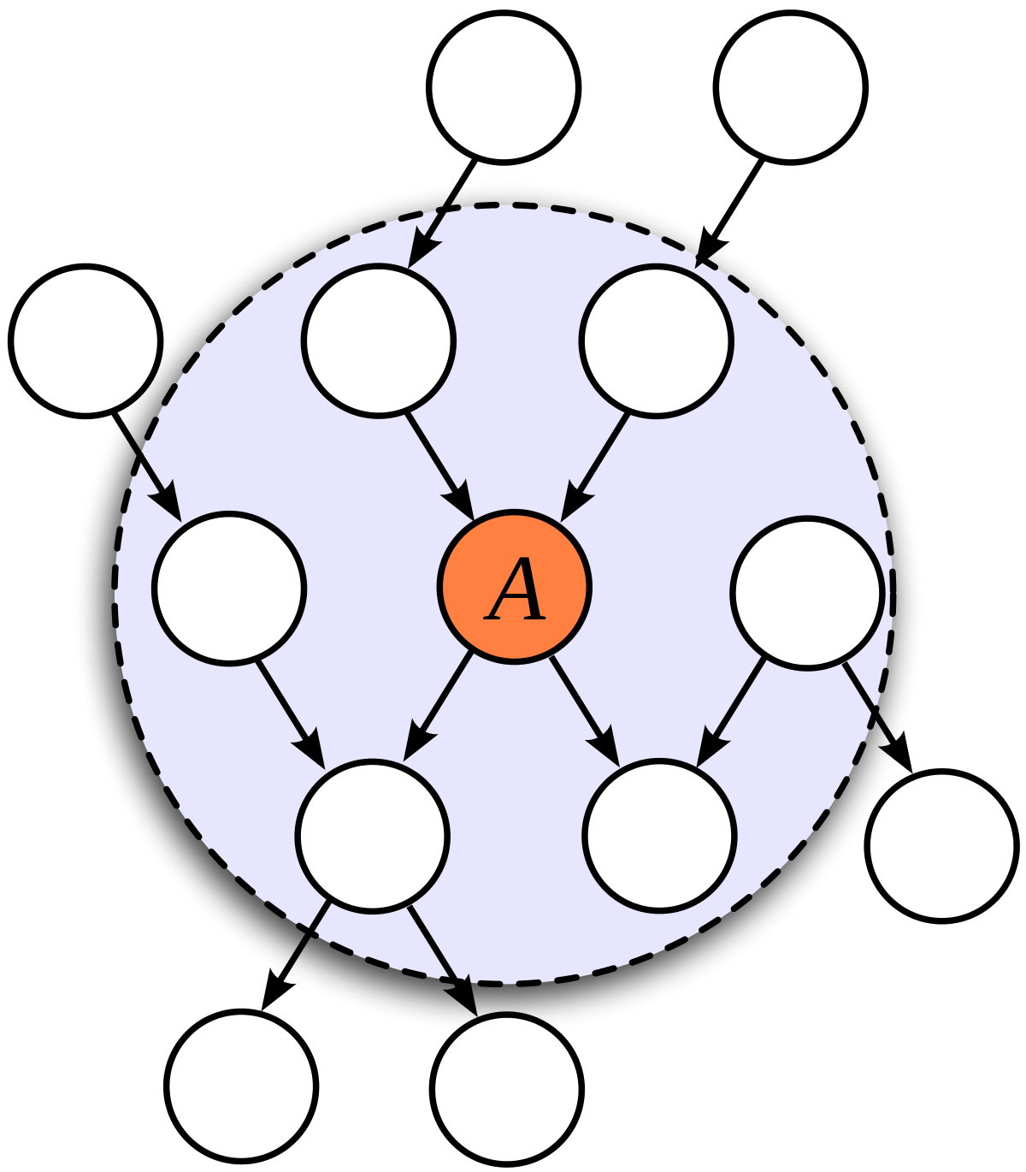
Markov blanket
The markov blanket of a target A is the optimal feature set of A.
Idea: use a structure learning algorithm on our potential features, identify the target’s markov blanket in the BN.
Problems?
26
Notes:
26

Slide 27
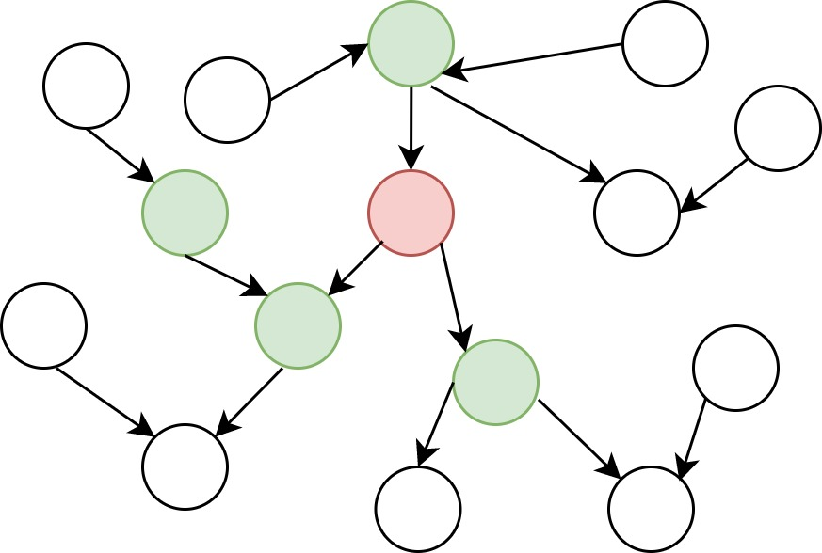
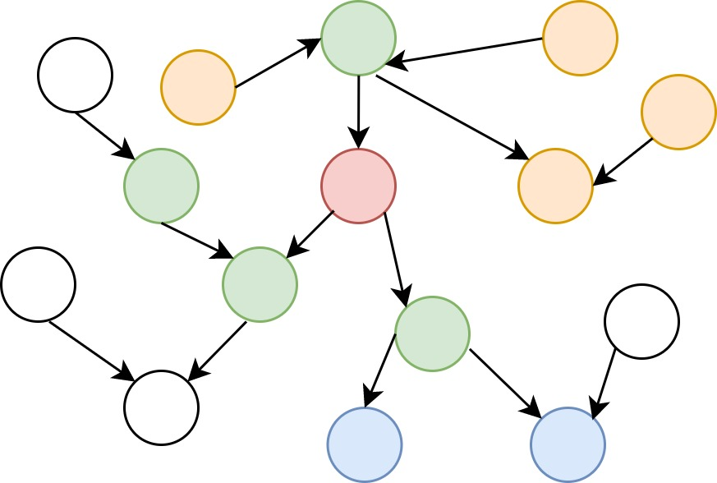
Markov blankets
L
M
27
Notes:
27

Slide 28
Our DBNs (only 2nd-layer features)
28
Notes:
28

Slide 29
Results
Some datasets are highly imbalanced
(1): 1st-wave training set (training set)
1st-wave test set (test set)
(2): 2nd-wave training set (training set)
2nd-wave test set (test set),
1st-wave training set (priors), 1st-wave test set (evidence)
29
Notes:
29

Slide 30
Future work
Use higher-order DBNs and decision-specific sampling rates
Combine advanced features: photos, more challenging demographic attributes
Studying the voting-intention inference task using temporal data and DBNs.
30
Notes:
30

Slide 31
PRShare: a framework for privacy-preserving, interorganizational data sharing
Proceedings of the 2020 ACM Workshop on Privacy in the Electronic Society (WPES@CCS).
Expanded version available as Yale University Technical Report
YALEU/DCS/TR-1554 (submitted for journal publication)
Notes:
31

Slide 32
Setting
Data owner: owns data records about data subjects
Data clients: use owner’s data records in their own applications
Challenge: A subject's data record may be shared without his consent.
32
Notes:
32

Slide 33
Real-world example
Motivation: law and enforcement and privacy-preserving surveillance.
Data owner: an email-service provider (ESP)
Data clients: law-enforcement and other government agencies
Data subjects: citizens who use this ESP
33
Notes:
33

Slide 34
Real-world examples
Electronic Medical Records (EMRs), governed by Health-Insurance Portability and Accountability Act (HIPAA):
Data owner: healthcare provider
Data clients: HIPAA’s “business associates’’
Credit reports, governed by the Fair Credit Reporting Act (FCRA):
Data owner: consumer-reporting agencies
Data clients: insurance companies, credit-card companies…
34
Notes:
34

Slide 35
PRShare is not appropriate for all data-sharing
applications
Not useful when:
Data subjects can give explicit consent
There are clear, persistent, efficiently decidable and organization-specific rules that specify which users can access each data record.
Very useful when:
Owner receives bulk or targeted data-retrieval requests, and data subjects cannot give explicit consent (e.g., law-enforcement requests)
Application is governed by legally mandated privacy principles.
Instantiating the principles requires data-specific, dynamically changing knowledge.
35
Notes:
35

Slide 36
Problem description, continued
Data owners
Data clients
Data users
Intermediaries: provide additional information about data records to clients
36
Notes:
36

Slide 37
Privacy-preserving data sharing
Data subjects
Organizations
A data-sharing scheme is privacy preserving with respect to data subjects if and only if:
A data user can decrypt a data record if and only if the record is essential to a current task task that she is currently working on.
37
Notes:
37

Slide 38
Requirements
Owner encrypts data records, uploads ciphertexts to a cloud-service provider (CSP), and goes offline. Plays no role in data retrieval.
Same ciphertexts are used by all clients and employees.
Owners do not know which clients and which employees of each client will access each record at the time records are encrypted.
Owners do not know the role structure of the clients or the identities of the users.
Efficient revocation
38
Notes:
38

Slide 39
Starting point: attribute-based encryption
Attribute-based encryption
Ciphertext-policy attribute-based encryption
(CP-ABE):
Users receive attribute-based keys.
Plaintexts are encrypted under access policies.
Key-policy attribute-based encryption (KP-ABE):
Plaintexts are encrypted under sets of attributes.
Users are given keys based on access policies.
39
Notes:
39

Slide 40
Using ABE
Owner encrypts records under attributes that belong to his vocabulary VOCowner.
Each data user u is issued an access-policy based key sku^{t} for each task, t ∈ T, on which she is currently working.
If u is an employee of client cj, then {sku^{t}}t ∈ T is composed of attributes from VOCj, cj’s vocabulary.
Division of trust: multiple trusted authorities
40
Notes:
40

Slide 41
Attributes
User-centric attributes lead to:
Owner must have prior knowledge about roles and identities of clients’ employees.
Cannot achieve a truly privacy-preserving scheme
Data-centric attributes
41
Notes:
41

Slide 42
Challenge
ABE IS NOT SUITED TO INTERORGANIZATIONAL DATA SHARING SCENARIOS
Implicit assumption: The universe of attributes under which ciphertexts are encrypted is identical to the universe of attributes from which keys are generated.
42
Notes:
42

Slide 43
ON_WATCHLIST=TRUE DATE=1\1\2020
∨
Attributes:
SENDER=abc@gmail.com, DATE=11/9/2020, SUBJECT_LINE=important, IS_FILE_ATTACHED=yes
Auxiliary information: watchlist
abc@gmail.com
uyi@gmail.com
Payload:
email message

Slide 44
Translation mechanism
Let x be a ciphertext that was created at time
T-3 and encrypted under a set S of attributes,
S VOCowner.
Hence: Y=[x]VOC_{owner}
Let u be a data user who belongs to client cj and retrieves x at time T.
Goal: Translate(Y)=Y^{t}=[x]VOC_{j}
44
Notes:
44

Slide 45
Translation mechanism
Not just syntax!
Translation must support:
Proprietary attributes (attribute privacy)
Proprietary Auxiliary information
Dynamic attributes
Hence Y=[x]^{T-3}VOC_{owner}
Goal: Translate(Y)=[x]^{T}VOC_{j}
45
Notes:
45

Slide 46
ON_WATCHLIST=TRUE DATE=1\1\2020
∨
Attributes:
SENDER=abc@gmail.com, DATE=11/9/2020, SUBJECT_LINE=important, IS_FILE_ATTACHED=yes
Auxiliary information: watchlist
abc@gmail.com
uyi@gmail.com
Payload:
email message

Slide 47
Two hours later…
ON_WATCHLIST=TRUE DATE=1\1\2020
∨
Attributes:
SENDER=abc@gmail.com, DATE=11/9/2020, SUBJECT_LINE=important, IS_FILE_ATTACHED=yes
Auxiliary information: watchlist
efg@gmail.com
uyi@gmail.com
Payload:
email message
lml@gmail.com

Slide 48
ON_WATCHLIST2=TRUE DATE=1\1\2020
∨
Attributes:
SENDER=nda@gmail.com, DATE=11/9/2020, SUBJECT_LINE=important, IS_FILE_ATTACHED=yes
Auxiliary information: watchlist
Auxiliary information: watchlist2
abc@gmail.com
nda@gmail.com
uyi@gmail.com
uyi@gmail.com
Payload:
email message

Slide 49
Solution: Attribute-based encryption with OBLIVIOUS ATTRIBUTE TRANSLATION
49
Notes:
49

Slide 50
Mediated cryptography
Introduced by Boneh, Ding and Tsudik as a method to allow immediate revocation.
Uses an online mediator, “proxy”, for every transaction. Usually assumed to be semi-trusted.
Used for similar purposes in ABE schemes.
Dan Boneh, Xuhua Ding, and Gene Tsudik. Fine-grained control of security capabilities. ACM Transactions on Internet Technology 4(1):2004, 60–82
50
Notes:
50

Slide 51
Oblivious translation
Delegate ciphertexts’ translation to a semi-trusted server (proxy) using the algorithm Translate().
Translate() can be computed dynamically based on up to date auxiliary information held by the proxy’s organization.
Payload privacy: Translate() can be computed such that the proxy does not learn the underlying plaintext.
Attribute privacy: Translate() can be computed such that proxies don’t learn the attributes under which the plaintext is encrypted.
[x]^{T-3}VOC_{owner}
[x]^{T}VOC_{j}
’
Qk={att2, att3}
Att1=<a,b>
Att2=<c,d>
Att3=<e,f>
Att1=<a,b>
Att2=<c,z>
Att3=<x,y>
M
M
Translate(x,k)
51
Notes:
51

Slide 52
Why use a proxy
Confidentiality of attributes (attribute privacy)
Proprietary auxiliary information
Security
Performance
52
Notes:
52

Slide 53
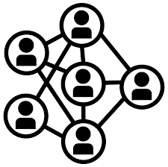
Translate(C2,..)=C2’
C2
Encrypt(M,S,PKi…)=
C={C1,C2,C3}
C3
Translate(C3,..)=C3’
C1
Revocation
Keygen(Auti,APi,msk_i,t,u,..)=Ski,t,u
Decrypt(Ski,u,t,C1,C2’,C3’,..)=M
53
Notes:
53

Slide 54
Main techniques
Our scheme is inspired by the the single-authority KP-ABE scheme of Yanis Rouselakis and Brent Waters
Some of the techniques used in our construction:
Use secret sharing to break the binder term into |translators|+1 shares. Each partial ciphertext contains only one share of the binder term.
The ciphertext contains an obfuscated value of the attribute, which can be used for oblivious translation operations.
A second blinding factor, lk , is used to “double blind” each partial ciphertext, using dk = fk ∗ lk as a blinding factor.
54
Notes:
54

Slide 55
Security
Selective security against chosen-plaintext attacks (original AND translated ciphertext)
Secure against collusion attacks
Attribute secrecy
Oblivious translation
Attribute privacy
Hidden access policy
55
Notes:
55

Slide 56
Implementation
Implemented using Charm, a framework for rapidly prototyping cryptographic schemes
56
Notes:
56

Slide 57
Conclusions
PRShare is a privacy-preserving, interorganizational data-sharing scheme that supports the following features:
Use of multiple vocabularies
Attribute privacy
Offline delegation
Dynamically reconfigurable attributes
Hidden access policy
Direct Revocation
Key-abuse protection
57
Notes:
57

Slide 58
Open questions and future directions
Relax the assumption that proxies semi-trusted by:
Improving our OTABE construction
Applying key features and functionalities of smart contracts and fair-exchange protocols
Using OTABE to improve existing blockchain access-control mechanisms
58
Notes:
58

