Slide 1
Software Engineering
CPSC 439/539
Spring 2014

Slide 2
Join Us For
A Yale Celebration of
Women in Computing
Saturday, January 25, 2014
10:00 am to 4:00pm
Join us at the Yale CEID (15 Prospect Street) for a day exploring the variety of opportunities in the growing field of computing!
Open to all, but registration is required. More information at:
www.cs.yale.edu

Slide 3
Acknowledgements
Many slides courtesy of Rupak Majumdar
Additinally, Rupak thanked Alex Aiken, Ras Bodik, Ralph Johnson, George Necula, Koushik Sen, A J Shankar
This course is inspired by various courses available on-line that combine software engineering and formal methods
  Alex Aiken’s course at Stanford
  Darko Marinov’s course at the University of Illinois

Slide 4
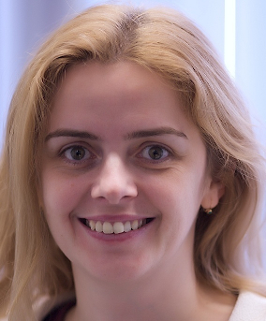
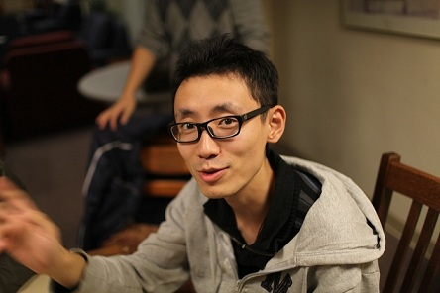
Course Staff
Instructor: Ruzica Piskac
  AKW 212, ruzica.piskac@yale.edu
Office Hours: Monday 3 – 5 and by appointment
TF: Ronghui Gu
  AKW 301, ronghui.gu@yale.edu
TF Office Hours: TBA this week

Slide 5
Course Structure
Lectures expected attendance
Homework 20%
In class short mid-term 10%
  Tentatively, March 5 (TBD?)
In class exam (May 2) 30%
Project … 40%
1st project-related assignment: think about the ideas for the project during the shopping period

Slide 6
Academic Integrity
Academic Integrity at Yale
Don’t use work from uncited sources
You can learn more about the conventions of using sources by referring to the Yale College Writing Center's Web site (from the Academic Integrity at Yale web site)
Expected to cooperate on projects
… but not on exams!
Default penalty: failing the class

Slide 7
Course Website
All class material will be available on the web
  http://www.cs.yale.edu/homes/piskac/teaching/softeng14.html
Lecture notes, handouts, papers to read, homework, project announcements, etc.
Important: Check the web site for the course announcements

Slide 8
Course Material
There is no compulsory textbook for the course
There will be a list of suggested readings from web resources and research papers on the course website
Interesting books to read:
  Steve McConnell: "Code Complete: A Practical Handbook of Software Construction", ISBN-10: 0735619670
  Roger Pressman: "Software Engineering: A Practitioner's Approach", ISBN-10: 0073375977
  Ian Sommerville: "Software Engineering", ISBN-10: 0137035152
  Frederick Brooks: “The Mythical Man-Month”, ISBN 0-201-83595-9

Slide 9
The Project
The only way to learn “software engineering” is by writing a large piece of code in a group
A BIG project solving a real-world problem
  Can be (almost) anything
Done in teams of 6-7 students
  You do everything
  Gather requirements, design, code, and test in several assignments
  This class should be very close to a startup experience

Slide 10
Project Timeline
Project nominations
  Start thinking about the project proposal already today
  Project nomination will be due in a week after the shopping period
  More detailed instruction next week
Project selection, team assignments
Projects will be reviewed and analyzed by others teams (and the instructors)
Requirements and specification
Project design & plan
Design review
  Done by other teams
Revised design & plan
Testing
  Tests performed by other teams (and the instructors)

Slide 11
The Ideas Behind the Project Structure
We will simulate the “real world”
In the real world, you often spend a lot of time maintaining/extending other people’s code
  This is where specifications, interfaces, documentation, etc pays off
  Shows the importance of institutional knowledge
You might be randomly assigned to a different team along the way!!!

Slide 12
What this course is (not) about?
Do not expect to learn a new language
Do not expect to learn programming tricks
  But you’ll learn techniques for “programming in the large”
Do not expect to learn management skills from the lectures
  Some things you learn by doing, not through lectures!

Slide 13
What this course is about?
Learn how to build a large software system in a team
  Learn how to collect requirements
  Learn how to write specification
  Learn how to design
Reliability is central to software engineering: This constitutes significant part of the course
  Version Control
  Testing
  Debugging
  Dynamic Analysis

Slide 14
What is Software Engineering?
As defined in IEEE Standard 610.12:
  The application of a systematic, disciplined, quantifiable approach to the development, operation, and maintenance of software; that is, the application of engineering to software.
Your opinion?
This definition is descriptive, not prescriptive
  It does not say how to do anything
  It just say what qualities S.E. should have
  As a result many people understand SE differently
A significant part of this course will be dedicated to a view on SE from the formal methods perspective

Slide 15
Software Engineering Myths: Management
“We have books with rules. Isn’t that everything my people need?”
  Which book do you think is perfect for you?
“If we fall behind, we add more programmers”
  “Adding people to a late software project, makes it later” – Fred Brooks (The Mythical Man Month)
“We can outsource it”
  If you do not know how to manage and control it internally, you will struggle to do this with outsiders

Slide 16
Software Engineering Myths: Customer
“We can refine the requirements later”
  A recipe for disaster.
“The good thing about software is that we can change it later easily”
  As time passes, cost of changes grows rapidly

Slide 17
Software Engineering Myths: Practitioner
“Let’s write the code, so we’ll be done faster”
  “The sooner you begin writing code, the longer it’ll take to finish”
  60-80% of effort is expended after first delivery
“Until I finish it, I cannot assess its quality”
  Software and design reviews are more effective than testing (find 5 times more bugs)
“There is no time for software engineering”
  But is there time to redo the software?

Slide 18
Our goals for software engineering
We want to build a system
How will we know the system works?
How do we develop system efficiently?
  Minimize time
  Minimize dollars
  Minimize …
How do we make software reliable?

Slide 19
How Do We Know the System Works?
Buggy software is a huge problem
  But you likely already know that
Defects in software are commonplace
  Much more common than in other engineering disciplines
Examples (see “Software Crisis” reading)
This is not inevitable---we can do better!

Slide 20
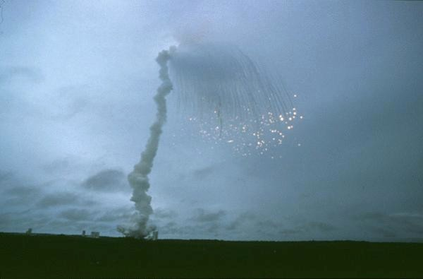
Software BUGs – SPACE disaster
Maiden flight of the Ariane 5 rocket on the 4th of June 1996
The reason for the explosion was a software error (Attempt to cram a 64-floating point number to a 16-bit integer failed)
Financial loss: $500,000,000
(including indirect costs: $2,000,000,000)

Slide 21
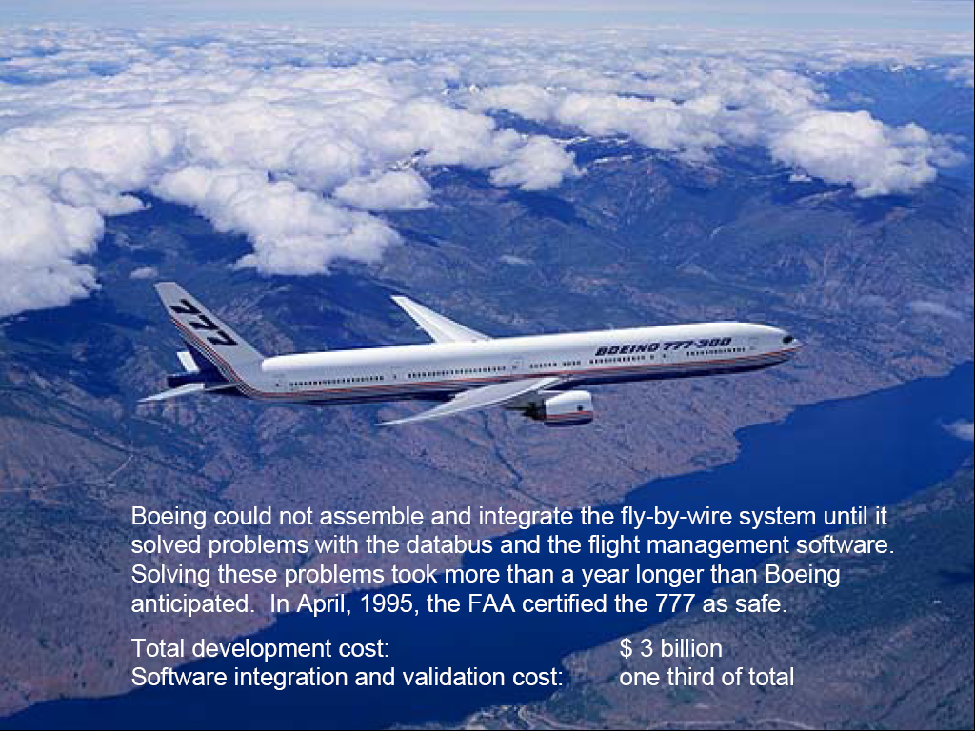
Air Transport

Slide 22
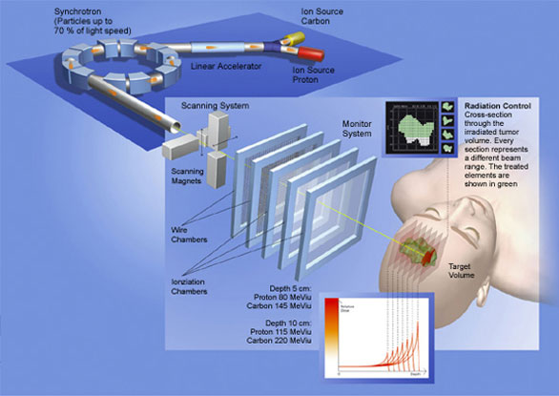
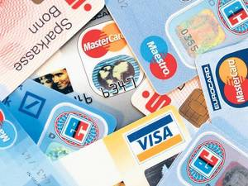
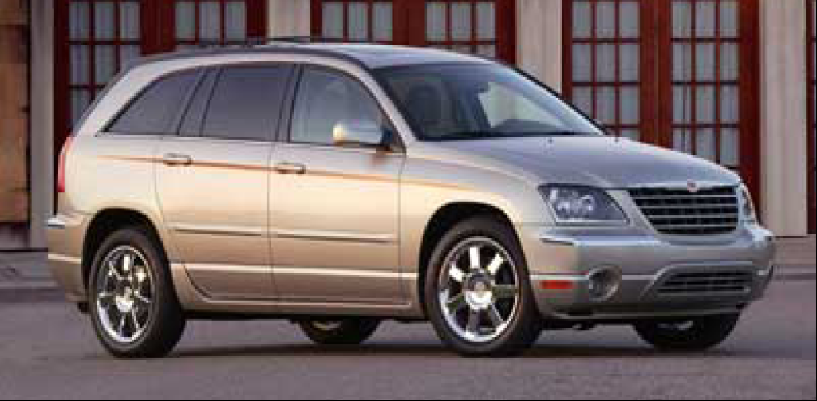
Examples of Software Errors
Radio Therapy Machine
software error
→ 6 people overdosed
Year 2010 Bug
30 million debit and credit cards have been rendered unreadable by the software bug
software in modern cars
>100K LOC
2006: error in pump control software
→ 128000 vehicles recalled
link

Slide 23
Financial Impact of Software Errors
Recent research at Cambridge University (2013, link) showed that the global cost of software bugs is
around 312 billion of dollars annually
Goal: to increase software reliability

Slide 24
How to identify software bugs?
How do we know behavior is a bug?
Because we have some separate specification of what the program must do
  Separate from the code
Thus, knowing whether the code works requires us first to define what “works” means
  A specification

Slide 25
Teams and Specifications
Do we really need to write specifications?
A typical software team will in general do the following:
  Discuss what to do
  Divide up the work
  Implement incompatible components
  Be surprised when it doesn’t all just work together

Slide 26
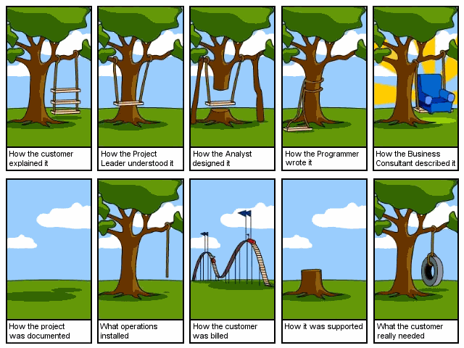
Cartoon

Slide 27
Cartoon

Slide 28
Cartoon

Slide 29
Cartoon

Slide 30
Cartoon

Slide 31
Cartoon

Slide 32
Cartoon

Slide 33
Cartoon

Slide 34
Cartoon

Slide 35
Cartoon

Slide 36
Specification
A specification allows us to:
  Check whether software works
  Build software in teams at all
Actually checking that software works is hard
  Code reviews
  Static analysis tools
  Testing and more testing
  We will examine this problem closely

Slide 37
How Do We Code Efficiently?
Assume we want to minimize time
  Usually the case
  Time-to-market exerts great pressure in software
How can we code faster?
  Obvious answer: Hire more programmers!

Slide 38
Parallel Development
How many programmers can we keep busy?
  As many as there are independent tasks
People can work on different modules
  Thus we get parallelism
  And save time
What are the pitfalls?

Slide 39
Pitfalls of Parallel Development
The problems are the same as in parallel computing
More people = more communication
  Which is hard
Individual tasks must not be too fine-grain
  Increases communication overhead further

Slide 40
Interfaces
The chunks of work must be independent
  But work together in the final system
We need interfaces between the components
  To isolate them from one another
  To ensure that the final system works
The interfaces must not change (much)!

Slide 41
Defining Interfaces
Interfaces are just specifications!
But of a special kind
  Interfaces are the boundaries between components
    And people
Specifying interfaces is most important
  Interfaces should not change a lot
  Effort must be spent ensuring everyone understands the interfaces
  Both things require preplanning and time
But often we can stop at specifying interfaces
  Let individual programmers handle the internals themselves

Slide 42
Efficient software development
Efficient development requires
  Decomposing system into pieces
  Good interfaces between pieces
The pieces should be large
  Don’t try to break up into too many pieces
Interfaces are specifications of boundaries
  Must be well thought-out and well communicated

Slide 43
How to obtain Software Reliability?
Testing, testing, testing, …
  Many software errors are detected this way
  Does not provide any correctness guarantee
  “Murphy’s Law”
Verification
  Provides a formal mathematical proof that a program is correct w.r.t. a certain property
  A formally verified program will work correctly for every given input
  Verification is algorithmically very hard task (problem is in general undecidable)

Slide 44
A Mathematical Proof of Program Correctness?
public void add (Object x)
{
Node e = new Node();
e.data = x;
e.next = root;
root = e;
size = size + 1;
}
Which property are you interested in?
Can you verify my program?

Slide 45
Example Questions in Verification
Will the program crash?
Does it compute the correct result?
Does it leak private information?
How long does it take to run?
How much power does it consume?
Will it turn off automated cruise control?

Slide 46
A Mathematical Proof of Program Correctness?
public void add (Object x)
{
Node e = new Node();
e.data = x;
e.next = root;
root = e;
size = size + 1;
}
I just want to be sure that
no element is lost in the list – if I insert an element, it is really there

Slide 47
A Mathematical Proof of Program Correctness?
//: L = data[root.next*]
public void add (Object x)
{
Node e = new Node();
e.data = x;
e.next = root;
root = e;
size = size + 1;
}
Let L be a set (a multiset) of all elements stored in the list …

Slide 48
A Mathematical Proof of Program Correctness?
//: L = data[root.next*]
//: invariant: size = card L
public void add (Object x)
//: ensures L = old L + {x}
{
Node e = new Node();
e.data = x;
e.next = root;
root = e;
size = size + 1;
}
Annotations

Slide 49
Annotations
Written by a programmer or a software analyst
Added to the original program code to express properties that allow reasoning about the programs
Examples:
  Preconditions:
    Describe properties of an input
  Postconditions:
    Describe what the program is supposed to do
  Invariants:
    Describe properties that have to hold in every program point

Slide 50
Decision Procedures for Collections
//: L = data[root.next*]
//: invariant: size = card L
public void add (Object x)
//: ensures L = old L + {x}
{
Node e = new Node();
e.data = x;
e.next = root;
root = e;
size = size + 1;
}
Prove that the following formula always holds:
∀ X. ∀ L. |X| = 1 → | L ⊎ X | = |L| + 1
Verification condition

Slide 51
Verification Conditions
Mathematical formulas derived based on:
  Code
  Annotations
If a verification condition always holds (valid), then to code is correct w.r.t. the given property
It does not depend on the input variables
If a verification condition does not hold, we should be able to detect an error in the code

Slide 52
Software Verification
correct
annotations
verifier
formulas
theorem prover
program
no

Slide 53
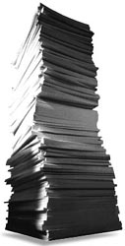
Automation of Verification
Windows XP has approximately 45 millions lines of source code
300.000 DIN A4 papers
12m high paper stack
Verification should be automated!!!

Slide 54
Conclusions
Software engineering boils down to several issues:
  Specification: Know what you want to do
  Design: Develop an efficient plan for doing it
  Programming: Do it
  Validation: Check that you have got what you wanted
Specifications are important
  To even define what you want to do
  To ensure everyone understands the plan

Slide 55
Disclaimer
CS Professors usually good at well-defined technical problems
May not be great at ill-defined non-technical problems
Take everything in this class with a pinch of salt
  Ultimately, the most important things you learn are those you learn through experience

