Slide 1
Software Engineering
CPSC 439/539
Spring 2014

Slide 2
Join Us For
A Yale Celebration of
Women in Computing
Saturday, January 25, 2014
10:00 am to 4:00pm
Join us at the Yale CEID (15 Prospect Street) for a day exploring the variety of opportunities in the growing field of computing!
Open to all, but registration is required. More information at:
www.cs.yale.edu

Slide 3
Acknowledgements
Many slides courtesy of Rupak Majumdar
Additinally, Rupak thanked Alex Aiken, Ras Bodik, Ralph Johnson, George Necula, Koushik Sen, A J Shankar
This course is inspired by various courses available on-line that combine software engineering and formal methods
  Alex Aiken’s course at Stanford
  Darko Marinov’s course at the University of Illinois

Slide 4
Verification: Success Stories
From academic research to industrially successful projects

Slide 5
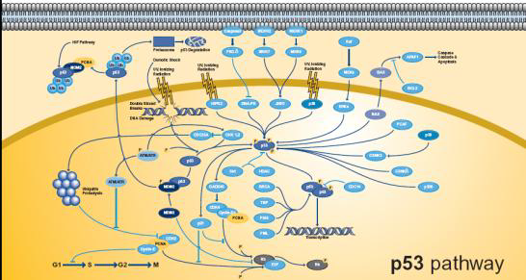
Astrée Static Analyzer
  In Nov. 2003, ASTRÉE was able to prove completely automatically the absence of any RTE in the primary flight control software of the Airbus A340 fly-by-wire system
  A program of 132,000 lines of C analyzed in 1h20 on a 2.8 GHz 32-bit PC using 300 Mb of memory (and 50mn on a 64-bit AMD Athlon™ 64 using 580 Mb of memory).

Slide 6

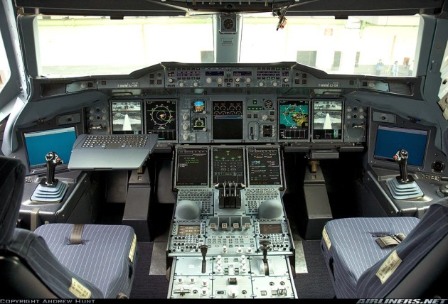
AbsInt – Analysis of WCET
April 2005: AbsInt contributes to guaranteeing the safety of the A380
The Analyzer is able to verify the proper response time of the control software of all components by computing the worst-case execution time (WCET) of all tasks in the flight control software
This analysis is performed on the ground as a critical part of the safety certification of the aircraft

Slide 7
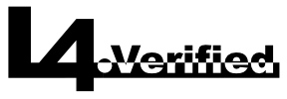
L4 – Formally Verified Operating System Kernel
High-performance microkernel with about 8,700 lines of C code
Critical core component of modern embedded systems
Many modern smart-phones are running on this microkernel
“The C code of the seL4 microkernel correctly implements the behaviour described in its abstract specification and nothing more.”

Slide 8
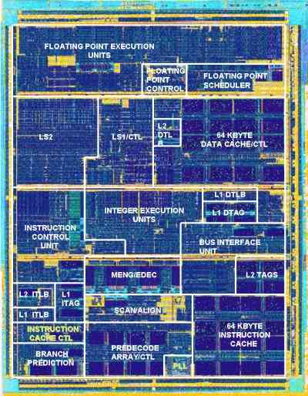
AMD K7 Floating Point Unit
First Pentiums has problem with division – Intel spent ~$500 millions to fix
AMD used ACL2 tool to formally verify that the floating point multiplication, division and square root instructions were correct

Slide 9
Microsoft’s Static Driver Verifier
Static Driver Verifier (SDV) is a thorough, compile-time, static verification tool designed for kernel-mode drivers
SDV systematically analyzes the source code of Windows drivers that are written in C
SDV is included in the Windows Driver Kit (WDK) and supports all x86-based and x64-based build environments

Slide 10
Software Process

Slide 11
Software Engineering Layers
Tools
Methods
Process
Process: framework of the required tasks
  e.g., waterfall, extreme programming
Methods: technical “how to”
  e.g., design review, code review, testing
Tools: automate processes and methods
link
Notes:
Layered Technology
Foundation is Process

Slide 12
Waterfall Process Phases
Gather Requirements
Specification
Design
Testing
Implementation
Integration
Product

Slide 13
1. Gather Requirements
Figure out what this thing is supposed to do
  A raw list of features
  Written down . . .
Usually a good idea to talk to users, clients, or customers!
  But note, they don’t always know what they want
Purpose:
  Make sure we don’t build the wrong thing
  Gather information for planning

Slide 14
2. Specification
A written description of what the system does
  In all circumstances
    For all inputs
    In each possible state
A written document
Because it covers all situations, much more comprehensive than requirements

Slide 15
3. Design
The system architecture
Decompose system into modules
Specify interfaces between modules
Much more of how the system works, rather than what it does

Slide 16
3. Design
The system architecture
Decompose system in modules
Specify interfaces between modules
Much more of how the system works, rather than what it does

Slide 17
4. Implementation
Code up the design
First, make a plan
  The order in which things will be done
  Usually by priority
  Also for testability
Test each module

Slide 18
5. Integration
Put the pieces together
A major QA effort at this point to test the entire system

Slide 19
5. Integration
Put the pieces together
A major QA effort at this point to test the entire system

Slide 20
6. Product
Ship and be happy
Actually, start maintenance

Slide 21
A Software Process: Waterfall Model
One of the standard models for developing software
Each stage leads on to the next
  No iteration or feedback between stages

Slide 22
The Waterfall Model
Gather Requirements
Specification
Design
Testing
Implementation
Integration
Product

Slide 23
The Waterfall Model (Cont.)
There is testing after each phase
  Verify the requirements, the spec, the design
  Not just the coding and the integration
Note the top-down design
  Requirements, spec, design
Bottom-up implementation
  Implement, integrate subparts, integrate product
Notes:
Rigorous effort at every stage leads to discovery of bugs in the early stage.
At every phase you know that the document from the previous phase is correct. Had there been any bug in any of the phases, your work on he subsequent would waste your effort.
Emphasis on documents.

Slide 24
The Waterfall Model (Discussion)
What are the risks with the waterfall model?

Slide 25
Opinions
The major risks are:
  Relies heavily on being able to accurately assess requirements at the start
  Little feedback from users until very late
    Unless they understand specification documents
  Problems in the specification may be found very late
    Coding or integration
  Whole process can take a long time before the first working version is seen
    Frequent intermediate builds are needed to build confidence for a team
  Sequential
    The programmers have nothing to do until the design is ready

Slide 26
Opinions
The waterfall model seems to be adopted from other fields of engineering
  This is how to build bridges
I believe very little software is truly built using the waterfall process
  Where is it most, least applicable?
But many good aspects
  Emphasis on spec, design, testing
  Emphasis on communication through documents

Slide 27
An Opinion on Time
Time is the enemy of all software projects
Taking a long time is inherently risky
  “It is hard to make predictions,
  especially about the future”

Slide 28
Why Time is Important?
The world changes, sometimes quickly
Technologies become obsolete
  Many products obsolete before they first ship!
Other people produce competitive software
Software usually depends on many 3rd-party pieces
  Compilers, networking libraries, operating systems, etc.
  All of these are in constant motion
  Moving slowly means spending lots of energy keeping up with these changes

Slide 29
A Case Study
California DMV software (‘87-’93)
Attempt to merge driver & vehicle registration systems
  thought to take 6 years and $8 million
Spent 7 years and $50 million before pulling the plug
  costs 6.5x initial estimate & expected delivery slipped to 1998 (or 11 years)!

Slide 30
The Flip Side: Advantages to Being Fast
In the short-term, we can assume the world will not change
  At least not much
Being fast greatly simplifies planning
  Near-term predictions are much more reliable
Unfortunately, the waterfall model does not lend itself to speed . . .

Slide 31
Something Faster: Rapid Prototyping
Write a quick prototype
Show it to users
  Use to refine requirements
Then proceed as in waterfall model
  Throw away the prototype
  Do spec, design, coding, integration, etc.

Slide 32
Comments on Rapid Prototyping
Hard to throw away the prototype
  Slogan “the prototype is the product”
  Happens more often than you might think!
A prototype is useful in refining requirements
  Much more realistic to show users a system rather than specification documents
A prototype exposes design mistakes
Experience building a prototype will improve greatly the accuracy of plans

Slide 33
Opinions on Reality
Neither of these models is true to life
In reality, feedback between all stages
  Specifications will demand refined requirements
  Design can affect the specification
  Coding problems can affect the design
  Final product may lead to changes in requirements
    I.e., the initial requirements weren’t right!
Waterfall model with “feedback loops”

Slide 34
What to Do?
Accept that later stages may force changes in earlier decisions
And plan for it
The key: Minimize the risk
  Recognize which decisions may need to be revised
  Plan to get confirmation/refutation as soon as possible

Slide 35
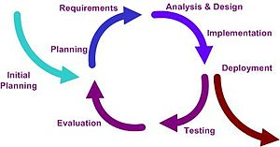
Iterative Models: Plan for Change
Use the same stages as the waterfall model
But plan to iterate the whole cycle several times
  Each cycle is a “build”
  Smaller, lighter-weight than entire product
Break the project into a series of builds which lead from a skeletal prototype to a finished product

Slide 36
Gather Requirements
Same idea as before
Talk to users, find out what is needed
But recognize diminishing returns
Without something to show, probably can’t get full picture of requirements on the first iteration

Slide 37
Specification
A written description of what the system does
  In all circumstances
    For all inputs
    In each possible state
Still need this
  Worth significant time
Recognize it will evolve
  Be aware of what aspects are under-specified

Slide 38
Design
Decompose system into modules and specify interfaces
Design for change
Which parts are most likely to change?
  Put abstraction there

Slide 39
Design
Decompose system into modules and specify interfaces
Which parts are most likely to change?
  Put abstraction there

Slide 40
Design
Plan incremental development of each module
From skeletal component to full functionality
From most critical to least critical features

Slide 41
Implementation: Build 1
Get a skeletal system working
All the pieces are there, but none of them do very much
But the interfaces are implemented
This allows
  A complete system to be built
  Development of individual components to rely on all interfaces of other components

Slide 42
Implementation: Subsequent Builds
After build 1, always have a demo to show
  To customers
  To the team
  Communication!
Each build adds more functionality

Slide 43
Integration
Integration and major test for each build
Stabilization point
Continues until last build
  But may begin shipping earlier builds

Slide 44
Advantages
Find problems sooner
  Get early feedback from users
  Get early feedback on whether spec/design are feasible
More quantifiable than waterfall
  When build 3 of 4 is done, product is 75% complete
  What percentage have we completed at the implementation stage of the waterfall model?

Slide 45
Disadvantages
Main risk is making a major mistake in requirements, spec, or design
  Because we don’t invest as much time before build 1
  Begin coding before problem is fully understood
Trade this off against the risks of being slow
  Often better to get something working and get feedback on that rather than study problem in the abstract

Slide 46
In Practice
Most consumer software development uses the iterative model
  Daily builds
  System is always working
  Microsoft is a well-known example
  IBM Rational Unified Process
Many systems that are hard to test use something more like a waterfall model
  E.g., unmanned space probes

Slide 47
Summary
Important to follow a good process
Waterfall
  top-down design, bottom-up implementation
  Lots of upfront thinking, but slow, hard to iterate
Iterative, or evolutionary processes
  Build a prototype quickly, then evolve it
  Postpone some of the thinking
Extreme programming, Agile process, next …

Slide 48
Extreme Programming
Waterfall model inspired by civil engineering
Civil engineering metaphor is not perfect
  Software is more organic than concrete
  You “grow the software” to meet changing requirements
Extreme Programming (XP) addresses this
  A version of the iterative model discussed before

Slide 49
Goals
Minimize unnecessary work
Maximize communication and feedback
Make sure that developers do most important work
Make system flexible, ready to meet any change in requirements
Notes:
Programmers tend to things that are fun. Make them focus on the important tasks.

Slide 50
History
Kent Beck
  Influential book “Extreme Programming Explained” (1999)
Speed to market, rapidly changing requirements
Some ideas go back much further
  “Test first development” used in NASA in the 60s

Slide 51
XP Practices
On-site customer
The Planning Game
Small releases
Testing
Simple design
Refactoring
Metaphor
Pair programming
Collective ownership
Continuous integration
40-hour week
Coding standards

Slide 52
XP Process
Multiple short cycles (2 weeks):
Meet with client to elicit requirements
  User stories + acceptance tests
Planning game
  Break stories into tasks, estimate cost
  Client prioritizes stories to do first
Implementation
  Write programmer tests first
  Simplest possible design to pass the tests
  Code in pairs
  Occasionally refactor the code
Evaluate progress and reiterate from step 1

Slide 53
Extreme Programming (XP)
XP: like iterative but taken to the extreme
Time
Waterfall
Iterative
XP
Test
Implement
Design
Analyze
Scope

