Slide 1
QoS-Aware In-Network Processing for Mission-Critical Wireless Cyber-Physical Systems
Qiao Xiang
Advisor: Hongwei Zhang
Department of Computer Science
Wayne State University
November 6th, 2012

Slide 2
Introduction
Wireless Sensor Networks
Highly resource-constrained
In-Network Processing
Reduce traffic flow → resource efficient
End-to-end QoS are usually not considered
Mission-Critical CPS:
Close-loop control
More emphasis on end-to-end QoS, especially latency and reliability

Slide 3
Introduction
Packet packing
Application independent INP
Simple yet useful INP in practice
UWB intra-vehicle control
IETF 6LowPAN: high header overhead
Network coding
First proposed in wireline networks
Provide benefits on throughput and robustness

Slide 4
Introduction
Our focus:
Joint optimization between INP and QoS
Understanding problem complexity
Designing simple distributed online algorithm
Explore systems benefits of different INP methods

Slide 5
Roadmap
Real-time packet packing protocol
Proactive protection using network coding against single node failure
What is next?
More generalized failure model, e.g., wireless jamming
Combination of packet packing and inter-flow network coding

Slide 6
Real-time packet packing
System Model
A directed collection tree T = (V,E)
Edge (v_{i}, v_{j}) ∈ E with weight ETX_{vi, vj} (l)
A set of information elements X = {x}
Each element x: (v_{x}, l_{x}, r_{x}, d_{x})
Problem (P):
Schedule the transmission of X to R
Minimize the total number of transmissions
Satisfy the latency constraints of each x ∈ X

Slide 7
Complexity Analysis
Problem P₀
Elements are of equal length
Each node has at most one element
Problem P₁
Elements are of equal length
Each node generates elements periodically
Problem P₂
Elements are of equal length
Arbitrary data generating pattern

Slide 8
Complexity Analysis
P_{0,} P₁, P₂, P | K ≥ 3 | K = 2
 |  | re-aggregation is not prohibited | re-aggregation is prohibited
Complexity | strong NP-hard | strong NP-hard | O(N³)
NP-hard to achieve approximation ratio
K = Maximal packet length N = |X|
Re-aggregation: a packed packet can be dispatched for further packing.

Slide 9
Complexity Analysis
When K ≥ 3 and T is a tree, regardless of re-aggregation
P₀ is NP-hard →P₁ is NP-hard → P₂ is NP-hard → P is NP-hard
When K ≥ 3, and T is a chain, regardless of re-aggregation
The reduction from SAT still holds*
When K = 2 and re-aggregation is not prohibited
The reduction from SAT still holds in both tree and chain structures
When K = 2 and re-aggregation is prohibited
Problem P is equivalent to the maximum weighted matching problem in an interval graph.
Solvable in O(N³) by Edmonds’ Algorithm
* This solves an open problem in batch processing

Slide 10
A Utility Based Online Algorithm
Utility of holding a packet:
Utility of transmitting a packet:
Cost with packing
Cost without packing
Every packet received by parent can get fully packed via pkt

Slide 11
A Utility Based Online Algorithm
Decision Rule
The packet should be immediately transmitted if U_{p} > U_{l}
The packet should be held if U_{p} ≤ U_{l}
Competitive Ratio
Problem P’
T is a complete tree
Leaf nodes generate elements at a common rate
Theorem: For problem P′, tPack is
-competitive, where K is the maximum number of information elements that can be packed into a single packet, V_{>1} is the set of nodes that are at least two hops away from the sink R.
Example: When ETX is the same for each link, tPack is 2-comptetive

Slide 12
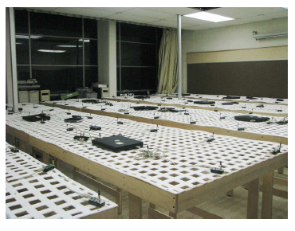
Performance Evaluation
Experiment Setting Up
Testbed: NetEye, a 130-sensor testbed
Topology: 120 nodes, half are source nodes
Protocols compared: noPacking, simplePacking, spreaded latency, common clock, tPack
Traffic patterns: periodic traffic and event traffic
Metrics:
packing ratio
delivery reliability
delivery cost
deadline catching ratio
latency jitter

Slide 13
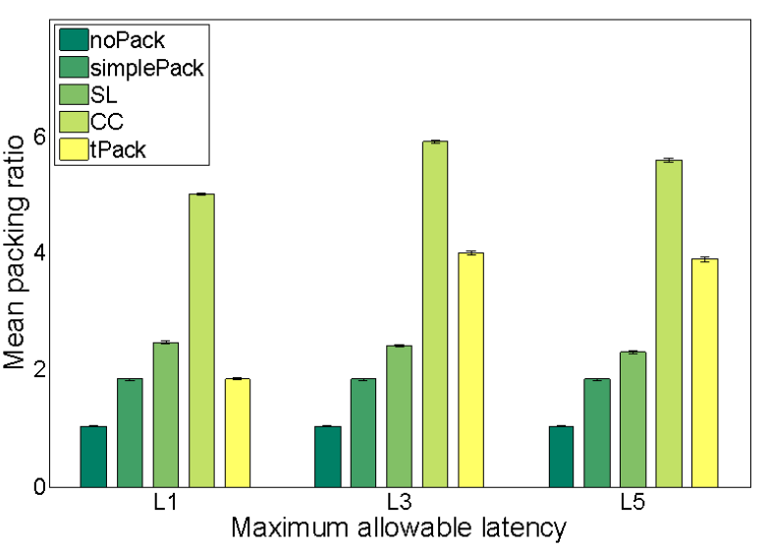
3 second packing ratio

Slide 14
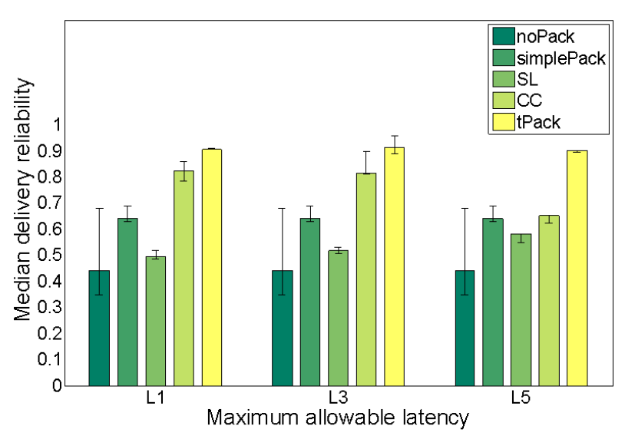
3 second delivery reliability

Slide 15
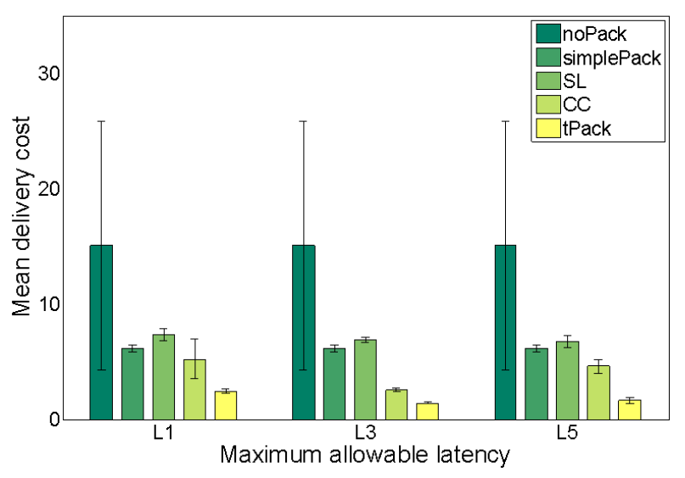
3 second delivery cost

Slide 16
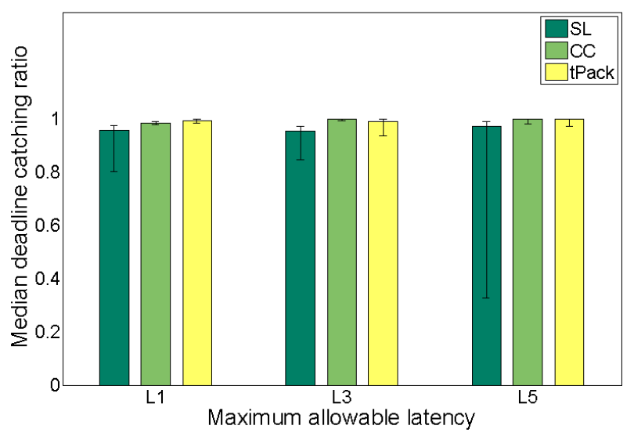
3 second deadline catching ratio

Slide 17
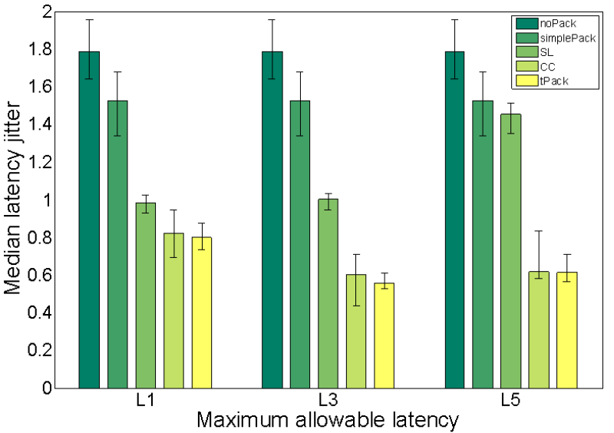
3 second latency jitter

Slide 18
Proactive protection using random network coding
Network coding uses broadcast to increase network throughput.
Broadcast is natural in wireless networks.
Random network coding: coding vectors are randomly chosen from a finite field. Achieve the same throughput as deterministic network coding while easier to use.

Slide 19
Motivation
Proactive protection: make sure the destination can always receive at least one copy of a packet even there is failure in the network.
In random network coding, every coded packet can be used for decoding at the destination, which has the potential for proactive protection.

Slide 20
Motivation
In traditional 1+1 protection, i.e. two node-disjoint paths, the total transmission cost is approximately twice of single path routing.
The combination of opportunistic routing and random network coding has a higher throughput than single path routing, yet may introduce a higher transmission cost.

Slide 21
Problem definition
Problem Q
Given a DAG G = (V,E) with one source S and one destination T , find two node-disjoint sub-DAGs to deliver K linear independent packets to T in each sub-DAG using intra-flow random network coding with minimal total transmission cost.
Problem Q_{0:}
Given a DAG G = (V,E) with one source S and one destination T , find the optimal total transmission cost and the corresponding FC_{i} for each node i to deliver K packets using intra-flow random network coding.

Slide 22
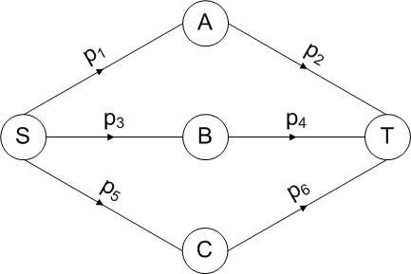
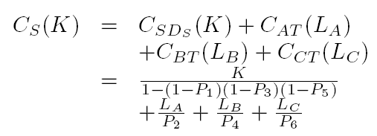

Slide 23
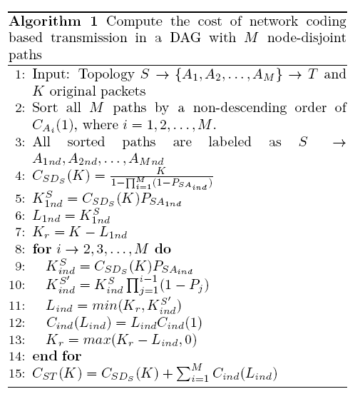
An optimal solution to Q₀

Slide 24
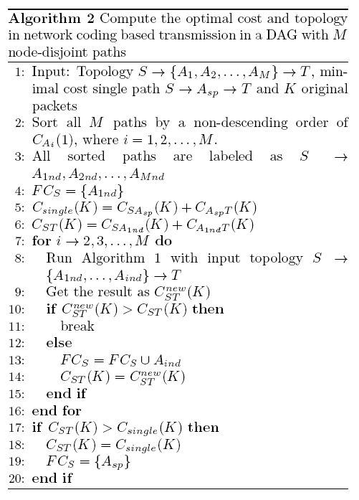

Slide 25
Theorem 1. Algorithm 2 results in the optimal transmission cost and the corresponding topology in NC-based opportunistic routing.

Slide 26
A heuristic solution to Q
Find 2 node-disjoint paths with minimal total cost
Assign other intermediate nodes into the two paths found earlier
Assignment rule: reduction of transmission cost of different decision

Slide 28
Current progress
Studying the approximation ratio of the solution to problem Q
Implementing the protocol in tinyos-2.x

Slide 29
What is next?
Compared with single node failures, protection against jamming is more important and complex.
Proved its NP-hardness
Exploring approximated solutions

Slide 30
Both two INP are effective in reducing data traffic flow while providing QoS guarantee, what if they are utilized together?
Packet packing is demonstrated in convergecast topology
Intra-flow network coding can be designed to protect single flow
Studying the combination of packet packing and inter-flow coding against failures in convergecast topology

