Slide 1

ShadowStream: Performance Evaluation as a Capability in Production Internet Live Streaming Networks
Chen Tian
Richard Alimi
Yang Richard Yang
David Zhang
Aug. 16, 2012
Notes:
Hi everyone,
I will be talking about our project ShadowStream. We will see through the talk that we can perform evaluations in production live streaming networks.
This is a joint work with my mentor Richard Yang and my colleges Richard Alimi and David Zhang.
(Click)

Slide 2
Live Streaming is a Major Internet App
Notes:
Live Streaming is an important Internet application.
In the past 20 days, what happened there in London was broadcast live over the internet to the whole world.
However, there is an important problem of streaming applications (Click)

Slide 3
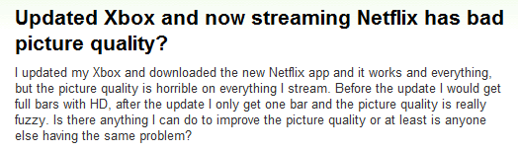
Poor Performance After Updates
Lacking sufficient evaluation before release
Notes:
Many times there would be performance issues after new version updates.
(Click) Here comes Netflix .
(Click) And PPLive.
(Click) It is clear that these new versions lack sufficient evaluation before their release.
How could this happen? (Click)

Slide 4
Don’t We Already Have …
Testbeds
Emulab
PlanetLab
….
Testing Channels
Gradually rolling out
They are not enough !
Notes:
People may think that we already have testbeds, which should be fine to evaluate live streaming networks.
Also there is a widely adopted industry practice that gradually rolling out the new versions in testing channels.
(Click) While, they are just not enough.
Before I tell you why, let me give you a single page of live streaming background.
(Click)

Slide 5

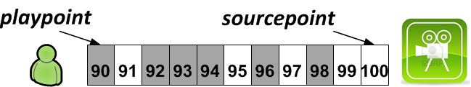
Live Streaming Background
We focus on hybrid live streaming systems: CDN + P2P
Notes:
Each peer in the live streaming network has a buffer to hold video pieces, those already downloaded pieces are marked gray color in the slides.
In our project, we focus on hybrid system, where video pieces can be downloaded from either CDN or from another peer via peer-2-peer mode.
the right most piece is sourcepoint, which points to the newest piece just generated by the video source,
the left most piece is playpoint, which is the next piece that will be submitted to the video player.
sourcepoint, playpoint and the whole buffer advance together with time. (Click)

Slide 6
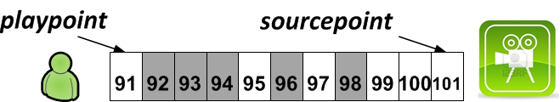
Live Streaming Background
We focus on hybrid live streaming systems: CDN + P2P
Notes:
If a piece is missing at the playpoint, such as 91, the user perceived Quality-of-Experience will be affected.
The percentage of piece missing is the most important metric in live streaming.
Next I will tell you why testbeds are not enough.
(Click)

Slide 7
Testbed: Misleading Results at Small Scale
Piece Missing Ratio
Production Default
Small-Scale
Large-Scale
3.5%
0.7%
With Connection Limit
3.7%
64.8%
Live streaming performance can be highly non-linear.
Notes:
The first issue is scale mismatch.
A testbed can rarely support thousands of peers, while a production live streaming channel could easily scale to hundreds of thousands peers.
Even for the same version, its performance at different scales could be quite different.
Let me give you two concrete examples from experiments.
For the first experiment, we use an unmodified commercial software version.
(Click) The piece missing ratio at small scale is around 3.5 percent.
(Click) However, the missing ratio at the large scale for the same version is less than 1 percent.
(Click) For the second experiment, we limit the number of network connections per peer to create a new version.
(Click) The small-scale doesn’t change too much.
(Click) While the large-scale network is almost broken.
It is clear that, Live streaming performance can be highly non-linear in different scales, the evaluation results from a small scale network may not directly translate to performance in large-scale networks.
(Click)

Slide 8
Testbed: Misleading Results due to Missing Features
Piece Missing Ratio
# Timed-out Requests
# Received Duplicate Packets
# Received Outdated Packets
LAN Style (Same BW)
1.5%
1404.25
0
5.65
ADSL Style (Same BW)
7.3%
2548.25
633
154.20
Realistic features can have large performance impacts.
Notes:
The second issue is missing network features.
We evaluate the same live streaming version in two different physical environments: one is LAN-style and the other is ADSL-style.
(Click) Here comes the results of LAN
(Click) And this is the results of ADSL
They are quite different.
It is also clear that, Realistic features can have large performance impacts.
The results from a testbed could be quite misleading, if we do not correctly emulate the critical network features.
But the problem is, there are many Internet features that we just cannot accurately emulate, such as ISP side polices.
As a comparison, testing channels do have both scale and realistic network features.
Then why testing channels are also not enough? (Click)

Slide 9
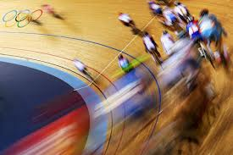

Testing Channel: Lacking QoE Protection
Notes:
Since a testing channel lacks of protection, poor new versions could hurt real users’ Quality-of-Experience.
(Click) which is highly undesirable.
Testing channels also lacks the capability of orchestration. (Click)

Slide 10
Testing Channel: Lacking Orchestration
What we want is …
What we have is …
Notes:
A developer may want to evaluate the new version’s performance under a flashcrowd, such as 5,000 users join in several seconds.
And currently we have a testing channel with over 5,000 online users.
(Click) But with real viewers naturally arrive and depart, we cannot create the target testing condition we want.
(Click)

Slide 11
ShadowStream Design Goal
Use production network for testing with
Protection of real user QoE
Transparent orchestration of testing conditions
Notes:
A production streaming network has both scale and realistic network features.
The design of ShadowStream is to add both protection and orchestration into production networks,
so that we can perform performance evaluations which we called live testing.
(Click)

Slide 12
Roadmap
Motivation
Protection Design
Orchestration Design
Evaluations
Conclusions and Future Work
Notes:
First I will tell you how we achieve Protection.
(Click)

Slide 13
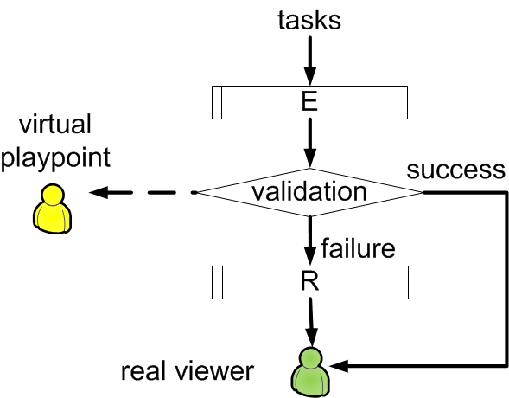
Protection: Basic Scheme
Note: R denotes Repair, E denotes Experiment
Notes:
Here we refer to a self-complete set of algorithms that can download and
upload pieces as a streaming machine or a machine for short.
The new version being evaluated is called Experiment machine.
The basic design is simple and intuitive.
The Experiment streaming machine needs to be running, which is E in the figure.
We let another streaming machine running concurrently with Experiment, which we called the Repair machine, shown as R in the figure.
We first assigns each piece downloading task to E, as if the Experiment machine was running alone, and
records the failure or success of each download task.
If there are any missing piece, Repair steps in to fix failures before they become visible to real viewers.
Let me give you two illustration examples (Click)

Slide 14


Example Illustration: E Success
Notes:
The first illustration is the successful case.
Piece 91 is assigned to E first.
(Click) And it is downloaded.
(Click) It is recorded as success at virtual playpoint, and
(Click) is delivered to the real viewer.
(Click)

Slide 15

Example Illustration: E Success

Slide 16
Example Illustration: E Success

Slide 17
Example Illustration: E Fail
Notes:
The second illustration is an failure case.
(Click) E failed to download 91.
(Click) It is recorded as failure at virtual playpoint, and the responsibility is reassigned to R.
(Click) If Repair downloads it successfully, and the real viewer is not affected.
Here, both R and E contribute to download the real pieces.
The natural following question is how to design the Repair machine (Click)

Slide 18

Example Illustration: E Fail

Slide 19
Example Illustration: E Fail

Slide 20
Example Illustration: E Fail

Slide 21
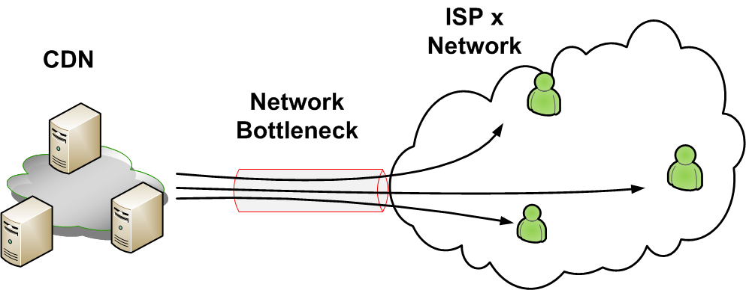
How to Repair?
Choice 1: dedicated CDN resources (R=rCDN)
  Benefit: simple
  Limitations
    requires resource reservation,
      e.g., 100,000 clients x 1 Mbps = 100 Gbps
    may not work well when there is network bottleneck
Notes:
The most intuitive choice here is to use dedicated CDN resources to repair the failed pieces.
This choice is simple, but has limitations in practical scenarios.
(Click) First, the required reserved resources could be very large.
Further, pure CDN repair may not work well when network bottleneck exists.
Is there any other choices?
Remember that we are evaluating new versions, and we already have a stable production streaming machine in hand. What if we use it as the Repair machine?
(Click)

Slide 22
How to Repair?
Choice 2: production machine (R=production)
  Benefit 1: Larger resource pool
  Benefit 2: Fine-tuned algorithms
  Benefit 3: A unified approach to protection & orchestration (later)
Notes:
Compared with dedicated CDN, it has three benefits.
(Click) it has a larger resource pool including the peer upload bandwidth,
(Click) it has fine-tuned algorithms that usually could get around network bottlenecks,
Also
(Click) it enable a unified approach to protection and orchestration, which we will talk later.
But, this choice has a problem. (Click)

Slide 23
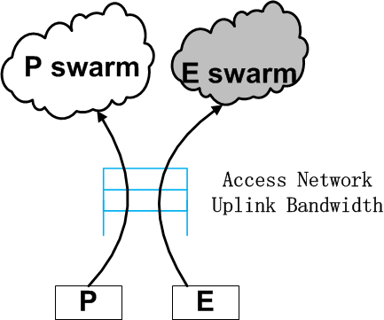
R= Production: Resource Competition
Repair and Experiment compete on client upload bandwidth
Competition leads to underestimation on Experiment performance
Notes:
Here we use P to denote Production machine.
P will use peer upload bandwidth to repair, so the resource available to E is reduced.
The resource competition leads to an underestimation of Experiment performance.
Let me get into a little bit details. (Click)

Slide 24
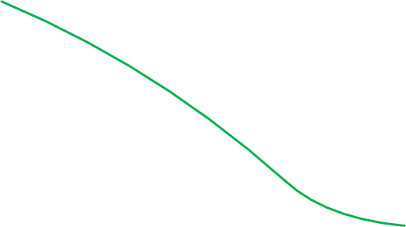
R= Production: Misleading Result
x+y=θ0
repair demand
misleading
result
missing
ratio
accurate
result
Notes:
The most critical parameter for a live streaming network is supply ratio, which is the ratio between the total supply bandwidth and the total required streaming bandwidth.
The piece missing ratio is dominated by the supply ratio.
In this example, supply ratio \theta is shown in x axis(?), while y axis is piece missing ratio.
(click1) This is an illustrative curve of piece missing ratio versus supply ratio. The higher the supply, the lower the missing.
(click2) Assume \theta_0 is the current network supply ratio. The red line denotes the resource taken away by Production.
(click3) And this is the accurate result we want to obtain from the evaluation.
However (click4), the missing pieces need to be repaired, Production will take away a portion of bandwidth supply from the system.
(click5) The supply of Experiment decrease.
(click6) At \theta_R, the repair demand is even higher, and the supply to Experiment will decrease again.
(click7) There is a cross between the green curve and the red line. If the supply falls to the left the cross point (click8) it will increase.
So the whole network would eventually reach a balance point \theta_star. (Click9).
The results would be misleading and is actually the upper bound of the real missing ratio of Experiment (Click10).
We have show that neither dedicated CDN nor Production could work alone as the Repair.
However, by combine them together, we find a solution that achieves our objective. (Click)

Slide 25

Putting Together: PCE
Notes:
The key observation here is that: if the Experiment machine works reasonable, the piece missing ratio should below a reasonable level.
So we let Repair has two streaming machines.
(Click) We insert a CDN machine in front of P.
This dedicated CDN is only allocated a bounded resources, say, 5 percent of the required bandwidth.
We get a bi-model result.
If E works reasonable, the bounded CDN can repair all missing pieces, P is not activated, and experiment accuracy can be achieved .
If otherwise, the system converges to a stationary point and we get an exact indication that missing ratio is larger than expectation.
Hereby is the final PCE scheme of protection.(Click)

Slide 26
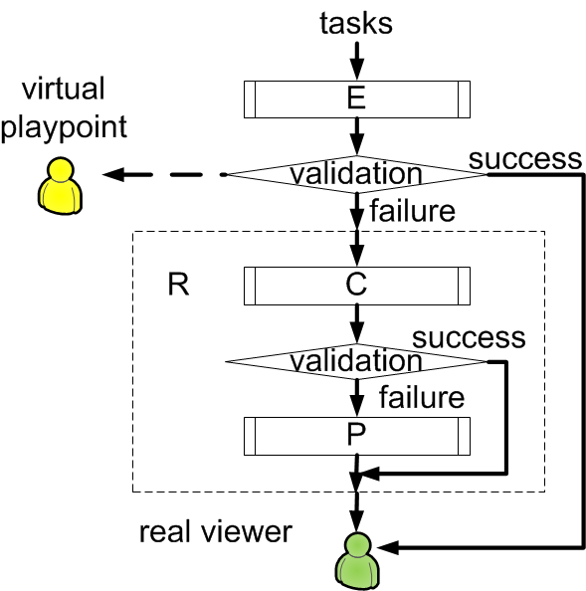
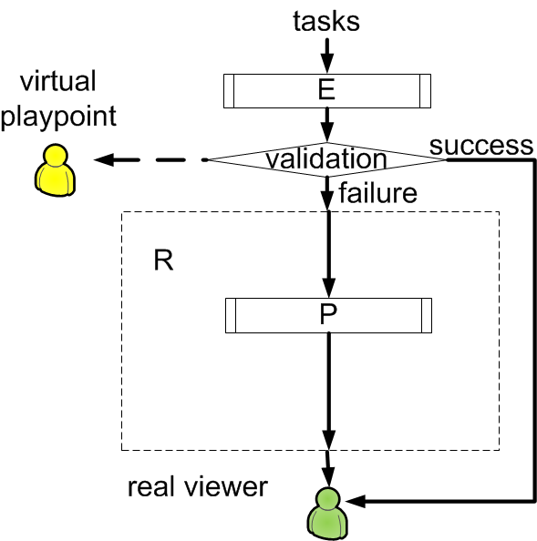
Putting Together: PCE
Notes:
(Click)
Following our design, there are 3 streaming machines.
The final question of Protection design is, how to implement the PCE scheme naturally and seamlessly in live streaming? (Click)

Slide 27
Implementing PCE
Requirements
Streaming machine transparent of testing state
Streaming machines are isolated from each other
Notes:
It is desirable that each streaming machine isolated from other streaming machines, without knowing
whether itself is in a evaluation testing as Experiment or Production, or
it is just running alone as Production machine.
The benefit is that the version being evaluated is exactly the version being released.
ShadowStream achieves this via a client driven implementation.
(Click)

Slide 28
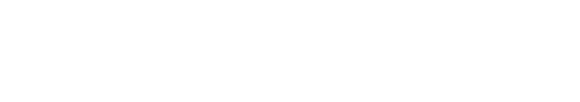
Implementing PCE: base observation
A simple partitioned sliding window to partition downloading tasks among PCE automatically
responsibility transferred
piece missing
unavailable
unavailable
Notes:
We can implement the PCE scheme naturally, seamlessly, by using a simple
sliding window to partition the downloading tasks at a client.
The example illustrates the partition at time 100. Piece 91 is not completed by E.
(Click) With the advance of windows, piece 91 becomes the playpoint, and is recorded as failure in the evaluation
(Click) And windows advance again, 91 moves into the CDN window, and the responsibility of download 91 is automatically transferred to C.
Also, the responsibility of 88 is transferred from C to P.
Start from this, we implement the Protection design (Click)

Slide 29
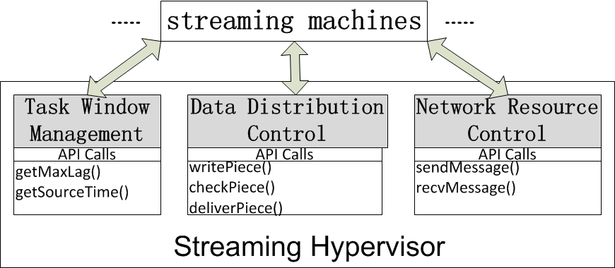
Client Components
Notes:
To manage these running streaming machines, a streaming hypervisor is introduced in the implementation.
The machines are independent to each other, and would only interact with the hypervisor via defined APIs.
There are 3 key components.
Task window management informs a streaming machine about
the pieces that it should download.
Data distribution control copies pieces among streaming machines.
Network resource control handles the network bandwidth allocation
among streaming machines, to guarantee the priority of Repair.
(Click)

Slide 30
Roadmap
Motivation
Protection Design
Orchestration Design
Evaluations
Conclusions and Future Work
Notes:
Next I will tell you how we achieve Orchestration.
(Click)

Slide 31
Orchestration Challenges
How to start an Experiment streaming machine
  Transparent to real viewers
How to control the arrival/departure of each Experiment machine in a scalable way
Notes:
Orchestrator is the organizer of an evaluation testing.
There are two challenges. First, an user should be served before the it joins the tesing.
Then the orchestrator should control an user’s Experiment machine to transparently join and leave a testing.
Second, this control should be performed in a scalable way.(Click)

Slide 32
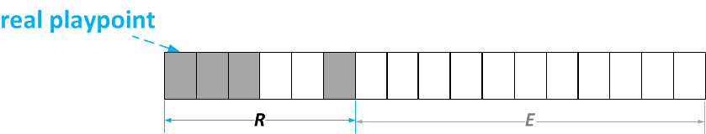
Transparent Orchestration Idea
Notes:
This example shows how ShadowStream activate/deactivate the Experiment machines transparently, without even disturb the real users.
(Click) When a user enters the channel, an additional lag is silently added and only the Repair is working.
(Click)

Slide 33
Transparent Orchestration Idea
Notes:
The orchestrator asks a client to join a testing, the Experiment machine is activated and starts to download pieces.
Since the real playpoint is maintained, the real viewer would not notice the join of a testing.
(Click)

Slide 34
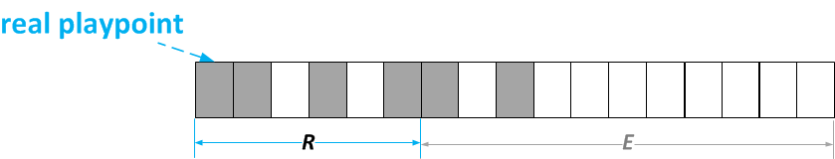
Transparent Orchestration Idea
Notes:
When it is time to quit the testing, the Experiment machine is silently deactivated.
By this simple design, we can achieve transparent orchestration for an individual client.
But for large scale testings, individual notifications to a large number of clients to activate their testing algorithms may not be scalable.
(Click)

Slide 35
Distributed Activation of Testing
Orchestrator distributes parameters to clients
Each client independently generates its arrival time according to the same distribution function F(t)
Together they achieve global arrival pattern
  Cox and Lewis Theorem
Notes:
ShadowStream introduces distributed orchestration, which
decouples the scenario parameters generation from their execution.
(Click) Orchestrator calculates the join probability, the distribution function, and distributes them together with other parameters
(Click) Each client can locally generates its arrival time
(Click) The arrival times of all clients would follow the desired global arrival
rate pattern
That is how we perform distributed activation. (Click)

Slide 36
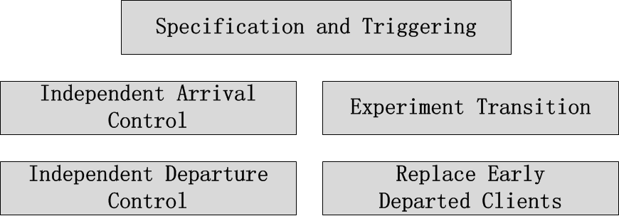
Orchestrator Components
Notes:
Despite arrival/departure control, there are also other components in the orchestrator.
First is Specification and Triggering.
ShadowStream allows intuitive specification of testing client behavior
patterns.
The orchestrator monitors the testing
channel to wait for the network to evolve to a state where the
testing can be triggered.
Next is Experiment Transition.
When a client joins a testing and changes from normal
state to testing state, a smooth transition is needed to guarantee that
the accuracy of the testing is not impaired.
The last is Replace Early Departed Clients.
real viewers have their real departure
behaviors, which cannot be controlled by ShadowStream. Clients
participating in a testing scenario may switch to different channels
or be terminated due to viewer-initiated operations.
We need to replace the so called early-departed clients
During our testing.
(Click)

Slide 37
Roadmap
Motivation
Protection Design
Orchestration Design
Evaluations
Conclusions and Future Work
Notes:
now lets see at how ShadowStream performs in practice
(Click)

Slide 38
Software Implementation
Compositional Runtime
  Modular design, including scheduler, dynamic loading of blocks, etc.
  3400 lines of code
Pre-packaged blocks
  HTTP integration, UDP sockets and debugging
  500 lines of code
Live streaming machine
  4200 lines of code
Notes:
ShadowStream system is fully implemented.
Hereby we give the client side statistics of streaming machine and hypervisor. It is around 10,000 line of codes in total.
(Click)

Slide 39
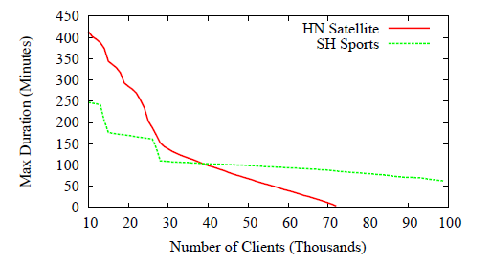
Experimental Opportunities
Notes:
We demonstrate that live testing provides evaluation scales that
are not possible in any existing testbed.
We use real traces from two live streaming testing channels.
The green channel can accommodate a testing of 100,000 clients for at least 60 minutes.
The red channel can host a test with smaller number of clients, but with longer duration.
(Click)

Slide 40
Protection and Accuracy
Piece Missing Ratio
Virtual Playpoint
Real Playpoint
Buggy
8.73%
N/A
R=rCDN
8.72%
0%
R=rCDN w/ bottleneck
8.81%
5.42%
Notes:
We evaluate protection and accuracy by running fully implemented ShadowStream clients on Emulab.
The benefit is that we can run an experiment multiple times repeatedly, all in the exact same setting.
A dedicated Experiment machine is customized for the purpose of evaluation by injecting a bug.
First we evaluate the performance of pure CDN repair.
(Click) The buggy machine running alone would have a piece missing ratio of 8.73%
(Click) Without network bottleneck, the dedicated CDN repair can get relatively satisfied results, and the viewer is not affected
(Click) When there exists bottleneck, the missing pieces can not be fully repaired. We see there are over 5% piece missing observed by real viewers.
Next we evaluate the PCE design (Click) .

Slide 41
Protection and Accuracy
Piece Missing Ratio
Virtual Playpoint
Real Playpoint
PCE bottleneck
9.13%
0.15%
PCE w/ higher bottleneck
8.85%
0%
Notes:
(Click)
When there is a bottleneck, the PCE result is misleading, but the Production machines are repairing the pieces, and the affection to users is minimized.
(Click) When bottleneck is increased, all missing pieces can be repaired by bounded CDN.
We get relatively accurate result, and the user QoE is guaranteed.
(Click)

Slide 42
Orchestration: Distributed Activation
Notes:
Next we evaluate orchestration control.
This is the result of a trace-driven simulation. There are over 300,000 arrivals simulated.
From the figure, we observe that distributed arrivals result in a close match to the target arrival rate function.
(Click)

Slide 43
Utility on Top: Deterministic Replay
Control non-deterministic inputs
Event
Message
Random seeds
Practical per-client log size
 | Log Size
100 clients; 650 seconds | 223KB
300 clients; 1,800 seconds | 714KB
Notes:
We build a replay capability on top of ShadowStream so that real
tests in production streaming can be played back step-by-step offline
for detailed analysis.
A streaming machine is typically an event driven system and it is not computationally-intensive.
We implement each streaming machine in a single thread and control all the non-deterministic inputs.
We observe that the sizes of logged data to achieve replay are practical.
(Click)

Slide 44
Roadmap
Motivation
Protection Design
Orchestration Design
Evaluations
Conclusions and Future Work
Notes:
Here are some discussions.
(Click)

Slide 45
Contributions
Design and implementation of a novel live streaming network that introduces performance evaluation as an intrinsic capability in production networks
  Scalable (PCE) protection of QoE despite large-scale Experiment failures
  Transparent orchestration for flexible testing

Slide 46
Future Work
Large-scale deployment and evaluation
Apply the Shadow (Experiment->Validation->Repair) scheme to other applications
Extend the Shadow (Experiment->Validation->Repair) scheme
  E.g., repair does not mean do the same job as Experiment, as long as it masks visible failures
Notes:
Here comes the future work.
(Click) We are working on the real deployment of ShadowStream.
(Click) ShadowStream’s Experiment->Validation>Repair scheme is
general and can be extended to other applications.
It requires that Failures of experiment can be efficiently identified.
Many computer science problems/systems have the asymmetric property that efficient validation of a solution is
feasible, but better algorithms take time to develop.
(Click) We also extend the Shadow scheme itself. We want to offer flexibility on designing Repair as long as it masks visible failure.
We will take dynamic streaming as an concrete example.
(Click)

Slide 47
Adaptive Rate Streaming Repair
Accuracy
Protected QoE
Protection Overhead
Follow
1.26x
1.59x
1.49 Kbps
Base
1.26x
1.42x
3.69 Kbps
Adaptive
1.26x
1.58x
1.39 Kbps
Notes:
Experiment machine will switch bit rates during the testing. The Repair can choose
(Click) Follow the Experiment rate selection,
(Click) Repair streaming with the base rate,or
(Click) Adaptively choose the best of the two repair schemes.
(Click)

Slide 48
Thank you!

Slide 49
Questions?

Slide 50
backup

Slide 51
Poor Performance After Updates
Lacking sufficient evaluation before release
Notes:
Many times there are performance issues after version updates.
(Click) Here comes Netflix .
(Click) And Hulu .
(Click) And this is between Flash and Firefox .
(Click) It is clear that these new versions lack sufficient evaluation before their release.
How could this happen? (Click)

Slide 52
Related Work
Debugging and evaluation of distributed systems
  e.g., ODR, Friday, DieCast
    Based on a key observation
    Allows scenarios customization
FlowVisor
  Allocate a fixed portion of tasks and resources
Notes:
There are significant previous studies on the debugging and
evaluation of distributed systems.
(Click) Compared with them, ShadowStream is the first system based on the
key observation that both the Repair system and the Experiment system can
contribute to the objective of accomplish the tasks.
Also ShadowStream allows customizing specific scenarios.
(Click) A particularly intresting project is FlowVisor [35], which proposes
to allocate a fixed portion of tasks and resources to experiment
to evaluate performance.
However, complex systems, such as live streaming, can be highly non-linear.
(Click)

Slide 53
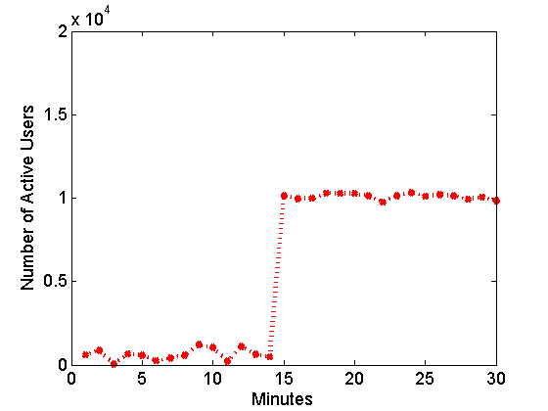
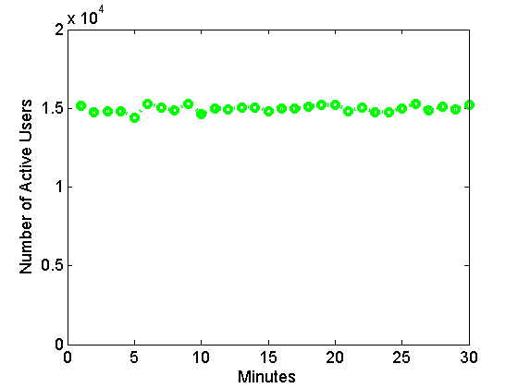
Why Not Testing Channel: orchestration
What we want is …
What we have is …
Notes:
A developer may want to evaluate the performance under a flashcrowd, such as shown in the Figure, (Click) 10,000 users join in several seconds.
And currently we have a big testing channel, (Click) there are 15,000 online users.
Although the user number is larger than the requirement, with real viewers naturally arrive and depart, we cannot create the target testing conditions.
(Click)

Slide 54
Experiment Specification & Triggering
A testing should define:
  One or more classes of clients
  Client-wide arrival rate functions
  Client-wide life duration function
Triggering Condition: prediction based

Slide 55
Experiment Transition
Connectivity Transition
Playbuffer State Transition
More details in the paper: Replace Early Departed Clients, Independent Departure Control

Slide 56
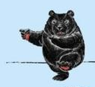


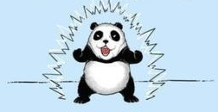
ShadowStream Design Goal
Testbeds
Production networks
By adding protection and orchestration into production networks, we have ….
Live Testing !
Notes:
We see the pros and cons of …. And …
Can we add protection and orchestion into……
Then we have …?

Slide 57
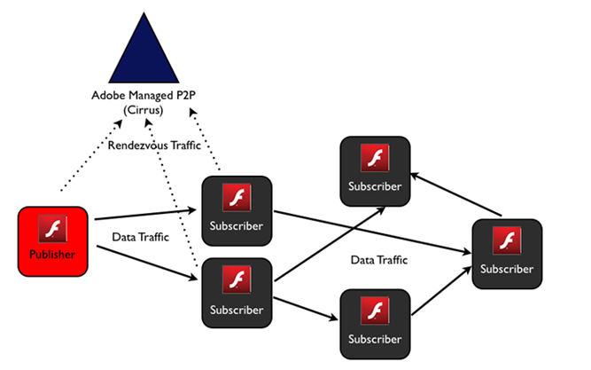
State of Art: Hybrid Systems
Notes:
Here I first give a little background of live streaming system implementation.
Many modern live streaming networks have become complex hybrid systems that use both peer-to-peer technology and content delivery networks.
As shown in the example, current Adobe Flash platform also support P2P mode.
We target this general, widely used streaming architecture in this talk.

Slide 58
Putting Together : ShadowStream
The first system, in the context of live streaming, that can perform live testing with both protection and orchestration
Design the Repair system that can simultaneously provide protection and experiment accuracy
Fully implemented and evaluated

Slide 59
Problem: Resource Competition
Repair and Experiment compete on key resource (client upload bandwidth)
Competition may lead to systematic underestimation on Experiment performance
How to get around ?

Slide 60
Experiment Orchestration
list Experiment Specification & Triggering
Independent Arrivals Control
Experiment Transition
Replace Early Departed Clients
Independent Departure Control

Slide 61






Example Illustration
Notes:
First see how our approach achieve protection.

Slide 62
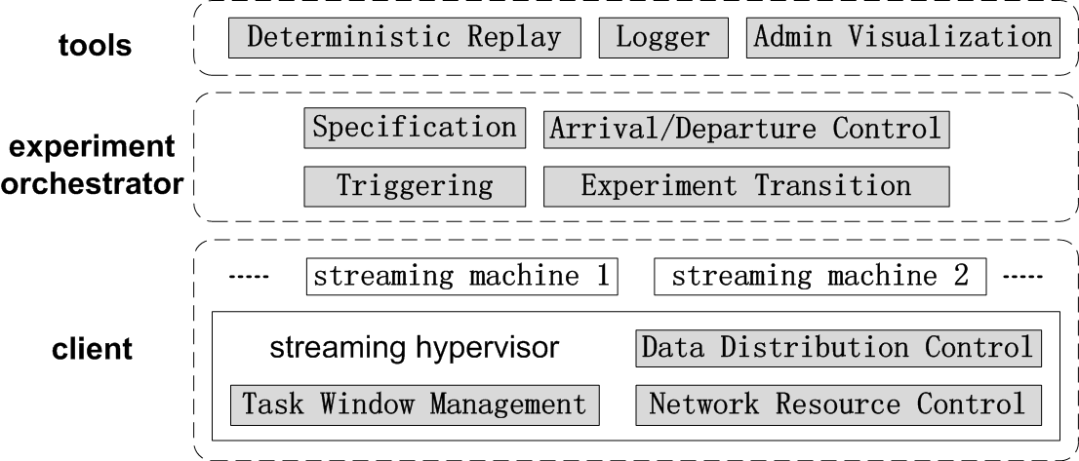
From Idea to System

Slide 63
Extended Works
Dynamic Streaming
Deterministic Replay

Slide 64

Example Illustration XX
Notes:
Piece 91 is also assigned to E first.
(Click) But E failed to retrieve it.
(Click) It is recorded as failure at virtual playpoint, and the responsibility is reassigned to R.
(Click) If Repair downloads it successfully, and the real viewer is not affected.
Here, both R and E contribute to download the real pieces.
The obvious following question is how to design the Repair machine (Click)

