Slide 1
Toward Compositional Verification of Interruptible OS Kernels and Device Drivers
Xiongnan (Newman) Wu
Joint work with Hao Chen, Zhong Shao, Joshua Lockerman, and Ronghui Gu
Yale University
PLDI 2016
June 16, 2016

Slide 2
Do we really need high-assurance OS?
Desktop
Transportation
Mobile
Health
Computer System
cloud
Aviation
Financial
Environment
Notes:
Ben Zorn

Slide 3
Do we really need high-assurance OS?
Desktop
Transportation
Mobile
Health
Applications
Computer System
OS
Hardware
cloud
Aviation
Financial
Environment

Slide 4
Do we really need high-assurance OS?
Desktop
Transportation
Mobile
Health
Applications
Computer System
OS
Hardware
cloud
Aviation
Financial
Environment

Slide 5
Do we really need high-assurance OS?
Crash
Accident
Mobile
Life
Applications
Computer System
OS
Hardware
cloud
Loss
Financial
Environment
Notes:
Correctness of the OS kernel is the baseline of building any high-assurance computer systems.

Slide 6
Formal Verification of OS Kernel
seL4
CertiKOS
Verve
Application
Trap
Kernel
Virtualization
Process Mgmt.
IPC
Thread
Memory Mgmt.
Hardware
CPU
Memory

Slide 7
Formal Verification of OS Kernel
Applications
Applications
Trap
Trap
Virtualization
Virtualization
Process Mgmt.
Process Mgmt.
IPC
IPC
Thread
Thread
Memory Mgmt.
Memory Mgmt.
AHCI / SATA (disk)
USB
NIC
Serial
Keybd
VGA
(video)
CPU
Memory
CPU
Memory
LAPIC
IOAPIC
…

Slide 8
Formal Verification of OS Kernel
VM Monitor
Virtual Dev. 1
Virtual Dev. N
Applications
…
Trap
Virtualization
Disk
PCI Dev.
PCI Dev.
Process Mgmt.
?
AHCI
Timer
Console
IPC
PCI Controller
Thread
APIC
Serial
Kbd
Video
PCI
Memory Mgmt.
TSC
LAPIC
IOAPIC
AHCI / SATA (disk)
USB
NIC
Serial
Keybd
VGA
(video)
CPU
Memory
LAPIC
IOAPIC
…

Slide 9

Device Drivers in Mainstream OS
70% of Linux 2.4.1 kernel are device drivers.
70% of Windows crash are caused by third-party driver code.

Slide 10
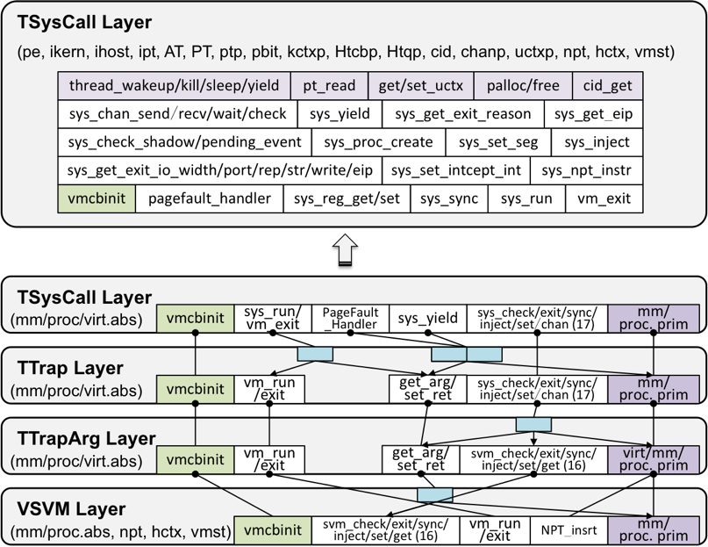
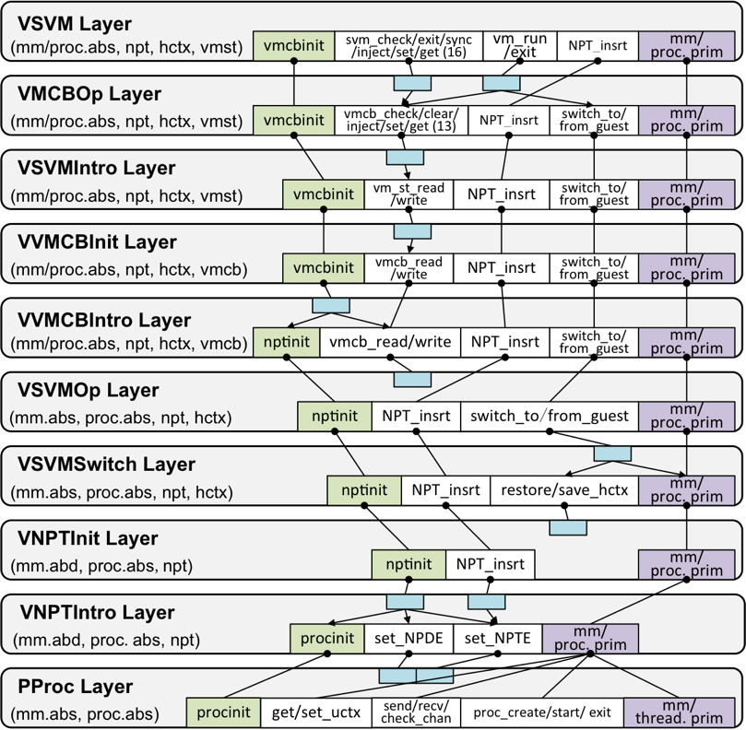
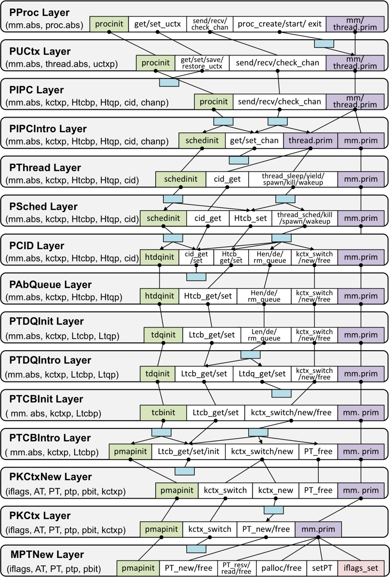
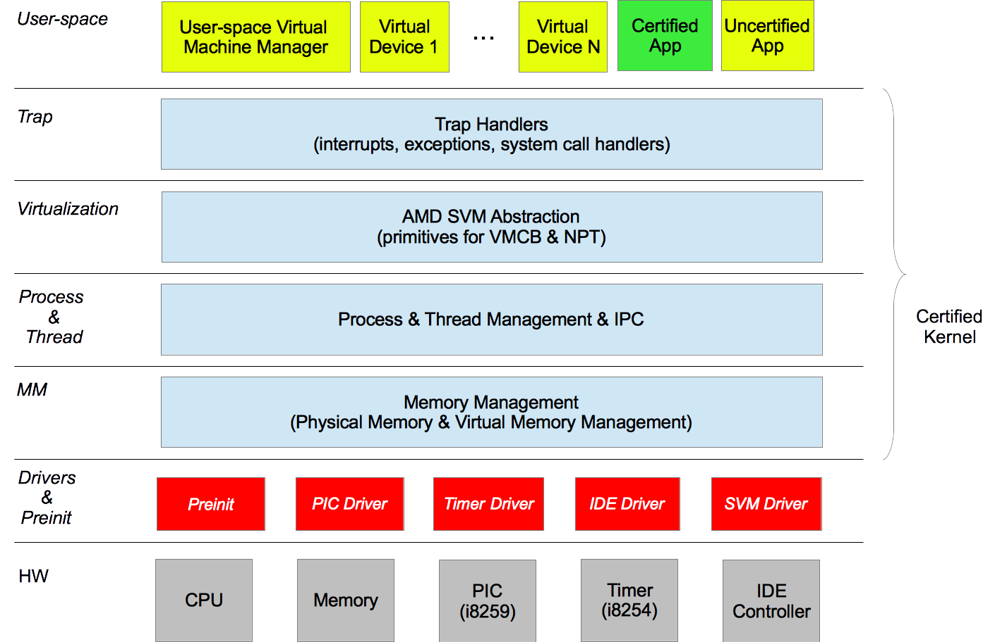
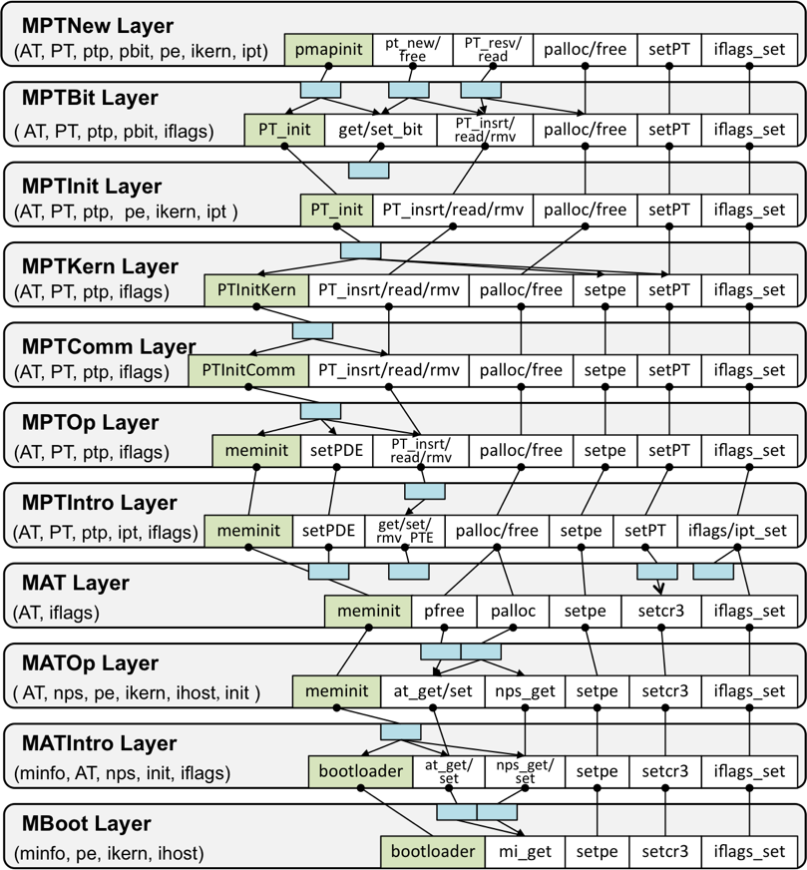
mCertiKOS Overview [POPL’15]
Single-core version of CertiKOS.
3k LOC, can boot Linux as guest.
Aggressive use of abstraction over deep specification (37 layers).
Notes:
Flash this slide quickly

Slide 11
Main Challenge
  Every fine-grained processor step could be interrupted.
?
?
Notes:
This is one abstraction layer.
Explain color coding, d m and lo.
Purple: Assembly Instruction Green: Driver primitives.
BE SLOW
Lightening

Slide 12
Other Challenges
  Interrupt hardware can be dynamically configured.
  Devices and CPU run in parallel.
  Device drivers are written in both C and assembly.
  The correctness results of different components should be linked formally.
Notes:
Just like any other system programs in the world, … written in THE language called C.
Small portion of assembly code that is married to the C code.

Slide 13
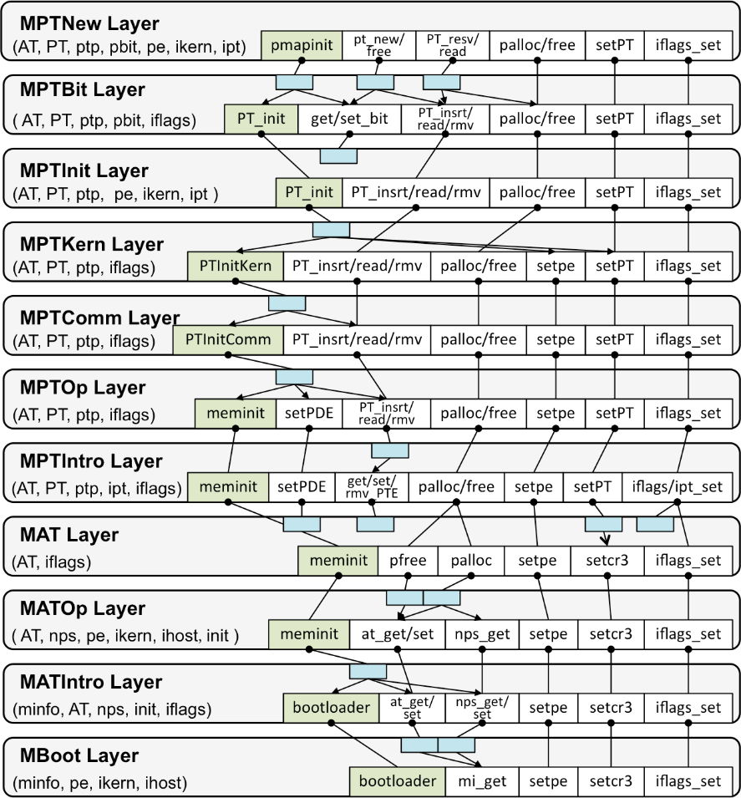
Our Contributions
  The first formally verified interruptible OS kernel with device drivers.
Notes:
Contextual refinement. The kernel is functionally correct and never crashes.
Unverified ones can still run at the user level.
The guarantee is about the actual assembly program running on the machine. Extracted.
Real CertiKOS runs on raw x86 hardware. Boot Linux. Sake of demo: Qemu
Printing Coq logo. Explain keys. Ring0. Interrupt process

Slide 14
Our Contributions
  New techniques for certifying abstraction layers with multiple logical CPUs and devices.
  New techniques for building formal certified device hierarchies.
  An abstraction-layer-based approach for reasoning about interrupts.
  Case study: interruptible mCertiKOS with device drivers.

Slide 15
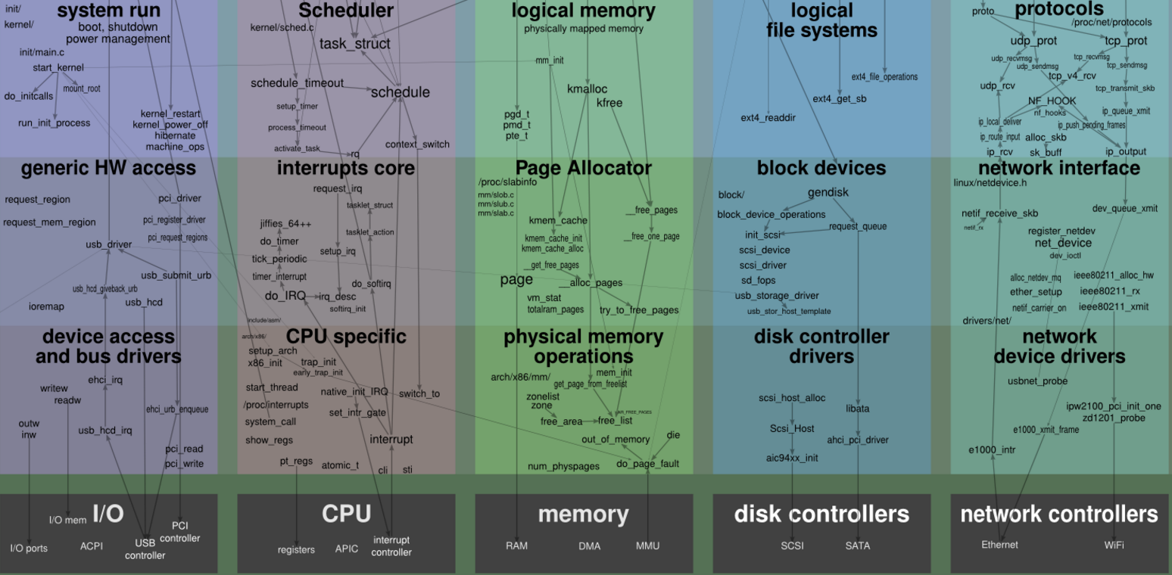
Linux Kernel Map
  Kernel components are sorted into different stacks of abstraction layers based on their underlying hardware device.

Slide 16
New Machine Model

Slide 17
Our Contributions
  New techniques for certifying abstraction layers with multiple logical CPUs and devices.
  New techniques for building formal certified device hierarchies.
  An abstraction-layer-based approach for reasoning about interrupts.
  Case study: interruptible mCertiKOS with device drivers.

Slide 18
Hardware Device Model
  Devices are modeled as transition systems parameterized by all possible lists of external events.
  Example external events:
    Recv (s: list char)
    KeyPressed (c: Z)
  State: observable registers.
  Transition:
    environmental transition:
    I/O transition:
Notes:
Explain delta env

Slide 19
Raw Device Object
  Local log for the list of observed external events.
  Multiple local logs to handle disjoint set of external events asynchronously.
  Read/Write instructions: IN/OUT, memory mapped
    I/O, etc.
Notes:
Device marks the interrupt request bit in its internal state.

Slide 20
Extended Device Object
  Driver as a logical device.
context

Slide 21
Recap: Machine Model
?
Notes:
What happens to interrupt?

Slide 22
Our Contributions
  New techniques for certifying abstraction layers with multiple logical CPUs and devices.
  New techniques for building formal certified device hierarchies.
  An abstraction-layer-based approach for reasoning about interrupts.
  Case study: interruptible mCertiKOS with device drivers.

Slide 23
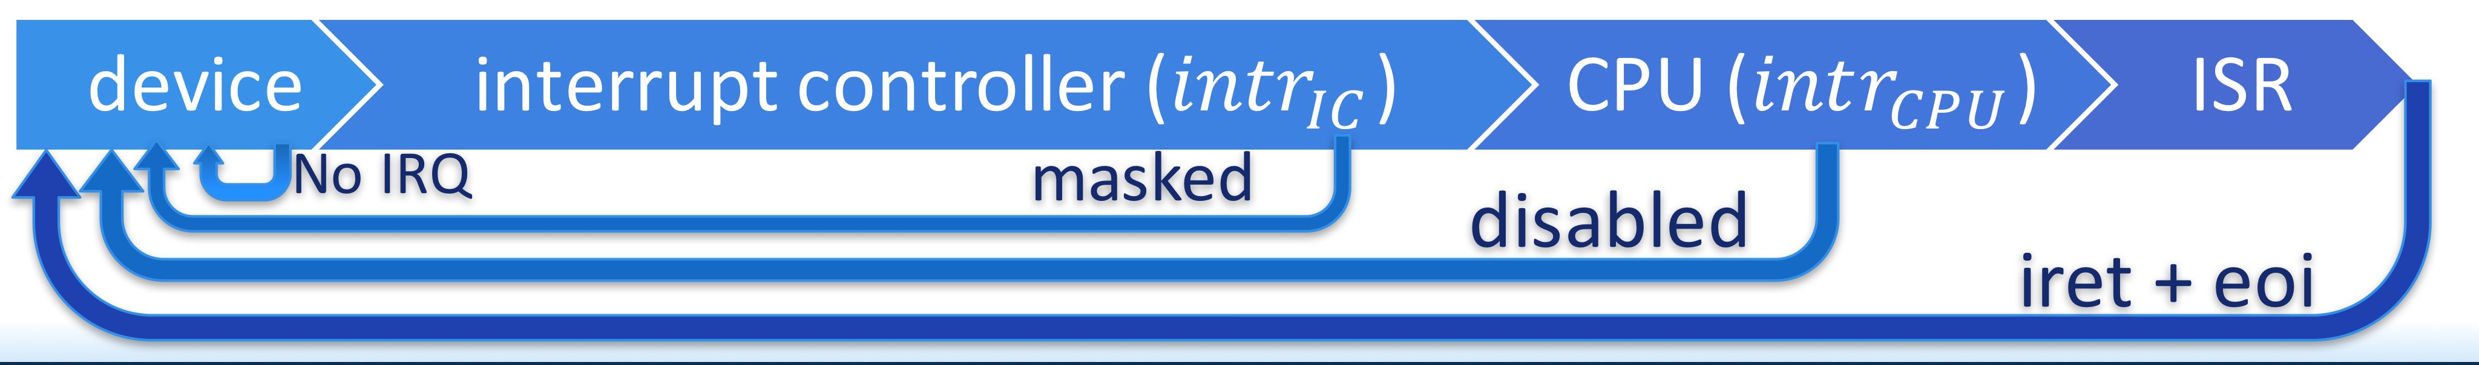
Interrupt Models

Slide 24
New HW Interrupt Model
Kernel
Device
Kernel
Device
mask
intr_disable
p
p
unmask
intr_enable
Notes:
Any low level interaction: wrapped by disable and enable
Disable and enable are only masking the interrupt for the particular device
Meaning of lightening

Slide 25
Semantics of intr_disable
Scans external events.
Recursively performs the environmental transition.
Synchronizes unhandled interrupts.
details in the paper
Notes:
Synchronizes the device state with the previously unhandled interrupts.
It does so by scanning the unhandled external events since the last place intr_enable was called.
Recursively performs the environmental transition on each event until we hit an event that does not trigger interrupts.

Slide 26
Semantics of intr_enable
Recursively discharges pending interrupts.
Delayed interrupts that occur while the interrupt is disabled.
details in the paper
Notes:
Discharges pending interrupts.
Models the machine behavior wherein interrupts occur while the interrupt is disabled get delayed until interrupts are re-enabled.
Recursive since the device could attempt to trigger interrupts within the interrupt handler itself.

Slide 27
Refinement btw. The HW & Abstract Interrupt Model

Slide 28
Our Approach
The driver code of each device runs on its own “logical CPU”, operates its own internal states.
Interruptible code can be naturally reasoned on top of the abstract interrupt model.

Slide 29
Our Contributions
  New techniques for certifying abstraction layers with multiple logical CPUs and devices.
  New techniques for building formal certified device hierarchies.
  An abstraction-layer-based approach for reasoning about interrupts.
  Case study: interruptible mCertiKOS with device drivers.

Slide 30
Interruptible mCertiKOS with Drivers
Notes:
2 bugs found
Extensively debugged/tested
Running on a military land vehicle in context of a large DARPA-funded research project

Slide 31
Case Study: Modeling HW Devices
Serial Port, I/O APIC, Local APIC, CPU interrupt handling.
Notes:
SLOW DONW.
We modeled all these hardware behaviors.
We verified drivers for these devices.

Slide 32
Case Study: Serial Device
States: see figure
Transitions: serial_trans_env + serial_trans_IO
Read/Write primitives: serial_read / serial_write

Slide 33
Serial Interrupt Handler
serial_intr
serial_getc
serial_getc
serial_getc
serial_exists
cons_buf_write
Notes:
Verification of interrupt handler is STAGED.
Not directly on raw device: grow abstraction step by step.
Interrupt handler can be built asap then interruptible driver. Or aby other way.

Slide 34
Serial Driver
serial_intr_disable
serial_putc
serial_intr_enable
serial_read
serial_write

Slide 35
What We Have Proved
Total functional correctness.
Safety.
Contextual refinement between the lowest and the top level abstract machine:
Data invariants:
  Console’s circular buffer is always well-formed.
  Interrupt controller states are always consistent.
The framework also ensures that:
  No code injection attacks, buffer overflow, integer overflow, null pointer access, etc.
Notes:
Simple functional correctness not enough: contextual refinement: host/guest/user/kernel
CR not obvious: page faults

Slide 36
Size of TCB and Spec/Proof
In the TCB
  X86 hardware model
  Hardware device/interrupt model (510 LOC)
  System call specification (126 LOC)
  Bootloader
  Coq proof checker
  Pretty-printing phase of the CompCert compiler
Rest of the spec/proof (about 20k LOC)
  Intermediate and auxiliary specifications and definitions
  Coq proof scripts

Slide 37
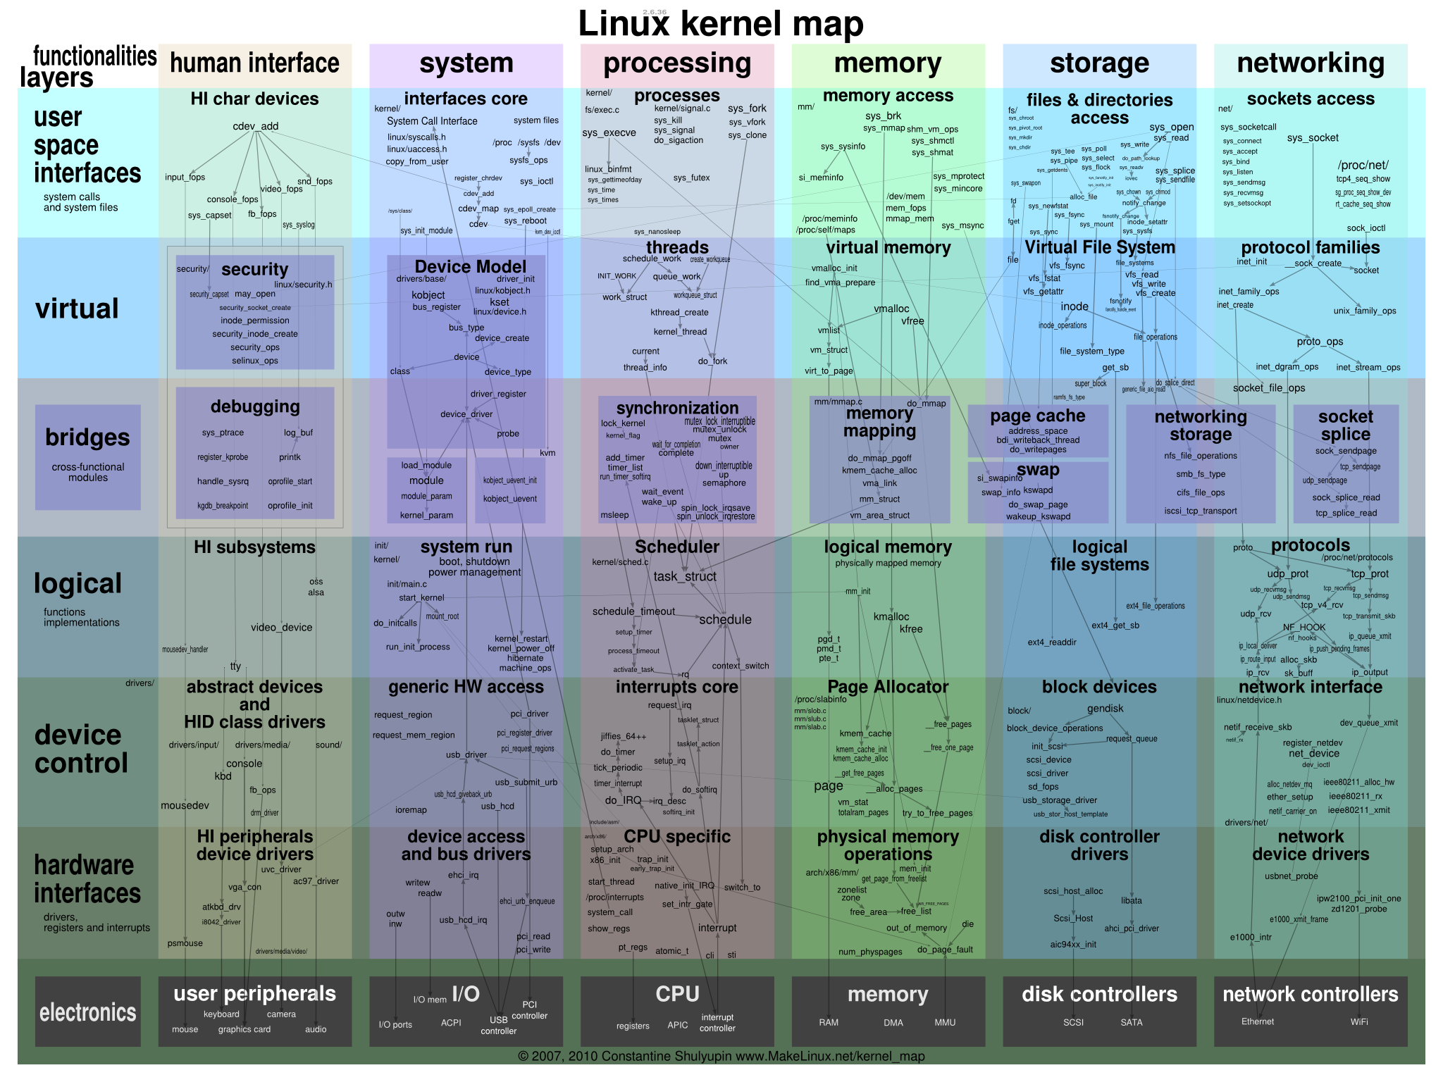
Conclusion
Compositional framework for building certified interruptible kernel with device drivers.
  Certified abstraction layers with multiple logical CPUs.
  An abstraction-layer-based approach for expressing interrupts.
The first formally verified interruptible OS kernel with device drivers.
Extensions:
  Other drivers
  Concurrency
  Larger kernel

Slide 38

Thank You

