Slide 1
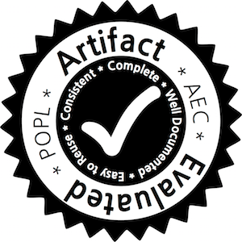
Deep Specifications and Certified Abstraction Layers
Ronghui Gu Jérémie Koenig Tahina Ramananandro Zhong Shao
Newman Wu Shu-Chun Weng Haozhong Zhang¹ Yu Guo¹
Yale University ¹University of Science and Technology of China
January 17, 2015
http://flint.cs.yale.edu

Slide 2
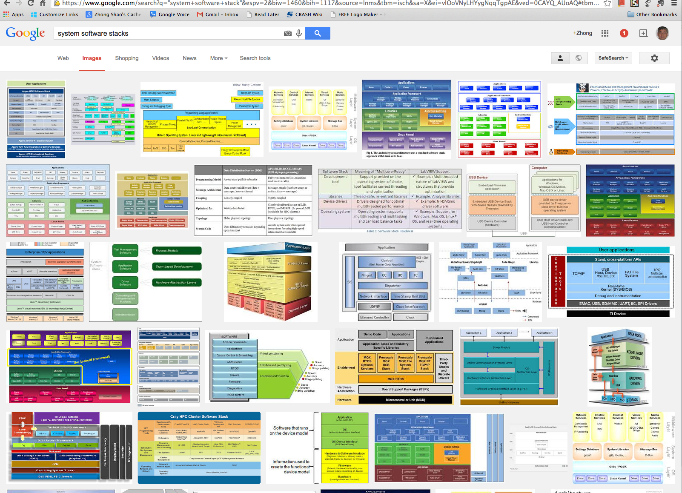
Motivation
How to build reliable & secure system software stacks?
system software stacks

Slide 3
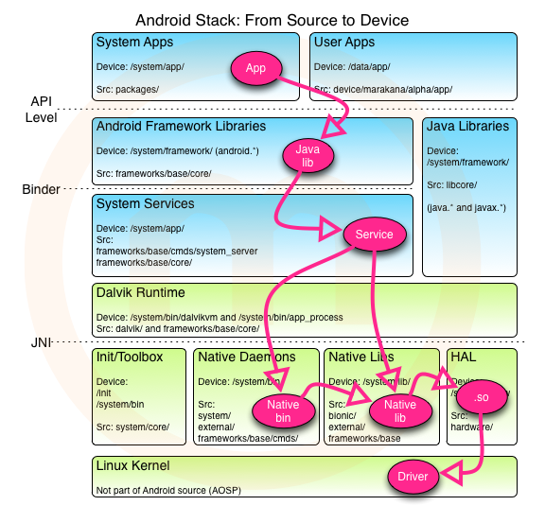
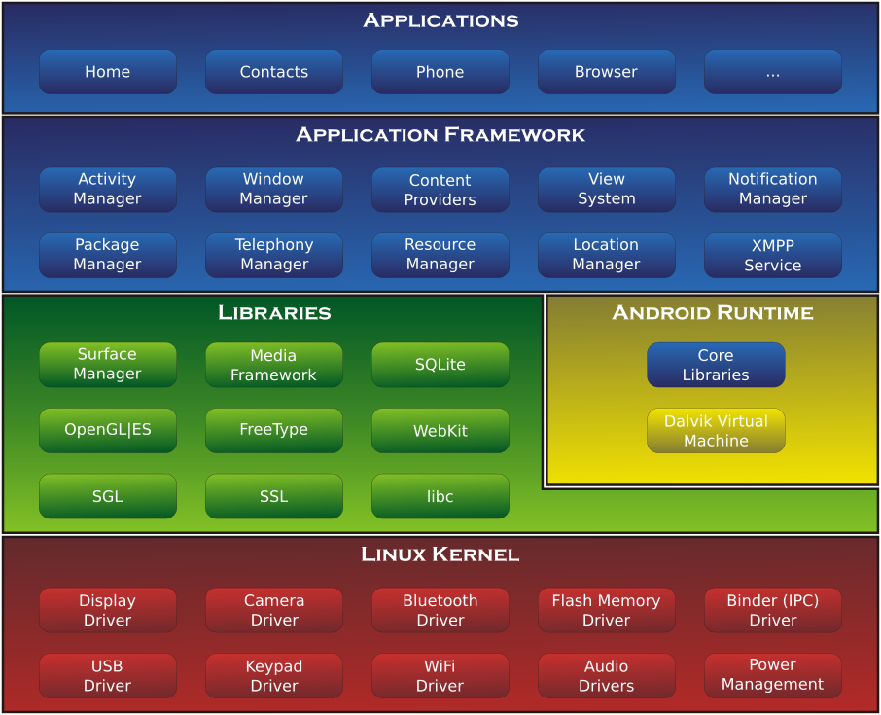
Motivation
Android architecture & system stack
From https://thenewcircle.com/s/post/1031/android_stack_source_to_device &
http://en.wikipedia.org/wiki/Android_(operating_system)

Slide 4
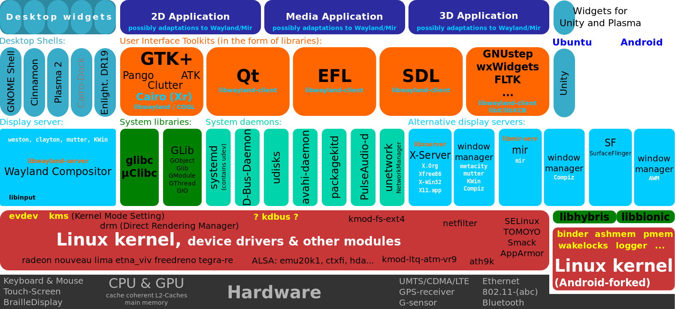
Motivation
Visible software components of the Linux desktop stack
From http://en.wikipedia.org/wiki/Linux

Slide 5
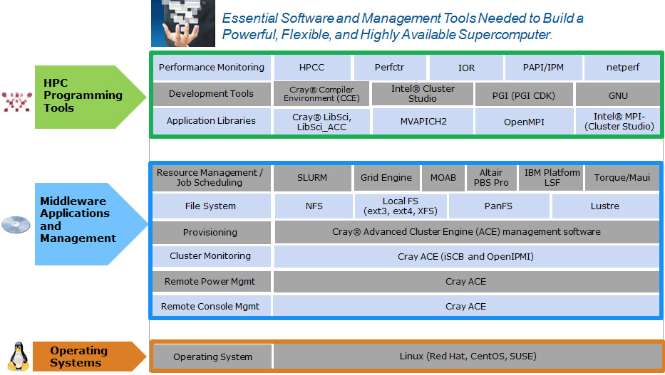
Motivation
Software stack for HPC clusters
From http://www.hpcwire.com/2014/02/24/comprehensive-flexible-software-stack-hpc-clusters/

Slide 6
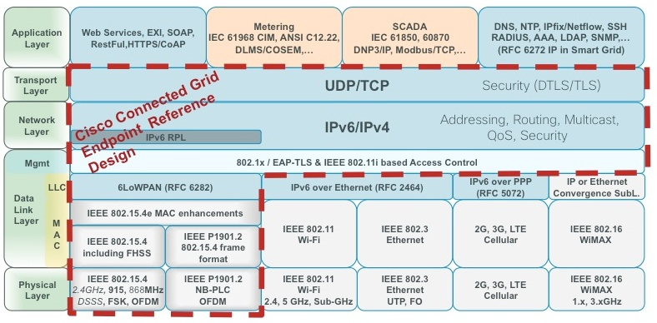
Motivation
Cisco’s FAN (Field-Area-Network) protocol layering
From https://solutionpartner.cisco.com/web/cegd/overview

Slide 7
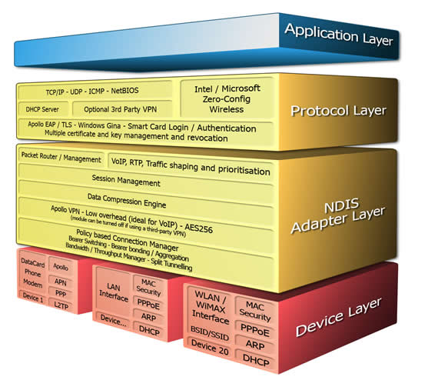
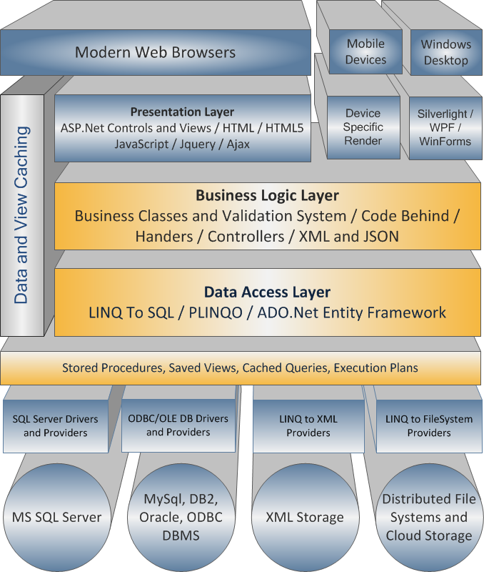
Motivation
Apollo Mobile Communication Stack http://www.layer2connections.com/apollo_clients.html
Web Application Development Stack
From http://www.brightware.co.uk/Technology.aspx

Slide 8
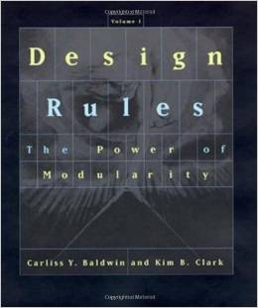
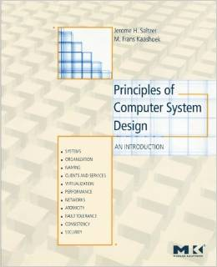
Motivation (cont’d)
Common themes: all system stacks are built based on abstraction, modularity, and layering
Abstraction layers are ubiquitous!
Such use of abstraction, modularity, and layering is “the key factor that drove the computer industry toward today’s explosive levels of innovation and growth because complex products can be built from smaller subsystems that can be designed independently yet function together as a whole.”
Baldwin & Clark “ Design Rules: Volume 1, The Power of Modularity”, MIT Press, 2000

Slide 9
Do We Understand Abstraction?
In the PL community:
(abstraction in the small)
In the System world:
(abstraction in the large)
Mostly formal but tailored within a single programming language
  (ADT, objects, existential types)
Specification only describes type or simple pre- & post condition
Hide concrete data representation (we get the nice repr. independence property)
Well-formed typing or Hoare-style judgment between the impl. & the spec.
Mostly informal & language-neutral (APIs, sys call libraries)
Specification describes full functionality (but in English)
Implementation is a black box (in theory); an abstraction layer hides all things below
The “implements” relation between the impl. & the spec
Something magical going on …
What is it?

Slide 10
Problems
What is an abstraction layer?
How to formally specify an abstraction layer?
How to program, verify, and compile each layer?
How to compose abstraction layers?
How to apply certified abstraction layers to build reliable and secure system software?

Slide 11
Our Contributions
We introduce deep specification and present a language-based formalization of certified abstraction layer
We developed new languages & tools in Coq
  A formal layer calculus for composing certified layers
  ClightX for writing certified layers in a C-like language
  LAsm for writing certified layers in assembly
  CompCertX that compiles ClightX layers into LAsm layers
We built multiple certified OS kernels in Coq
  mCertiKOS-hyper consists of 37 layers, took less than one-person-year to develop, and can boot Linux as a guest

Slide 12

What is an Abstraction Layer?
overlay L₂
abs-state
memory
primitives
abs
R
C or Asm module
implementation
M
underlay L₁
abs-state
memory
primitives
mem

Slide 13
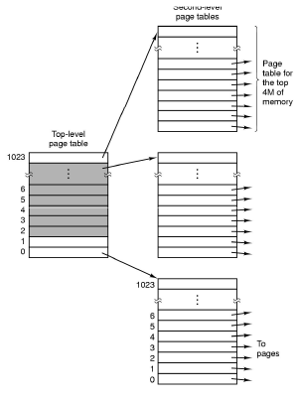
Example: Page Tables
concrete C types
struct PMap {
char * page_dir[1024];
uint page_table[1024][1024];
};
abstract Coq spec
Inductive PTPerm: Type :=
| PTP
| PTU
| PTK.
Inductive PTEInfo:=
| PTEValid (v : Z) (p : PTPerm)
| PTEUnPresent.
Definition PMap := ZMap.t PTEInfo.

Slide 14
Example: Page Tables
abstract state
abstract primitives
(Coq functions)
abstract layer spec
PMap := ZMap.t PTEInfo
(* vaddr ⇀ (paddr, perm) *)
Invariants: kernel page table is
a direct map; user parts are isolated
Function page_table_init = …
Function page_table_insert =…
Function page_table_rmv = …
Function page_table_read = …
memory
C functions
concrete C
implementation
char * page_dir[1024];
uint page_table[1024][1024];
int page_table_init() { … }
int page_table_insert { … }
int page_table_rmv() { … }
int page_table_read() { … }

Slide 15
Formalizing Abstraction Layers
What is a certified abstraction layer (L₁, M, L₂) ?
overlay
interface
spec L₂ with
abstract state abs
simulation (implements)
relation R(abs, mem)
R
module M with concrete state: mem
C or Asm
implementation
calling abstract
primitives in L₁
underlay
interface
spec L₁
Recorded as the well-formed layer judgment
L₁ ⊢_{R} M : L₂

Slide 16
The Simulation Relation
compositional per-module semantics 〖 • 〗
L₁ ⊢_{R} M : L₂
L₂ ≤_{R} 〖 M 〗 L₁
for each function f in Dom(L₂)
L₂ (f)
abs1
abs2
R
R
mem1
mem2
〖 M 〗(L₁)(f)
Forward Simulation:
Whenever L₂(f) takes abs1 to abs2 in one step, and R(abs1, mem1) holds,
then there exists mem2 such that 〖 M 〗(L₁)(f) takes mem1 to mem2 in zero or more steps , and R(abs2, mem2) also holds.

Slide 17
Reversing the Simulation Relation
L₁ ⊢_{R} M : L₂
L₂ ≤_{R} 〖 M 〗 L₁
If 〖M 〗 (L₁) is deterministic relative to external events
( a la CompCert )
〖 M 〗 L₁ ≤_{R} L₂
〖 M 〗 L₁ ∼_{R} L₂
〖M 〗 (L₁) and L₂ are bisimilar!
L₂ captures everything about running M over L₁

Slide 18
Deep Specification
〖 M 〗 L₁ ∼_{R} L₂
〖M 〗 (L₁) and L₂ are bisimilar!
L₂ captures everything about running M over L₁
Making it “contextual” using
the whole-program semantics 【•】
L₂
L₂ is a deep specification of M over L₁
if under any valid program context P of L₂ ,
【 P ⊕M 】 (L₁) and 【P 】(L₂) are
observationally equivalent
R
M
L₁
Notes:
Mention that the definition of deep spec is relative to the definition of “observational equivalence”. Even types can be considered as deep specs if the observers are somewhat “blind”.

Slide 19
Why Deep Spec is Really Cool?
L₂
L₂ is a deep specification of M over L₁
if under any valid program context P of L₂ ,
〖 P ⊕M 〗 (L₁) and 〖P 〗(L₂)are
observationally equivalent
R
M
L₁
Deep spec L captures all we need to know about a layer M
  No need to ever look at M again!
  Any property about M can be proved using L alone.
Impl. Independence : any two implementations of the same deep spec are contextually equivalent

Slide 20
Is Deep Spec Too Tight?
Not really! It still abstracts away:
  the efficient concrete data repr & impl. algorithms & strategies
It can still be nondeterministic:
  External nondeterminism (e.g., I/O or scheduler events) modeled as a set of deterministic traces relative to external events (a la CompCert)
  Internal nondeterminism (e.g., sqrt, rand, resource-limit) is also OK, but any two implementations must still be observationally equivalent
It adds new logical info to make it easier-to-reason-about:
  auxiliary abstract states to define the full functionality & invariants
  accurate precondition under which each primitive is valid

Slide 21
Problem w. Shallow Specs
C or Asm module
shallow spec A
shallow spec B
C & Asm Module Implementation
C & Asm Modules w. Shallow Spec A
Want to prove another spec B ?
? ? ?
Need to revisit & reverify all the code!
Notes:
Please refrain calling “types” and partial correctness specification as shallow specification since the definition of whether a specification is shallow or deep depends on the definition of “observational equivalence” …

Slide 22
Shallow vs. Deep Specifications
C or Asm module
shallow spec
deep spec
C & Asm Module Implementation
C & Asm Modules w. Shallow Specs
C & Asm Modules w. Deep Specs

Slide 23
How to Make Deep Spec Work?
No languages/tools today support deep spec & certified layered programming
Challenges:
Implementation done in C or assembly or …
Specification done in richer logic (e.g., Coq)
Need to mix both and also simulation proofs
Need to compile C layers into assembly layers
Need to compose different layers

Slide 24
Our Contributions
We introduce deep specification and present a language-based formalization of certified abstraction layer
We developed new languages & tools in Coq
  A formal layer calculus for composing certified layers
  ClightX for writing certified layers in a C-like language
  LAsm for writing certified layers in assembly
  CompCertX that compiles ClightX layers into LAsm layers
We built multiple certified OS kernels in Coq
  mCertiKOS-hyper consists of 37 layers, took less than one-person-year to develop, and can boot Linux as a guest

Slide 25
What We Have Done
Coq
Layer Spec
L
Parametrize it w. abstract states & primitives in L
L₁
Layered prog. in ClightX
L₂
R
R
M_{c}
N_{c}
Clight
ClightX[L]
L
L
CompCert
CompCertX[L]
compositional
compiler
LayerLib calculus
Link everything together
Asm
Extended
Asm Language
LAsm
LAsm[L]
L₁
L₃
R
R
M_{a}
N_{a}
Layered prog. in LAsm
L
L

Slide 26
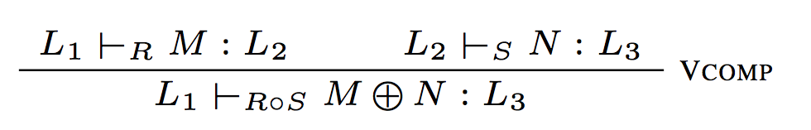
LayerLib: Vertical Composition
L₃
S
L₂
L₃
N
L₃
R
S
R o S
M
N
L₂
M ⊕N
R
L₁
L₂
M
L₁
L₁

Slide 27
Example: Thread Queues
tcbp(0)
tcbp(1)
tcbp(2)
High
Abs-State
1
::
0
::
2
::
nil
Ready
Ready
Ready
tcbp(0)
tcbp(1)
head
tcbp(2)
tail
Low
Abs-State
Ready
1
2
Ready
0
Ready
0
tcbp[0]
tcbp[1]
tcbp[2]
head
tail
Concrete Memory
Ready
Ready
Ready
Notes:
In the concrete memory, we use doubly linked list to implement the thread queue.
For each element, we have to store the pointers to the previous and the next elements in the queue.
In the low level abstract state, we can still use the abstract doubly linked list to represent the thread queue,
but storing the index instead of the pointers.
In the high abstract state, we can come up with some highly abstract representation, like the Coq defined list.

Slide 28
Example: Thread Queues
C Implementation
typedef enum {
TD_READY, TD_RUN,
TD_SLEEP, TD_DEAD
} td_state;
struct tcb {
td_state tds;
struct tcb *prev, *next;
};
struct tdq {
struct tcb *head, *tail;
};
struct tcb tcbp[64];
struct tdq tdqp[64];
struct tcb * dequeue
(struct tdq *q) {
…… }
Low Layer Spec in Coq
Inductive td_state :=
| TD_READY | TD_RUN
| TD_SLEEP | TD_DEAD.
Inductive tcb :=
| TCBV (tds : td_state)
(prev next : Z)
Inductive tdq :=
| TDQV (head tail: Z)
Record abs:={
tcbp : ZMap.t tcb;
tdqp : ZMap.t tdq }
Function dequeue
(d : abs) (i : Z) :=
………………
High Layer Spec in Coq
Inductive td_state :=
| TD_READY | TD_RUN
| TD_SLEEP | TD_DEAD.
Definition tcb := td_state.
Definition tdq := List Z.
Record abs':={
tcbp : ZMap.t tcb;
tdqp : ZMap.t tdq }
Function dequeue
(d : abs') (i : Z) :=
match (d.tdqp i) with
| h :: q' =>
Some(set_tdq d i q', h)
| nil => None
end

Slide 29
Example: Dequeue
tcbp(0)
tcbp(1)
tcbp(2)
High
Abs-State
1
::
0
::
2
::
nil
Ready
Ready
Ready
tcbp(0)
tcbp(1)
head
tcbp(2)
tail
Low
Abs-State
Ready
1
2
Ready
0
Ready
0
tcbp[0]
tcbp[1]
tcbp[2]
head
tail
Concrete Memory
Ready
Ready
Ready

Slide 30
Conflicting Abstract States?
client program P
L₁ with abs1
L₂ with abs2
?
R₁
R₂
module M₁
module M₂
interface L with abstract state: abs
R
R
module M with concrete state: mem

Slide 31
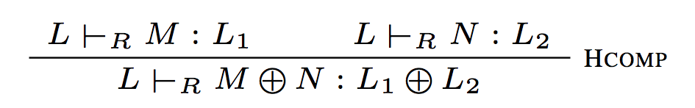
LayerLib: Horizontal Composition
L₁
L₂
L₁+L₂
R
R
R
M
N
M ⊕N
L
L
L
L₁ and L₂ must have the same abstract state
both layers must follow the same simulation relation R

Slide 32
Programming & Compiling Layers
ClightX
L ⊢_{R} M_{c} : L₁
L₁ ≤_{R} 〖 M_{c} 〗_{ClightX} (L)
CompCertX correctness theorem (where minj is a special kind of memory injection)
〖 M_{c} 〗_{ClightX} (L) ≤_{minj} 〖 CompCertX[L](M_{c} )〗_{LAsm} (L)
L₁ ≤_{R ◦ minj} 〖 CompCertX[L](M_{c} )〗_{LAsm} (L)
R must absorb such memory injection: R ◦ minj = R then we have:
L₁ ≤_{R} 〖 CompCertX[L](M_{c} )〗_{LAsm} (L)
Let M_{a} = CompCertX[L](M_{c} ) then L ⊢_{R} M_{a} : L₁
LAsm

Slide 33
Our Contributions
We introduce deep specification and present a language-based formalization of certified abstraction layer
We developed new languages & tools in Coq
  A formal layer calculus for composing certified layers
  ClightX for writing certified layers in a C-like language
  LAsm for writing certified layers in assembly
  CompCertX that compiles ClightX layers into LAsm layers
We built multiple certified OS kernels in Coq
  mCertiKOS-hyper consists of 37 layers, took less than one-person-year to develop, and can boot Linux as a guest

Slide 34
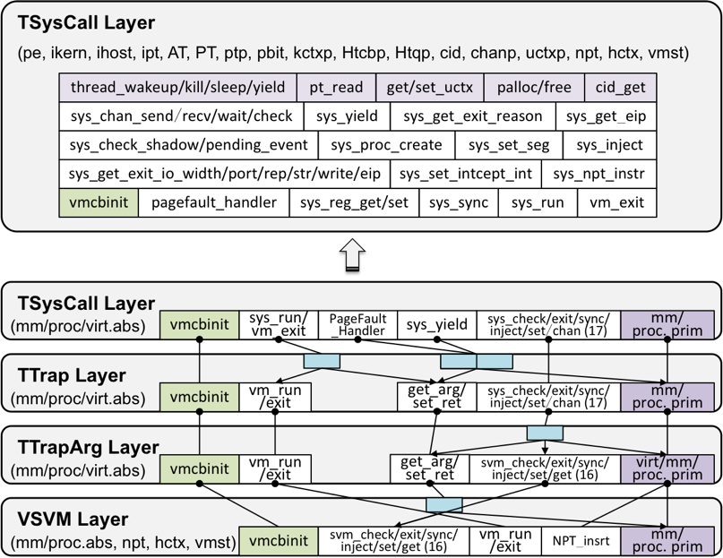
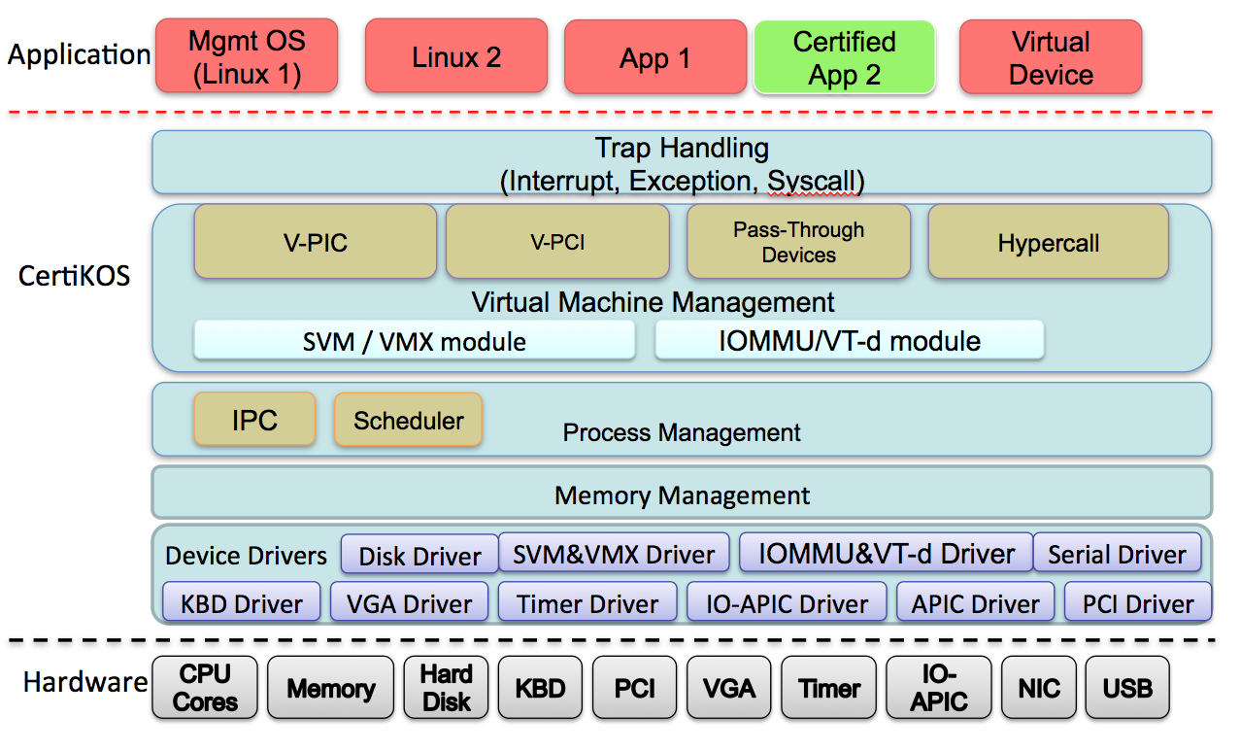
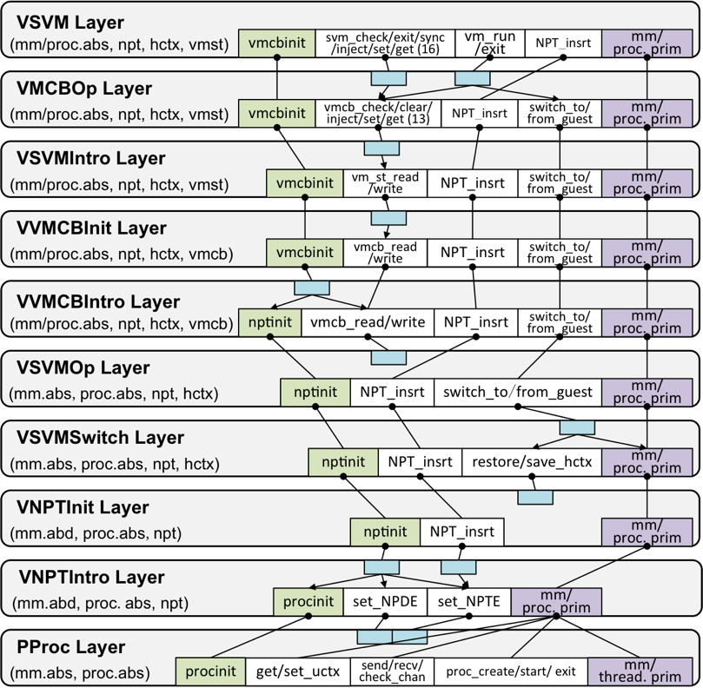
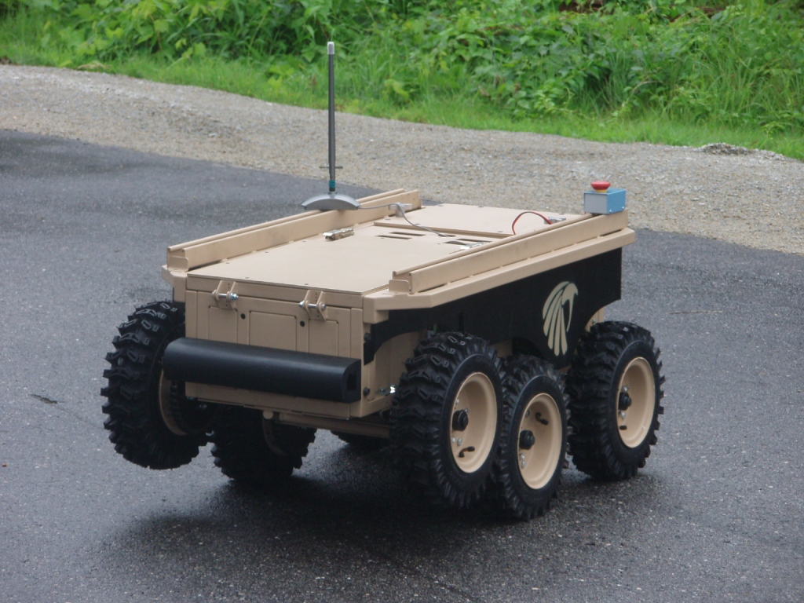
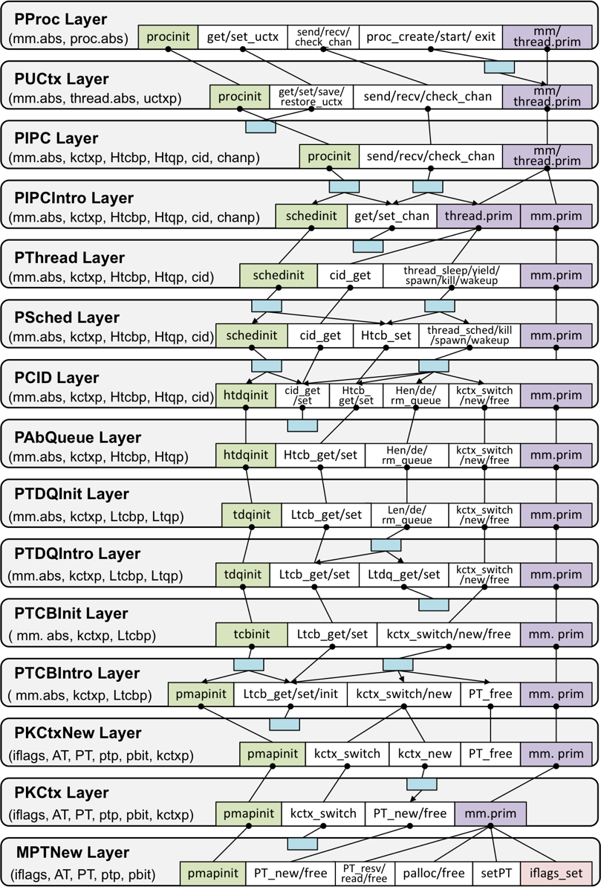
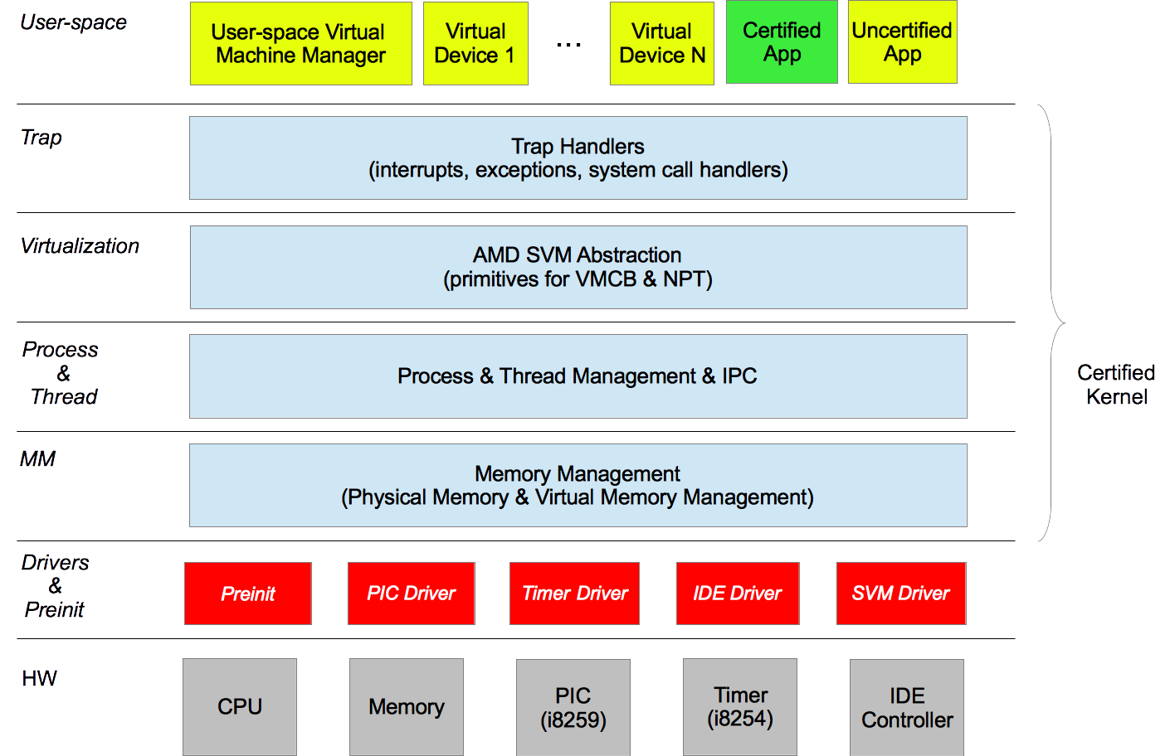
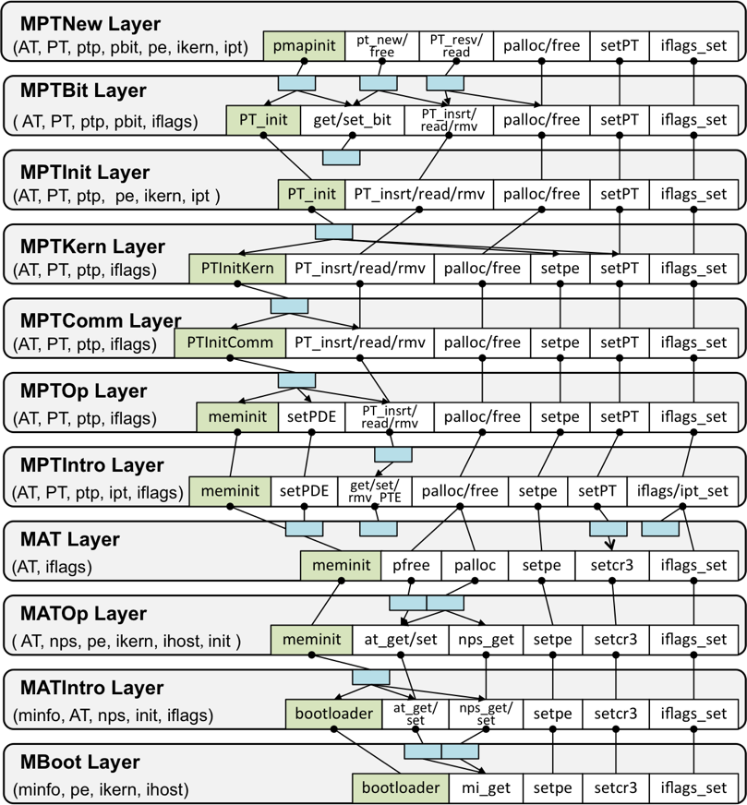
Case Study: mCertiKOS
Single-core version of CertiKOS (developed under DARPA CRASH & HACMS programs), 3 kloc, can boot Linux
Aggressive use of abstraction over deep specs (37 layers in ClightX & LAsm)

Slide 35
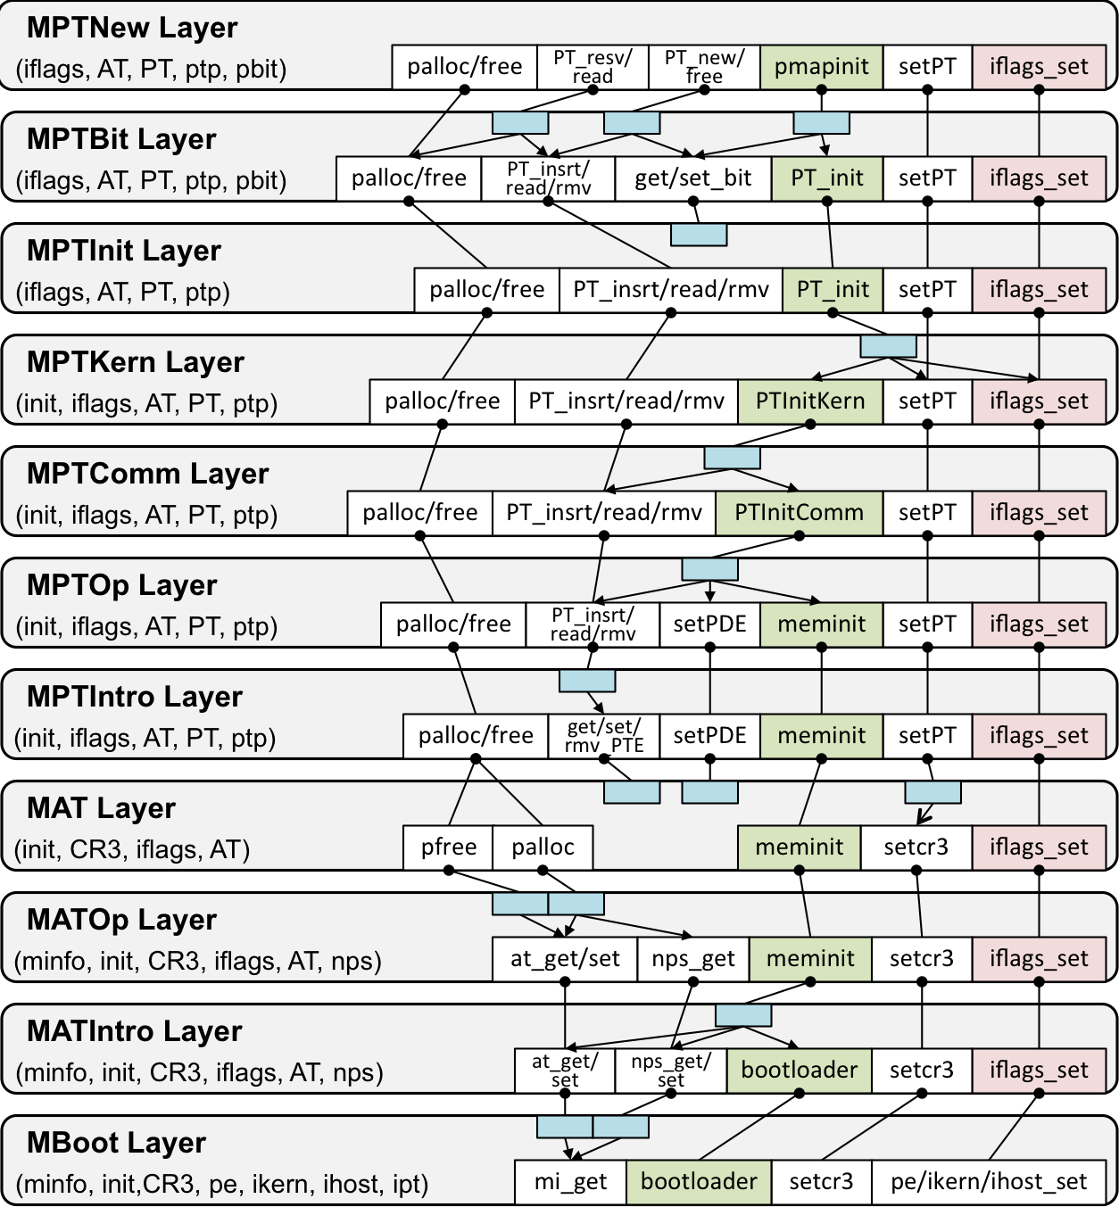
Decomposing mCertiKOS
Physical Memory and Virtual Memory Management
(11 Layers)
Based on the abstract machine provided by boot loader

Slide 36
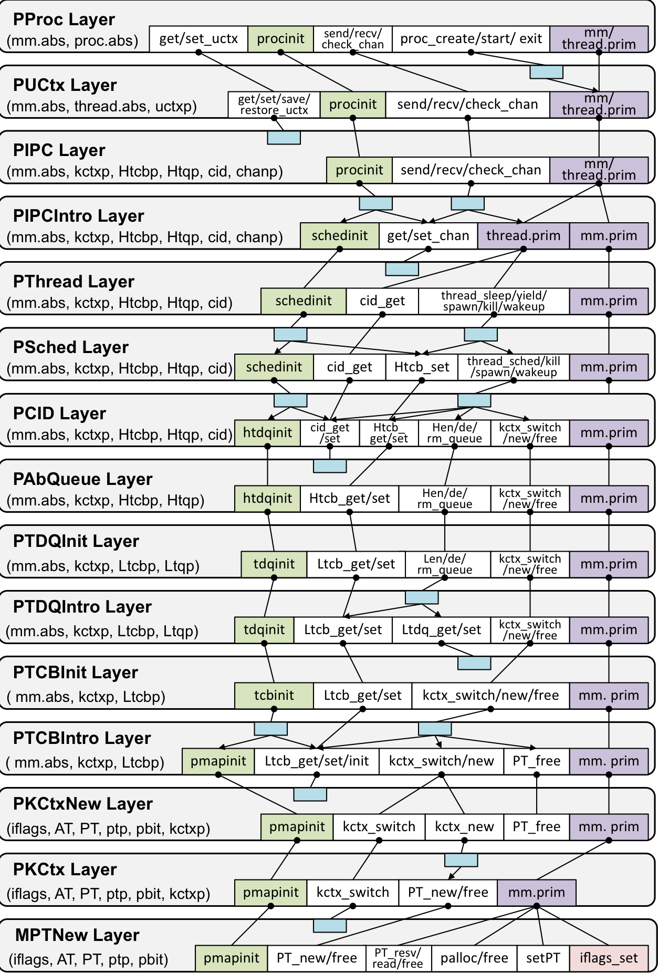
Decomposing mCertiKOS (cont’d)
Thread and Process Management
(14 Layers)

Slide 37
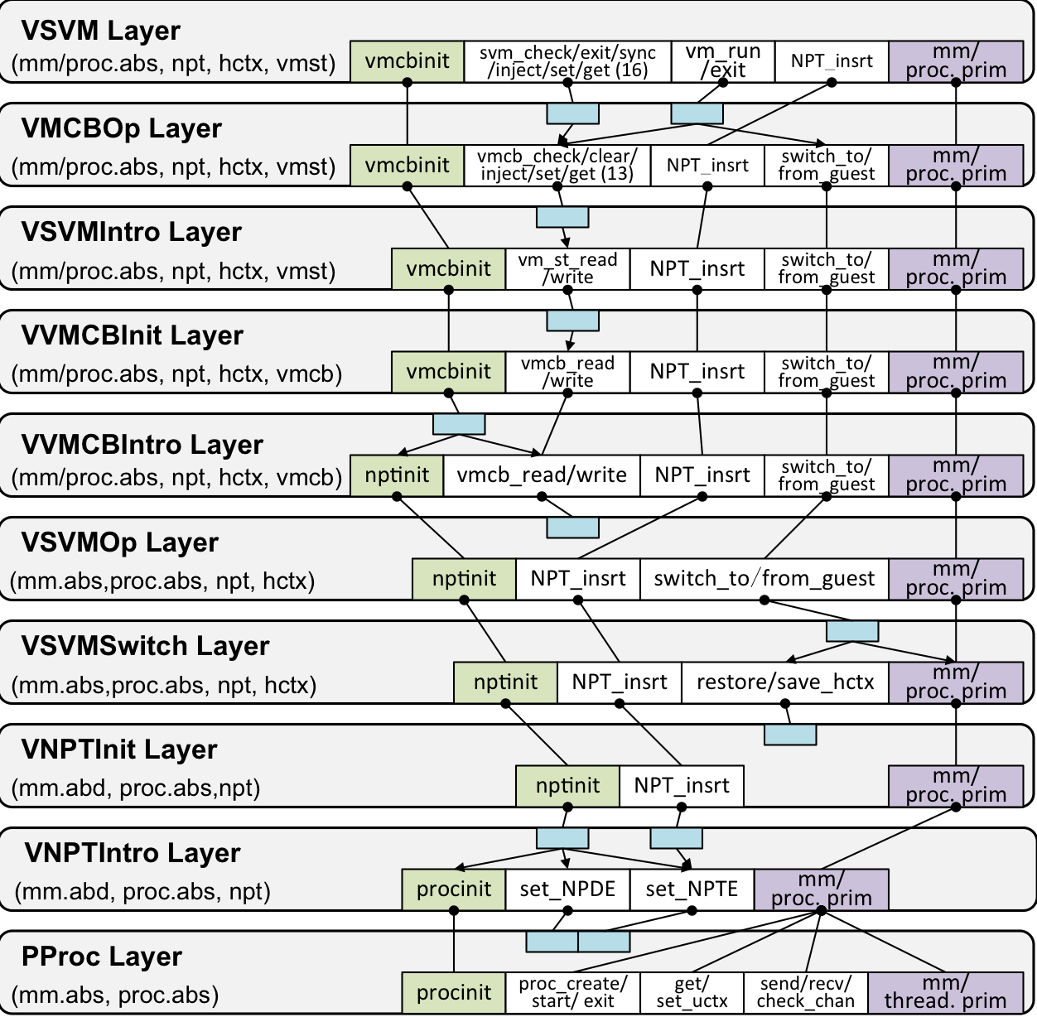
Decomposing mCertiKOS (cont’d)
Virtualization Support
(9 Layers)

Slide 38
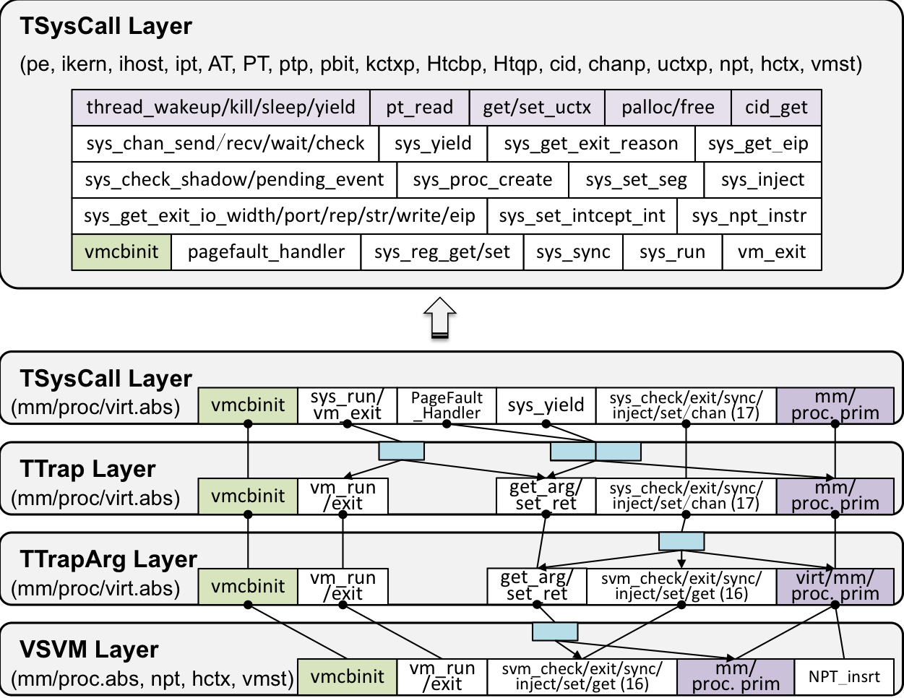
Decomposing mCertiKOS (cont’d)
Syscall and Trap Handlers
(3 Layers)

Slide 39
Variants of mCertiKOS Kernels
(base)
(hyp)
(rz)
(emb)
TRAP
TRAP
TRAP
PROC
VIRT
VIRT
THR
PROC
PROC
PROC
VM
THR
THR
THR
MM
VM
VM
MM
MM
MM
PThread
PSched
PCID
PAbQueue
PTDQInit
PTDQIntro
PTCBInit
PTCBIntro
PKCtxOp
PKCtx
VVM
VSVM
VVMCBOp
VSVMIntro
VVMCBInit
VVMCBIntro
VSVMSwitch
VNPTInit
VNPTIntro
TSysCall
TTrap
TTrapArg
MPMap
MBit
MPTInit
MPTKern
MPTComm
MPTOp
MPTIntro
MAT
MATOp
MATIntro
PreInit
PProc
PUCtx
PIPC
PIPCIntro

Slide 40
Example: Page Fault Handler

Slide 41
Conclusions
Great success w. today’s system software … but why?
We identify, sharpen, & formalize two possible ingredients
  abstraction over deep specs
  a compositional layered methodology
We build new lang. & tools to make layered programming rigorous & certified --- this leads to huge benefits:
  simplified design & spec; reduced proof effort; better extensibility
They also help verification in the small
  hiding implementation details as soon as possible
Still need better PL and tool support (Coq / ClightX / LAsm)

Slide 42
Thank You!
Interested in working on the CertiKOS project? we are hiring & recruiting at all levels:
postdocs,
research scientists,
PhD students, and visitors

Slide 43
A Subtlety for LAsm
Some functions (e.g., kernel context switch) do not follow the C calling convention and must be programmed in LAsm[L].
L ⊢_{R} M_{a} : L₂
L₂ ≤_{R} 〖 M_{a} 〗_{LAsm} (L)
Problem: per-module semantics 〖M_{a} 〗_{LAsm} (L) is NOT deterministic relative to external events
〖 M_{a} 〗_{LAsm} (L) ≤_{R} L₂
Fortunately, whole-machine semantics 【•】_{LAsm} (L) is deterministic relative to external events, so it can still be reversed:
∀P . 【P ⨁ M_{a} 】_{LAsm} (L) ∼_{R} 【P 】_{LAsm} (L₂)

Slide 44
Layer Pattern 1: Getter/Setter
L₂
abs-state
memory
primitives
get
set
abs
R
C or Asm
implementation
Load/Store
L₁
abs-state
memory
primitives
mem
Hide concrete memory; replace it with Abstract State
Only the getter and setter primitives can access memory

Slide 45
Layer Pattern 2: AbsFun
L₂
abs-state
memory
primitives
C or Asm
implementation
M
L₁
abs-state
memory
primitives
get
set
Memory does not change
New implementation code does not access memory directly!

