Slide 1
End-to-End Verification of Information-Flow Security for C and Assembly Programs
David Costanzo, Zhong Shao, Ronghui Gu
Yale University
PLDI 2016
June 17, 2016

Slide 2
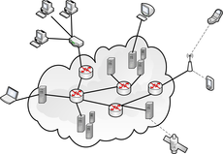
Information-Flow Security
Goal: formally prove an end-to-end information-flow policy that applies to the low-level code of these systems
Proc 1
Proc 2
VM 1
VM 2
OS Kernel
Hypervisor
a.com
b.com
Mach 1
Mach 2
Web Browser
Distributed System

Slide 3
Challenges
How to specify the information flow policy?
ideally, specify at high level of abstraction
allow for some well-specified flows (e.g., declassification)
Proc 1
Proc 2
policy?
OS Kernel

Slide 4
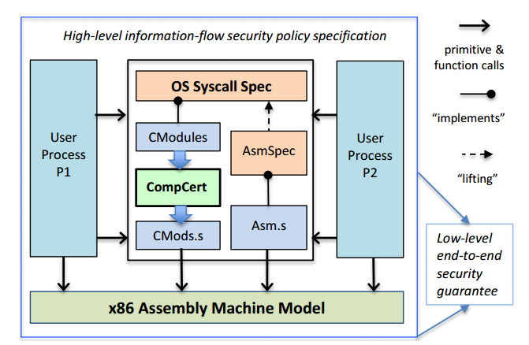
Challenges
Most systems are written in both C and assembly
must deal with low-level assembly code
must deal with compilation
even verified compilation may not preserve security

Slide 5
Challenges
How to prove security on low-level code?
Security type systems (e.g., JIF) don’t work well for weakly-typed languages like C and assembly
How do we deal with declassification?
Systems may have “internal leaks” hidden from clients
How to prove security for all components in a unified way that allows us to link everything together into a system-wide guarantee?

Slide 6
Contribution 1
New methodology to specify, prove, and propagate IFC policies with a single unifying mechanism: the observation function
specify – expressive generalization of classical noninterference
prove – general proof method that subsumes both security label proofs and information hiding proofs
propagate – security-preserving simulations

Slide 7
Contribution 2
Application to a real OS kernel (CertiKOS [POPL15])
First fully-verified secure kernel involving C and assembly, including compilation
Verification done entirely within Coq
Fixed multiple bugs (security leaks)
Policy: user processes running over CertiKOS cannot influence each other in any way (IPC disabled)

Slide 8
Our Solution
Observation Function
Security Policy
Proof: spec secure wrt policy
Security-Preserving Simulation
Verified
x86 Machine Model
End-to-End Guarantee

Slide 9
Rest of Talk
Specifying security
Proving security (example)
Propagating security across simulations
Experience with CertiKOS security proof

Slide 10
Pure Noninterference
“Alice’s behavior is influenced only by her own data.”
Bob₁
Bob₁'
Alice
Alice'
=
=
Bob₂
Bob₂'
Alice
Alice'

Slide 11
Generalized Noninterference
“Alice’s behavior is influenced only by her own observation.”
σ₁
σ₁'
Θ_{A}(σ₁)
Θ_{A}(σ₁' )
σ₂
σ₂'
=
=
Θ_{A}(σ₂)
Θ_{A}(σ₂' )

Slide 12
Observation Function
Θ : principal → program state → observation
(can be any type)
S : program state → program state → prop
“spec S is secure for principal p”
$∀$ σ_{1 ,} σ_{2,} σ’_{1,} σ’₂ .
Θ_{p}(σ₁) = Θ_{p}(σ₂) ∧ S(σ_{1,} σ’₁) ∧ S(σ_{2,} σ’₂)
$⟹$
Θ_{p}(σ’₁) = Θ_{p}(σ’₂)

Slide 13
Example Observation Functions
w | (5, {A})
x | (17, {A,B})
y | (42, {B})
z | (13, {})
Θ_{A}
w | (5, {A})
x | (?, {A,B})
y | (?, {B})
z | (13, {})
{A,B}
⊑
⊑
{A}
{B}
⊑
⊑
Θ_{A}
{}

Slide 14
Example Observation Functions
employee salaries
Θ_{A}
avg salary
Bob’s detailed event calendar
Bob’s available / unavailable time slots
M | T | W | F
Θ_{A}
M | T | W | F

Slide 15
Rest of Talk
Specifying security
Proving security (example)
Propagating security across simulations
Experience with CertiKOS security proof

Slide 16
Virtual Address Translation
Process p
va_load
global heap
Θ_{p}(σ)
:= fun va => va_load va σ
va
page tables
pa
data
Definition va_load va σ rs rd :=
match ZMap.get (PDX va) (ptpool σ) with
PDEValid _ pte =>
match ZMap.get (PTX va) pte with
| PTEValid pg _ =>
Next (rs # rd <-
FlatMem.load (HP σ) (pg*PGSIZE + va%PGSIZE))
| PTEUnPresent => exec_pagefault σ va rs
end
end.
Declassify?
High Security
Notes:
v is the physical page number – if we did label reasoning, v would have to be high security => we would need Flatmem.load to perform a declassification – how would we know such a declassification is secure?

Slide 17
Rest of Talk
Specifying security
Proving security (examples)
Propagating security across simulations
Experience with CertiKOS security proof

Slide 18
Insecure Simulation
OS and compiler refinement proofs use simulations
Simulations may not preserve security!
swap(x,y)
Machine M
x | 17
y | 42
x | 42
y | 17
R
R
Machine N
x | 17
y | 42
z | 0
z = x; x = y; y = z
x | 42
y | 17
z | 17
$R\left(σ_{M}, σ_{N}\right) ≔{(σ}_{M}\left(x\right)=σ_{N}\left(x\right) ∧σ_{M}\left(y\right)=σ_{N}(y)$)

Slide 19
Propagating Security
Define an observation function for each machine, Θ^{M} and Θ^{N}
Require that the simulation is security-preserving
No significant changes to CompCert were needed
Security-Preserving Simulation (for principal p)
$∀$ σ_{1 ,} σ_{2,} s_{1,} s₂ .
Θ^{M}_{p} (σ₁) = Θ^{M}_{p} (σ₂) ∧ R(σ_{1,} s₁) ∧ R(σ_{2,} s₂)
$⟹$
Θ^{N}_{p} (s₁) = Θ^{N}_{p} (s₂)

Slide 20
Rest of Talk
Specifying security
Proving security (examples)
Propagating security across simulations
Experience with CertiKOS security proof

Slide 21
CertiKOS Overview
Certified functionally correct OS kernel with 32 layers
354 lines of assembly code, ~3000 lines of C code
CompCert compiles C to assembly
Each layer has primitives that can be called atomically
Bottom layer MBoot is the x86 machine model
Top layer TSysCall contains 9 system calls as primitives
init, vmem load/store, page fault, memory quota, spawn child, yield, print

Slide 22
CertiKOS Observation Function
For a process p, the observation function is:
registers, if p is currently executing
the output buffer of p
the function from p’s virtual addresses to values
p’s available memory remaining (quota)
the number of children p has spawned
the saved register context of p
the spawned status and currently-executing status of p

Slide 23
CertiKOS Security Property
TSysCall
Θ^{S}_{p} = (as described)
R
MBoot
Θ^{I}_{p} = p’s current output buffer
B^{I}_{p} =
p’s “final” output buffer
(whole-execution behavior)
Generalized Noninterference:
$$∀σ_{1},σ_{2},σ_{1}^{′},σ_{2}^{′} .$$
$${\text{Θ}}_{p}^{S}\left(σ_{1}\right)={\text{Θ}}_{p}^{S}\left(σ_{2}\right)∧\left(σ_{1},σ_{1}^{′}\right)∈S∧\left(σ_{2},σ_{2}^{′}\right)∈S$$
$$⇒{\text{Θ}}_{p}^{S}\left(σ_{1}^{′}\right)={\text{Θ}}_{p}^{S}(σ_{2}^{′})$$
End-to-End Security:
$$∀σ_{1},σ_{2},s_{1},s_{2} .$$
$${\text{Θ}}_{p}^{S}\left(σ_{1}\right)={\text{Θ}}_{p}^{S}\left(σ_{2}\right)∧\left(σ_{1},s_{1}\right)∈R∧\left(σ_{2},s_{2}\right)∈R$$
$$⇒B_{p}^{I}\left(s_{1}\right)=B_{p}^{I}(s_{2})$$

Slide 24
CertiKOS Security Leak
function alice {
int pid1 = proc_spawn();
yield();
int pid2 = proc_spawn();
print(pid2 – pid1 + 1);
}
function bob {
int secret = 42;
for i = 0 to secret {
proc_spawn();
}
yield();
}
||
IDs
pid1
pid2
secret

Slide 25
Solution to Leak
max children = 3
0
1
2
3
4
5
6
7
8
9
10
11
12

Slide 26
Conclusion
New methodology using observation function to specify, prove, and propagate IFC policies
applicable to all kinds of real-world systems!
Verification of secure kernel done fully within Coq
machine-checked proofs!
Future Work: virtualized time (already done), more realistic x86 model, preemption, concurrency

Slide 27
Thank You!
CertiKOS info - http://flint.cs.yale.edu/certikos/
PLDI certified artifact - ask me for link

