Slide 1


Taming Uncertainties in Real-Time Routing for Wireless Networked Sensing and Control
Xiaohui Liu, Hongwei Zhang
Qiao Xiang, Xin Che, Xi Ju
Notes:
{xiaohui,hongwei,xiangq27,chexin,xiju}@wayne.edu
http://www.cs.wayne.edu/~hzhang/group

Slide 2
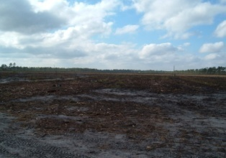
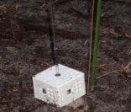



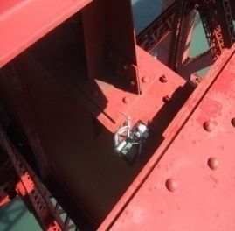

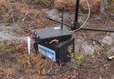


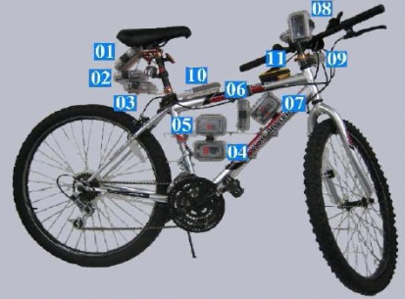
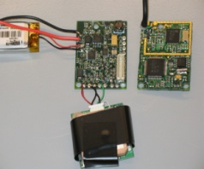

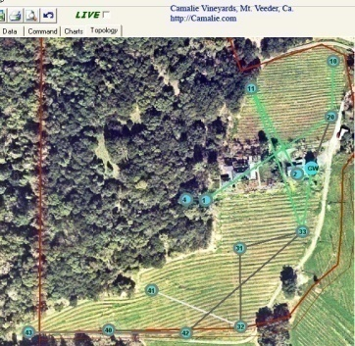

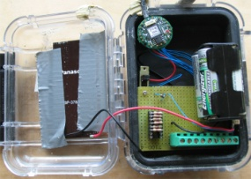




Last decade of WSN research and deployment: open-loop sensing

Slide 3
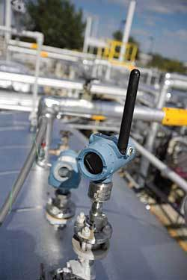

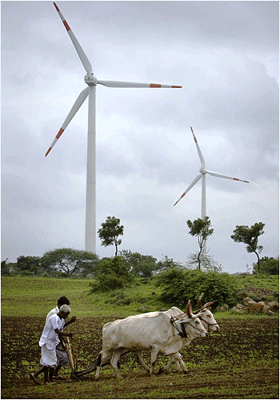


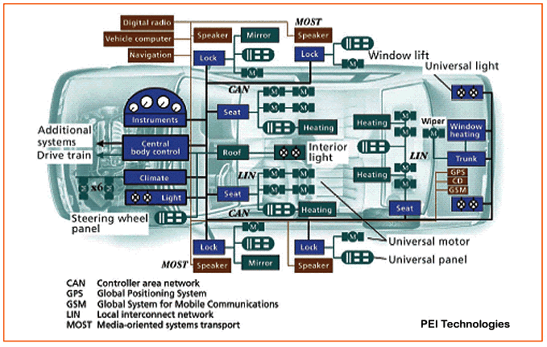
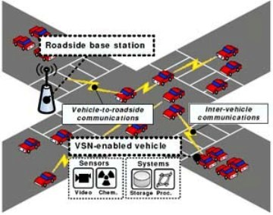
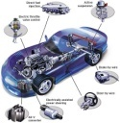
From open-loop sensing to closed-loop, real-time sensing and control
Industrial process control, alternative energy grid, automotive
  Industry standards: IEEE 802.15.4e/4g, WirelessHART, ISA SP100.11a
Wireless networks as carriers of mission-critical sensing and control information
  Stringent requirements on predictable QoS such as reliability and timeliness
Notes:
Sensing, networking, and computing tightly coupled with the physical process

Slide 4
Control-oriented real-time requirement
Link/path delays are probabilistic in nature
Probabilistic real-time requirement <D, q>
  Maximum tolerable delay D
    Delay affects stability region and settling time
  Least probability q of deadline success
    Packet loss affects system estimation and control, and late packets can be treated as being lost
Notes:
Prob. Link/path delay:
Success of a wireless packet transmission is probabilistic
For both TDMA- and CSMA-based channel access control

Slide 5
Challenges of <D, q>-oriented real-time routing
NP-hardness of quantifying probabilistic path delay
  Given delay distributions of individual links, it is NP-hard to decide whether the prob. of having a less-than-D path delay is no less than q
Instability, estimation error, and low performance of delay-based routing
  Route flapping and low throughput in Internet
  Low data delivery ratio in wireless networks
Notes:
Instability => estimation error => low performance

Slide 6
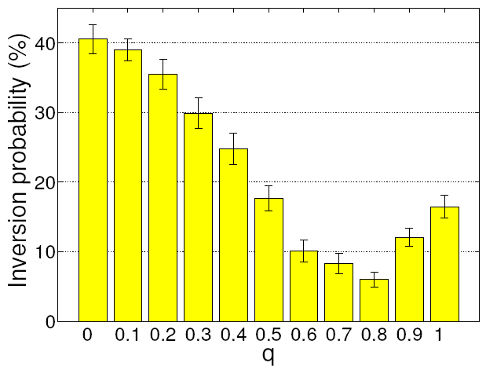
Challenges not addressed by existing studies
Mean-delay-based routing
  Goodness inversion
Maximum-delay-based routing
  False negative
Link-state-routing-based approach (Orda et al’98-02)
  High overhead, not suitable for resource-constrained, embedded system
Notes:
90 percentile: 86
Max: 728
Median: 23

Slide 7
Outline
Multi-timescale estimation of path delays
Multi-timescale adaptation for real-time routing
Measurement evaluation
Concluding remarks

Slide 8
Circumvent computational complexity (1): measurement-based estimation via delay samples?
Path delay varies too fast for sample-based estimation to converge
Notes:
Sample size for estimating 90 percentile; P^2 algorithm.
Coherence window size for node queuing levels;
Coherence window: maximal consecutive segment of a time series where all the sample values are the same

Slide 9
Circumvent computational complexity (2): path delay bound via probability inequalities?
Probability inequalities requires mean and/or standard deviation of path delay
Path delay varies too fast for accurate estimation of the mean and/or standard deviation of path delay
Notes:
Empirical CDF of the sample size required to estimate mean path delay at 90\% accuracy and 90\% confidence level;
Path queueing level correlation

Slide 10
Our approach: multi-timescale estimation (MTE)
Decompose contributors to delay uncertainties for identifying relatively stable attributes in a fast-changing system
  Dynamic per-packet transmission time
    Relatively stable mean and standard deviation over long timescales
  Dynamic queueing
    Relatively stable in very short timescales
Use probability inequality to derive probabilistic path delay bound
  Derived delay bounds are still orders of magnitude less than the maximum delays

Slide 11
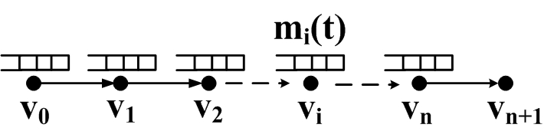
A simple scenario
node queueing level
source
destination
Instantaneous path delay at time t:
path delay
packet-time
Notes:
Assuming
FCFS service discipline => EDF later;
Node/path queueing does not change.
Assuming that the number of packets queued at node $v_i (i = 0 \ldots n))$ is $m_i(t)$ at time $t$ and that the packet transmission scheduling algorithm at each node is first-come-first-serve (FCFS), the instantaneous delay along path $P$ at time $t$, denoted by $d_P(t)$, is the delay that a packet arriving at $v_0$ at time $t$ experiences in reaching the destination node $v_{n+1}$ assuming that the number of queued packets at each node does not change while the packet is being delivered to $v_{n+1}$.

Slide 12
Observation #1: Packet-time distribution is stable
Stability of packet-time distribution enables accurate estimation of the mean and standard deviation of packet-time
Notes:
Each stationary window of a time series is a maximal consecutive segment of the time series that is weak-sense stationary (i.e., with a constant mean and variance over time).
Empirical CDF of the sample size required for estimating the mean packet-time at 90\% accuracy and 90\% confidence level

Slide 13
Accurate estimation of mean path delay
Notes:
Given the real-time requirement on data delivery and the constrained memory size in embedded WSC networks, the stationarity window size tends to be greater than the maximum node queue size in general.

Slide 14
Observation #2: packet-time is uncorrelated
Packet-time along the same link
Packet-time across different links along a path

Slide 15
Accurate estimation of standard deviation of path delay
Variance of path delay equals sum of the variance of the packet-time of all queued packets

Slide 16
Distributed computation?

Slide 17
Distributed computation
needs to be small
  Achieved by piggybacking control information to data transmissions
  Limited path hop-length in wireless sensing and control networks
Network queueing change needs to be small at the timescale of information diffusion delay

Slide 18
Observations #3: network queueing is relatively stable at short timescales
With more than 90% probability, absolute changes in link queueing levels are no more than 1
Notes:
Enables distributed computation of the mean and standard deviation of path delay

Slide 19
Probabilistic path delay bound
Upper bound ofq-quantile of a random variable X:
Using Markov Inequality,
Using one-tailed Chebyshev Inequality,

Slide 20
Bounds on 90-percentile path delay
Bounds by Chebyshev Inequality are greater than the actual 90-percentile delay and orders of magnitude less than the maximum delay
Bounds by Chebyshev Inequality are less than that by Markov Inequality and OPMD
Bounds by assuming normally distributed delays may underestimate
Notes:
Typical path

Slide 21
From FCFS to EDF
Earliest-deadline-first (EDF) is a commonly used algorithm in real-time scheduling
Conclusions based on FCFS service discipline apply to EDF
  FCFS-based estimation is a conservative estimate of the delay bound if EDF is used
Notes:
Conjecture: applies to general priority-based service disciplines
Earliest deadline first (EDF) or least time to go is a dynamic scheduling algorithm used in real-time operating systems. It places processes in a priority queue. Whenever a scheduling event occurs (task finishes, new task released, etc.) the queue will be searched for the process closest to its deadline. This process is the next to be scheduled for execution.
EDF is an optimal scheduling algorithm on preemptive uniprocessors, in the following sense: if a collection of independent jobs, each characterized by an arrival time, an execution requirement, and a deadline, can be scheduled (by any algorithm) such that all the jobs complete by their deadlines, the EDF will schedule this collection of jobs such that they all complete by their deadlines.
With scheduling periodic processes that have deadlines equal to their periods, EDF has a utilization bound of 100%. Thus, the schedulability test for EDF is:
where the are the worst-case computation-times of the processes and the are their respective inter-arrival periods (assumed to be equal to the relative deadlines).
That is, EDF can guarantee that all deadlines are met provided that the total CPU utilization is not more than 100%. So, compared to fixed priority scheduling techniques like rate-monotonic scheduling, EDF can guarantee all the deadlines in the system at higher loading.
However, when the system is overloaded, the set of processes that will miss deadlines is largely unpredictable (it will be a function of the exact deadlines and time at which the overload occurs.) This is a considerable disadvantage to a real time systems designer. The algorithm is also difficult to implement in hardware and there is a tricky issue of representing deadlines in different ranges (deadlines must be rounded to finite amounts, typically a few bytes at most). If one uses modular arithmetic to calculate future deadlines relative to now, the field storing a future relative deadline must accommodate at least the value of the (("duration" {of the longest expected time to completion} * 2) + "now"). Therefore EDF is not commonly found in industrial real-time computer systems.
Instead, most real-time computer systems use fixed priority scheduling (usually rate-monotonic scheduling). With fixed priorities, it is easy to predict that overload conditions will cause the low-priority processes to miss deadlines, while the highest-priority process will still meet its deadline.
There is a significant body of research dealing with EDF scheduling in real-time computing; it is possible to calculate worst case response times of processes in EDF, to deal with other types of processes than periodic processes and to use servers to regulate overloads.

Slide 22
Outline
Multi-timescale estimation of path delays
Multi-timescale adaptation for real-time routing
  Control timescales of spatial dynamics
Measurement evaluation
Concluding remarks

Slide 23
Multi-Timescale Adaptation (MTA)
  Timescales of system dynamics and uncertainties
  Slowly-changing environment conditions such as path loss
  Fast-changing network delay
  For long-term optimality and stability: a DAG is maintained, at lower frequencies, for data forwarding based on link/path ETX
  ETX reflects achievable throughput, reliability, and timeliness
  ETX-based routing structure tends to be stable even if ETX is dynamic
  For adaptation to fast-changing network queueing and delay: spatiotemporal data flow within the DAG is controlled, at higher frequencies, based on MTE-enabled delay estimation
  Water-filing effect: use minimal-ETX paths as much as possible

Slide 24
Challenges of implementing MTA/MTE in TinyOS
Limited memory space to record information about all paths
  Path aggregation
Computation overhead and task management
  Subtasking
  Prioritized task scheduling
Global vs. local time synchronization
  Localized estimation of time passage

Slide 25
Outline
Multi-timescale estimation of path delays
Multi-timescale adaptation for real-time routing
Measurement evaluation
Concluding remarks

Slide 26
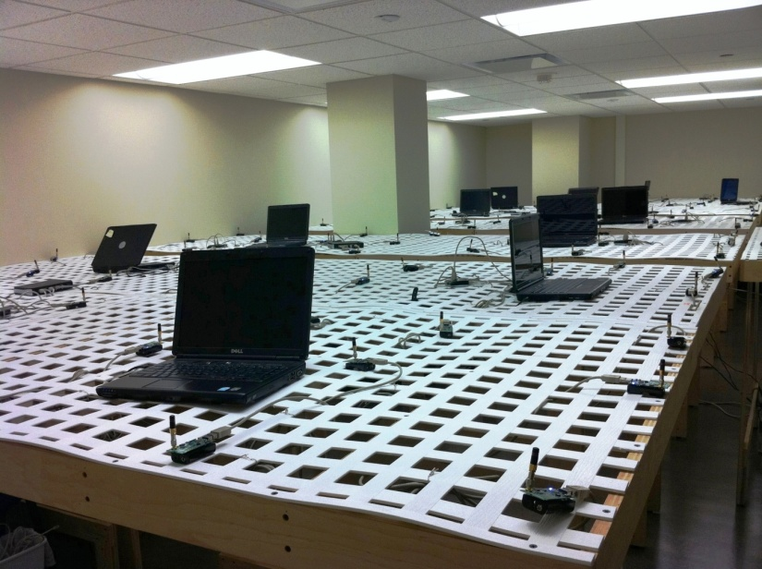
WSN testbeds NetEye and Indriya
NetEye @ Wayne State Univ.
130+ TelosB motes in a large lab
Indriya @ National Univ. of Singapore
  127 TelosB motes at three floors

Slide 27
Measurement scenarios
One sink and 10 source nodes farthest away from the sink
Medium-load, periodic data traffic
  Mean packet interval: 400ms and 600ms in NetEye and Indriya respectively
  Maximum allowable delay: 2 seconds
  Required delay guarantee probability: 90%
Other scenarios available in technical report
  Light-/heavy-load, periodic data traffic
  Event traffic
Notes:
Light and heavy traffic scenarios: no and high queueing respectively
Routing hop counts up to 10; doubles in Indriya

Slide 28
Design decisions of MTA/MTE
On MTE
  M-DS: directly estimate path delay quantiles using non-parametric method P²
  M-DB: directly estimate the mean and variance of path delay
  M-ST: estimate the mean and variance of path delay as the sum of the mean and variance of the sojourn time at each node along the path
On MTA
  M-MD: maintain the data forwarding DAG based on mean link/path delay
  M-mDQ: forwards packets to the next-hop candidate with the minimum path delay quantile
  mDQ: same as M-mDQ but do not use the data forwarding DAG
M-FCFS: use FCFS instead of EDF for intra-node transmission scheduling

Slide 29
Measurements in NetEye
M-DS, M-DB, M-ST all underestimates delay quantiles
  High probability of deadline miss (e.g., rejection and expiration)
More route changes in M-MD, M-mDQ and mDQ than in MTA, thus more estimation error of delay quantiles and lower performance
  Still better performance than non-MTE-based protocols, implying the importance of MTE
Notes:
Underestimation of quantile
M-DS, M-DB: less variability due to “a sample of link delay may be used multiple times in distributed sampling of path delay”;
M-ST: sojourn times at different hops are positively correlated, leading to underestimation of path delay variation

Slide 30
Comparison with existing protocols
MCMP
  Uniformly partition end-to-end QoS requirements on reliability and timeliness per-hop requirements which are then enforced through multi-path forwarding
MM (i.e., MMSPEED)
  Route and schedule packet transmissions to enable required data delivery speed in 2D plane
  Use multi-path forwarding to improve reliability
MM-CD
  same as MM but use conservative estimate of delay (i.e., mean plus three times standard deviation)
SDRCS
  Similar to MM, but use RSSI-based hop-count instead of geometric distance, and use opportunistic instead of multi-path forwarding
CTP
  ETX-based single-path routing
Notes:
MCMP: a multi-path QoS routing protocol where end-to-end QoS requirements on reliability and timeliness are uniformly divided into per-hop reliability and timeliness requirements, upon which a node chooses the minimum number of next-hops to satisfy the per-hop requirements in data delivery \cite{Fang:multiConstraintQoSMultipath};

Slide 31
Measurements in NetEye
Assumption of uniform network conditions in MCMP, MM, MM-CP, and SDRCS lead to deadline miss
Significant queue overflow in MCMP, MM, MM-CD due to multipath forwarding;
Less queue overflow in SDRCS due to non-multipath, opportunistic forwarding
CTP is not delay adaptive, thus leading to deadline miss
Notes:
Use of mean delay in MM, MM-CD, SDRCS lead to bad performance too;
Deadline miss: rejection in network and expiration at sink
Hops: MTA (3 - 4) SPEED (3 - 6) MMSPEED (3 - 5)
Causes of deadline miss:
Longer route: MTA can find stable shortest paths, SPEED has to switch among multiple paths including suboptimal ones, MMSPEED can also use suboptimal paths other than optimal ETX path
Mean delay: inversion
SPEED-based metrics are inherently localized: a “fast” neighbor may lead to slow 2-hop or farther away neighbors, while MTA global (e2e delay)
…

Slide 32
Measurements in Indriya
Performance of MM, MM-CD, and SDRCS become worse in the presence of higher degree of non-uniformity in Indriya

Slide 33
Outline
Multi-timescale estimation of path delays
Multi-timescale adaptation for real-time routing
Measurement evaluation
Concluding remarks

Slide 34
Concluding remarks
Leveraging multiple timescales in adaptation and control
  Multi-Timescale Estimation (MTE) for accurate, agile estimation of fast-changing path delay distributions
  Multi-Timescale Adaptation (MTA) for ensuring long-term optimality and stability while adapting to fast-changing network queueing and delay
Future directions
  Temporal data flow control such as coordinated multi-hop scheduling;
  Joint optimization of spatial and temporal data flow control
  Leverage different timescales of dynamics for protocol design in general, e.g., interference control
  Systems platforms for real-time networking
Notes:
Real-time networking requires us to rethink the whole stack
Low cost platforms for development and measurement study

Slide 35
Backup Slides

Slide 36
Challenges of multi-hop, real-time messaging
The basic problem of computing probabilistic path delays is NP-hard
  Our solution: multi-timescale estimation & probabilistic delay bound
Delay-based routing tends to introduce instability, estimation error, and low data delivery performance
  Our solution: multi-timescale estimation & adaptation
  Multi-timescale estimation (MTE)
    Accurate estimation of mean and variance of per-hop transmission delay (longer timescale)
    Accurate, agile estimation of queueing (shorter timescale)
  Multi-timescale adaptation (MTA)
    ETX-based DAG control (longer timescale)
    Spatiotemporal data flow control within DAG (shorter timescale)
Notes:
Open questions: real-time capacity estimation, multi-hop coordinated real-time scheduling, joint real-time routing and scheduling

Slide 37
Challenges of <D, p>-oriented real-time routing
NP-hardness of real-time satisfiability testing
  Given delay distributions of individual links, it is NP-hard to decide whether the prob. of having a less-than-D path delay is no less than p
Instability, estimation error, & low performance of delay-based routing
H. Zhang, L. Sang, A. Arora, “Comparison of Data-Driven Link Estimation Methods in Low-Power Wireless Networks”, IEEE Transactions on Mobile Computing, Nov. 2010
Notes:
Instability => estimation error => low performance

Slide 38
Why not existing approaches?
Mean-delay-based routing
  Goodness inversion
Maximum-delay-based routing
  False negative
Link-state-routing-based approach (Orda et al’98-02)
  High overhead, not suitable for resource-constrained, embedded system
Notes:
90 percentile: 86
Max: 728
Median: 23

Slide 39
Key findings of our work
Different timescales of dynamics are key for simple, effective estimation and control
Delay estimation
  Leverage different timescales of dynamics to accurately estimate probabilistic path delay bounds in an agile manner
Spatiotemporal data flow control
  Adapt spatiotemporal data flow control at the same timescales of the dynamics themselves

Slide 40
Observation #1: Packet-time distribution is stable
Stability of packet-time distribution enables accurate estimation of the mean and standard deviation of packet-time
Notes:
Each stationary window of a time series is a maximal consecutive segment of the time series that is weak-sense stationary (i.e., with a constant mean and variance over time).
Empirical CDF of the sample size required for estimating the mean packet-time at 90\% accuracy and 90\% confidence level

Slide 41
Circumvent computational complexity (2): path delay bound via probability inequalities?
Probability inequalities requires mean and/or standard deviation of path delay
Path delay varies too fast for accurate estimation of the mean and/or standard deviation of path delay
Notes:
Empirical CDF of the sample size required to estimate mean path delay at 90\% accuracy and 90\% confidence level

Slide 42
A node with multiple next-hop forwarders

Slide 43
Relative errors in estimating the standard deviation of path delay

Slide 44
NetEye (contd.)
Non-uniform network setting

Slide 45
Relative error in estimating 90 percentile of path delay
Notes:
empirical cumulative distribution function (CDF) of the relative error in estimating the 90 percentile of path delay using MTA, M-DS, M-DB, and M-ST respectively, where the relative error is defined as the estimated percentile minus the actual percentile and then divided by the actual percentile. We see that M-DS, M-DB, and M-ST underestimate the 90 percentile for 100\%, 60\%, and 20\% of the time respectively.

Slide 46
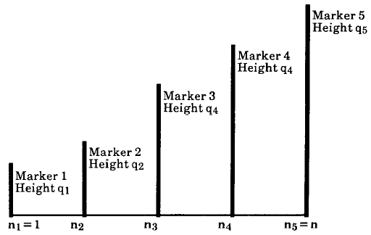
Low-cost, online quantile estimation
P² algorithm (Jain & Chlamtac’85)
Extended P² algorithm (Raatikainen’87)
  Simultaneous estimation of multiple quantiles at the same time ⇒
  more makers, thus higher accuracy
max
(0.5+p/2) -quantile
p-quantile
p/2-quantile
min
Notes:
Piecewise-parabolic (p^2) prediction

Slide 47
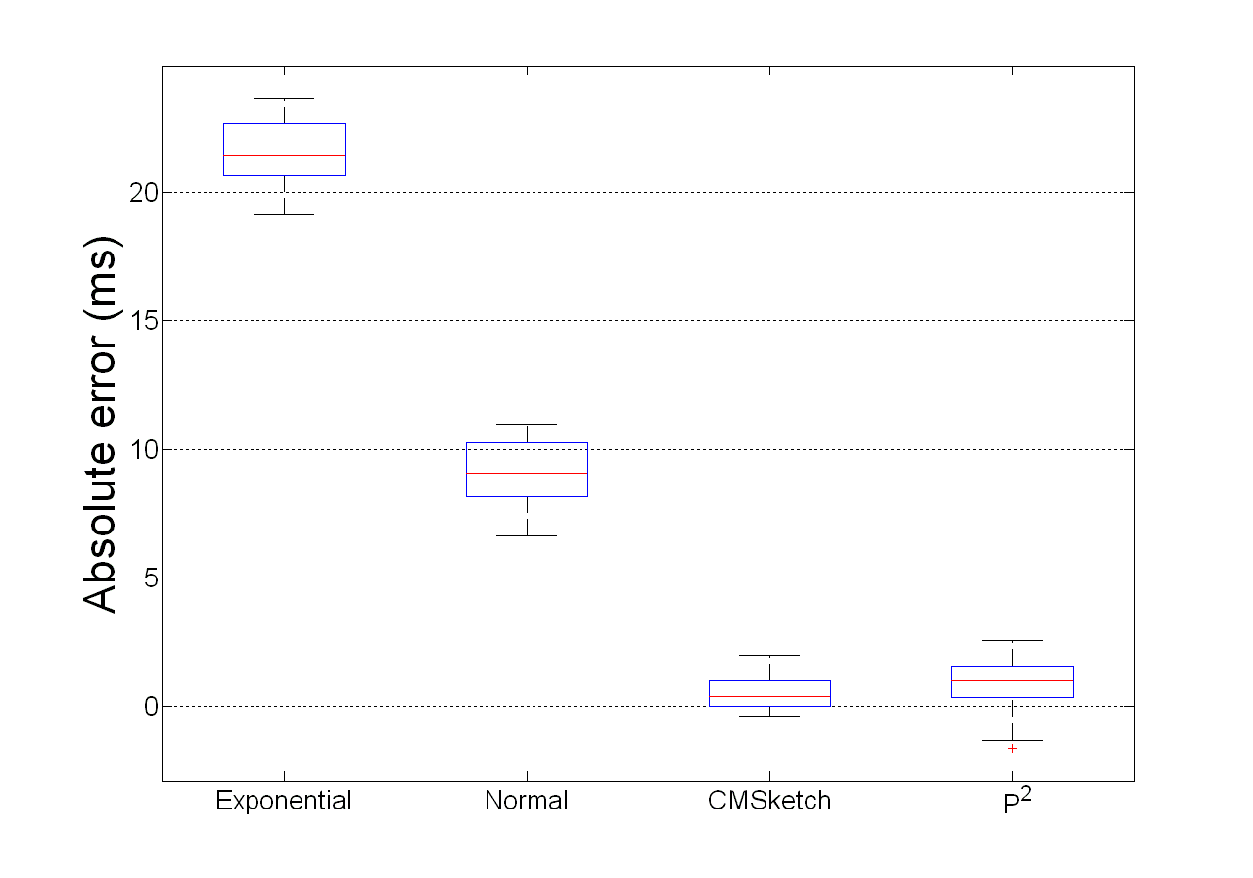
Accuracy of extended P² algorithm (0.9-quantile)
Notes:
Estimated – actual 90 percentile

