Slide 1

Understanding Networks
through
Physical Metaphors
Daniel A. Spielman

Slide 2
Graphs and Networks
Analysis by Physical Metaphors
Algorithms (what I usually do)

Slide 3
A Social Network Graph

Slide 4
A Social Network Graph
“vertex”
or “node”
“edge” =
pair of nodes

Slide 5
A Social Network Graph
“vertex”
or “node”
“edge” =
pair of nodes

Slide 6
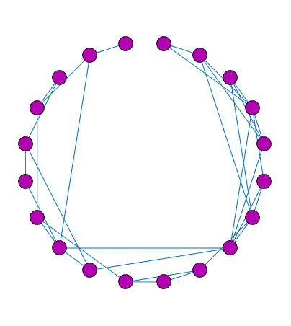
A Social Network Graph

Slide 7
A Social Network Graph

Slide 8
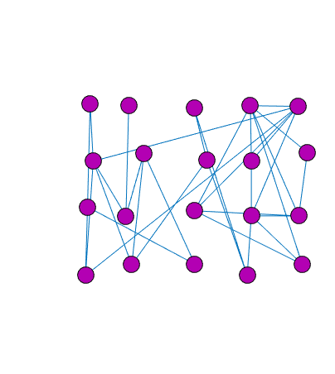
A Social Network Graph

Slide 9
A Social Network Graph

Slide 10
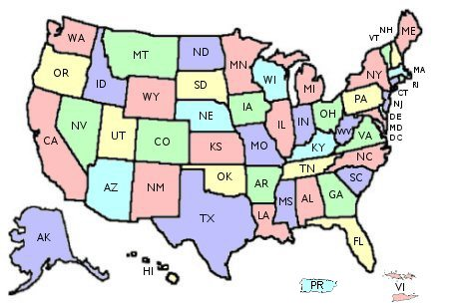
from: http://nrc.uchsc.edu/STATES/united-states-map.jpg

Slide 11
Vertices = States. Edges connect adjoining states.

Slide 12
Vertices = States. Edges connect adjoining states.

Slide 13
Planar = can draw without crossing edges

Slide 14
Planar implies can draw with 4 colors

Slide 15
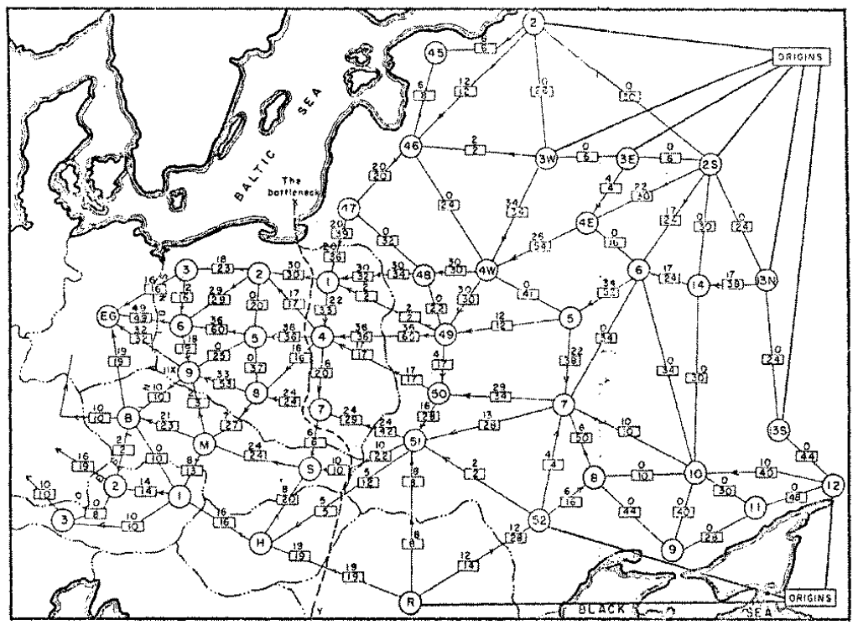
A Transportation Network
Harris and Ross, RAND Corporation, 1955
Notes:
soviet railway network

Slide 16
A Mathematician’s Network
Vertices = Natural numbers
Edges between pairs where one divides another
1
2
3
5
7
11
4
6
9
8
12
10

Slide 17
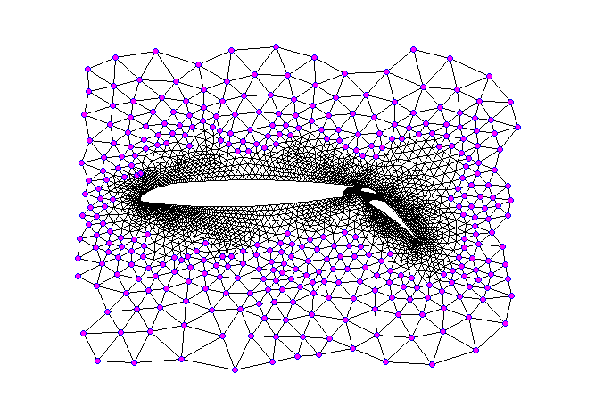
The Graph of a Mesh

Slide 18
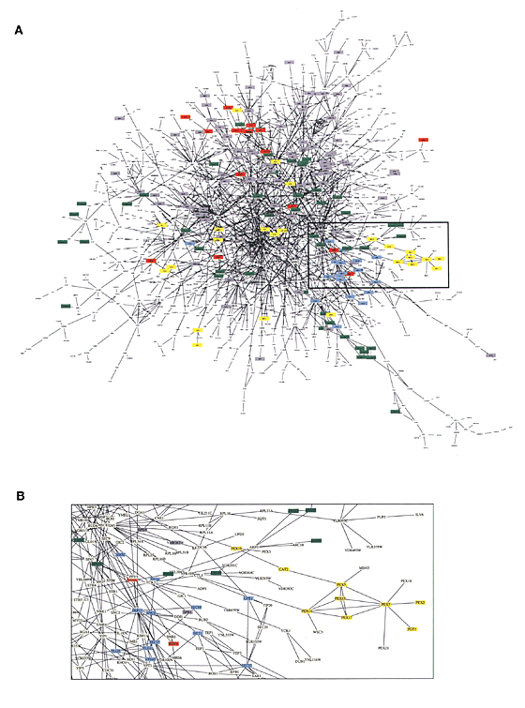
Protein-protein Interaction Networks
vertex = protein
edge if “interact”
Schwikowski, Uetz & Fields, Nature Biotechnology 2000
Notes:
socnetbad10

Slide 19
Protein-protein Interaction Networks
vertex = protein
edge experimentally observed interaction
Schwikowski, Uetz & Fields, Nature Biotechnology 2000
Notes:
socnetbad10

Slide 20
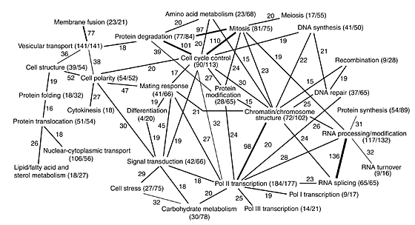
Protein-protein Interaction Networks
vertex = group of proteins
edges between groups with interacting proteins
Schwikowski, Uetz & Fields, Nature Biotechnology 2000
Notes:
1500 proteins in yeast

Slide 21
Other Networks
Web
Vertices = Web pages. Edges = links.
Trade networks
Vertices = Companies. Edges when trade.
Gene regulatory networks
Vertices = Genes.
Edge when one regulates another.
Etc.
Notes:
socnetbad10

Slide 22
Local Analysis of Networks
Examine degrees (number of attached edges)
of nodes.
Count triangles based at nodes
Notes:
socnetbad10

Slide 23
Local Analysis of Networks
Examine degrees (number of attached edges)
of nodes.
Count triangles based at nodes
Small configurations
Notes:
socnetbad10

Slide 24
Global Analysis of Networks
Diameter: how many steps between nodes
Drawing: understand overall structure
Clusters: how to group the nodes
Inference: extrapolate from a few nodes
Importance: find most important nodes
Notes:
socnetbad10

Slide 25
Graphs as Spring Networks
View edges as rubber bands or ideal linear springs
Nail down some vertices, let rest settle

Slide 26
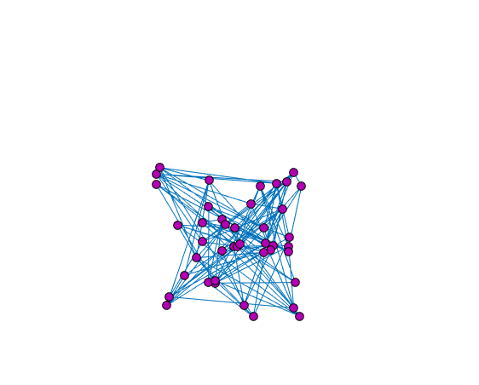
Drawing by Spring Networks
Notes:
socnetbad10

Slide 27
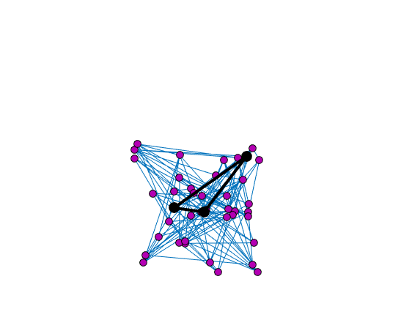
Drawing by Spring Networks
Notes:
socnetbad10

Slide 28
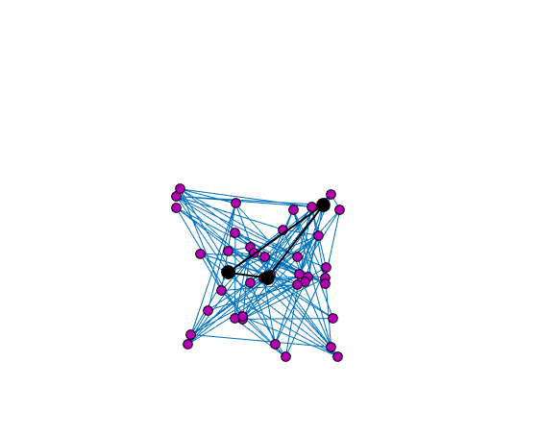
Drawing by Spring Networks
Notes:
socnetbad10

Slide 29
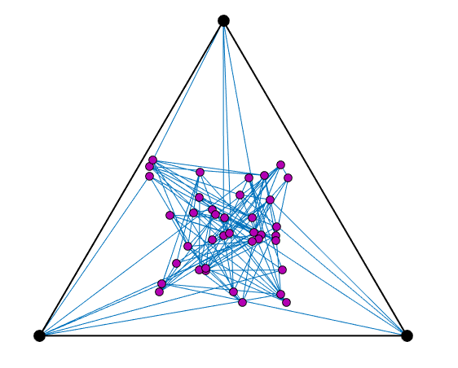
Drawing by Spring Networks
Notes:
socnetbad10

Slide 30
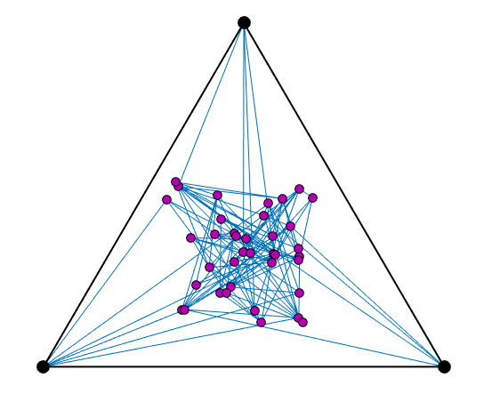
Drawing by Spring Networks
Notes:
socnetbad10

Slide 31
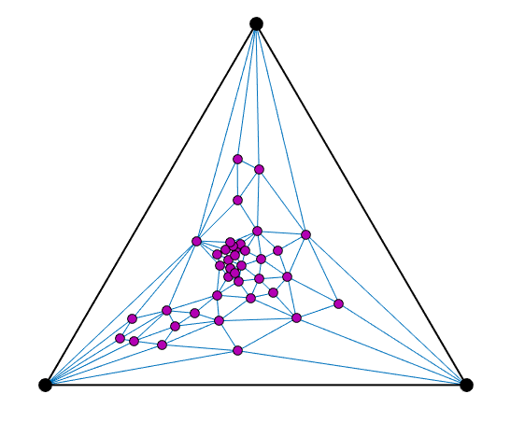
Drawing by Spring Networks
If the graph is planar,
then the spring drawing
has no crossing edges!
Notes:
socnetbad10

Slide 32
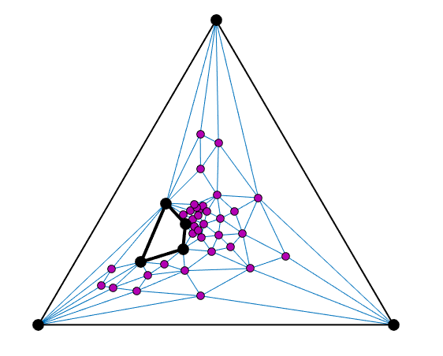
Drawing by Spring Networks
Notes:
socnetbad10

Slide 33
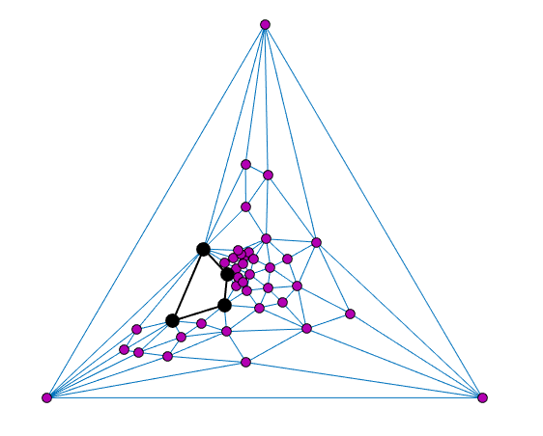
Drawing by Spring Networks
Notes:
socnetbad10

Slide 34
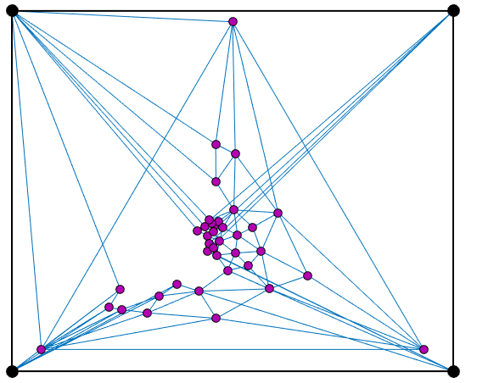
Drawing by Spring Networks
Notes:
socnetbad10

Slide 35
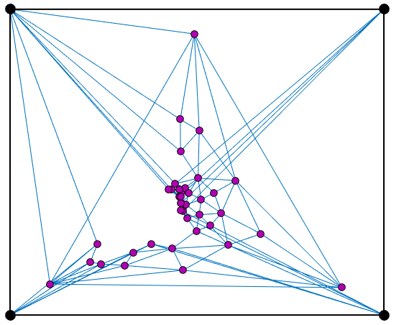
Drawing by Spring Networks
Notes:
socnetbad10

Slide 36
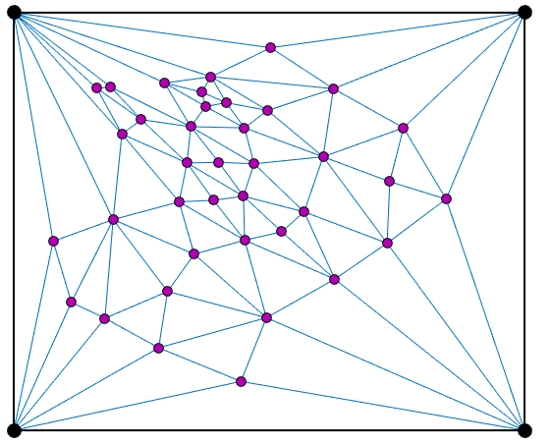
Drawing by Spring Networks
Notes:
socnetbad10

Slide 37
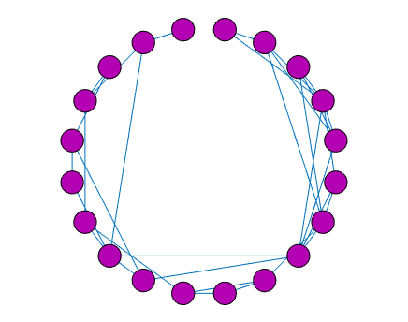
Inference by Spring Networks
Assuming friends are similar, infer from limited data.
Notes:
socnetbad10

Slide 38
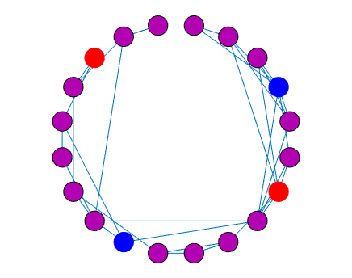
Inference by Spring Networks
Will you donate to X?
“no”
“yes”
“no”
“yes”
Notes:
socnetbad10

Slide 39
Inference by Spring Networks
Will you donate to X?
Notes:
socnetbad10

Slide 40
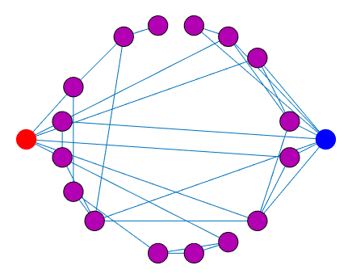
Inference by Spring Networks
Will you donate to X?
“no”
“yes”
Notes:
socnetbad10

Slide 41
Inference by Spring Networks
Will you donate to X?
“no”
“yes”
Notes:
socnetbad10

Slide 42
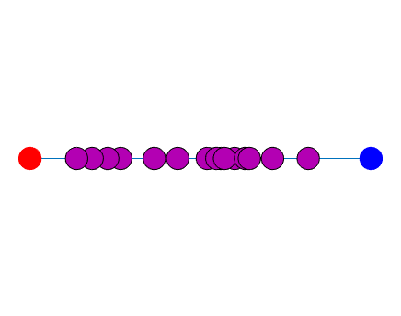
Inference by Spring Networks
Will you donate to X?
“no”
“yes”
0
Estimate of Probability of “yes”
1
Notes:
socnetbad10

Slide 43
Inference by Spring Networks
Will you donate to X?
0
Estimate of Probability of “yes”
1
Notes:
socnetbad10

Slide 44
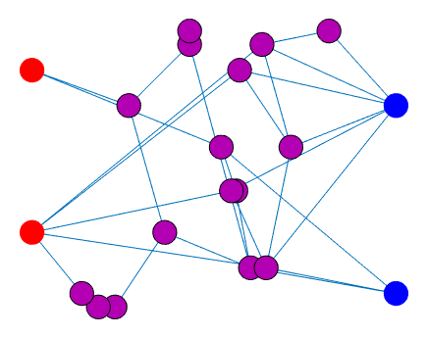
Inference by Spring Networks
Will you donate to X?
0
Estimate of Probability of “yes”
1
Notes:
socnetbad10

Slide 45
Some Networks
can not
be nicely drawn.
Notes:
socnetbad10

Slide 46
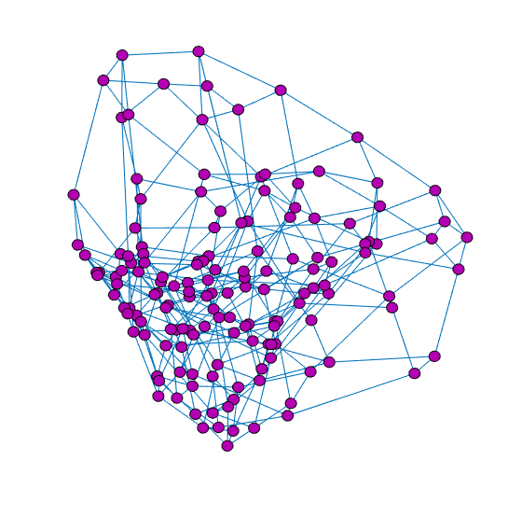
A “bad” drawing: mostly edges,
many edge crossings
edges are long
Notes:
socnetbad10

Slide 47
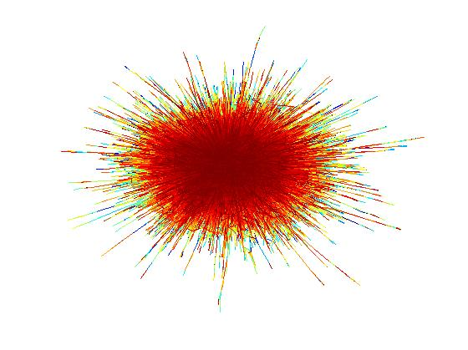
A “bad” drawing: mostly edges,
many edge crossings
edges are long
Notes:
socnetbad10

Slide 48
Some Networks
can not
be nicely drawn.
So,
we group their
nodes into clusters.
Notes:
socnetbad10

Slide 49
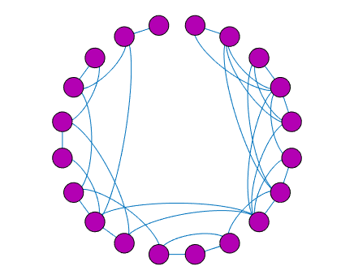
Diffusion in Graphs

Slide 50
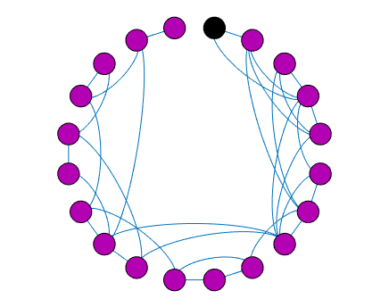
Diffusion in Graphs
Put stuff at a node.
Let stuff flow along
edges to other nodes

Slide 51
Diffusion in Graphs
Put stuff at a node.
Let stuff flow along
edges to other nodes

Slide 52
Diffusion in Graphs
Put stuff at a node.
Let stuff flow along
edges to other nodes

Slide 53
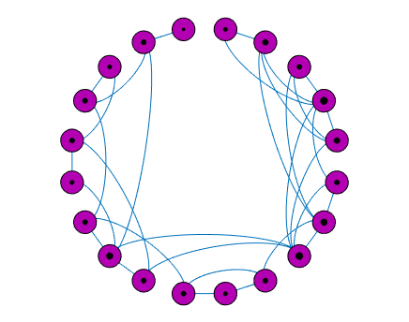
Diffusion in Graphs
Eventually…
amount of stuff
at nodes
is proportional to
their number
of edges

Slide 54
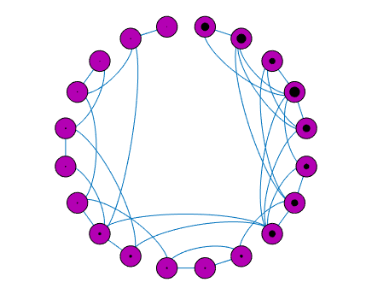
Clustering by Diffusion in Graphs
Earlier in the process
the nodes with
the most stuff
are clusters.

Slide 55
Clustering by Diffusion in Graphs
Earlier in the process
the nodes with
the most stuff
are clusters.
If there are clusters,
this finds them!

Slide 56
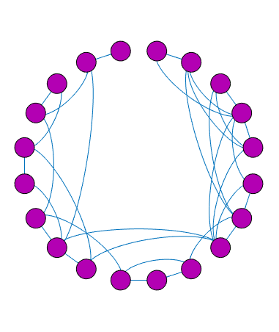
Importance: Personal PageRank
Spill paint at a node.
Paint both spreads
and dries.

Slide 57
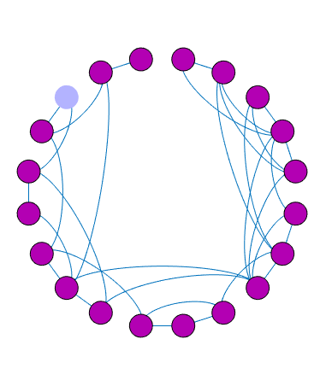
Importance: Personal PageRank
Spill paint at a node.
Paint both spreads
and dries.

Slide 58
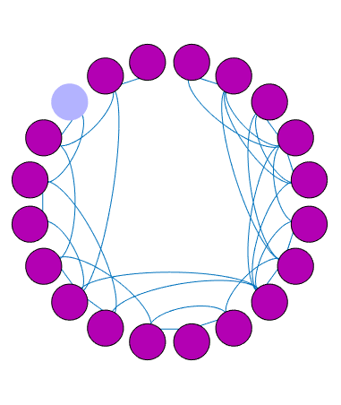
Importance: Personal PageRank
Spill paint at a node.
Paint both spreads
and dries.

Slide 59
Importance: Personal PageRank
Spill paint at a node.
Paint both spreads
and dries.
Amount of dried paint,
measures importance
relative to initial node

Slide 60
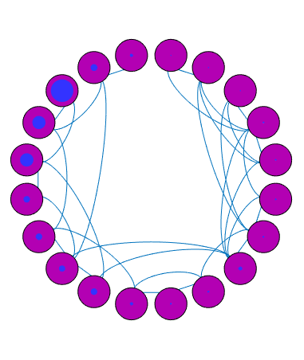
Importance: Personal PageRank
Spill paint at a node.
Paint both spreads
and dries.
Amount of dried paint,
measures importance
relative to initial node

Slide 61
Importance: Personal PageRank
Spill paint at a node.
Paint both spreads
and dries.
Amount of dried paint,
measures importance
relative to initial node
Most important nodes
give clusters, if they exist.

Slide 62
PageRank, used by Google to rank web
Similar idea.
But,
paint only flows in the
directions of links.

Slide 63
Vibrations / Eigenvectors
The springs never stop vibrating
The “stuff” never stops moving
The motions are small

Slide 64


Slide 66
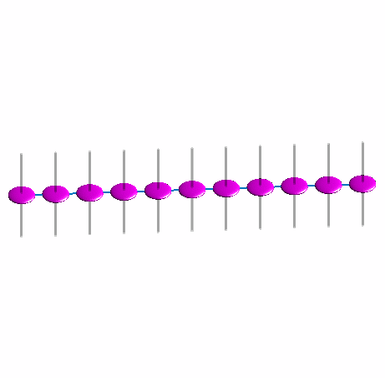

Slide 67
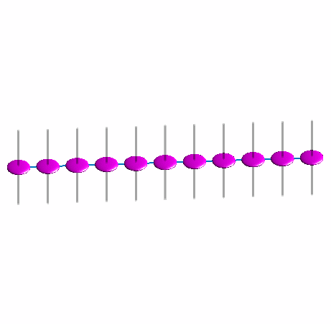

Slide 68
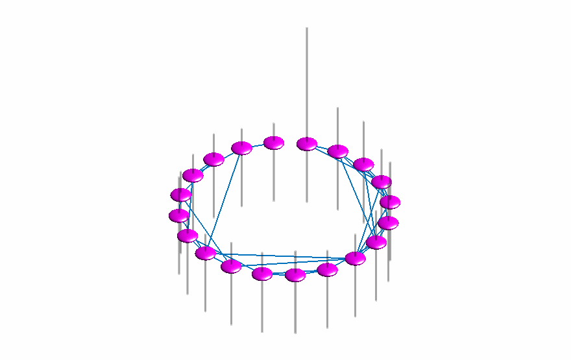

Slide 70
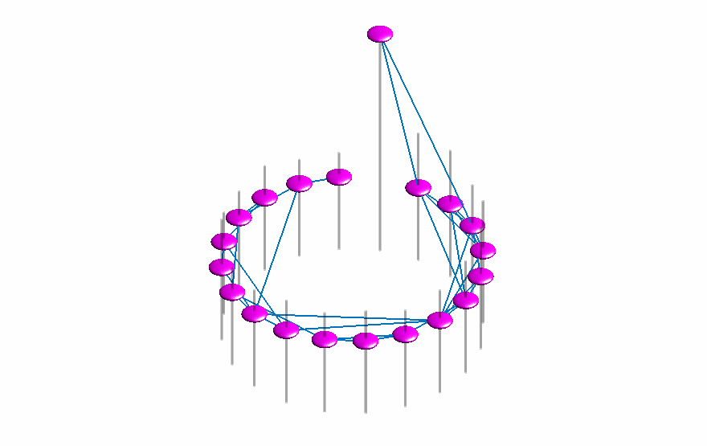

Slide 72
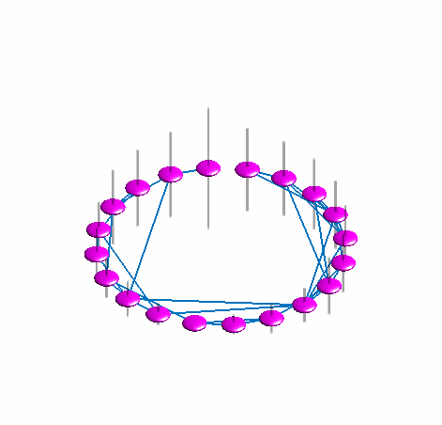
The fundamental mode

Slide 73
The fundamental mode
I used this to choose the order and draw the network

Slide 74
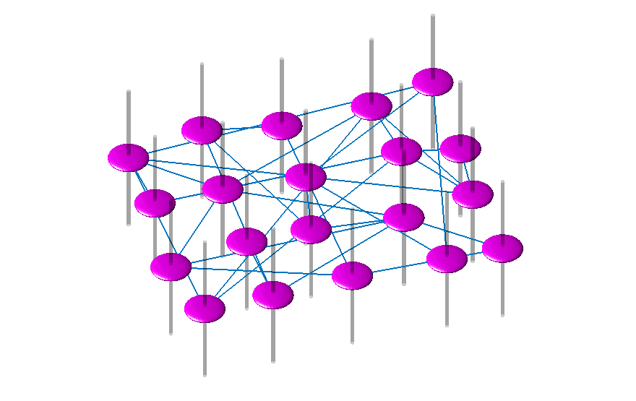
The fundamental mode

Slide 75
The fundamental mode
I used this to choose the order and draw the network

Slide 76
Nice drawings
require
low frequency vibrations.
If there are none,
then there are no nice pictures.
Notes:
socnetbad10

Slide 77
Algorithmic Problems: how to quickly compute
The stable configuration of springs =
solve linear equations
The vibrations / fundamental modes =
compute eigenvectors
State of diffusion after a long time,
without just simulating and waiting

Slide 78
The difficult cases: Chimeric graphs
1
2
3
5
7
11
4
6
9
8
12
10

Slide 79
The difficult cases: Chimeric graphs
1
2
3
5
7
11
4
6
9
8
12
10

Slide 80
Finding the Stable Configuration
is a problem of solving linear equations
Can solve exactly by Gaussian Elimination

Slide 81
Finding the Stable Configuration
is a problem of solving linear equations
Can solve exactly by Gaussian Elimination
Can solve approximately by simulating physics

Slide 82
Finding the Stable Configuration
is a problem of solving linear equations
Can solve exactly by Gaussian Elimination
Can solve approximately by simulating physics
Or, by much fancier algorithms (preconditioning)

Slide 83
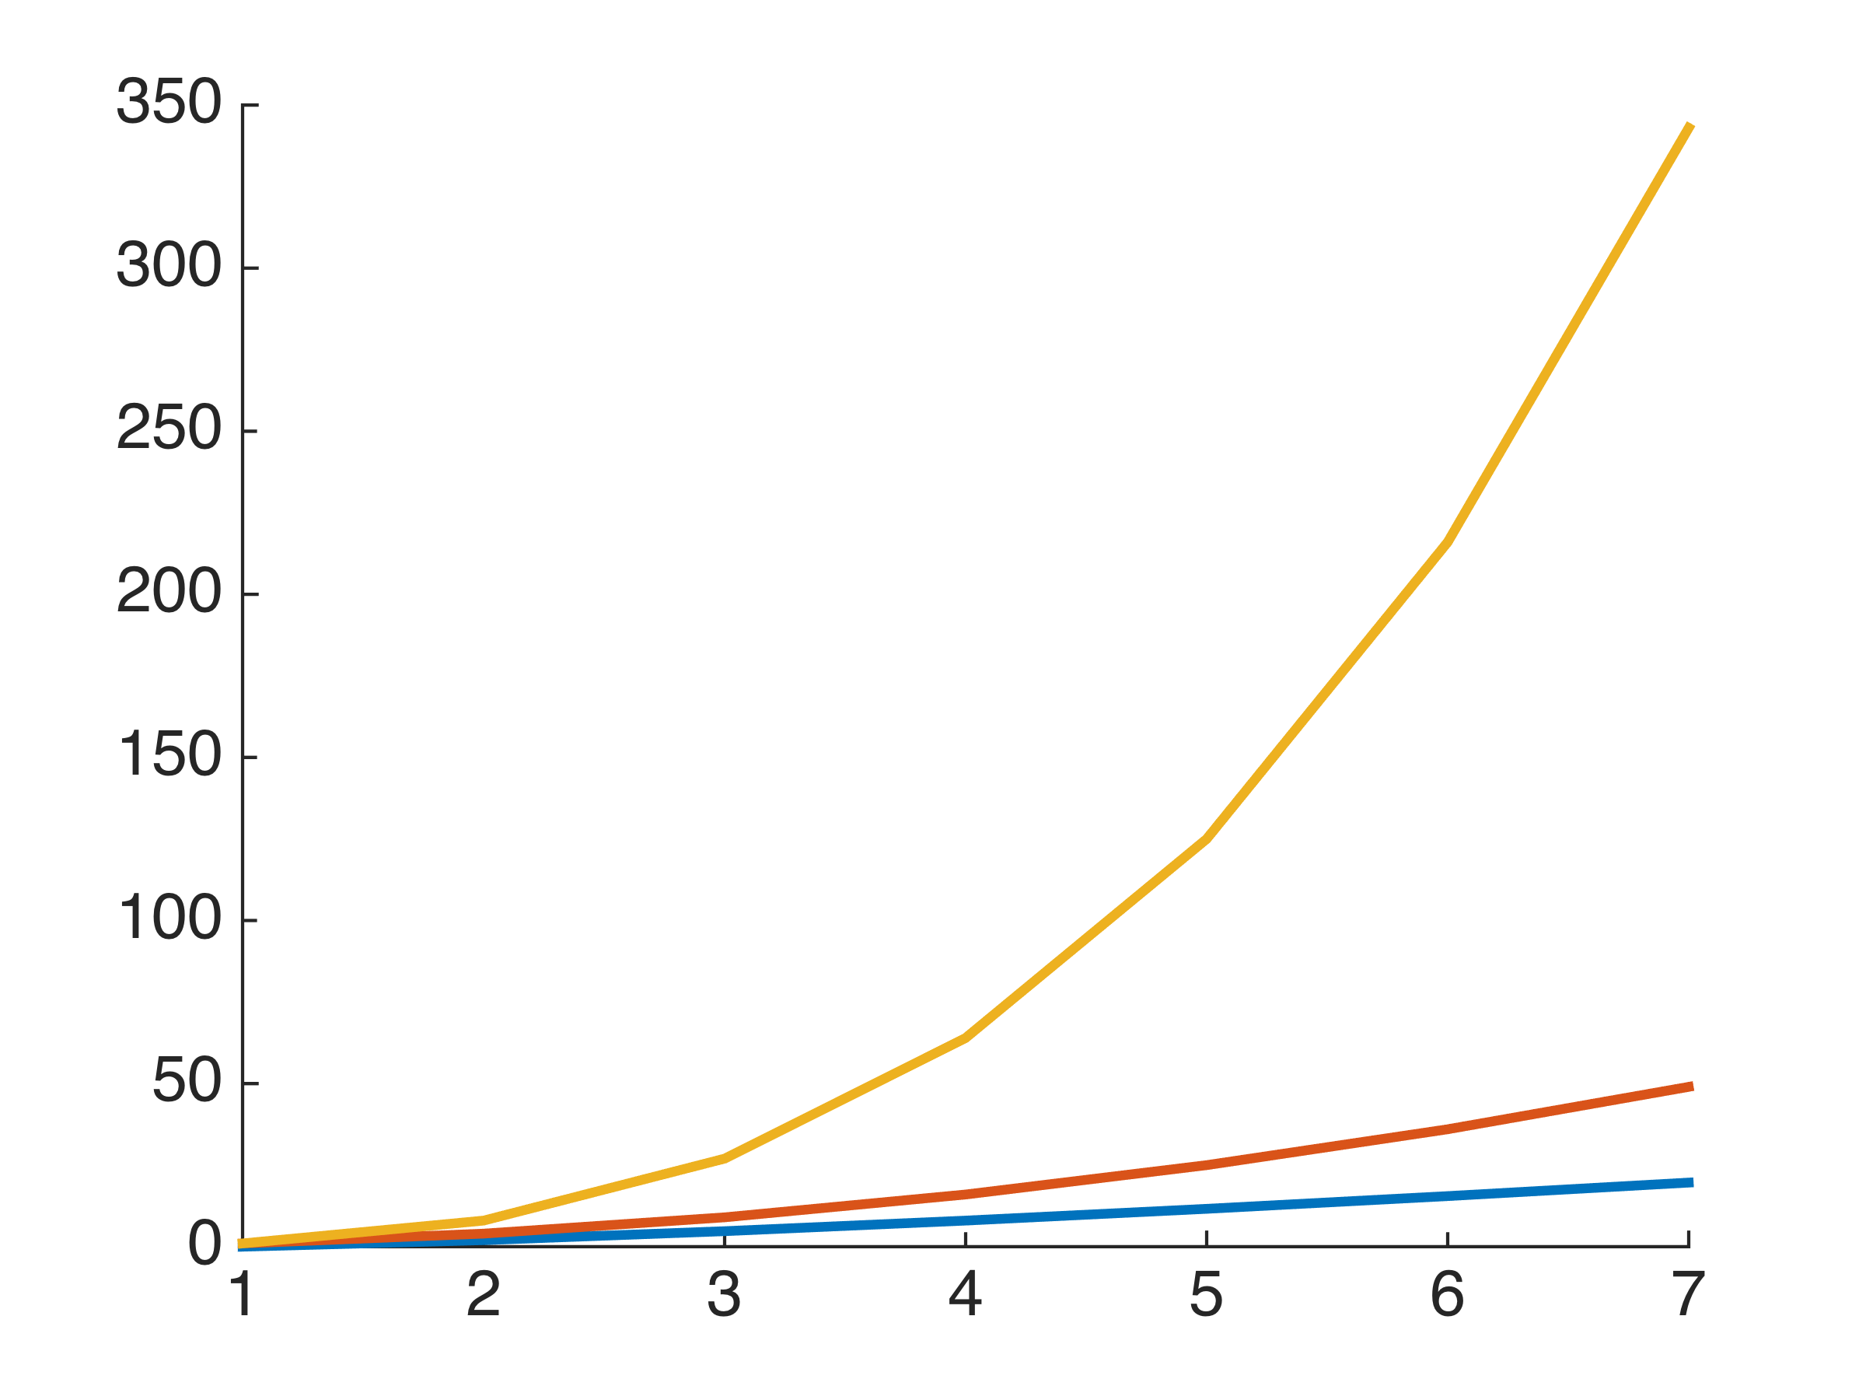
Running Times of Algorithms
Measure by n, the number of variables
n³ : elimination
number of steps
n² : simulation
n log n: preconditioning
n = number of variables

Slide 84
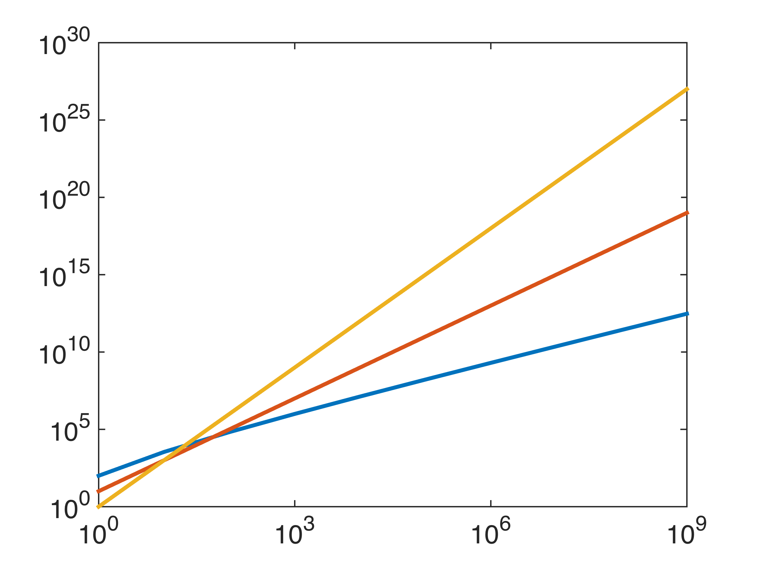
Running Times of Algorithms
Measure by n, the number of variables
n³ : elimination
n² : simulation
number of steps
n log n: preconditioning
n = number of variables

Slide 85
Running Times of Algorithms
Measure by n, the number of variables
n³ : elimination
n² : simulation
number of steps
n log n: preconditioning
one laptop second
n = number of variables

Slide 86
Running Times of Algorithms
Measure by n, the number of variables
n³ : elimination
n² : simulation
number of steps
one supercomputer second
n log n: preconditioning
one laptop second
n = number of variables

Slide 87
Running Times of Algorithms
Measure by n, the number of variables
n³ : elimination
one year on all the supercomputers
n² : simulation
number of steps
one supercomputer second
n log n: preconditioning
one laptop second
n = number of variables

Slide 88
To learn more (and all the caveats)
See
my web page on Laplacians, Clustering, etc.
or
lecture notes from “Spectral Graph Theory”
and “Graphs and Networks”

