Slide 1
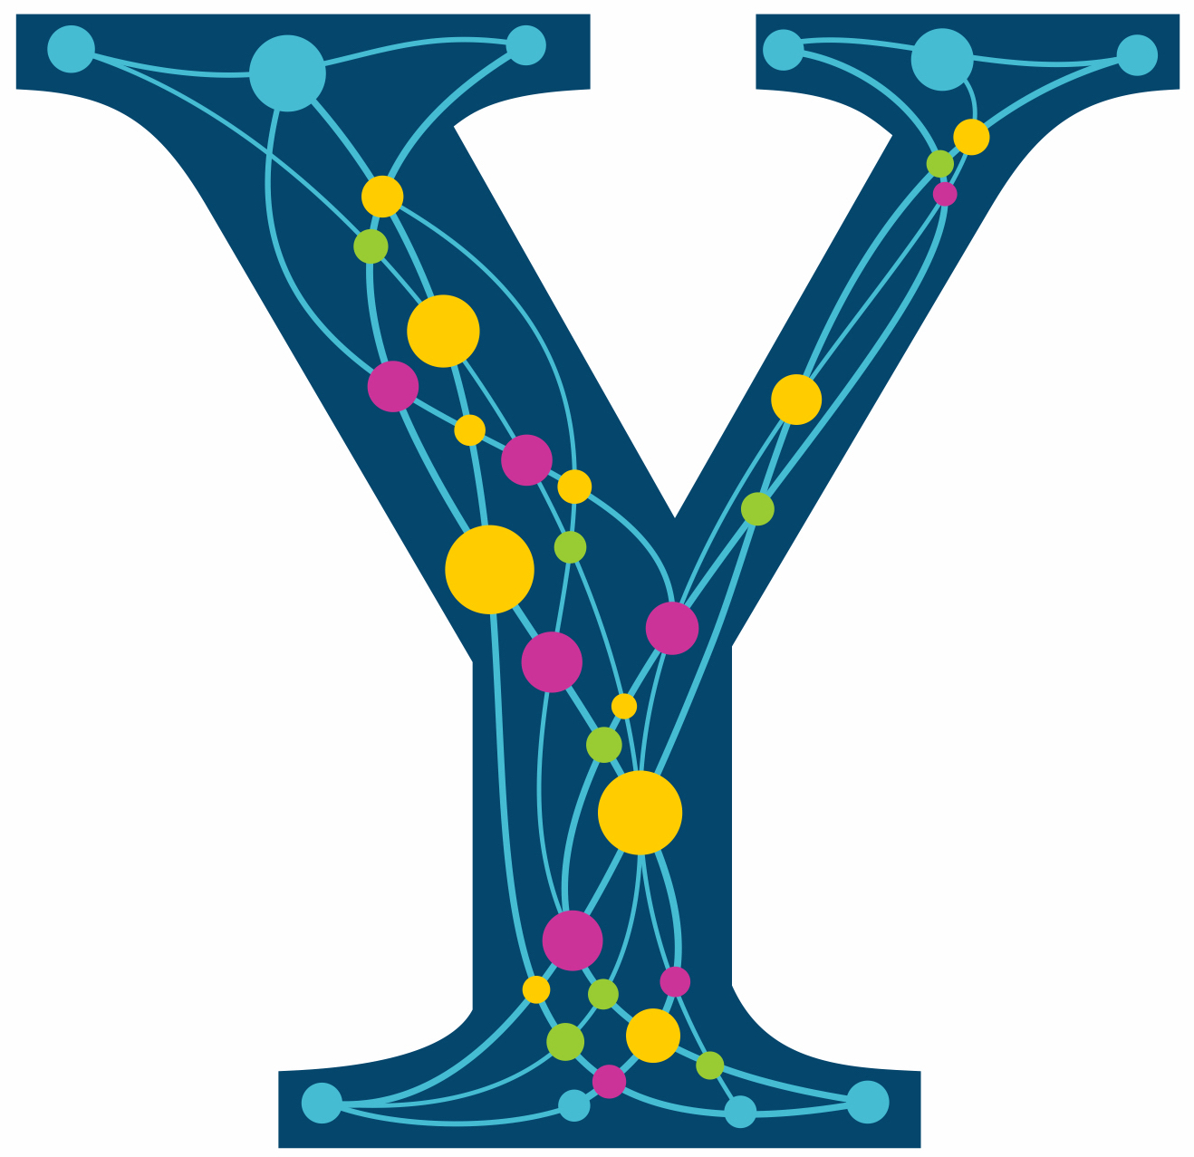

The Laplacian Matrices of Graphs
Daniel A. Spielman
ISIT, July 12, 2016

Slide 2
Outline
Laplacians
Interpolation on graphs
Resistor networks
Spring networks
Graph drawing
Clustering
Linear programming
Sparsification
Solving Laplacian Equations
Best results
The simplest algorithm

Slide 3
Interpolation on Graphs
(Zhu,Ghahramani,Lafferty ’03)
Interpolate values of a function at all vertices
from given values at a few vertices.
Minimize
Subject to given values
CDC20
ANAPC10
1
0
CDC27
ANAPC2
ANAPC5
UBE2C

Slide 4
Interpolation on Graphs
(Zhu,Ghahramani,Lafferty ’03)
Interpolate values of a function at all vertices
from given values at a few vertices.
Minimize
Subject to given values
0.51
CDC20
ANAPC10
1
0
CDC27
ANAPC2
0.53
0.30
ANAPC5
UBE2C
0.61

Slide 5
Interpolation on Graphs
(Zhu,Ghahramani,Lafferty ’03)
Interpolate values of a function at all vertices
from given values at a few vertices.
Minimize
Subject to given values
0.51
CDC20
ANAPC10
1
0
CDC27
ANAPC2
0.53
0.30
ANAPC5
UBE2C
0.61

Slide 6
Interpolation on Graphs
(Zhu,Ghahramani,Lafferty ’03)
Interpolate values of a function at all vertices
from given values at a few vertices.
Minimize
Subject to given values
0.51
CDC20
ANAPC10
1
0
CDC27
ANAPC2
0.53
0.30
ANAPC5
UBE2C
0.61
Take derivatives. Minimize by solving Laplacian

Slide 7
The Laplacian Quadratic Form of
0.51
1
0
0.53
0.61
0.30
Notes:
Have an example here!

Slide 8
The Laplacian Quadratic Form of
0.51
(0.49)²
1
(0.51)²
(0.02)²
(0.47)²
0
(0.53)²
0.53
(0.39)²
(0.30)²
(0.08)²
0.61
(0.31)²
0.30
Notes:
Have an example here!

Slide 9
Graphs with positive edge weights
Notes:
Have an example here!

Slide 10
Resistor Networks
View edges as resistors connecting vertices
Apply voltages at some vertices.
Measure induced voltages and current flow.
1V
0V

Slide 11
Resistor Networks
Induced voltages minimize
subject to constraints.
1V
0V

Slide 12
Resistor Networks
Induced voltages minimize
subject to constraints.
1V
1V
0.5V
0V
0.5V
0.375V
0.625V
0V

Slide 13
Resistor Networks
Induced voltages minimize
subject to constraints.
1V
1V
1V
0.5V
0V
0.5V
0.375V
0.625V
0V

Slide 14
Resistor Networks
Induced voltages minimize
subject to constraints.
Effective resistance = 1/(current flow at one volt)
1V
1V
1V
0.5V
0.5
0.5
0.5
0V
0.5V
0.5
0.375
0.375
0.125
0.125
0.25
0.375V
0.625V
0V

Slide 15
Spring Networks
View edges as rubber bands or ideal linear springs
Nail down some vertices, let rest settle
When stretched to length
potential energy is

Slide 16
Spring Networks
Nail down some vertices, let rest settle
Physics: position minimizes total potential energy
subject to boundary constraints (nails)

Slide 17
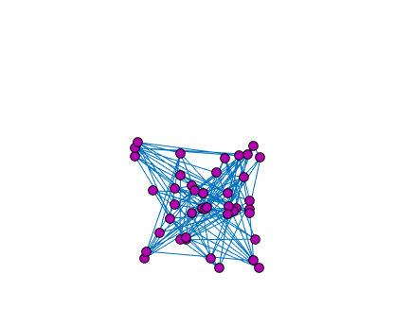
Drawing by Spring Networks
(Tutte ’63)
Notes:
socnetbad10

Slide 18
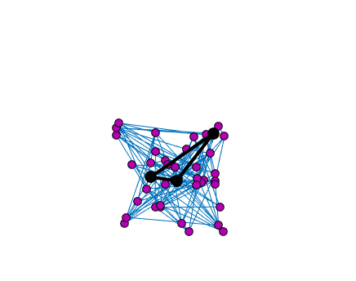
Drawing by Spring Networks
(Tutte ’63)
Notes:
socnetbad10

Slide 19
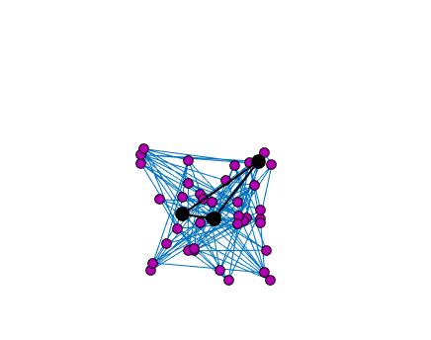
Drawing by Spring Networks
(Tutte ’63)
Notes:
socnetbad10

Slide 20
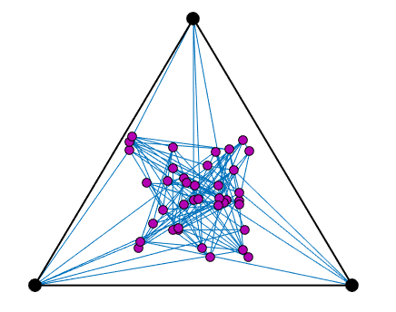
Drawing by Spring Networks
(Tutte ’63)
Notes:
socnetbad10

Slide 21
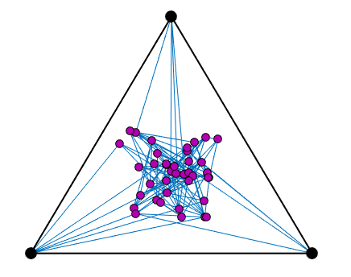
Drawing by Spring Networks
(Tutte ’63)
Notes:
socnetbad10

Slide 22
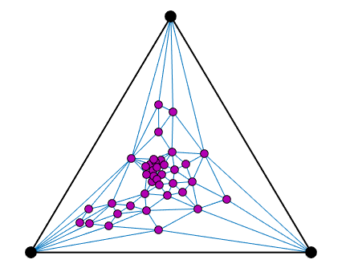
Drawing by Spring Networks
(Tutte ’63)
If the graph is planar,
then the spring drawing
has no crossing edges!
Notes:
socnetbad10

Slide 23
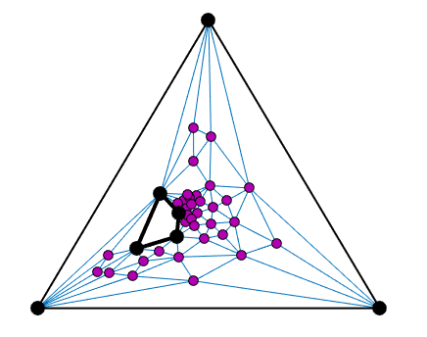
Drawing by Spring Networks
(Tutte ’63)
Notes:
socnetbad10

Slide 24
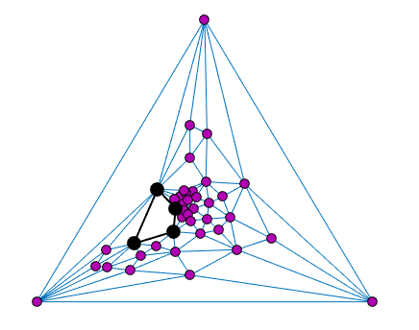
Drawing by Spring Networks
(Tutte ’63)
Notes:
socnetbad10

Slide 25
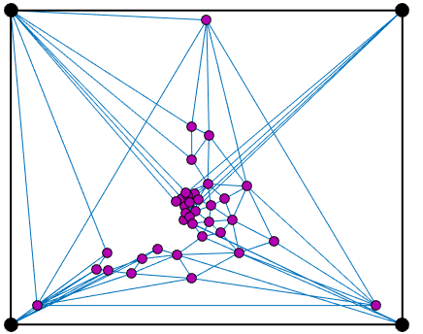
Drawing by Spring Networks
(Tutte ’63)
Notes:
socnetbad10

Slide 26
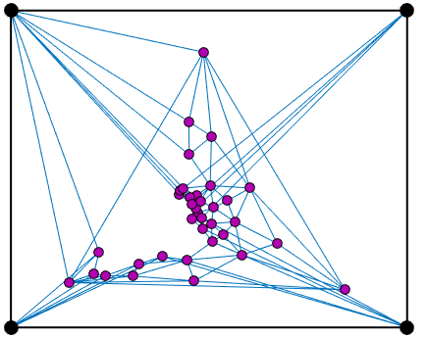
Drawing by Spring Networks
(Tutte ’63)
Notes:
socnetbad10

Slide 27
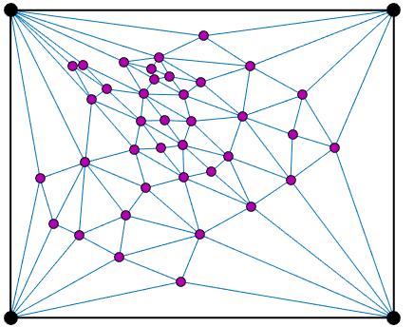
Drawing by Spring Networks
(Tutte ’63)
Notes:
socnetbad10

Slide 28
Spectral Graph Theory
A n-by-n symmetric matrix has n
real eigenvalues
and eigenvectors such that
These eigenvalues and eigenvectors tell us
a lot about a graph!

Slide 29
Spectral Graph Theory
A n-by-n symmetric matrix has n
real eigenvalues
and eigenvectors such that
These eigenvalues and eigenvectors tell us
a lot about a graph!
(excluding )

Slide 30
Spectral Graph Drawing
(Hall ’70)
1
2
3
4
6
7
5
8
9
Original
Drawing

Slide 31
Spectral Graph Drawing
(Hall ’70)
Plot vertex at
draw edges as straight lines
9
1
2
3
5
3
2
4
1
6
7
5
6
4
8
8
9
7
Original
Drawing
Spectral
Drawing

Slide 32
Spectral Graph Drawing
(Hall ’70)
Original
Drawing
Spectral
Drawing

Slide 33
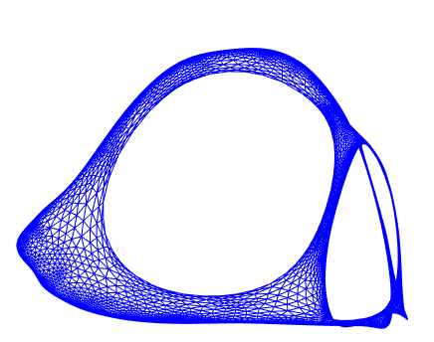
Spectral Graph Drawing
(Hall ’70)
Original
Drawing
Spectral
Drawing

Slide 34
Dodecahedron
Best embedded by first three eigenvectors

Slide 35
Erdos’s co-authorship graph

Slide 36
When there is a “nice” drawing
Most edges are short
Vertices are spread out and don’t clump too much
is close to 0
When is big, say
there is no nice picture of the graph

Slide 37
Measuring boundaries of sets
Boundary: edges leaving a set
S
S

Slide 38
Measuring boundaries of sets
Boundary: edges leaving a set
Characteristic Vector of S:
0
0
0
0
0
0
1
0
1
1
0
1
1
1
S
S
1
1
0
0

Slide 39
Measuring boundaries of sets
Boundary: edges leaving a set
Characteristic Vector of S:
0
0
0
0
0
0
1
0
1
1
0
1
1
1
S
S
1
1
0
0

Slide 40
Spectral Clustering and Partitioning
Find large sets of small boundary
Heuristic to find
x with small
Compute eigenvector
Consider the level sets
-0.4
0.7
0.2
-1.1
0.5
1.3
-0.20
1.6
0.9
0.4
1.3
1.0
0.8
S
S
1.1
0.8
0.5
-0.3

Slide 41
Spectral Partitioning
(Donath-Hoffman ‘72, Barnes ‘82, Hagen-Kahng ’92)
for some
Cheeger’s inequality implies good approximation

Slide 42
Spectral Partitioning
(Donath-Hoffman ‘72, Barnes ‘82, Hagen-Kahng ’92)
for some
Cheeger’s inequality implies good approximation

Slide 43
The Laplacian Matrix of a Graph
2
6
1
4
3
5
Symmetric
Non-positive
off-diagonals
Diagonally dominant

Slide 44
The Laplacian Matrix of a Graph
Notes:
Get in edge vector earlier?

Slide 45
Quickly Solving Laplacian Equations
S,Teng ’04: Using low-stretch trees and sparsifiers
Where m is number of non-zeros and n is dimension

Slide 46
Quickly Solving Laplacian Equations
S,Teng ’04: Using low-stretch trees and sparsifiers
Koutis, Miller, Peng ’11: Low-stretch trees and sampling
Where m is number of non-zeros and n is dimension

Slide 47
Quickly Solving Laplacian Equations
S,Teng ’04: Using low-stretch trees and sparsifiers
Koutis, Miller, Peng ’11: Low-stretch trees and sampling
Cohen, Kyng, Pachocki, Peng, Rao ’14:
Where m is number of non-zeros and n is dimension

Slide 48
Quickly Solving Laplacian Equations
S,Teng ’04: Using low-stretch trees and sparsifiers
Koutis, Miller, Peng ’11: Low-stretch trees and sampling
Cohen, Kyng, Pachocki, Peng, Rao ’14:
Good code:
LAMG (lean algebraic multigrid) – Livne-Brandt
CMG (combinatorial multigrid) – Koutis

Slide 49
Quickly Solving Laplacian Equations
S,Teng ’04: Using low-stretch trees and sparsifiers
An -accurate solution to
is an satisfying
where

Slide 50
Quickly Solving Laplacian Equations
S,Teng ’04: Using low-stretch trees and sparsifiers
An -accurate solution to
is an satisfying
Allows fast computation of eigenvectors
corresponding to small eigenvalues.

Slide 51
Laplacians in Linear Programming
Laplacians appear when solving Linear Programs on
on graphs by Interior Point Methods
Maximum and Min-Cost Flow (Daitch, S ’08, Mądry ‘13)
Shortest Paths (Cohen, Mądry, Sankowski, Vladu ‘16)
Isotonic Regression (Kyng, Rao, Sachdeva ‘15)
Lipschitz Learning : regularized interpolation on graphs
(Kyng, Rao, Sachdeva, S ‘15)

Slide 52
Interior Point Method for Maximum s-t Flow
maximize
subject to
/1
/3
s
/1
t
/1
/4

Slide 53
Interior Point Method for Maximum s-t Flow
maximize
subject to
1/1
2/3
3
s
1/1
t
3
1/1
2/4

Slide 54
Interior Point Method for Maximum s-t Flow
maximize
subject to
Multiple calls with varying weights
maximize
subject to

Slide 55
Spectral Sparsification
Every graph can be approximated
by a sparse graph with a similar Laplacian

Slide 56
Approximating Graphs
A graph H is an -approximation of G if
for all x

Slide 57
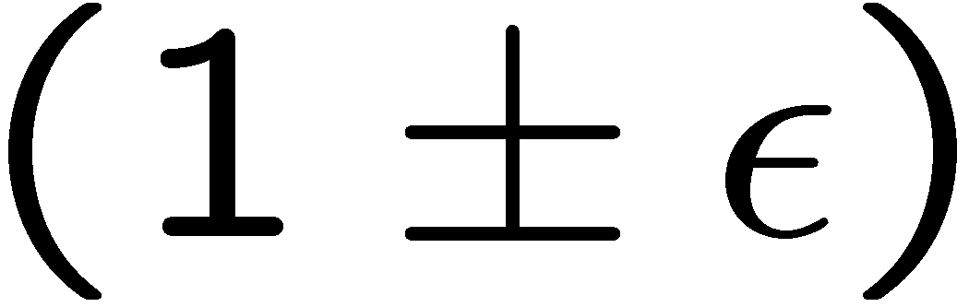
Approximating Graphs
A graph H is an -approximation of G if
for all x
Preserves boundaries of every set

Slide 58
Approximating Graphs
A graph H is an -approximation of G if
for all x
Solutions to linear equations are similar
As are effective resistances

Slide 59
Expanders Sparsify Complete Graphs
Yield good LDPC codes
Every set of vertices has large boundary
is large
Random regular graphs are usually expanders

Slide 60
Sparsification by Random Sampling
Assign a probability p_{a,b} to each edge (a,b)
Include edge (a,b) in H with probability p_{a,b.}
If include edge (a,b), give it weight w_{a,b} /p_{a,b}

Slide 61
Sparsification by Random Sampling
Choose p_{a,b} to be w_{a,b} times the
effective resistance between a and b.
Low resistance between a and b means there
are many alternate routes for current to flow and
that the edge is not critical.
Proof by random matrix concentration bounds
(Rudelson, Ahlswede-Winter, Tropp, etc.)
Only need edges
(S, Srivastava ‘08)

Slide 62
Optimal Graph Sparsification?
For every , there is a s.t.
and
Is within a factor of 2 of how well
Ramanujan expanders approximate complete graphs
(Batson, S, Srivastava ‘09)

Slide 63
Approximate Gaussian Elimination
(Kyng & Sachdeva ‘16)
Gaussian Elimination:
compute upper triangular U so that
Approximate Gaussian Elimination:
compute sparse upper triangular U so that

Slide 64


Additive view of Gaussian Elimination
Find $U$, upper triangular matrix, s.t $U^{⊤}U=A$
$$A=$$
Notes:
additive view of Chol
sums are good for random matrix theory

Slide 65
Additive view of Gaussian Elimination
Find the rank-1 matrix that agrees on the first row and column.
Notes:
additive view of Chol
sums are good for random matrix theory

Slide 66
Additive view of Gaussian Elimination
Subtract the rank 1 matrix.
We have eliminated the first variable.
Notes:
additive view of Chol
sums are good for random matrix theory

Slide 67
Additive view of Gaussian Elimination
Notes:
additive view of Chol
sums are good for random matrix theory

Slide 68
Additive view of Gaussian Elimination
Find the rank-1 matrix that agrees on the next row and column.
Notes:
additive view of Chol
sums are good for random matrix theory

Slide 69
Additive view of Gaussian Elimination
Subtract the rank 1 matrix.
We have eliminated the second variable.
Notes:
additive view of Chol
sums are good for random matrix theory

Slide 70

Additive view of Gaussian Elimination
$$A=$$
Running time proportional to sum of squares
of number of non-zeros in these vectors.
Notes:
additive view of Chol
sums are good for random matrix theory

Slide 71
Additive view of Gaussian Elimination
$$A=$$
Notes:
additive view of Chol
sums are good for random matrix theory

Slide 72

Additive view of Gaussian Elimination
$$A=$$
$${=U}^{⊤}U$$
Notes:
additive view of Chol
sums are good for random matrix theory

Slide 73
Gaussian Elimination of Laplacians
If this is a Laplacian, then so is this

Slide 74
Gaussian Elimination of Laplacians
If this is a Laplacian, then so is this
When eliminate a node, add a clique on its neighbors
4
2
5
2
5
1
2
4
1
4
2
4
2
8
3
6
3
6

Slide 75
Approximate Gaussian Elimination
(Kyng & Sachdeva ‘16)
1. when eliminate a node, add a clique on its neighbors
4
2
5
2
5
1
2
4
1
4
2
4
2
8
3
6
3
6
2. Sparsify that clique, without ever constructing it

Slide 76
Approximate Gaussian Elimination
(Kyng & Sachdeva ‘16)
When eliminate a node of degree d,
add d edges at random between its neighbors,
sampled with probability proportional to
the weight of the edge to the eliminated node
1

Slide 77
Approximate Gaussian Elimination
(Kyng & Sachdeva ‘16)
0. Initialize by randomly permuting vertices, and
making copies of every edge
When eliminate a node of degree d,
add d edges at random between its neighbors,
sampled with probability proportional to
the weight of the edge to the eliminated node
Total time is

Slide 78
Approximate Gaussian Elimination
(Kyng & Sachdeva ‘16)
0. Initialize by randomly permuting vertices, and
making copies of every edge
When eliminate a node of degree d,
add d edges at random between its neighbors,
sampled with probability proportional to
the weight of the edge to the eliminated node
Total time is
Can be improved by sacrificing some simplicity

Slide 79
Approximate Gaussian Elimination
(Kyng & Sachdeva ‘16)
Analysis by Random Matrix Theory:
Write U^{T}U as a sum of random matrices.
Random permutation and copying
control the variances of the random matrices
Apply Matrix Freedman inequality (Tropp ‘11)

Slide 80
Recent Developments
Other families of linear systems
complex-weighted Laplacians
connection Laplacians
(Kyng, Lee, Peng, Sachdeva, S ‘16)
Laplacians.jl

Slide 81
To learn more
My web page on:
Laplacian linear equations, sparsification, local graph clustering, low-stretch spanning trees, and so on.
My class notes from
“Graphs and Networks” and “Spectral Graph Theory”
Lx = b, by Nisheeth Vishnoi

